Slide 1
GCP
- Geeth

Slide 2
Agenda
Introduction
Account Setup
Cloud Shell and Editor
Storage
Compute Engine
VPC
MemoryStore
Load Balencing
Exam

Slide 3
Introduction
Geeth

Slide 4
Serverless Approch
Every service is serverless(may not solve all problems)
GCP “Developer in mind” make sure you have developer background
Not as broad as AWS(service for every thing)
Build on your own services

Slide 5
GCP structure and design
Design Princples: Global, Secure, Huge Scale, for developers
Global System: world wide customers, Easier to handel latency, But Sensitive to global failures
Physical Infrastructure: vCPU, Physical Server, Rack, Data center, Zone, Region, Multi-Region, *Private global network(Cables accross the world), Points of Presence(POPs that connect to internet) - Network Edges and CDN locations, Global System
***NOTE: Data center will not have access to services and vice-versa
Almost every thing is encrypted

Slide 6
Terminologies
Provision: Make sure you’re ready to handle X
CRUD: Create Read Update Delete

Slide 7
Cloud Comparisons
- GCP was built from dev towards ops/infra which is opposite to AWS
- GCP trying to reach AWS
- Avoide some mistakes done by AWS
- GCP want to be “a cloud” not “the cloud”
- Google provide some service like Google Firebase which is saperate console, not a part of GCP.
- Services available globally Not like region specific like AWS

Slide 8
Account Setup
Geeth

Slide 9
Account Setup
New Google Account
Credit/Debit Card
search GCP
Organization of GCP:
  Projects: Just like AWS Accounts
  Project own resources
  resources can be shared by accross
  Projects can be grouped and controlled in hierachy

Slide 10
Account Setup
Organization of GCP:
  Projects: Just like AWS Accounts managed in the form of projects
  Project own resources
  resources can be shared by accross
  Projects can be grouped and controlled in hierachy
  25 Project quota

Slide 11
Tasks
Console
  Dashboard: Customize, enable everything, Explore, drag
  Activity: Explore
Select Project from top drop-down
Project Info
  Edit
  Note: Project ID cannot be changed
  Check quota limit
  New Project
Upgrade GCP(Don’t do it until trail)

Slide 12
Cloud Shell >/
Geeth

Slide 13
Cloud shell and Editor(Lab)
- Web browser Access
- No need fot local terminal(SSH)
- Automatic SSH Key management
- 5GB of persistent storage free
- Easy-access to preinstalled tools(with auto update)
(gcloud, bq, kubectl, docker, node, python,ruby , vim, bash etc.,
- 60 hours a week quota
- Any active process will be persisted
- You can preview the web app running on Cloud shell with URL

Slide 14
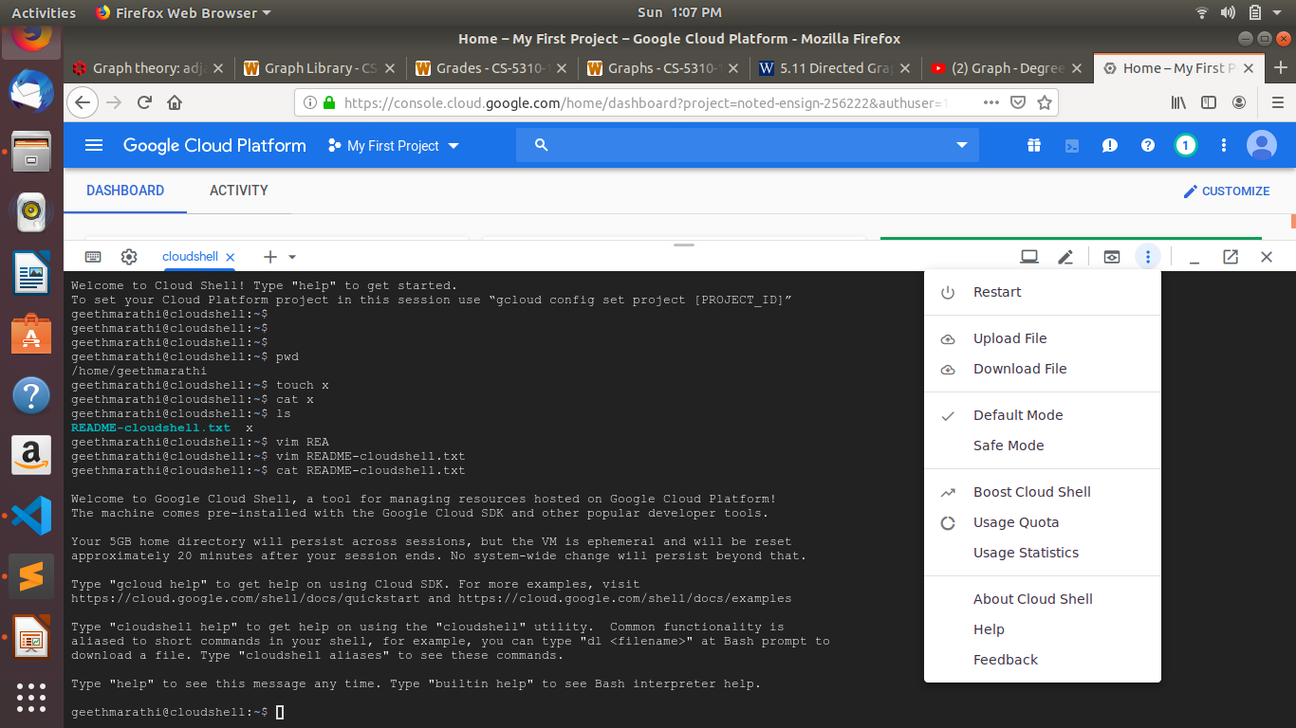

Slide 15
The Storage
Geeth

Slide 16
Storage(Lab)
Console Navigation
  Dashboard: Storage > Create Bucket
  Explore: Monthly cost Estimate
Creating a bucket
  Unique name, Global, All small Letters
  Regional
  Storage Class(Purpose of Data)(Editable)
  Access control(Editable)
  Encryption Keys(Editable) & Retaination Policy
Upload File into bucket
  Properties
    All files are private(default)
    Parllel upload
Permissions
  Object level permissions
  Set, See, Delete
Rename file:
  On console can be done on shell
  gsutil mv -p gs://geethlearn/Wallpaper-16-9.png gs://geethlearn/Wallpaper-16-9.png

Slide 17
The Compute
Geeth

Slide 18
Compute(Change)
Console Navigation
  Dashboard: Storage > Create Bucket
  Explore: Monthly cost Estimate
Creating a bucket
  Unique name, Global, All small Letters
  Regional
  Storage Class(Purpose of Data)(Editable)
  Access control(Editable)
  Encryption Keys(Editable) & Retaination Policy
Upload File into bucket
  Properties
    All files are private(default)
    Parllel upload
Permissions
  Object level permissions
  Set, See, Delete
Rename file:
  On console can be done on shell
  gsutil mv -p gs://geethlearn/Wallpaper-16-9.png gs://geethlearn/Wallpaper-16-9.png

Slide 19
The Networking
Geeth

Slide 20
Compute(Change)
Console Navigation
  Dashboard: Storage > Create Bucket
  Explore: Monthly cost Estimate
Creating a bucket
  Unique name, Global, All small Letters
  Regional
  Storage Class(Purpose of Data)(Editable)
  Access control(Editable)
  Encryption Keys(Editable) & Retaination Policy
Upload File into bucket
  Properties
    All files are private(default)
    Parllel upload
Permissions
  Object level permissions
  Set, See, Delete
Rename file:
  On console can be done on shell
  gsutil mv -p gs://geethlearn/Wallpaper-16-9.png gs://geethlearn/Wallpaper-16-9.png

Slide 21
The Exam
Geeth

Slide 22
Idea behind exam
Deploy apps
Monitor Apps (1 or more)
Reach target performance
Cli mandatory
Common platform based jobs

Slide 23
Exam sections
Section 4: Ensuring successful operation of a cloud solution
  Managing Compute Engine resources
  Managing Kubernaties Engine resources
  Managing App Engine resources
  Managing data solutions
  Managing networking resources
  Monitoring and logging
Section 5: Configuring access and security
  Managing Identity and Access Management (IAM)
  Managing Service accounts
  Viewing audit logs for project and managed services
Section 1: Setting up a cloud solution environment
  Setting up cloud projects and accounts
  Managing billing configuration
  Installing and configuring the command line interface(CLI)
Section 2: Planning and configuring a cloud solution
  Planning and estimating GCP product use using the price Calculator
  Planning and configuring compute resources
  Planning and configuring data storage options
  Planning and confugring network resources
Section 3: Deploying and implimenting a cloud section
  Deploying and implimenting Compute Engine resources
  Deploying and implimenting Kubernetes Engine resources
  Deploying and Implimenting App Engine and Cloud Functions resources
  Deploying and Implimenting data solutions
  Deploying and implimenting networking resources

