Slide 1


Slide 2
Virtualization
H/W – Dual Boot(Windows and Ubuntu)
S/W –
Driver(Speeker)
VM(Hiperviser driver) and Containers
Virtual Machines

Slide 3
What is Docker?
It’s a ‘light weight’ Virtual Machine service.
This works on a princple of “Operating System Virtualization”.
It’s a Container technology.

Slide 4
What is Container?
Container is an instance of Image.
“IMAGE” is any type of service which is majorly clasified into 3 types.
        1- Operating System ( Linux, Ubuntu etc., )
        2- Software as a image ( Nginx, MySQL etc., )
        3- Process as a image ( Jobs that we perform for application support Ex. MySQL long jobs, Quing System as Micro Services)

Slide 5
“Image on run inside
Docker engine as an Isolated process is called
Container”

Slide 6
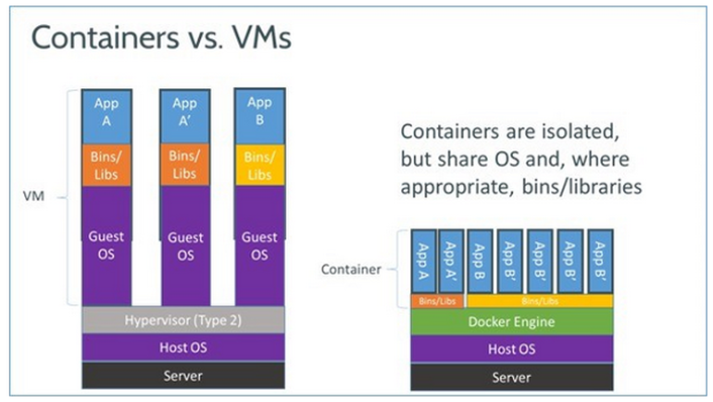

Slide 7
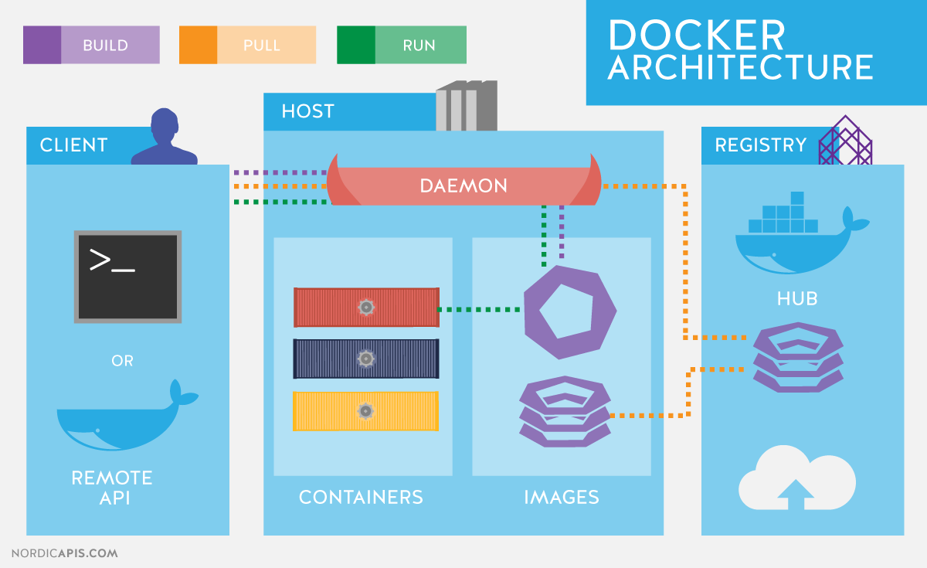

Slide 8
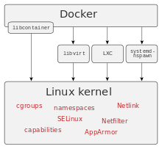
Four pillers of Docker Framwork
Linux Kernal services
    - Chroot
    - Union File System
    - Cgroups
    - Name Space

Slide 9
Advantages
Redused cost of instances on Cloud.
Effective use of system resources.
Noise less processing.
Isolated Process for Dedicated Services.
Complete control on everything.

Slide 10
Disadvantages
Less control over I/O shared resources.
Monitoring.
Crash recovery.
Change in current architucture of application.
Less support for windows Operating System.
Inefficient use of docker leads to starvation of others in terms of cpu, memory, io, or networking

Slide 11
Install Docker
Windows Pro 10 – Direct Support
Docker-for-windows < - LiteVM -> Linux OS -> docker engine -> Child OS
Linux Directly
  Available
  Docker-CE
  Docker-EE
  Install on Ubuntu
  sudo apt update
    sudo apt install docker.io
    service docker start

Slide 12
Docker Commands
- for docker image
:>sudo docker images
List images
:>sudo docker search ubuntu<image name is ubuntu>
Seraching the image Docker Hub(Search on Google for more Info)
:>sudo docker pull ubuntu
Download the Docker Image

Slide 13
Docker Commands
- Container
docker run ubuntu
Setup the ubuntu OS
Start the ubuntu Os
Shut down the ubuntu OS
sudo docker run –help
  Mannual of docker

Slide 14
Modes of docker container
2 modes
-i -> interactive
-t -> terminal
sudo docker run -it centos
sudo docker ps -a
  List all the operating systems dead or alive both
sudo docker ps
  List all the operating systems live
  ctrl+d to kill
  Ctrl+p+q to exit from terminal
-d -> demon
-itd
sudo docker run -itd centos

Slide 15
docker run -itd --name <mention some name> <IMAGE NAME> <COMMAND>
Ex- docker run -itd --name nginx ubuntu /bin/bash -c “apt update && apt install apt-utils -y && apt install nginx -y”
docker run -it --name nginx ubuntu
/bin/bash -c “apt update && apt install apt-utils -y && apt install nginx -y”
CTRL+p+q (demon mode)
docker logs <container name>
  getting output of console of demon container

Slide 16
docker inspect <container_name>
Complete discription of docker container
sudo docker attach <container_name>
Relogin into the container

Slide 17
Start, stop|kIll, restart existing container
START
docker start <container_name>
STOP
docker stop <container_name>
KILL
docker kill <container_name>
RESTART
docker restart <container_name>

Slide 18
rm (remove the stopped container)
docker rm <container_name>
rmi(removing the image)
docker rmi <image_name>

Slide 19
Copy
Docker cp <source> <destination>
docker cp abc nginx:/root
Base OS to docker container
docker cp nginx:/root/abc ./

Slide 20
Exec
docker exec -it nginx bash

Slide 21
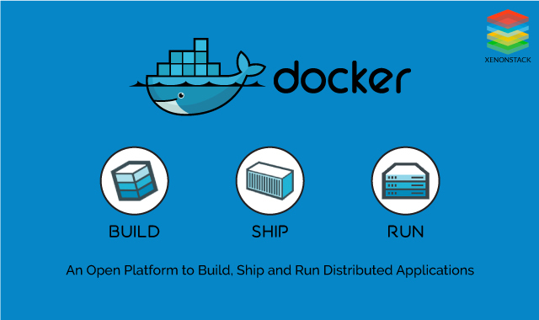
Finally! How we do?

