Slide 1
Chain of Responsibility
George McMullen and Jada Senebouttarath

Slide 2
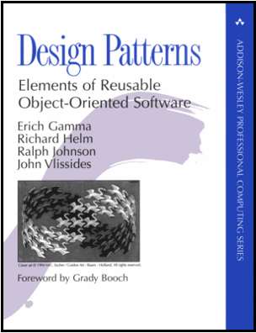
Gang of Four
“Avoid coupling the sender of a request to its receiver by giving more than one object the chance to handle the request. Chain the receiving objects and pass the request along the chain until an object handles it.”
Or, in other words…
Create a set for your request as to avoid coupling the sender and
receiver together. Make the handlers into a chain so it’s clear where
the handler receives and sends the request until handled.

Slide 3
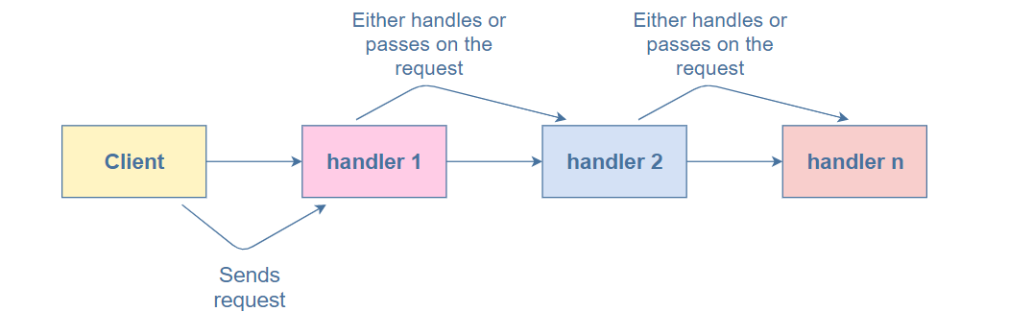
Chain of Responsibility
Goal: Create a chain of objects to examine requests. Each object in turn examines a request and either handles it, or passes, it onto the next object in the chain.
Category: Behavioral design pattern
Participants
Handler: Ingests client requests and passes them to the first handler in the chain of handlers.
Concrete Handlers: Each link of the chain of handlers, these are set in a specific order and always try to fully handle the request.
Client: Originator of the requests being sent

Slide 4
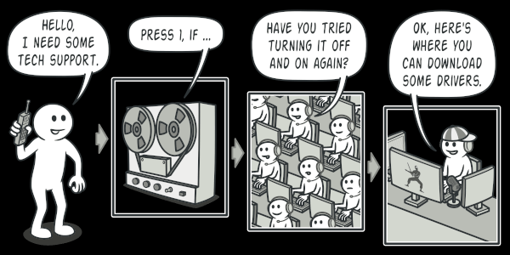
Real world example of
Chain of Responsibility

Slide 5

Walk-Through
When to use:
When you don’t want to specify handlers in your code for the client
When to not use:
If you don’t have a lot of handlers for each request being given, as this would be inefficient
Pros:
Decouples handlers and clients (where requests originate from)
Handlers will be determined at run time
Cons:
Debugging is more difficult with tracking all the external calling
More code must be written/less efficient and less performant

Slide 6
Code Example Time!
https://github.com/gmcmullengrc/chainofresponsibilityexample

Slide 7

Implementing the Chain of Responsibility
https://github.com/gmcmullengrc/chainofresponsibilityexample
Below are the individual classes needed for implementation in an ATM example
Client
Represents the ATM that the client is interacting with (where the request originates from)
Handler
Representing the first handler to pass the request (which is using the Chain of Responsibility to call the next handlers)
Concrete Handlers
Represents each program dispensing each individual type of bill
Depending on the amount, the request for a withdrawal could be handled before all of the programs are cycled through (e.g. If you ask for $40, the ATM won’t ask how many 10s need to be dispensed after it dispenses two 20s)
Objects
Represents the money amount being handled (constantly updating after each bill type is dispensed)
*Objects are not needed for every Chain of Responsibility program

Slide 8
Code example
cheat sheet
Concrete Handlers (in order from first to last)
Dispense20s.java - Handler for resolving the amount of 20’s
Dispense10s.java - Handler for resolving the amount of 10’s
Dispense5s.java - Handler for resolving the amount of 5’s
Dispense1s.java - Handler for resolving the amount of 1’s
Objects
Dispenser.java - Our concrete handlers will extend this dispenser object so they can be set in the order of the chain
Money.java - Public object to hold our amountRemaining between each concrete handler
Client
Client.java - Represents a real client program interacting with the program
Test.java - Represents a test client as to automate testing functionality
Handler
ATM.java - Represents the first class to handle the request to the appropriate concrete handlers
https://github.com/gmcmullengrc/chainofresponsibilityexample

Slide 9
Time to CODE!

Slide 10


Thank You
Questions?

