Slide 1

Front-end Development with ReactJS
Harini Priya K
Software Engineer, Mr.Cooper

Slide 2
What is ReactJS?
ReactJS is an open-source JavaScript library that is used for building user interfaces specifically for single-page applications.
It’s used for handling the view layer for web and mobile apps.
Allows us to create reusable UI components.
React allows developers to create large web applications that can change data, without reloading the page

Slide 3
What is a JS Library?
JavaScript libraries are collections of pre-written JavaScript code that can be used for common JS tasks, allowing you to bypass the time intensive (and unnecessary) process of coding by hand. If there’s a run-of-the-mill JavaScript function that you keep needing to code (and that other developers before you have needed for their own projects) there’s probably a JS library to ease your pain.

Slide 4
What is Single Page Application?
A single-page application (SPA) is a web application that interacts with the user by dynamically rewriting the current web page with new data from the web server, instead of the default method of the browser loading entire new pages. The goal is faster transitions that make the website feel more like a native app.
What is JSX?
JSX is a simple JavaScript that allows HTML quoting and uses these HTML tag syntax to render subcomponents. HTML syntax is processed into JavaScript calls of React Framework. We can also write in pure old JavaScript.

Slide 5
Virtual DOM
If you’re not using React JS (and JSX), your website will use HTML to update its DOM (the process that makes things “change” on screen without a user having to manually refresh a page). This works fine for simple, static websites, but for dynamic websites that involve heavy user interaction it can become a problem (since the entire DOM needs to reload every time the user clicks a feature calling for a page refresh).
However, if a developer uses JSX to manipulate and update its DOM, React JS creates something called a Virtual DOM. The Virtual DOM (like the name implies) is a copy of the site’s DOM, and React JS uses this copy to see what parts of the actual DOM need to change when an event happens (like a user clicking a button).

Slide 6

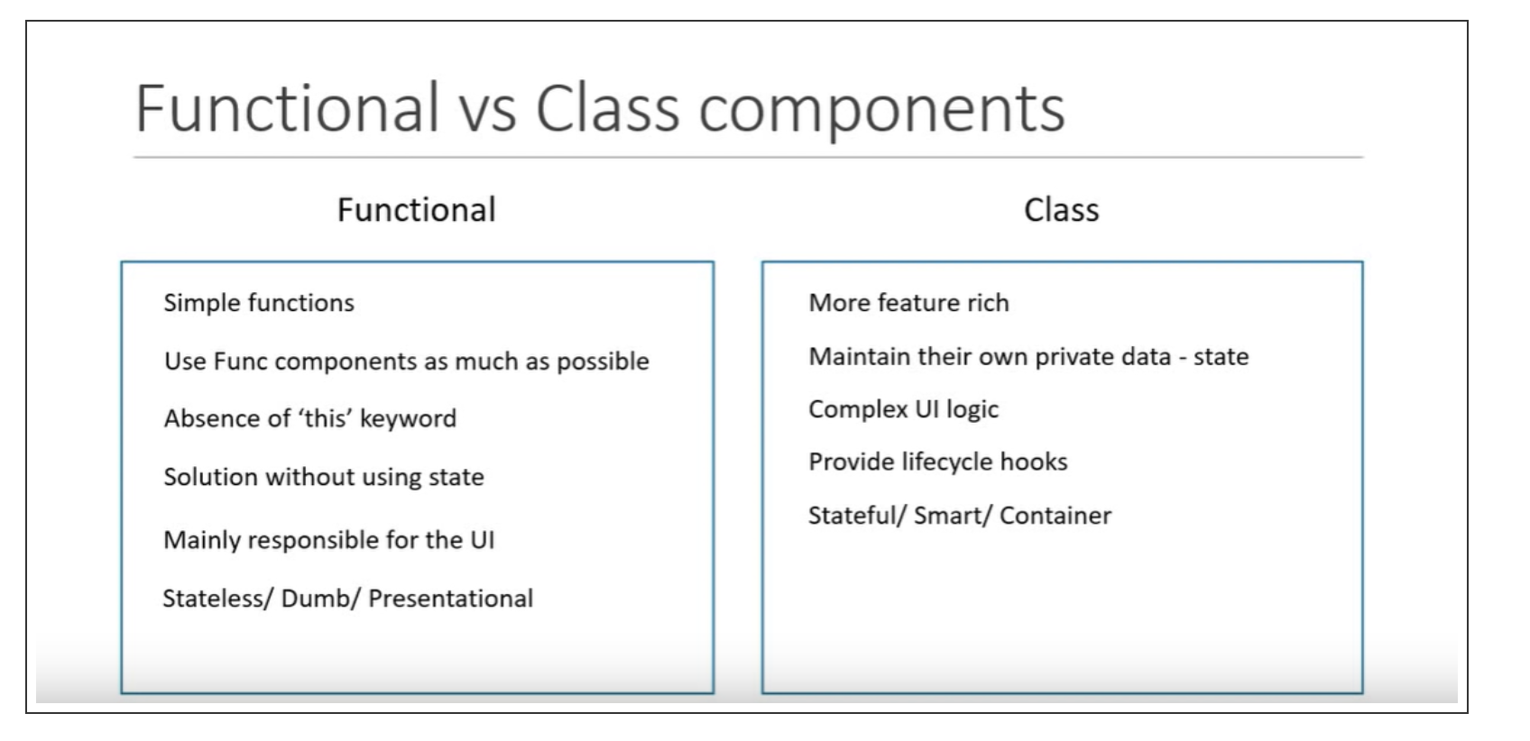
Functional vs Class Components

Slide 7
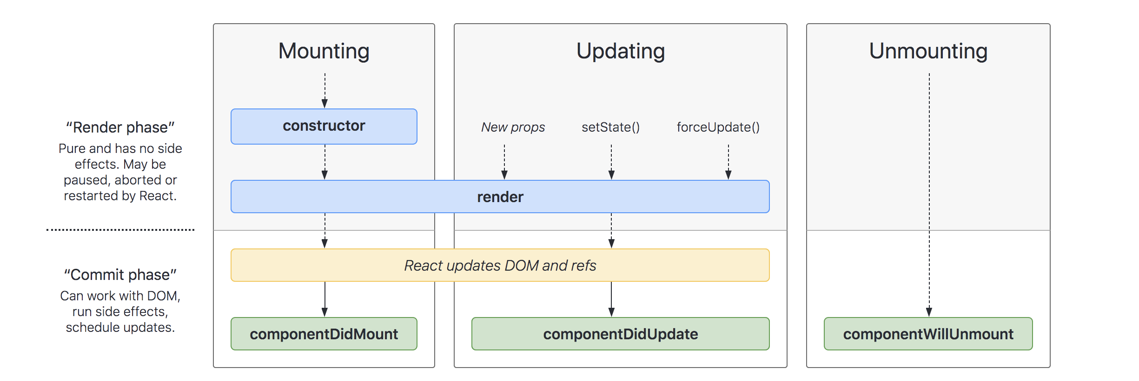
Some Basic Lifecycle Methods

Slide 8
React Hooks
Hooks are the new feature introduced in the React 16.8 version. It allows you to use state and other React features without writing a class. Hooks are the functions which "hook into" React state and lifecycle features from function components. It does not work inside classes.
If you write a function component, and then you want to add some state to it, previously you do this by converting it to a class. But, now you can do it by using a Hook inside the existing function component.

Slide 9
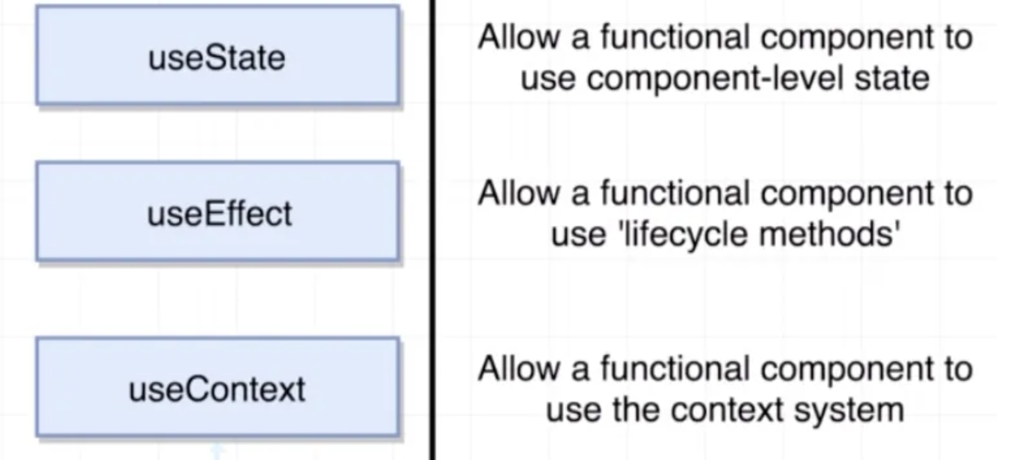
React Hook Methods

Slide 11
What is Babel and Webpack?
Babel is simply a translator, who translates your 'fancy' (ES6+) JS code into 'not-so-fancy' (ES5) ones that browser (front-end) or Node.js (back-end) understands.
That's why Babel is sometimes called a transpiler.
If Babel is a translator for JS, you can think of Webpack as a mega-multi-translator that works with all kinds of languages (or assets). Webpack can collect all your inline CSS styles in your Javascript files and bundle them into one.
Because front-end has many kinds of assets such as CSS, SASS, images, fonts and is way more complex and dynamic than back-end which only has JS. And in the end of day we need to somehow package all variety of assets into a small file that our users' browser can download at page load time. This is also known as minify and uglify. You see, back-end has none of the above requirement.
Webpack's job to figure out all the dependencies among all the modules that we use in the code, and compile them into one big chunk of JS code that the browser actually understands.

