Slide 1

Introduction to
MongoDB
Aneerudh Prabhakaran
SDE II, Mr Cooper

Slide 2
Problems with RDBMS
Before we understand what MongoDb is, we need to understand the issues with traditional RDBMS.

Slide 3

Scalability
Difficult to scale millions of millions of data.
Data stored in multiple tables (relationship) it is difficult to scale.
To Ensure ACID, consistency has to be maintained and that would mean writes to all nodes inside a cluster.

Slide 4

Flexibility
Fixed data structure therefore not easy to make modifications to data structure.
You need to spend hours and hours on designing the database before development.
In Agile projects database requires constant restructuring.

Slide 5
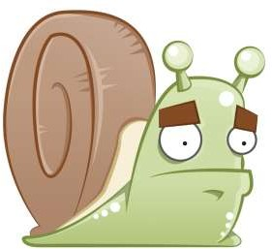
Performance
Data is generally stored across multiple tables. Joins have huge performance impact as it requires lot of CPU and resources
Need to install and configure complex caching mechanism to make it faster

Slide 6
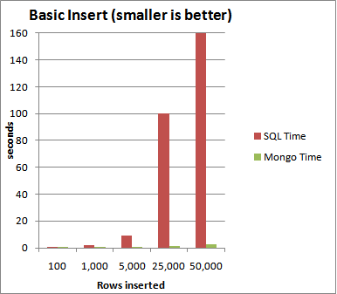
Performance comparison

Slide 7
What is MongoDB ?
MongoDB is an open source, document-based, distributed database built for modern application developers.
Built for Speed.
Rich Document based queries for Easy readability.
Replication and Failover for High Availability.
Auto Sharding for Easy Scalability.

Slide 8
Other reasons to use MongoDB
SQL was invented in the 70’s to store data.
MongoDB stores documents (or) objects.
Now-a-days, everyone works with objects (Python/Ruby/Java/etc.)
And we need Databases to persist our objects. Then why not store objects directly ?
Embedded documents and arrays reduce need for joins. No Joins and No-multi document transactions.

Slide 9
Mongo is a great choice when
Evolving data requirements
Support rapid iterative development
Speed and scalability is imperative

Slide 10
Not great for?
Highly Transactional Applications.
Problems requiring SQL.
Applications requiring strong ACID principles.

Slide 11
Let’s Dive in !

Slide 12
How MongoDB looks when compared to RDBMS ?
{
“first_name” : “Joe”, “last_name” : “Satana”,
“email” : “joe@abc.in”
},
{
“first_name” : “Bob”, “last_name” : “Michel”,
“email” : “bob@abc.in”
}
]
first_name | last_name | email
Joe | Satana | joe@abc.in
Bob | Michel | bob@abc.in

Slide 13
When I say
Think
Database
Database
(Mongo)
(RDBMS)
Made up of Multiple Collections.
Created on-the-fly when referenced for the first time.

Slide 14
When I say
Think
Collection
Table
(Mongo)
(RDBMS)
Schema-less, and contains Documents.
Indexable by one/more keys.
Created on-the-fly when referenced for the first time.
Capped Collections: Fixed size, older records get dropped after reaching the limit.

Slide 15
When I say
Think
Document
Record/Row
(Mongo)
(RDBMS)
Stored in a Collection.
Can have _id key – works like Primary keys in MySQL.

Slide 16
Quick Summary
SQL | MongoDB
Database | Database
Table | Collection
Index | Index
Row | Document
Column | Field
Joining | Linking & Embedding

Slide 17
Demo Rundown
Mongo commands
Mongoose – package
Mongoose setup
Mongo Interactions in CRUD APIs.

Slide 18
MongoDB Commands
mongo | Enter the MongoDB client.
show dbs | List all database. Should have at least on record to display the database in list.
use db_name | To switch / create a database.
db.dropDatabase() | Removes the current database, deleting the associated data files.
show collections | Print a list of all collections for current database.
db.createCollection(‘collection Name’) | create a collection with the name specified.
db.collectionName.drop() | Drops or removes completely the collection.

Slide 19
Mongo Commands
{
id:1,
name: ‘Apple watch’,
price: 25000,
sold: false
}
// Insert a new product object into products collection
db.products.insert(obj);

Slide 20
Queries in Mongo
// find posts which has an id value of 1.
db.products.find({id:1});
// find posts written after 31st March.
db.posts.find({‘timestamp’: {‘$gte’: Date(’31-03-12’)}});
// find posts written after 31st March.
> db.products.update(
{id: 2},
{$set:{price: 28000}}
);
// Remove a particular document using it’s id field.
> db.products.remove({id:1})
$gt, $lt, $gte, $lte, $ne, $all, $in, $nin, count, limit, skip, group, etc…

Slide 21
Where Conditions in Mongo
Operation | Syntax | Example | RDBMS Equivalent
Equality | {<key>:<value>} | db.posts.find({"by": "Batman"}).pretty() | where by = Batman'
Less Than | {<key>:{$lt:<value>}} | db.posts.find({"likes":{$lt:50}}).pretty() | where likes < 50
Less Than Equals | {<key>:{$lte:<value>}} | db.posts.find({"likes":{$lte:50}}).pretty() | where likes <= 50
Greater Than | {<key>:{$gt:<value>}} | db.posts.find({"likes":{$gt:50}}).pretty() | where likes > 50
Greater Than Equals | {<key>:{$gte:<value>}} | db.posts.find({"likes":{$gte:50}}).pretty() | where likes >= 50
Like | {<key>:{'$regex':<value>}} | db.posts.find({“title”: {'$regex': ‘How’} }) | where title like ‘%How%’

Slide 22
An object modelling tool for NodeJS
Mongoose

Slide 23
Questions?

