Slide 1
Enrolment and Leaving Analysis
Gabriel Medina Galicia

Slide 2
Agenda
Enrolment Findings
Leaving Findings

Slide 3
Enrolment Findings

Slide 4
Enrolment Demographics
How many enrolments have we had since the beginning?
What countries do the enrolments come from?
What are the demographics of the learners?
What are the proportions of learners archetypes enrol the course?

Slide 5
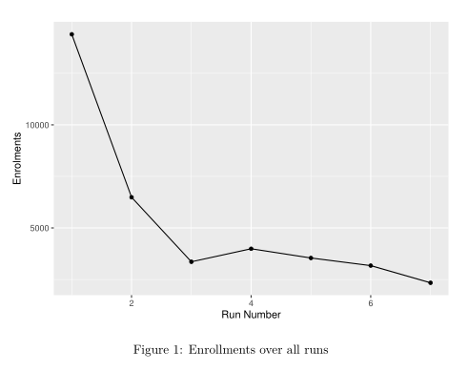
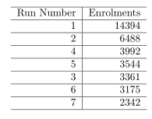
How many enrolments have we had since the beginning?

Slide 6
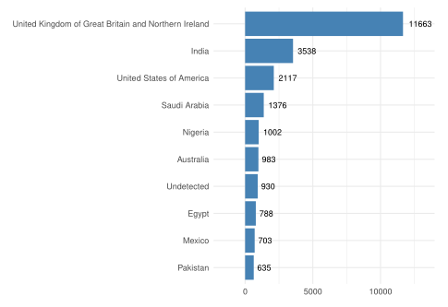



What countries do the enrolments come from?
49%
14.9%
8.9%

Slide 7
What are the demographics of the learners?

Slide 8
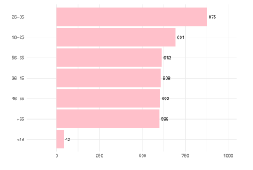
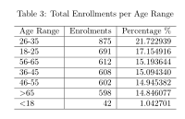
Age

Slide 9
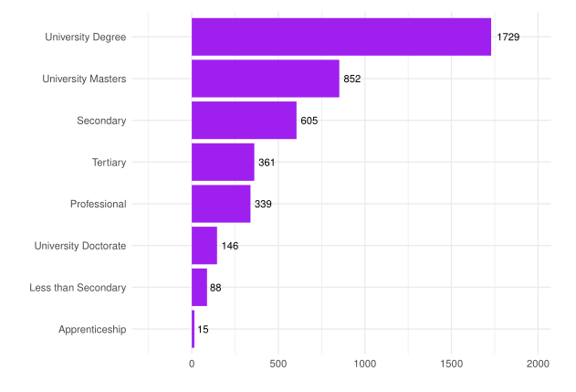
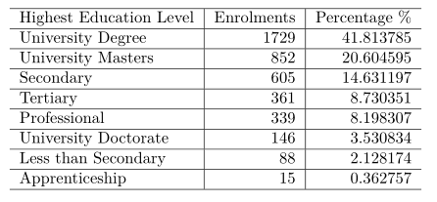
Highest Education Level

Slide 10
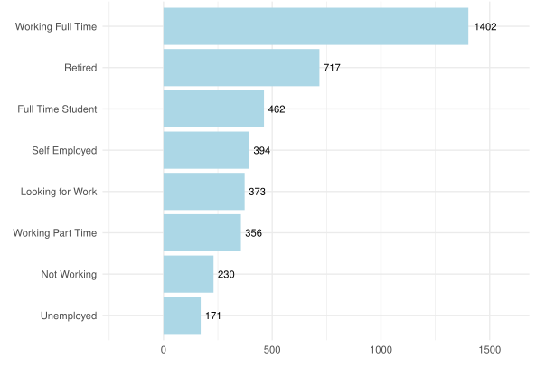
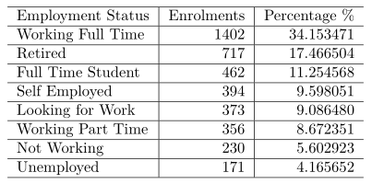
Employment Status

Slide 11
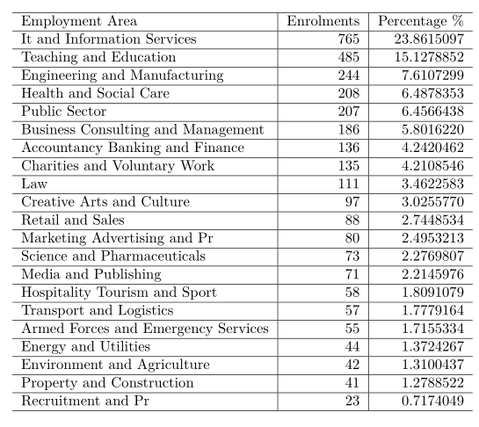
Employment Area

Slide 12
Leaving Findings

Slide 13
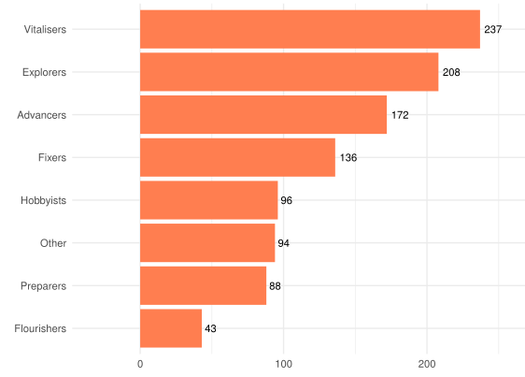
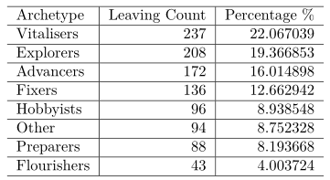
What are the proportions of learners archetypes that leave the course?

Slide 14
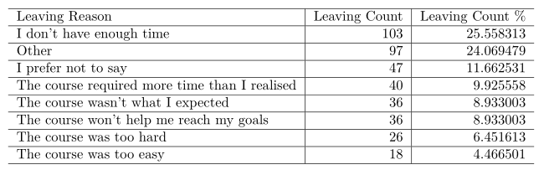
What are the most common reasons to leave?

Slide 15
Thank you

