Slide 1
A Two-Channel Cascade Model of Bank Failure
Coupling a Janson solvency threshold with a self-referential fear channel
Research progress update — Summer Undergraduate Research
Gary Mei · Georgia Tech ISyE · Advisor: Prof. Souvik Dhara · June 16, 2026

Slide 2
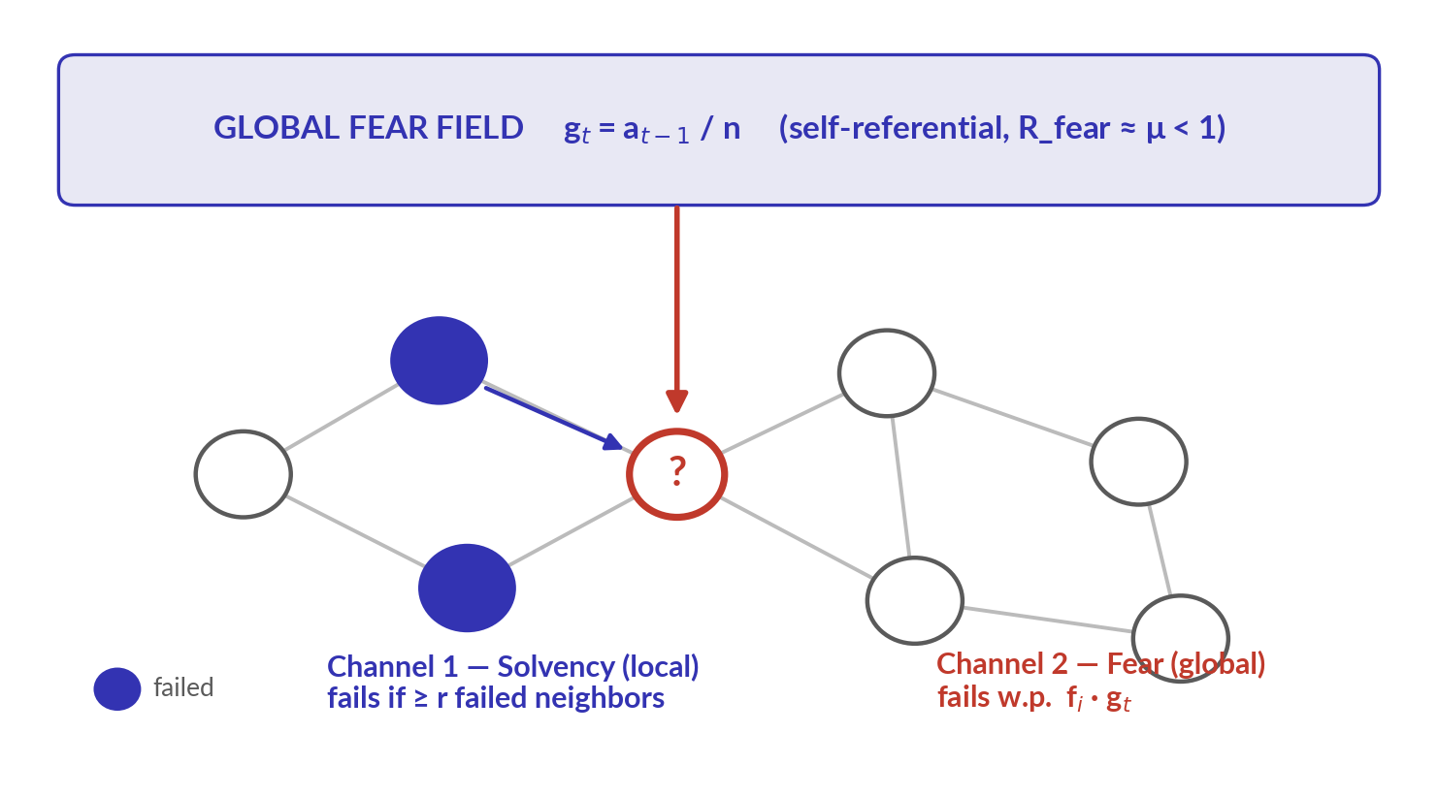
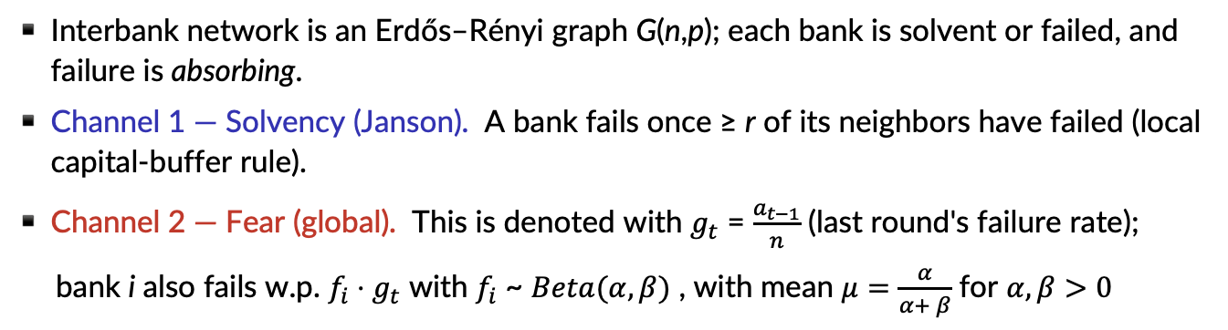
The model: two ways a bank can fail
Interbank network is an Erdős–Rényi graph G(n,p); each bank is solvent or failed, and failure is absorbing.
Channel 1 — Solvency (Janson). A bank fails once ≥ r of its neighbors have failed (local capital-buffer rule).
Channel 2 — Fear (global). This is denoted with $g_{t}$ = $\frac{a_{t−1}}{n}$ (last round's failure rate);
bank i also fails w.p. $f_{i}⋅g_{t}$ with $f_{i}$ ~ $Beta(α, β)$ , with mean $μ=\frac{α}{α+ β}$ for $α, β>0$
Key fact: fear is a subcritical amplifier — R_fear ≈ μ < 1. It cannot ignite a cascade alone; it only amplifies one that the solvency channel has already started.

Slide 3
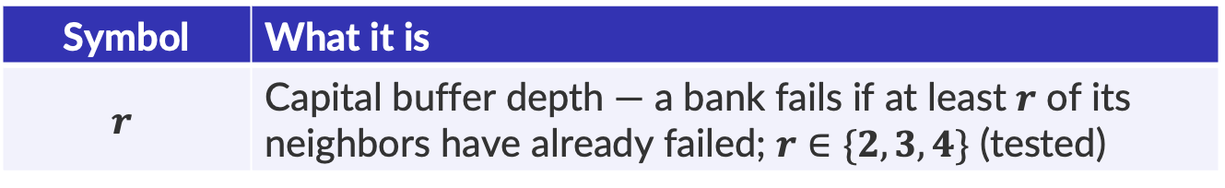
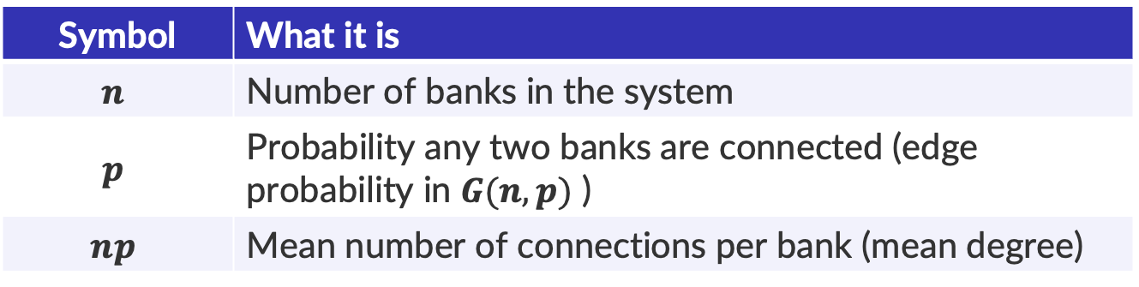
The Variables: Network & Solvency channel
The Network
Symbol | What it is
$$n$$ | Number of banks in the system
$$p$$ | Probability any two banks are connected (edge probability in $G(n,p)$ )
$$np$$ | Mean number of connections per bank (mean degree)
Channel 1: Solvency
Symbol | What it is
$$r$$ | Capital buffer depth — a bank fails if at least $r$ of its neighbors have already failed; $r∈\{2, 3, 4\}$ (tested)

Slide 4
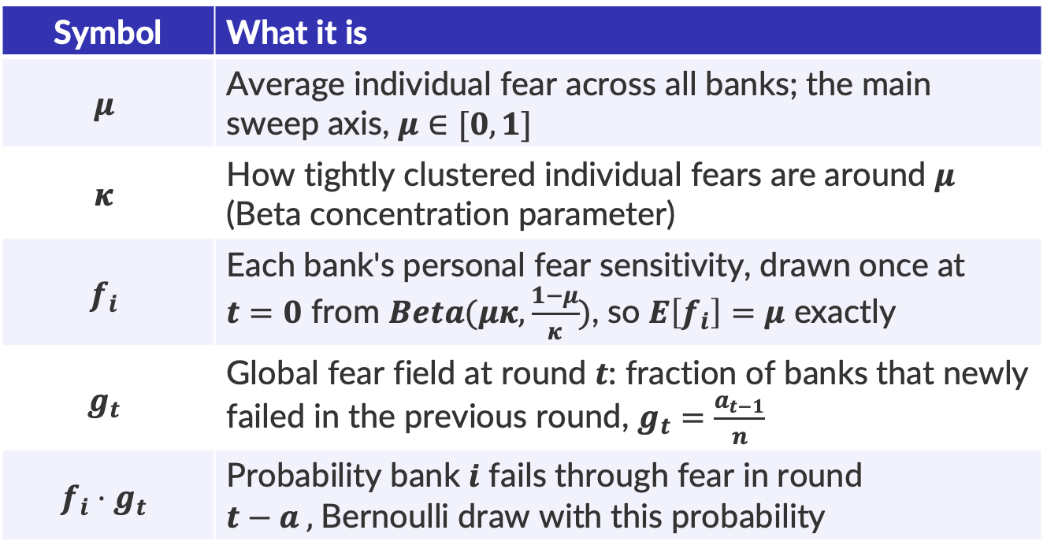
The Variables: Fear Channel
Channel 2: Fear
Symbol | What it is
$$μ$$ | Average individual fear across all banks; the main sweep axis, $μ∈[0,1]$
$$κ$$ | How tightly clustered individual fears are around $μ$ (Beta concentration parameter)
$$f_{i}$$ | Each bank's personal fear sensitivity, drawn once at $t=0$ from $Beta(μκ,\frac{1−μ}{κ})$, so $E\left[f_{i}\right]=μ$ exactly
$$g_{t}$$ | Global fear field at round $t$: fraction of banks that newly failed in the previous round, $g_{t}=\frac{a_{t−1}}{n}$
$$f_{i}⋅g_{t}$$ | Probability bank $i$ fails through fear in round $t−a ,$Bernoulli draw with this probability

Slide 5
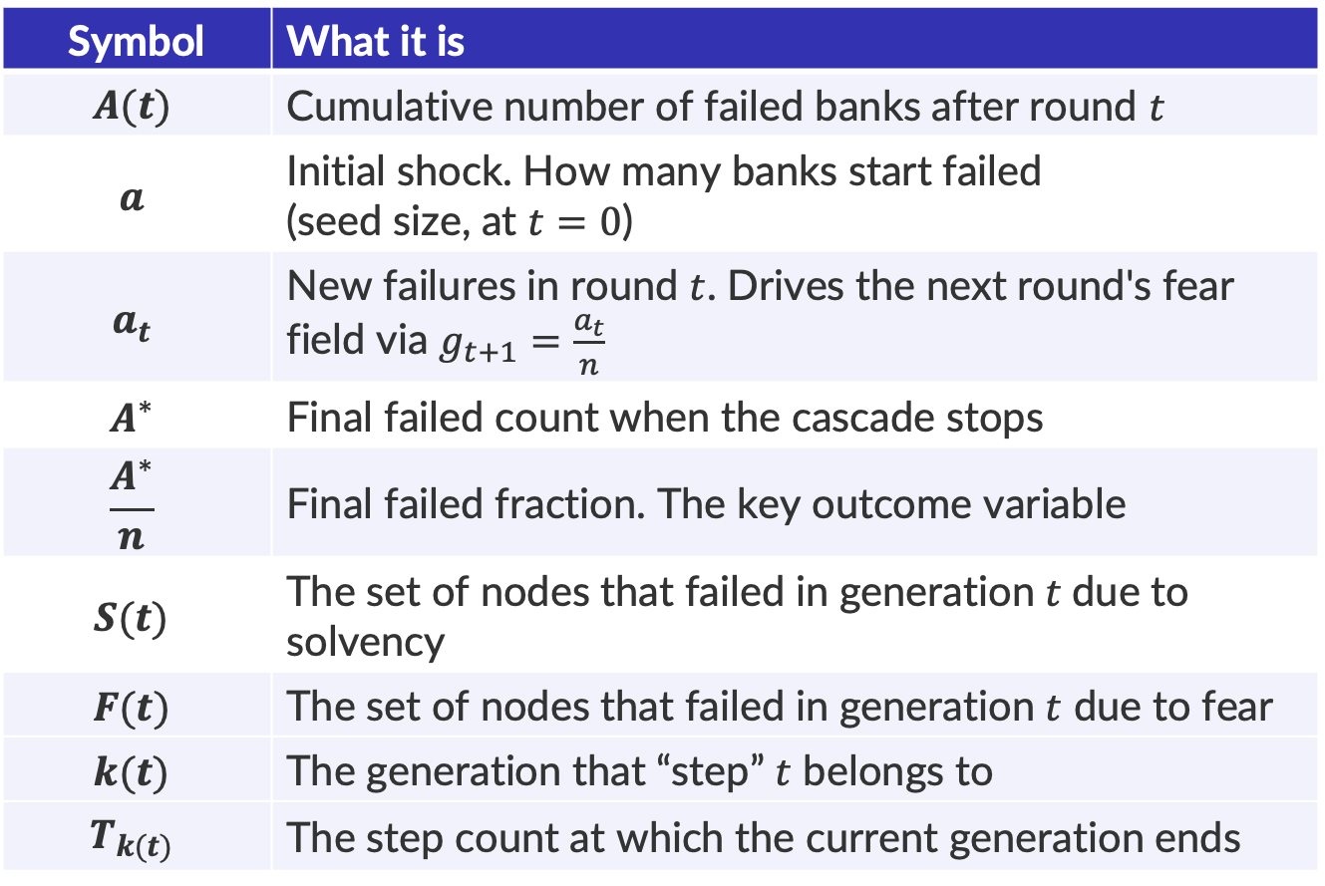
The Variables
State Variables (change each round)
Symbol | What it is
$$A(t)$$ | Cumulative number of failed banks after round $t$
$$a$$ | Initial shock. How many banks start failed (seed size, at $t=0$)
$$a_{t}$$ | New failures in round $t$. Drives the next round's fear field via $g_{t+1}=\frac{a_{t}}{n}$
$$A^{∗}$$ | Final failed count when the cascade stops
$$\frac{A^{∗}}{n}$$ | Final failed fraction. The key outcome variable
$$S(t)$$ | The set of nodes that failed in generation $t$due to solvency
$$F(t)$$ | The set of nodes that failed in generation $t$ due to fear
$$k(t)$$ | The generation that “step” $t$ belongs to
$$T_{k(t)}$$ | The step count at which the current generation ends

Slide 6
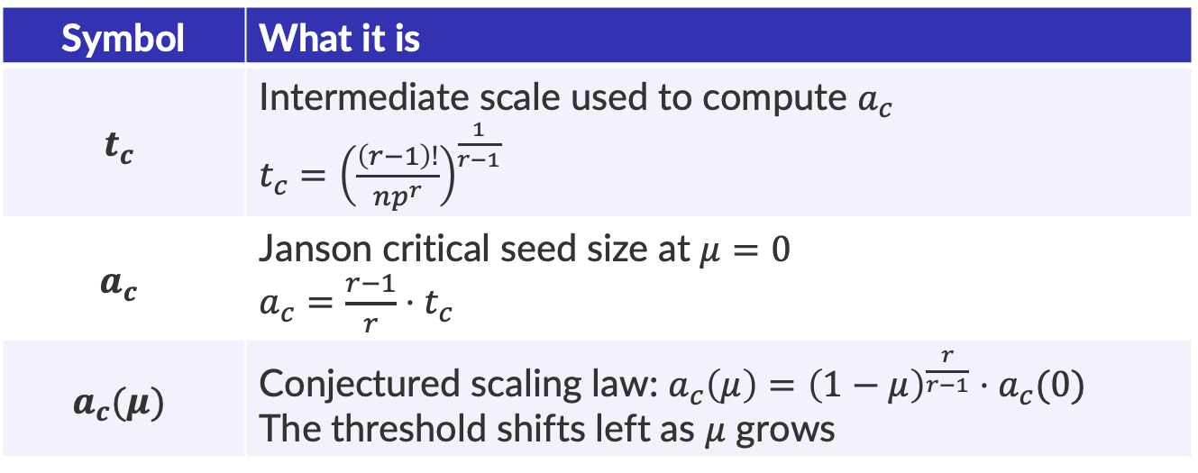
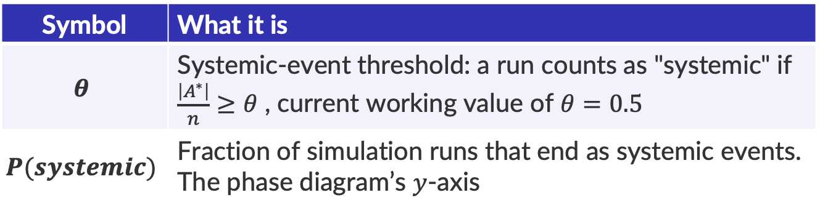
The Variables
Measurement
Symbol | What it is
$$θ$$ | Systemic-event threshold: a run counts as "systemic" if $\frac{\left|A^{∗}\right|}{n}≥θ$ , current working value of $θ=0.5$
$$P(systemic)$$ | Fraction of simulation runs that end as systemic events. The phase diagram’s $y$-axis
Analytical Benchmarks (no-fear baseline, $μ=0$)
Symbol | What it is
$$t_{c}$$ | Intermediate scale used to compute $a_{c}$ $t_{c}={\left(\frac{\left(r−1\right)!}{np^{r}}\right)}^{\frac{1}{r−1}}$
$$a_{c}$$ | Janson critical seed size at $μ=0$ $a_{c}=\frac{r−1}{r}⋅t_{c}$
$$a_{c}(μ)$$ | Conjectured scaling law: $a_{c}\left(μ\right)={\left(1−μ\right)}^{\frac{r}{r−1}}⋅a_{c}(0)$ The threshold shifts left as $μ$ grows

Slide 7
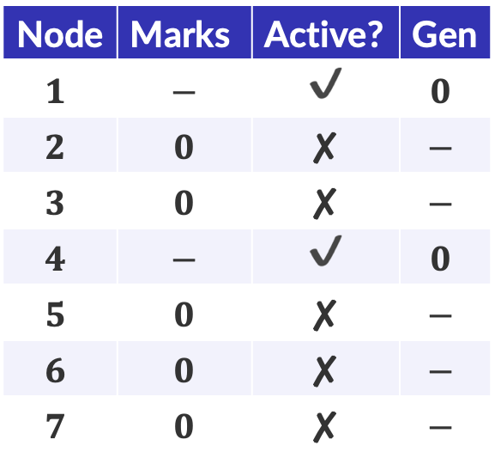
Now to walk through an example
We initialize with generation $k=0$, $Z\left(0\right)=∅$, $A\left(0\right)= \{1, 4\}$, and $r=2$
$$t$$ | $$u_{t}$$ | $$k\left(t\right)$$ | $$T_{k(t)}$$ | $$Z\left(t\right)$$ | $$A(t)$$ | $$g_{k(t)}$$ | $$S(k)$$ | $$F(k)$$
x
This denotes an inactive and unused node
x
This denotes an active but unused node
x
This denotes an active and used node
Note that Gen denotes generation
Node | Marks | Active? | Gen
$$1$$ | $$−$$ | ✔ | $$0$$
$$2$$ | $$0$$ | ✘ | $$−$$
$$3$$ | $$0$$ | ✘ | $$−$$
$$4$$ | $$−$$ | ✔ | $$0$$
$$5$$ | $$0$$ | ✘ | $$−$$
$$6$$ | $$0$$ | ✘ | $$−$$
$$7$$ | $$0$$ | ✘ | $$−$$
2
6
5
7
1
4
3

Slide 8
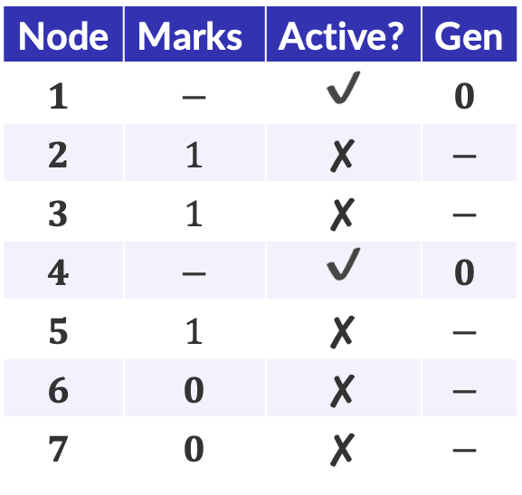
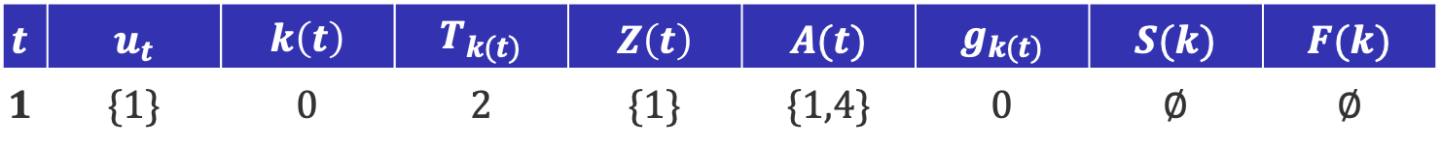
Example
$$t$$ | $$u_{t}$$ | $$k\left(t\right)$$ | $$T_{k(t)}$$ | $$Z\left(t\right)$$ | $$A(t)$$ | $$g_{k(t)}$$ | $$S(k)$$ | $$F(k)$$
$$1$$ | $$\{1\}$$ | $$0$$ | $$2$$ | $$\{1\}$$ | $$\{1,4\}$$ | $$0$$ | $$∅$$ | $$∅$$
Node | Marks | Active? | Gen
$$1$$ | $$−$$ | ✔ | $$0$$
$$2$$ | $$1$$ | ✘ | $$−$$
$$3$$ | $$1$$ | ✘ | $$−$$
$$4$$ | $$−$$ | ✔ | $$0$$
$$5$$ | $$1$$ | ✘ | $$−$$
$$6$$ | $$0$$ | ✘ | $$−$$
$$7$$ | $$0$$ | ✘ | $$−$$
2
6
5
7
1
4
3

Slide 9
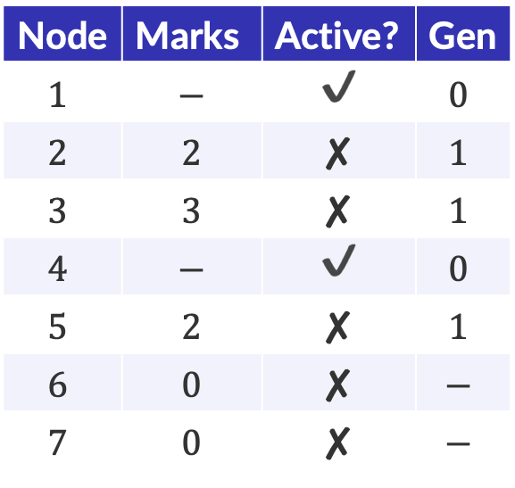
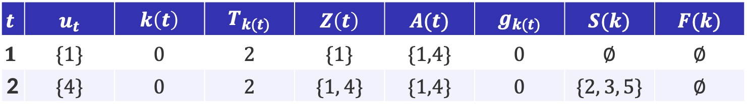
Example
$$t$$ | $$u_{t}$$ | $$k\left(t\right)$$ | $$T_{k(t)}$$ | $$Z\left(t\right)$$ | $$A(t)$$ | $$g_{k(t)}$$ | $$S(k)$$ | $$F(k)$$
$$1$$ | $$\{1\}$$ | $$0$$ | $$2$$ | $$\{1\}$$ | $$\{1,4\}$$ | $$0$$ | $$∅$$ | $$∅$$
2 | $$\{4\}$$ | $$0$$ | $$2$$ | $$\{1, 4\}$$ | $$\{1,4\}$$ | $$0$$ | $$\{2, 3, 5\}$$ | $$∅$$
Node | Marks | Active? | Gen
$$1$$ | $$−$$ | ✔ | $$0$$
$$2$$ | $$2$$ | ✘ | $$1$$
$$3$$ | $$3$$ | ✘ | $$1$$
$$4$$ | $$−$$ | ✔ | $$0$$
$$5$$ | $$2$$ | ✘ | $$1$$
$$6$$ | $$0$$ | ✘ | $$−$$
$$7$$ | $$0$$ | ✘ | $$−$$
2
6
5
7
1
4
3

Slide 10
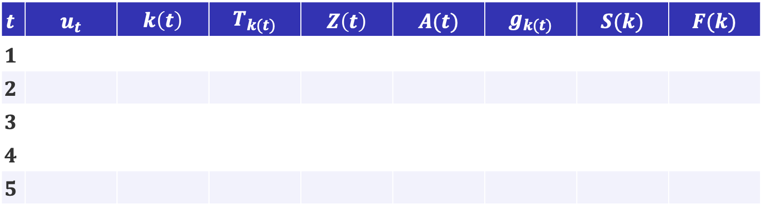
Now to walk through an example
$$t$$ | $$u_{t}$$ | $$k\left(t\right)$$ | $$T_{k(t)}$$ | $$Z\left(t\right)$$ | $$A(t)$$ | $$g_{k(t)}$$ | $$S(k)$$ | $$F(k)$$
$$1$$
$$2$$
$$3$$
$$4$$
$$5$$
Node | Marks | Active? | Gen
$$1$$ | $$−$$ | ✔ | $$0$$
$$2$$ | $$0$$ | ✘ | $$−$$
$$3$$ | $$0$$ | ✘ | $$−$$
$$4$$ | $$−$$ | ✔ | $$0$$
$$5$$ | $$0$$ | ✘ | $$−$$
$$6$$ | $$0$$ | ✘ | $$−$$
$$7$$ | $$0$$ | ✘ | $$−$$
2
6
5
7
1
4
3

