Slide 1
Bootstrap Percolation on the Random Graph G_{n,p}
Janson, Łuczak, Turova & Vallier (2012)
Gary Mei · ISyE Summer Scholars Program · June 16, 2026

Slide 2
Outline
The model and the central question
Reformulation as a one-dimensional process
Sharp threshold for activation, and the phase diagram
Gaussian fluctuations and the number of generations
Dynamical variants and boundary regimes
Idea of the proof: a bottleneck

Slide 3
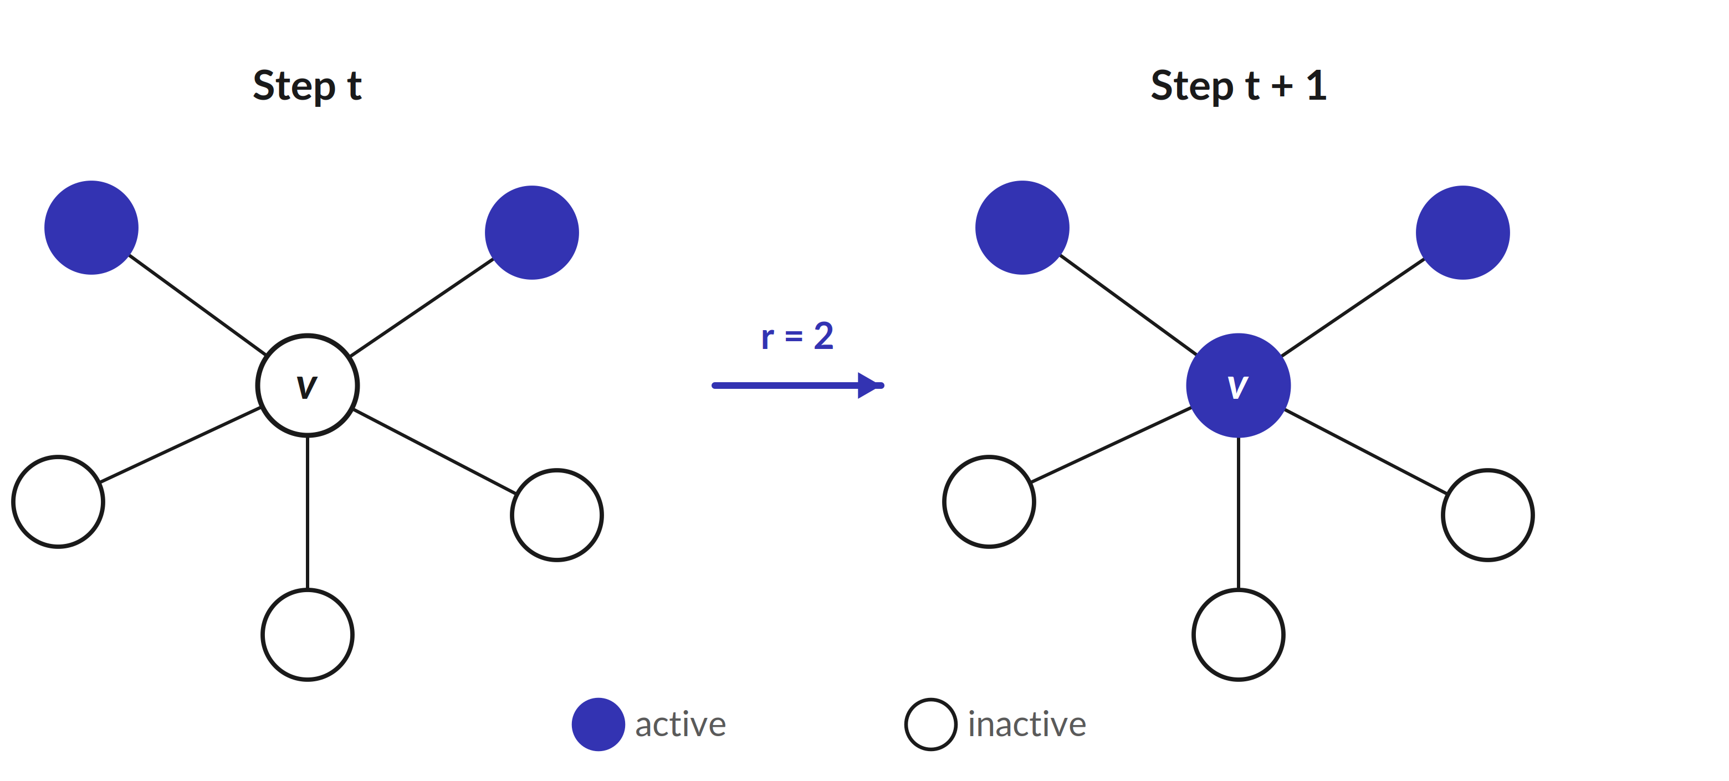
Bootstrap percolation: the model
Definition (Chalupa–Leath–Reich, 1979).
Fix an integer threshold r ≥ 2 and an initial active set A(0) of size a. At each step, every inactive vertex with at least r active neighbours becomes active; repeat until nothing changes.
A* = the final number of active vertices. The process percolates if A* = n, and almost percolates if A* = n − o(n).
The update rule for r = 2: a vertex turns active once two neighbours are active.

Slide 4
Setup: the graph and the parameters
The setting.
Graph: the Erdős–Rényi random graph G_{n,p} on n vertices, each edge present independently with probability p.
Parameters: threshold r ≥ 2, seed size a, edge probability p; the seed A(0) is a uniform a-subset of the vertices.
Quantities of interest: the final size A*, whether percolation occurs, and the number of generations τ until the process stops.
Main regime studied: 1/n << p << n^{−1/r} — sparse, but above the scale where percolation becomes possible.

Slide 5
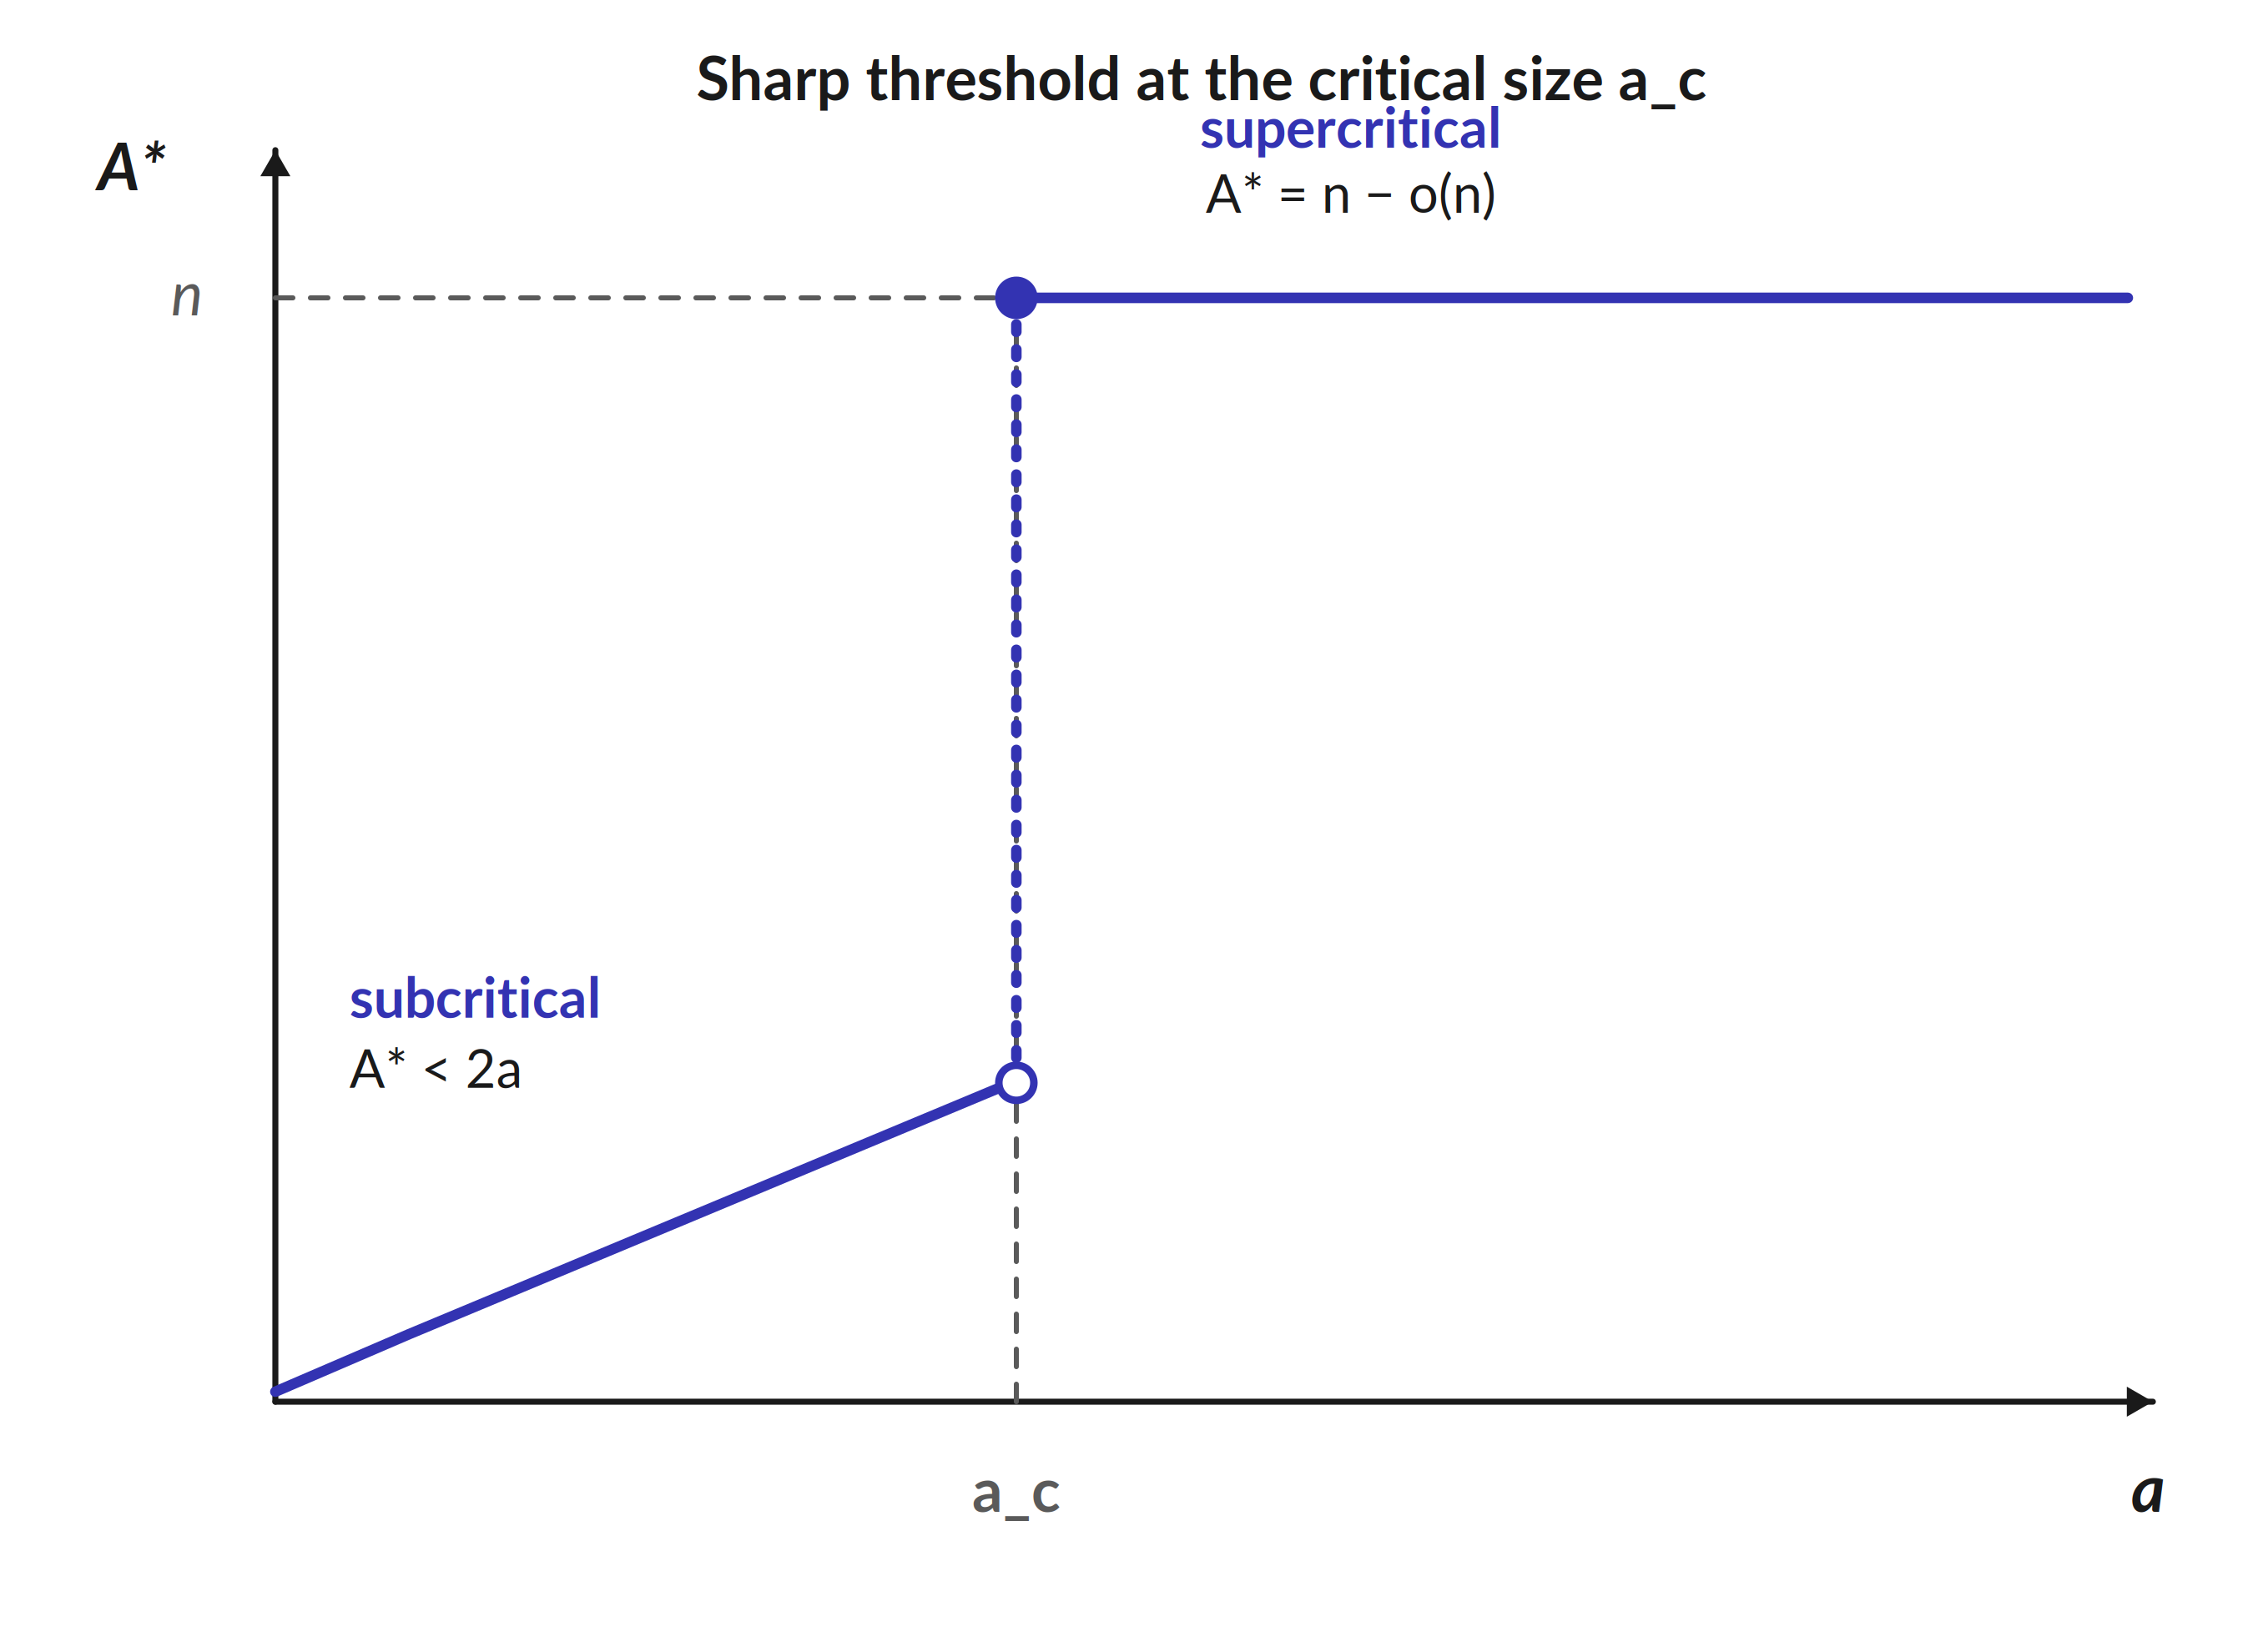
The central question: a sharp transition
Small seed or (almost) everything.
Depending on the seed size a, the final active set is either small or essentially the whole graph:
subcritical: A* < 2a — the seed barely spreads;
supercritical: A* = n − o(n) — almost all vertices.
The jump between the two happens within a narrow window of a.
Final active fraction A*/n as a crosses a_{c}.

Slide 6
A useful reformulation
From a graph process to a 1-D walk
Activate vertices one at a time; when a vertex becomes active, reveal its edges to the still-inactive vertices.
For the i-th activated vertex, the number of inspections needed to reach r active neighbours is Y_{i} ~ NegBin(r, p), independent across vertices.
After t activations, the number of newly triggered vertices is S(t) ~ Bin(n − a, π(t)), with π(t) = P(Bin(t, p) ≥ r).
Stop at T = min{ t : A(t) ≤ t }; then A* = T. The whole question reduces to the one-dimensional process S(t) − t.

Slide 7
Main result: the critical seed size
Theorem 3.1 (sharp threshold).
Assuming that 1/n << p << n^{−1/r} and r ≥ 2
t_{c} = ( (r − 1)! / (np^{r}) )^{1/(r−1)} a_{c} = (1 − 1/r) t_{c}.
If a/a_{c} → α < 1 (subcritical): A* < 2a w.h.p.
If a/a_{c} → α > 1 (supercritical): A* = n − O_{p}(b_{c}).
Complete percolation (A* = n w.h.p.) holds iff
np − ( log n + (r − 1) log log n ) → +∞.
For r = 2 : t_{c} = 1/(np²), a_{c} = 1/(2np²).

Slide 8
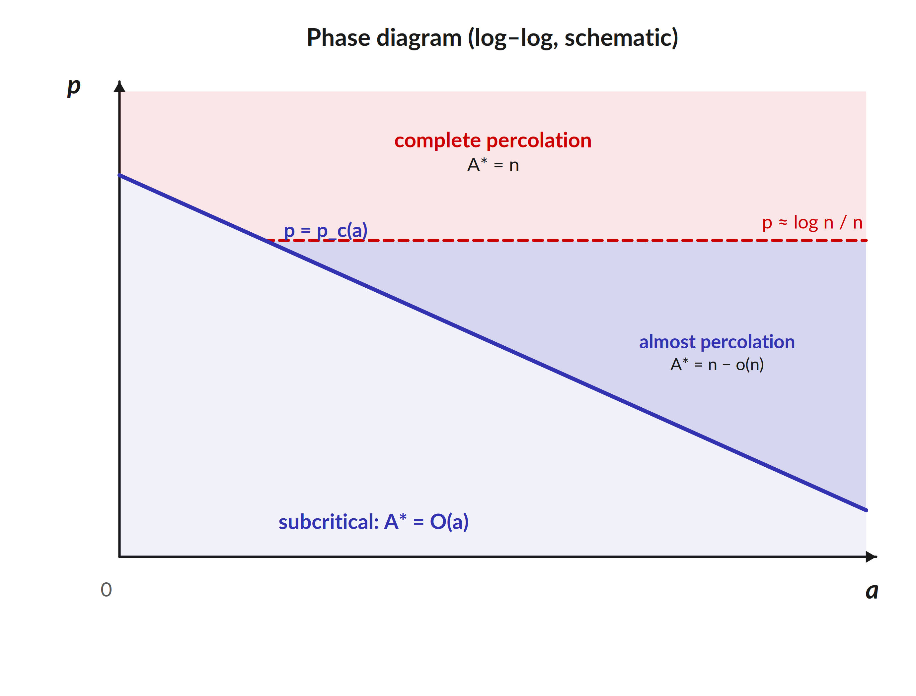
The phase diagram
Critical curve and the two flavours.
p_{c}(a) = Θ( (na^{r−1})^{−1/r} ).
For r = 2 : p_{c} = (2na)^{−1/2}.
Tuning a at fixed p, or p at fixed a, gives the same transition (the two are inverse).
"Almost" and "complete" percolation differ only for large seeds: e.g. a = n/log n, r = 2 gives almost-percolation at
p ~ √(log n/n), complete at
p ~ (log n)/n.
Regimes in the (a, p)-plane (log–log).

Slide 9
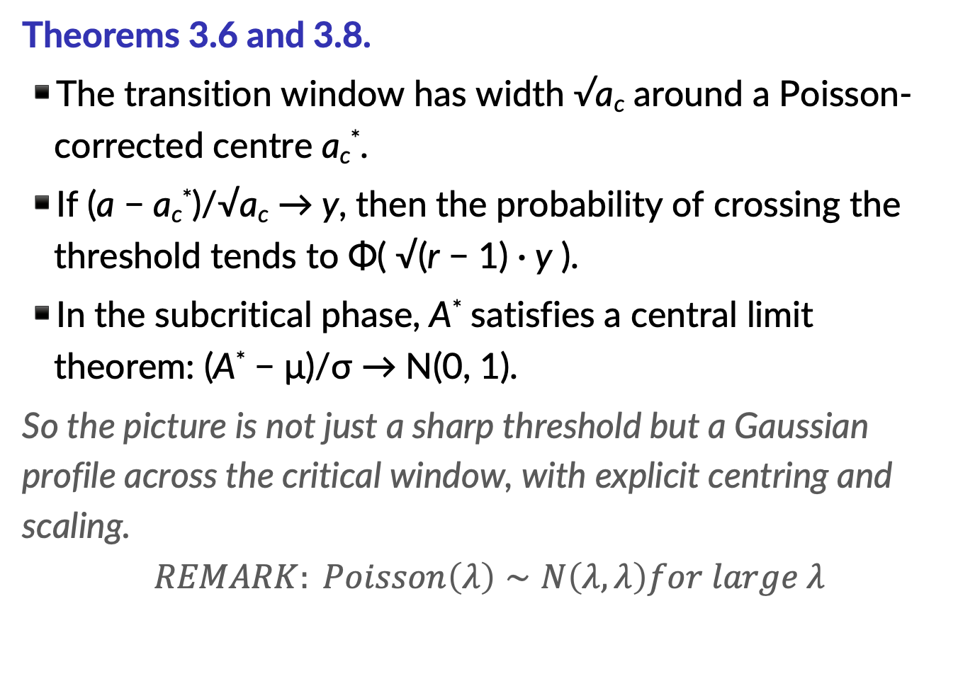
Gaussian fluctuations
Theorems 3.6 and 3.8.
The transition window has width √a_{c} around a Poisson-corrected centre a_{c}*.
If (a − a_{c}*)/√a_{c} → y, then the probability of crossing the threshold tends to Φ( √(r − 1) · y ).
In the subcritical phase, A* satisfies a central limit theorem: (A* − μ)/σ → N(0, 1).
So the picture is not just a sharp threshold but a Gaussian profile across the critical window, with explicit centring and scaling.
$$REMARK: Poisson\left(λ\right)∼N\left(λ,λ\right)for large λ$$

Slide 10
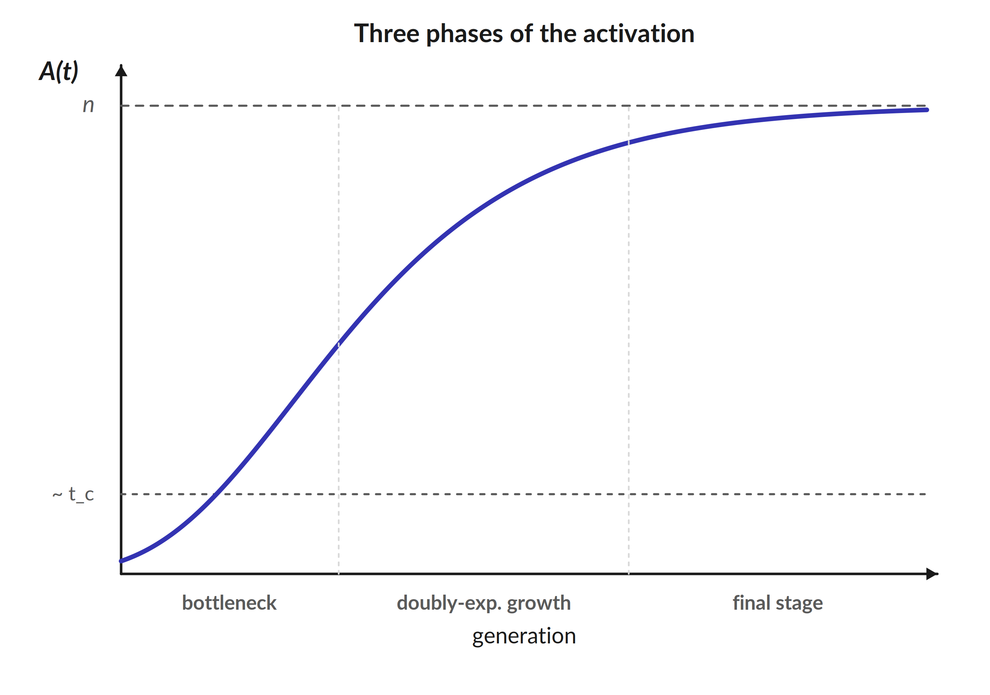
The number of generations
Theorem 3.10.
The number of generations τ splits into three additive pieces:
a slow bottleneck phase near t_{c};
a doubly-exponential growth phase;
a short final sweep over the remaining vertices.
Example (p = n^{−α}, a = 2a_{c}) :
τ ~ (log log n)/log r.
Active set A(t) by generation; essentially a Gompertz curve.

Slide 11
Dynamical variants
Adding activity over time (Sec. 4).
Add activations: if the running seed satisfies A₀/a_{c} → 1 the system is critical, with Poissonised fluctuations around a_{c}.
Add infections: critical when J₀/(np · a_{c}) → 1.
Add edges one at a time: percolation sets in at M = C(n, 2) · p_{c} (1 + o_{p}(1)) edges.
A single common construction couples all three pictures — and even one extra seed can move the threshold from t_{c} all the way to n.

Slide 12
Boundary regimes
Outside the main window (Sec. 5).
Sparse, p ~ c/n, a ~ θn: A*/n → x₀(θ); a genuine threshold exists only if c > c_{c} (c_{c} = 3 for r = 2, 9/2 for r = 3).
Dense, p ~ cn^{−1/r}: P(A* = n) → ζ(a, c) in (0, 1) — percolation is non-degenerate.
For p >> n^{−1/r} and a ≥ r, the graph percolates w.h.p.
The case r = 1 recovers the classical Reed–Frost epidemic.

Slide 13
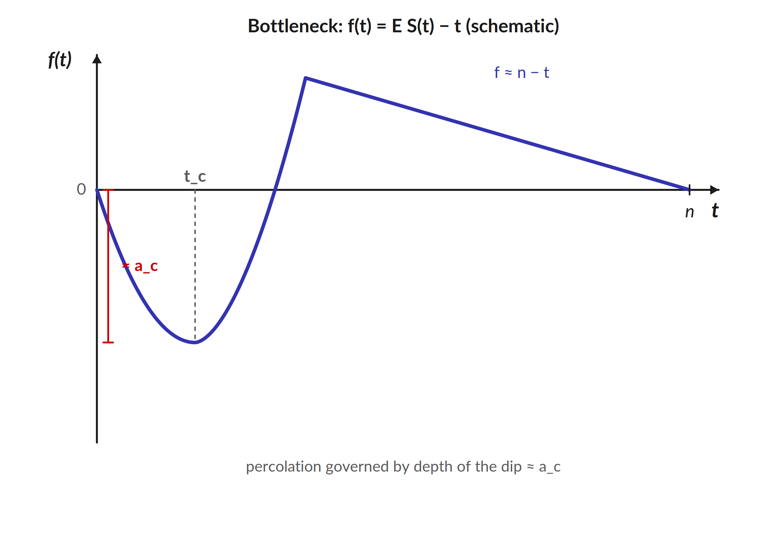
Proof idea: a bottleneck
Overview of the proofs (Sec. 6).
Since A* = T is the first time S(t) drops to t, everything is governed by the deterministic drift f(t) = E S(t) − t.
f starts at 0, dips to a minimum ≈ −a_{c} near t = t_{c}, climbs to ≈ n − t, and returns to 0 at t = n.
The seed gets past the bottleneck iff a exceeds the depth a_{c} of the dip.
The behaviour near t = n separates almost- from complete percolation.
The drift f(t) = E S(t) − t and its critical dip.

Slide 14
Summary
Takeaways.
Bootstrap percolation on G_{n,p} has a sharp threshold at seed size a_{c} = (1 − 1/r) t_{c}, with transition window √a_{c}.
The full (a, p) phase diagram is known, including the gap between almost- and complete percolation for large seeds.
The number of generations decomposes into bottleneck + doubly-exponential growth + final sweep.
Method: reparametrise the graph process in time into a one-dimensional walk S(t) − t (after Scalia-Tomba), then study its bottleneck.
The same framework handles dynamical variants and the sparse / dense boundary regimes.

