Slide 1


Slide 2

Automated Data Visualisation for Policymaking. Week 8. Seminar

Slide 3
Week 8. Reminders
Reminder: Office hours.
RD: Thurs, 11:00-12:00 (SPP office)
FM: Friday, 14:30-15:30 (CBG 5.01 or lse.zoom.us/j/7930269151)
JH: Mon, 14:00-15:00 (CBG 5.01)
Reminder: Portfolio tasks
These are set each week and make up 20% of your grade. They can be found in the course DropBox. The file is here

Slide 4

Data Science projects.

Slide 5
Assessment. {Deadline: 8th Jan}
Coursework. The coursework consists of two parts.
DS Portfolio (20%). In each of the first 10 weeks you learn the steps to produce charts, tables or visualisations. These are worth 20% of your grade. Each week is graded equally, i.e. 2%. These should be completed during the week. Note that the portfolio is NOT the same as for 2022.
DS Project (80%).
Between 3 and 8 charts. Embedded in your site, hosted by GitHub pages.
An accompanying write-up (also embedded on your page) discussing:
the aims of your project;
the data you used, how you accessed it, including notes on automation/replication;
challenges in data cleaning and/or analysis, and the tools you used to overcome them;
your conclusions.
Each section must not exceed 200 words.

Slide 6
Practical. UK Price Microdata

Slide 7
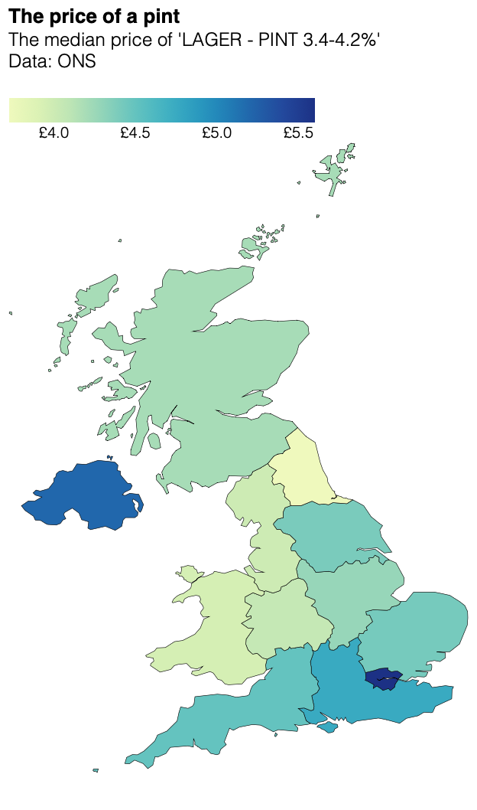
Our target:
An interactive choropleth of UK beer prices

