Slide 1
RBE595 - Reinforcement Learning
End-to-End Motion Planning of
Quadrotors Using Deep
Reinforcement Learning
Author: Efe Camci and Erdal Kayacan
Project: Giorgio Mendoza

Slide 2
Introduction
Develop a Deep Reinforcement Learning (DRL) Model: Implement a DRL system that utilizes raw depth images for navigating quadrotors in cluttered environments.
Utilize Depth Images for Navigation:
Generate and use depth images obtained from a front-facing camera.
Transform depth images into local motion plans using deep neural networks.
Create Smooth Motion Primitives:
Employ Bézier curves to formulate smooth, dynamic motion paths (if possible).
Train the model to select optimal motion primitives based on real-time environmental data.
Achieve Autonomous Navigation:
Enable the quadrotor to autonomously navigate without prior obstacle location information, relying solely on visual inputs.
Replicate System Functionality:
Validate the model's effectiveness in AirSim simulations, mirroring the original study's setup and results.
Notes:
Show Work Environment ROS2 & NAV2 & Gazebo

Slide 3
Algorithm Overview: Deep Q-Network (DQN) for Action-Value Estimation
Purpose: Estimate action-value function Q(s,a)Q(s,a) for decision-making in environments with high-dimensional action spaces.
Deep Q-Network (DQN) Structure: Combines convolutional neural networks (CNNs) and fully connected layers.
Uses 2 main lanes: First lane & Second Lane
Processing Pipeline:
First lane, Second Lane
Combination and Output: Combines outputs for both lanes
Training and Optimization:
Uses the Bellman equation to train the DQN, incorporating rewards and discount factors for future rewards.
Employs the Huber loss for stability during training.
Optimized using the Adam optimizer, a method for stochastic gradient descent.
Notes:
Show Work Environment ROS2 & NAV2 & Gazebo

Slide 4
State
Current situation or status of the agent in environment
Components:
Depth Image - 32 x 32 pixel image
Relative Position Information
Integration in State Definition:
Provides the agent with comprehensive situational awareness.
Functionality:
Allows the quadcopter to understand its environment
Notes:
Show Work Environment ROS2 & NAV2 & Gazebo

Slide 5
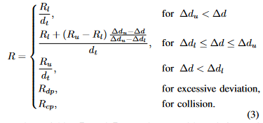
Rewards
To assess the quality of the quadrotor’s actions based on its movement relative to a dynamic setpoint.
Components:
Notes:
Show Work Environment ROS2 & NAV2 & Gazebo

Slide 6
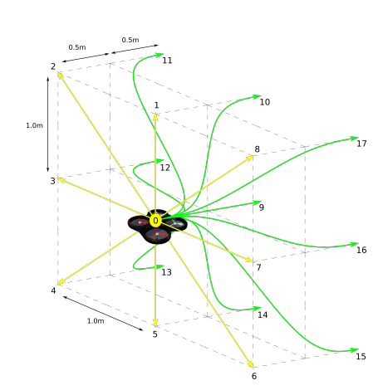
Actions
Action Definition: The agent's move at each timestep, designed to increase rewards through smooth motion primitives.
Bézier Curves for Motion
Parametric Definition
Control Points
Advantages:
Smooth Trajectories
Reactivity
Notes:
Show Work Environment ROS2 & NAV2 & Gazebo

Slide 7
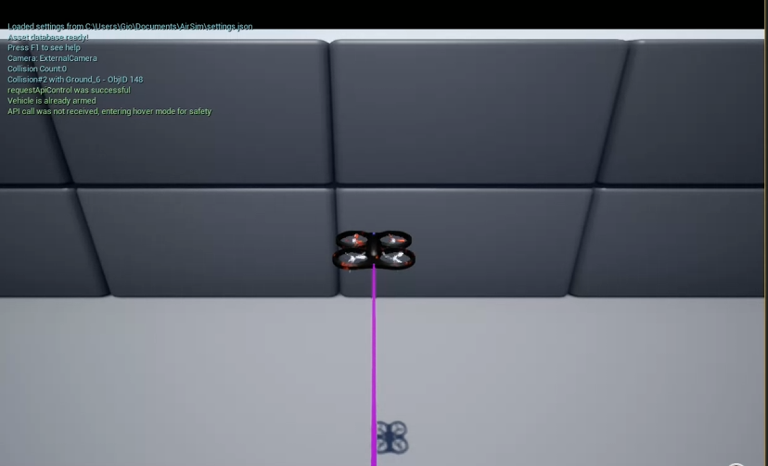
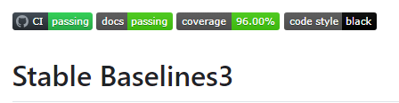

RL Framework
The RL framework and tools used for this project consists of:
Airsim
Open AI Gym env
stable-baselines3
Notes:
Show Work Environment ROS2 & NAV2 & Gazebo

Slide 8
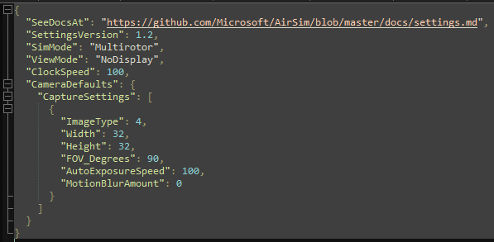
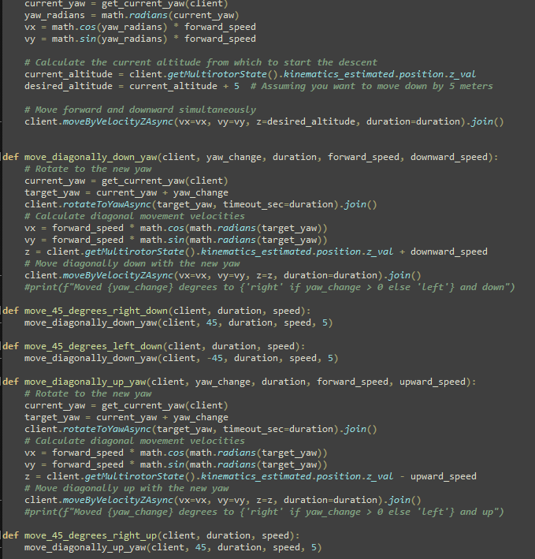
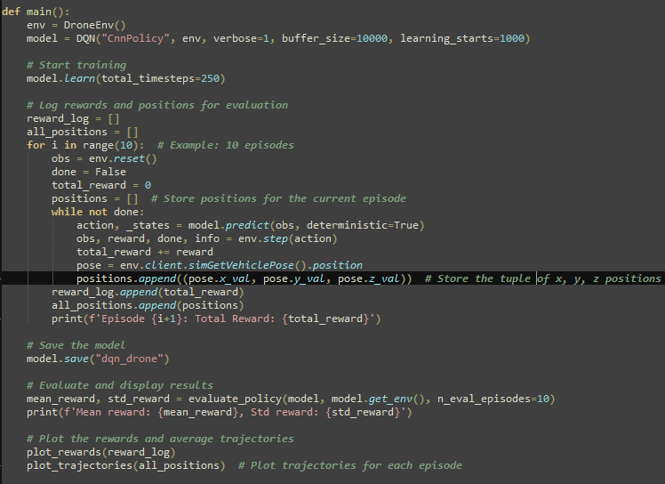
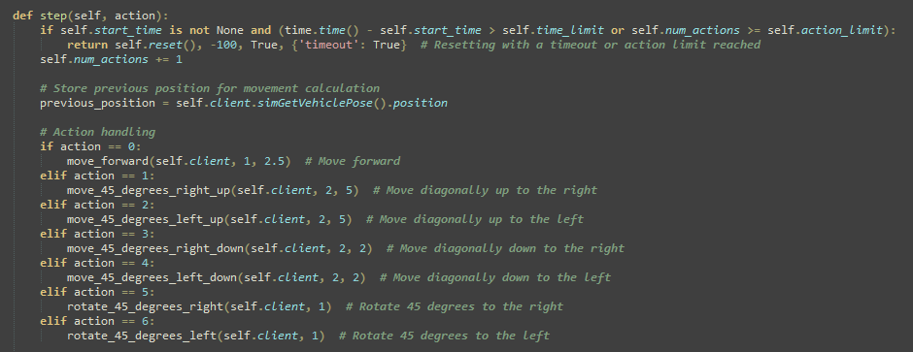
Architecture/Implementation
The implementation of this project consists of three Python files and a JSON file.
Json FIle for initial config
Movements
DroneEnvironment
Main file
Notes:
Show Work Environment ROS2 & NAV2 & Gazebo

Slide 9
Demo 1
Notes:
Show Work Environment ROS2 & NAV2 & Gazebo

Slide 10
Demo 2
Notes:
Show Work Environment ROS2 & NAV2 & Gazebo

Slide 11
Demo 3
Notes:
Show Work Environment ROS2 & NAV2 & Gazebo

Slide 12
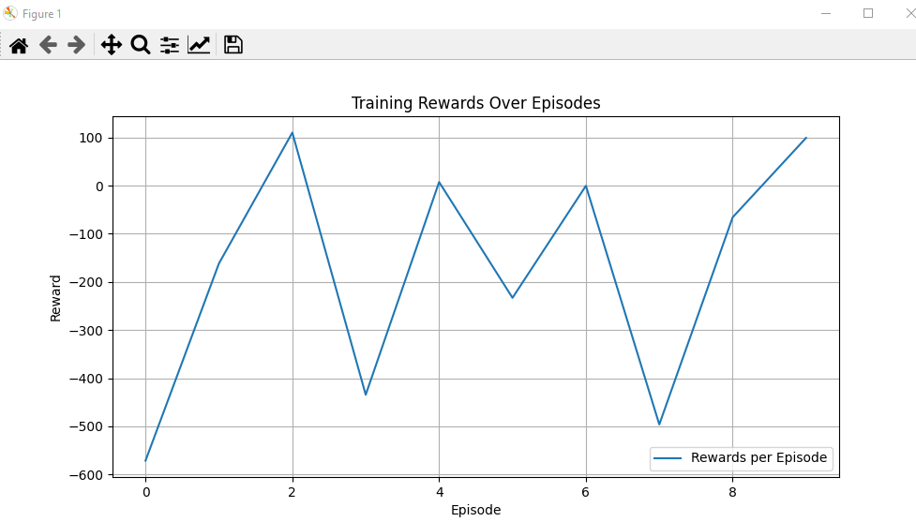
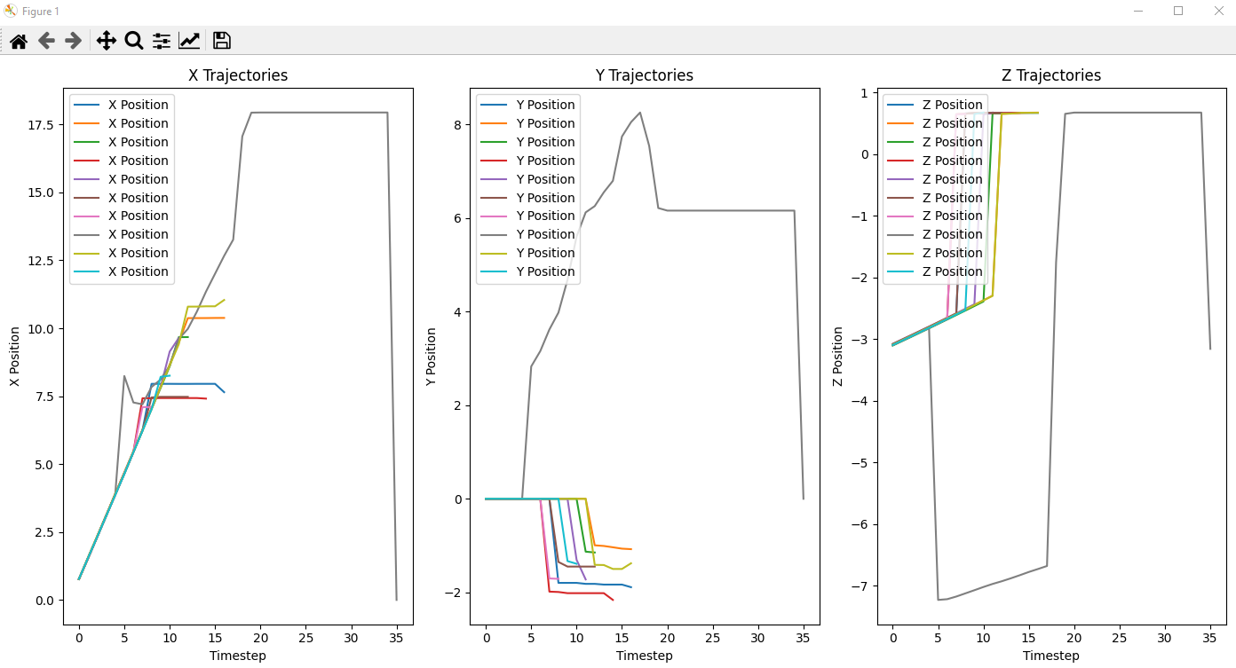
Results - 1000 timesteps
Notes:
Show Work Environment ROS2 & NAV2 & Gazebo

Slide 13
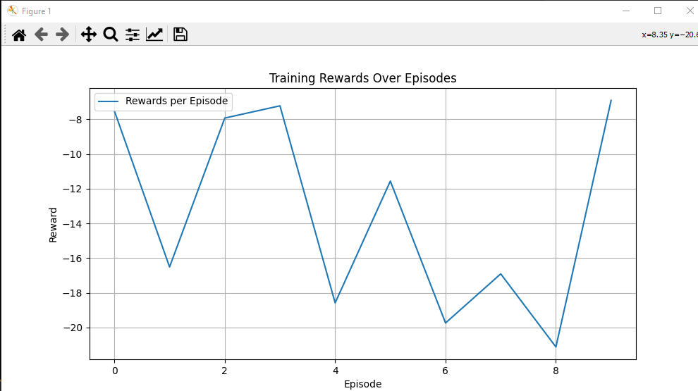
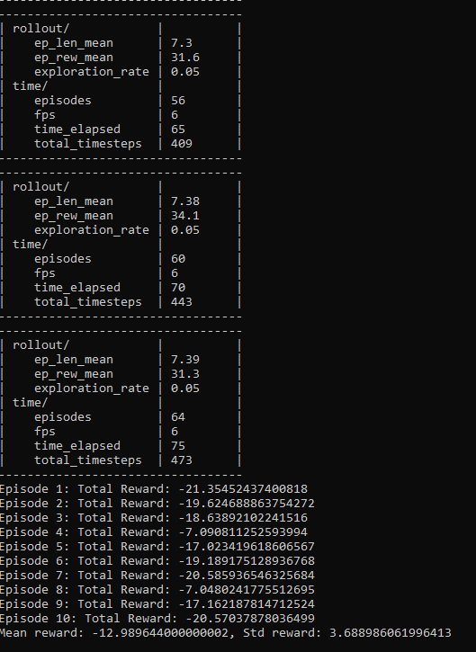
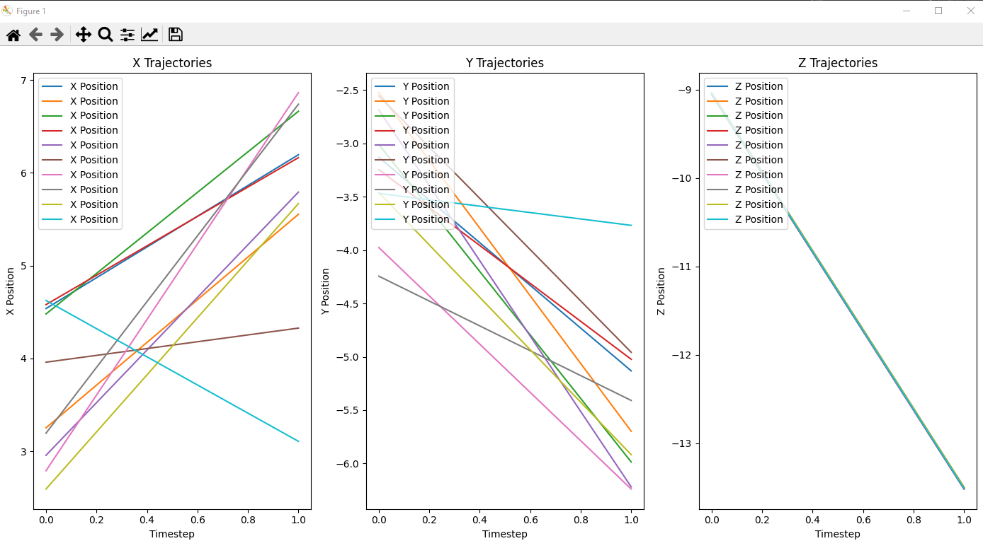
Results - 500 timesteps
Notes:
Show Work Environment ROS2 & NAV2 & Gazebo

Slide 14
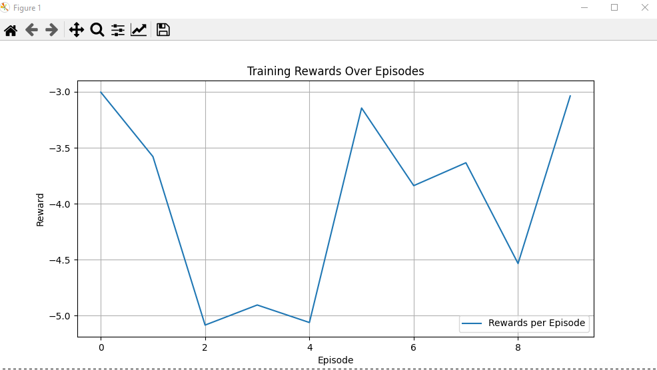
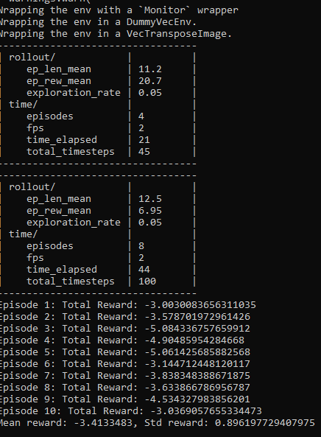
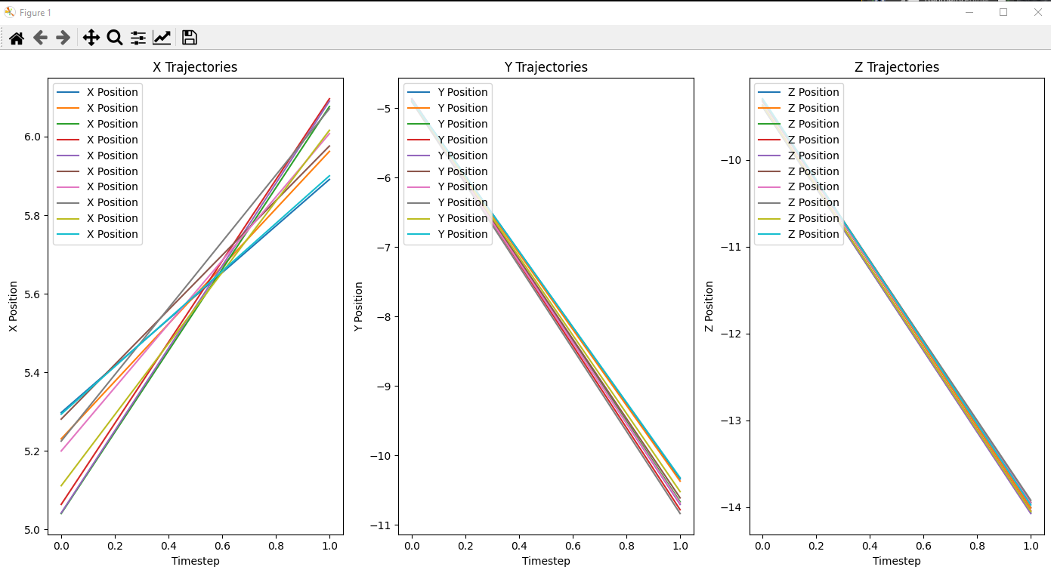
Results - 100 timesteps
Notes:
Show Work Environment ROS2 & NAV2 & Gazebo

Slide 15
Room for improvement
Solve issue with drone going upwards initially
Implement and use Bézier curves from research paper
Implement PID algorithm for improved actions precision
Determine proper use of NoDisplay setting and Overclock setting
Notes:
Show Work Environment ROS2 & NAV2 & Gazebo

Slide 16
Thank you

