Slide 1

Predicting Turnover Intentions
November 29, 2021
Tyler Hurt & Gordon Goodwin

Slide 2

Introduction
Primary goal was predicting turnover intentions
1,454 employees across 199 Organizations
Convenience Sample of small and medium-sized businesses from 2017-2019 in The Netherlands
Level 1: Individual Employee-Level data
Demographics (Gender, Age, Education)
Job Specific (Position, Hours per week, FTE)
Work Culture (LMX, Info Share, Employee Voice, Pay Satisfaction, Fairness Perceptions, Career Guidance)
Level 2: Organizational-Level data
HR Availability
Turnover Rates
Employee Involvement
Corporate Entrepreneurship

Slide 3

Introduction cont.
Original Study
Compared predictive models with both Level 1 and Level 2 predictors
Predicted Turnover Intentions from a variety of employee-level and organizational-level factors
Multilevel Modeling Approach: Compared fixed-effects and random-effects models for several different model-types
Yuan, S., Kroon, B., & Kramer, A. (2021). Building prediction models with grouped data: A case study on the prediction of turnover intention. Human Resource Management Journal.
Our Study
Goal: Classify employees as high-risk or low-risk in terms of turnover
Compared predictive models with only Level 1 predictors
Demographics (Gender, Age, Education)
Job-specific (Voice Level, Proactivity, Pay Satisfaction)
Work-culture perceptions (LMX, Career Guidance, Fairness)

Slide 4
Research Methods
Dichotomized Turnover Intentions (originally 5-point Likert scale)
All employees with TO intentions > 3 labelled as High Risk
Class imbalance after dichotomizing
1,239 Low Risk vs 215 High Risk (85% vs 15%)
SMOTE (Synthetic Minority Oversampling Technique) to address imbalance
Oversampling of minority class by creating similar composites
771 Low Risk vs 683 High Risk (53% vs 47%)
Data set split into training and test sets (70% split)
All models trained on training data and evaluated on testing data
Used 3 different classification models on both original and synthetic datasets
Logistic Regression, K-Nearest Neighbors (KNN), Random Forest (RF)
Evaluated predictive performance across final 9 models (3 models x 3 datasets)
AUC, Accuracy, Precision, Recall, Weighted Score

Slide 5
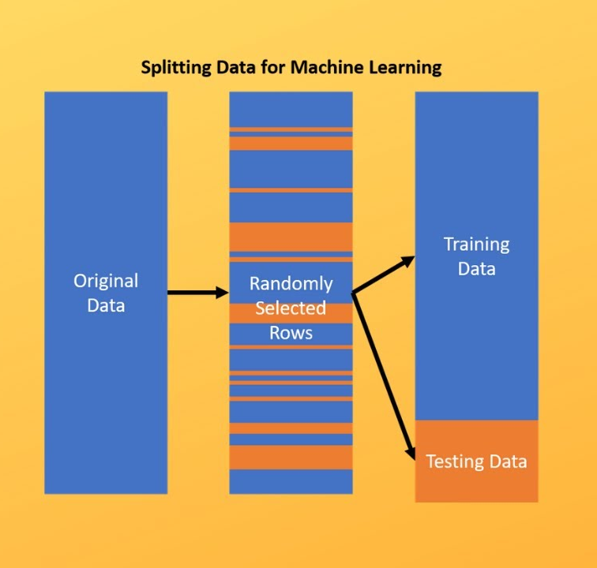
Train/Test Split

Slide 6
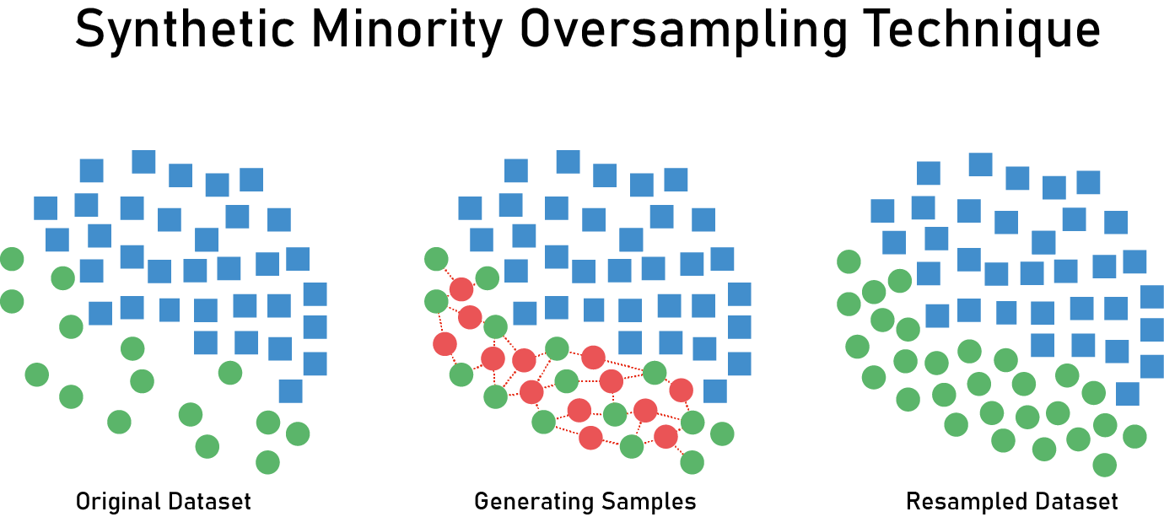

Slide 7
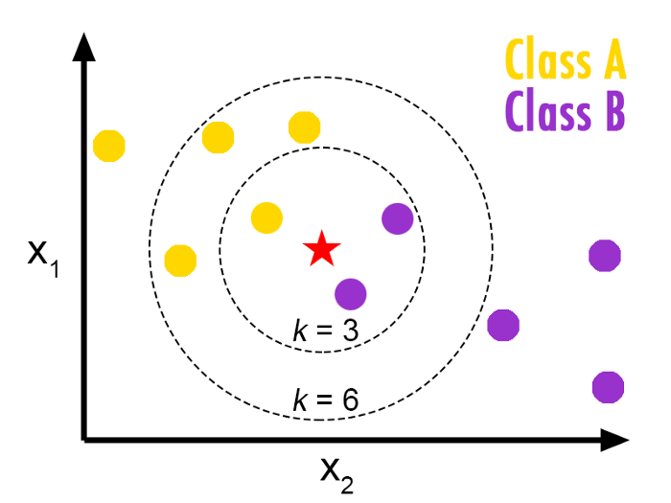
K-Nearest Neighbors

Slide 8
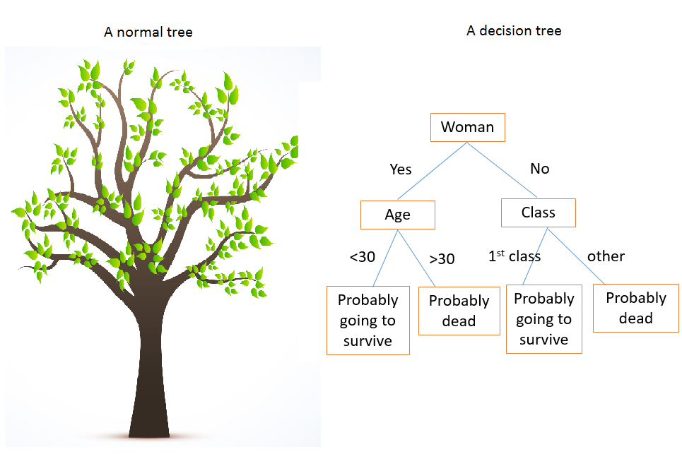
Decision Tree

Slide 9
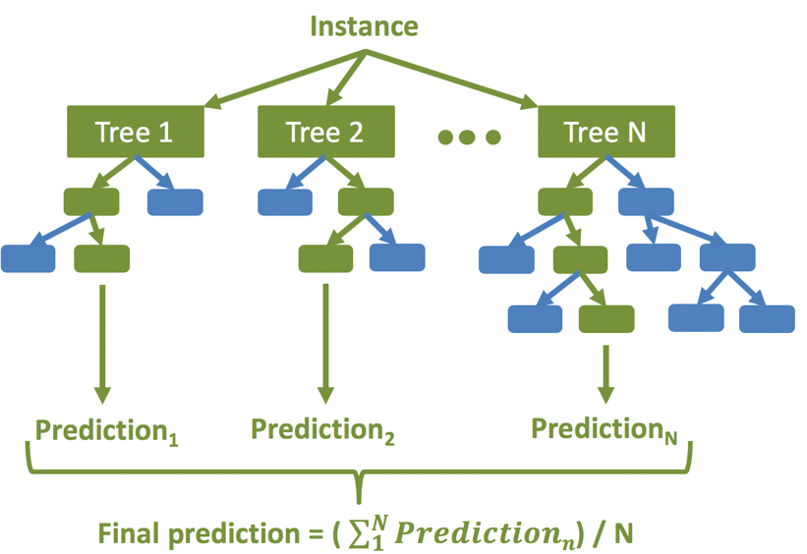
Random Forest

Slide 10
Performance Metric Selection
Attempted to prioritize metrics from the viewpoint of employer
Goal: identify employees who are thinking of quitting in order to employ potential interventions for employee retention
Precision vs Recall?
Precision: Percentage of predictions made for each class that were accurate (focusing on prediction accuracy)
Recall: Percentage of actual class members that were accurately detected and predicted as such (focusing on class detection)
Prioritized identification of positive class (high risk) in a manner that would still attempt to minimize false positives
Failing to detect employees who are at high risk of quitting is the costliest mistake an employer can make
False positives are also costly to the employer because they represent unnecessary interventions, but less costly than rehiring
Created custom composite performance metric for final model selection
Positive Recall (2/3 weight) + Positive Precision (1/3 weight)
Percentage of actual high-risk accurately detected weighted 2x higher than percentage of high-risk predictions that were correct

Slide 11
Results
Original Data Set
Model | Weighted Average
Random Forest | 0.388
Logistic Regression | 0.349
K-Nearest Neighbors | 0.207
SMOTE Data Set
Model | Weighted Average
Logistic Regression | 0.570
K-Nearest Neighbors | 0.473
Random Forest | 0.402
Border Line SMOTE Data Set
Model | Weighted Average
Logistic Regression | 0.568
K-Nearest Neighbors | 0.495
Random Forest | 0.430

Slide 12
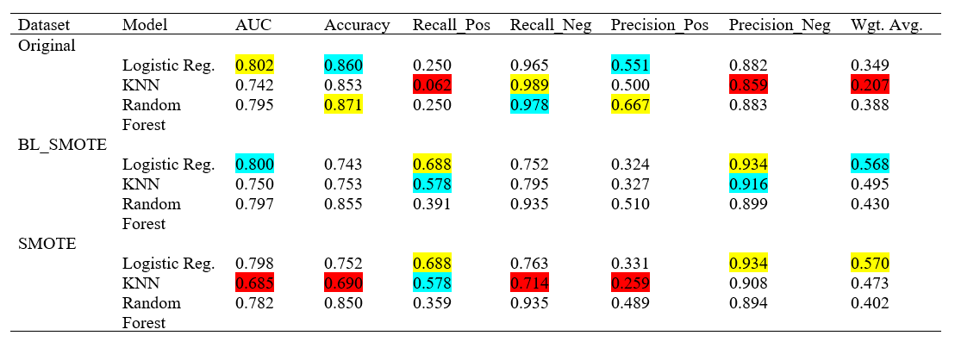
Results

Slide 13
Conclusion
The single-best model was Logistic Regression trained upon the Classic SMOTE dataset
All models had better out-of-sample performance when trained upon datasets that adjusted for class imbalances
Logistic Regression models also had the highest AUC (.802), Overall Accuracy (86%), and Negative Precision (.934)
Bottom Line: Don't get fancy, use logistic regression and account for unbalanced data!
Is Big Data dumb? You decide...

