Slide 1

Project # 2 World bank
Extract + Transform + Load
The question to answer:
Do access to electricity has a direct correlation to GDP and population? In other words, does higher GDP mean better access to electricity? And does a larger population mean less electricity access?

Slide 2
STEP 1: Extract
I used 3 datasets from World Bank. All data is by Country from years 2016 to 2020.
My dataset are as follows:
GDP in US$ by Country
Population by Country
Access to Electricity by Country
Source of Data: https://databank.worldbank.org/source/world-development-indicators

Slide 3
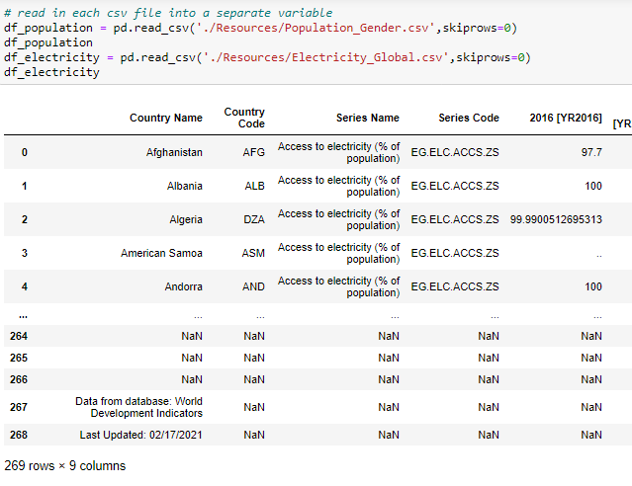
Step 2: Transform
The first steps in cleaning up the datasets was to figure out which variables are not relevant.

Slide 4
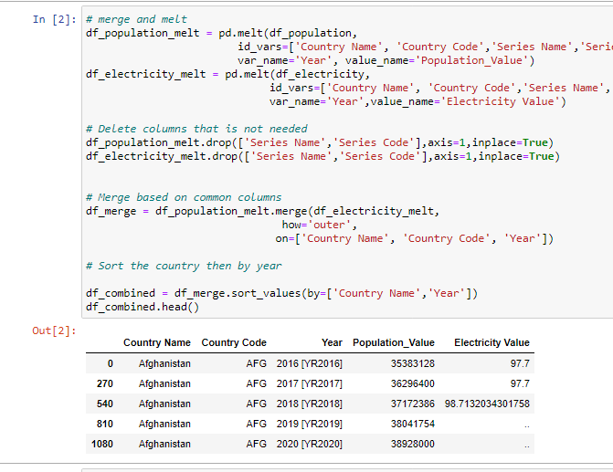
Step 2: Transform
I reformatted the data frame using the melt function then merged the Electricity and Population files into one data frame by Country.
I dropped the columns Series Name, and Series Code. I also deleted the rows that are null.
I noticed that the year column is not formatted properly so I removed the values inside [ ].

Slide 5
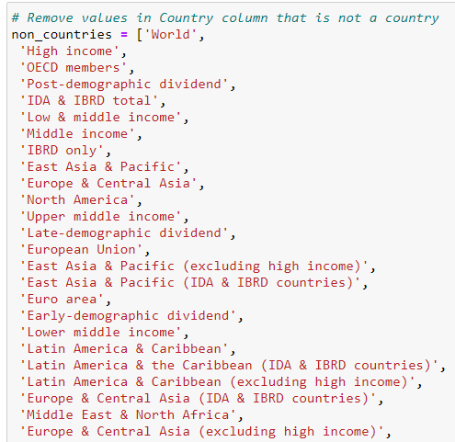
Step 2: Transform
I removed values under country that is not a country.

Slide 6
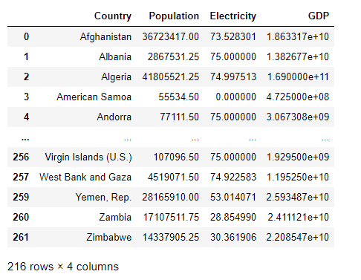
Step 2: Transform
This is the final output merging all three datasets into a one data frame.

Slide 7
Step 3: transform
Lastly, I noticed that the year column is not formatted properly so I removed the values inside [ ]. This is the final output merging all three datasets into a one data frame.

Slide 8

Step 3: load
I transferred my output to a database. I created a database in PostgreSQL and created tables to match the columns from my panda’s data frame.

Slide 9

Step 3: load
I performed an analysis using SQL Alchemy in Pandas to determine whether GDP and population directly correlate to access to electricity.

Slide 10
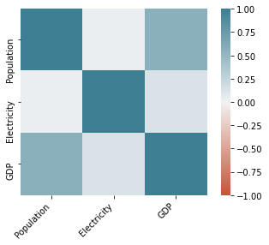
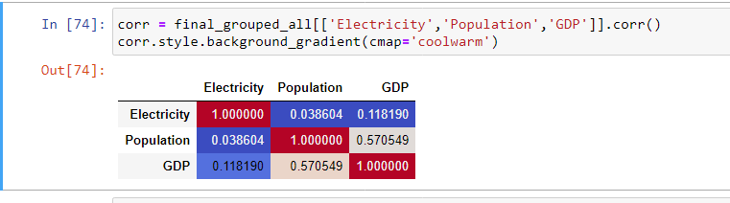
Analysis 1
Do access to electricity has a direct correlation to GDP and population?
Based on the correlation matrix below, the answer is there is no strong correction between electricity access, GDP and population.

Slide 11
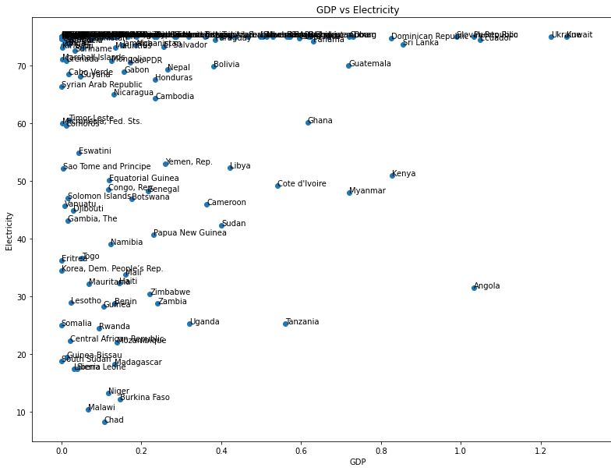
Analysis 2
Does higher GDP mean better access to electricity?
Based on the below plot, it doesn’t appear that higher GDP necessarily mean better access to electricity.

Slide 12
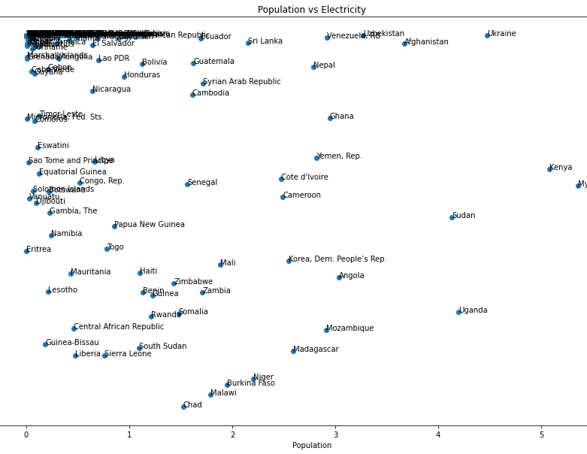
Analysis 2
Does a larger population mean lesser access to electricity?
Based on the plot below, it doesn’t appear that a larger population mean lesser access to electricity.

