Slide 1
Brown Bags Series
Neural Networks

Slide 2
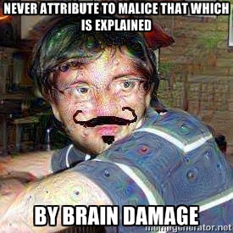

Slide 3
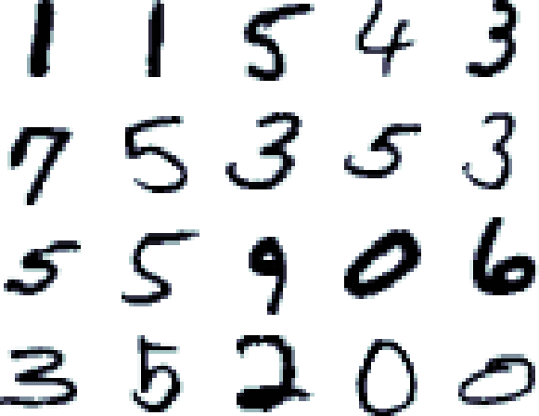
How do you read this?

Slide 4

Is this a cat?

Slide 5
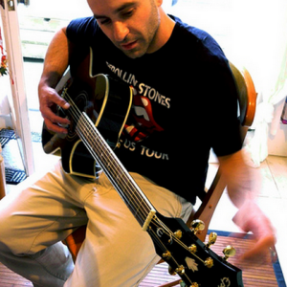
"man in black shirt is playing guitar."

Slide 6

"a young boy is holding a baseball bat."

Slide 7
Cool, now program it
Not so easy, maybe after a million conditionals
Requires a lot of input sanitation, any variance can skew results
I spent 2K on you, why can't you just learn to read already
People are good at learning, lets just make them out of people

Slide 8
Some more applications
Banks – to recognise cheques
Shazam
Post offices – to recognise address
Computer Vision
Speech Recognition
Natural Language processing
Advertisement display (Google Ads, Facebook Ads)
Netflix making recommendations based on previous likes
Spotify, Pandora (echo nest)– music discovery sites
Better video encoder – reduction in AV file sizes – transmission bandwidth opening.
Game design for progressive intelligent opponents
Naive Bayes spam filtering

Slide 9
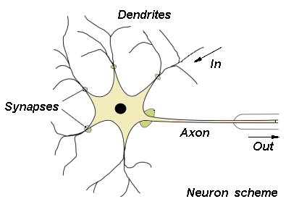
Brain Matter
Synaptic weights
Cumulative stimulus
Activation

Slide 10
Fun Facts
Active connections are used
Visual system
Grandfather neuron

Slide 11
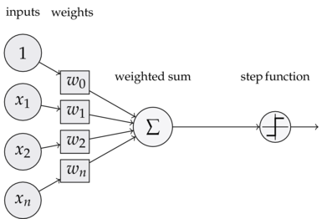
A single perceptron

Slide 12
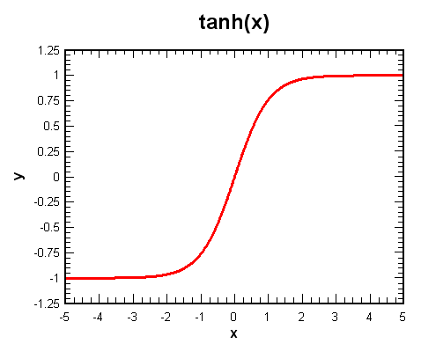
Step functions are naughty

Slide 13
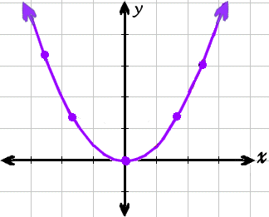
How wrong are we?
There has to be a measure of error
MSE = (d – y )^2

Slide 14
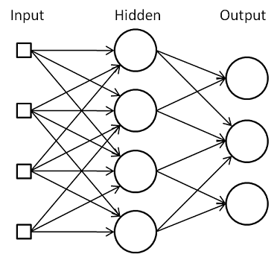
Put it all together

Slide 15
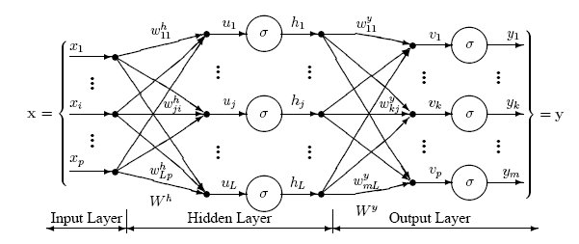
Take a closer look

Slide 16
Backpropogate the Error

Slide 17
Look at some code
Random Weights – basically guessing
Normalize input
Batch learning – the more data you have the better
Choose activation funct wisely – tanh is recommended
Bias-variance

Slide 18
Cool MNIST demo
http://myselph.de/neuralNet.html

Slide 19
Surely You're Joking
Anyone the claims they understand ANN is a liar and slanderer
The 5 whys end quickly
you almost don't know what you're doing
Only google has the resources to do it right, something, something skynet

Slide 20
Latest work
Art https://github.com/jcjohnson/neural-style
Deep Dreamhttp://googleresearch.blogspot.com/2015/06/inceptionism-going-deeper-into-neural.html
Google image caption http://googleresearch.blogspot.com/2014/11/a-picture-is-worth-thousand-coherent.html
http://cs.stanford.edu/people/karpathy/deepimagesent/

