Slide 1

Intro to Design Patterns
CS321: Advanced Programming Techniques
Prof: Gregory Mierzwinski
Date: January 31, 2022
Notes:
Multi-instrument / Multi-instrument Inter-process (minus the)-with Eye Trackers-

Slide 2
What are patterns?
Patterns have been used for centuries in many industries
designing clothing
designing buildings
designing cities
You can solve a problem once, then provide the solution as a pattern that others can apply to solve the same problem over and over

Slide 3
What are patterns? (cont.)
“Each pattern describes a problem which occurs over and over again in our environment, and then describes the core of the solution to that problem, in such a way that you can use this solution a million times over, without ever doing it the same way twice.”
Christopher Alexander, “A Pattern Language”
a book on patterns in the design of buildings and cities

Slide 4
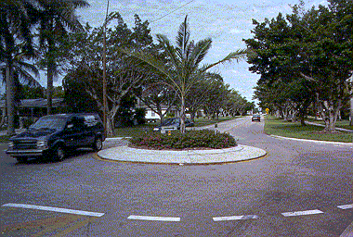
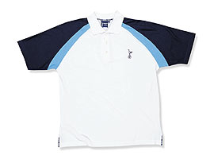
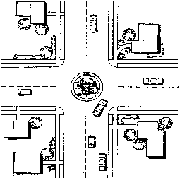
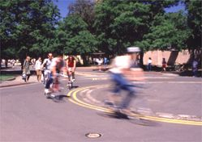
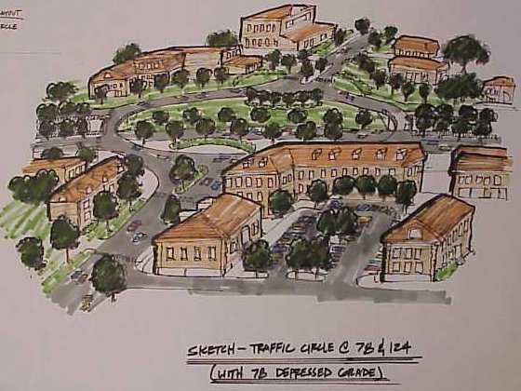
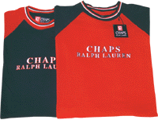
Examples
Clothing
A - line skirt
raglan sleeve
Buildings
French window
pocket door
Cities
traffic circle
town square

Slide 5
What are patterns? (cont.)
A good pattern will provide:
a name
the problem to be solved
the solution
the consequences of using it
possibly alternative solutions

Slide 6
Example: Pocket Door
Problem: We need a door in a location where there is no room for it to swing to open.
Solution: Install a door that slides into the wall when open.
Consequences (of our choice of solution ): We have to have a thick enough wall to accommodate sliding a door into it.
Alternative: A sliding door that slides over the outside of a wall when open, similar to a sliding door to a patio

Slide 7
Why use patterns?
Good software engineers have their favorite solutions they use over and over
They have used and tested these in many applications over many years and know they work
Take advantage of someone else’s experience by using known solutions to well defined problems

Slide 8
Historic Examples
Knuth’s The Art of Computer Programming (a catalogue of algorithms)
Coplien’s Advanced C++ : Programming Styles and Idioms
Class libraries such as Rogue Wave’s Tools.h++

Slide 9
Why use patterns? (cont.)
Patterns are another mechanism for passing on solutions discovered through years of programming experience
Patterns enable you to think in larger chunks
They are a natural evolution
from an algorithm, to a stack class, to a factory pattern we increase the complexity of the problem solved and the solution

Slide 10
Where are patterns applied?
Work is in progress defining patterns for:
architecture
analysis
design
particular industries
telecom
banking
accounting
medical

Slide 11
The patterns community
http://hillside.net/patterns/
This web site includes
tutorials about patterns
references to email groups for patterns
references to people and companies active in the patterns community
Good starting point with excellent references
http://en.wikipedia.org/wiki/Design_pattern_%28computer_science%29

Slide 12
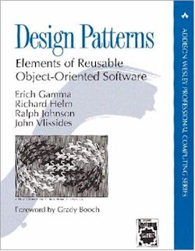
Intro to the pattern Catalog from “Design Patterns : Elements of Reusable Object Oriented Software” also known as the GOF book by Gamma, Helm, Johnson, Vlissides also known as the Gang of Four ( not to be confused with the Gang of Three … the UML people, Booch, Jacobson and Rumbaugh )

Slide 13
Up next
Categories of Patterns
creational
structural
behavioral
Brief description of the patterns
Format of design pattern description

Slide 14
Categories of Patterns
Creational
abstract the instantiation process
Structural
describe ways to compose classes or objects to form larger structures
Behavioral
concerned with algorithms and assignment of responsibility

Slide 15
Creational Patterns
Make a system independent of how objects are created, composed, and represented
encapsulate knowledge about which concrete classes are used by the system
hide how instances of these classes are created and put together
Give you a lot of flexibility in what gets created, who creates it, how it gets created, and when it gets created

Slide 16
Creational Patterns
A Class creational pattern uses inheritance to vary the class that is instantiated (using a method)
Factory Method
An interface method implemented in a child class
Derived class that might override behaviour
An Object creational pattern delegates instantiation to another object
Abstract Factory
Provides a method to create a family of objects
Builder
Prototype
Singleton

Slide 17
Structural Patterns
Combine independently developed classes
Make one interface conform to another
Change the composition of objects at run-time

Slide 18
Structural Patterns (cont.)
A Class structural pattern uses inheritance to compose interfaces or implementations
Adapter (class)

Slide 19
Structural Patterns (cont.)
An Object structural pattern describes ways to compose objects to realize new functionality
Adapter (object)
Bridge
Composite
Decorator
Façade
Flyweight
Proxy

Slide 20
Behavioral Patterns
Describe patterns of classes and objects, and the communication between them
Encapsulate complex flows of control

Slide 21
Behavioral Patterns (cont.)
A Class behavioral pattern uses inheritance to distribute behavior between classes
Interpreter
Template Method

Slide 22
Behavioral Patterns (cont.)
An Object behavioral pattern uses object composition to distribute behavior between objects
Chain of Responsibility
Command
Iterator
Mediator
Memento
Observer
State
Strategy
Visitor

Slide 23
Brief Description of each Pattern
Creational Class pattern
Factory Method - Defines an interface for creating an object, but lets subclasses decide which class to instantiate. Lets a class defer instantiation to subclasses.
Creational Object patterns
Abstract Factory - Provides an interface for creating families of related or dependent objects without specifying their concrete classes.

Slide 24
Brief Description of each Pattern (cont.)
Builder - Separates the construction of a complex object from its representation so that the same construction process can create different representations.
Prototype - Specifies the kinds of objects to create using a prototypical instance, and creates new objects by copying this prototype.
Singleton - Ensures a class has only one instance, and provides a global point of access to it.

Slide 25
Brief Description of each Pattern (cont.)
Structural Class pattern
Adapter - Converts the interface of a class into another interface clients expect. Lets classes work together that couldn’t otherwise because of incompatible interfaces.
Structural Object patterns
Bridge - Decouples an abstraction from its implementation so that the two can vary independently.

Slide 26
Brief Description of each Pattern (cont.)
Composite - Composes objects into tree structures to represent part-whole hierarchies. Lets clients treat individual objects and compositions of objects uniformly.
Decorator - Attaches additional responsibilities to an object dynamically. Provides a flexible alternative to subclassing for extending functionality.
See Python decorators (heavily used and similar to this pattern)

Slide 27
Brief Description of each Pattern (cont.)
Façade - Provides a unified interface to a set of interfaces in a subsystem. Defines a higher-level interface that makes the subsystem easier to use. (“wrapper”)
Flyweight - Uses sharing to support large numbers of fine-grained objects efficiently.
Proxy - Provides a surrogate or placeholder for another object to control access to it.

Slide 28
Brief Description of each Pattern (cont.)
Behavioral Class patterns
Interpreter - Given a language, defines a representation for its grammar, along with an interpreter that uses the representation to interpret sentences in the language.
Template Method - Defines the skeleton of an algorithm in an operation, deferring some steps to subclasses. Lets subclasses redefine certain steps of an algorithm without changing the algorithm’s structure.
Deferring calculation of area to a subclass
Useful technique even without having to use subclasses: https://github.com/gmierz/pupil-lib/blob/97484d169ab487e05843d7c4afdfe44ede0e57b8/pupillib/core/workers/trial_worker.py#L522-L527

Slide 29
Brief Description of each Pattern (cont.)
Behavioral Object patterns
Chain of Responsibility - Avoids coupling the sender of a request to its receiver by giving more than one object a chance to handle the request. Chains the receiving objects and passes the request along the chain until an object handles it.
Events
Command - Encapsulates a request as an object, thereby letting you:
parameterize clients with different requests
queue or log requests
support the ability to undo operations

Slide 30
Brief Description of each Pattern (cont.)
Iterator - Provides a way to access the elements of an aggregate object sequentially without exposing its underlying representation.
Mediator - Defines an object that encapsulates how a set of objects interact. Promotes loose coupling by keeping objects from referring to each other explicitly, and lets you vary their interaction independently.

Slide 31
Brief Description of each Pattern (cont.)
Memento - Without violating encapsulation, captures and externalizes an object’s internal state so that the object can be restored to this state later.
Saving your objects to a file
Observer - Defines a one-to-many dependency between objects so that when one object changes state, all its dependents are notified and updated automatically.
State - Allows an object to alter its behavior when its internal state changes. The object will appear to change its class.

Slide 32
Brief Description of each Pattern (cont.)
Strategy - Defines a family of algorithms, encapsulates each one, and makes them interchangeable. Lets the algorithm vary independently from clients that use it.
Visitor - Represents an operation to be performed on the elements of an object structure. Lets you define a new operation without changing the classes of the elements on which it operates.

Slide 33
Brief Description of each Pattern (cont.)
Composite - Composes objects into tree structures to represent part-whole hierarchies. Lets clients treat individual objects and compositions of objects uniformly.
Decorator - Attaches additional responsibilities to an object dynamically. Provides a flexible alternative to subclassing for extending functionality.

Slide 34
Brief Description of each Pattern (cont.)
Things to think about:
Do you have favorite things you use in your design efforts?
algorithms
classes
patterns
tools
How do you keep track of these things when you move to a new assignment/project or a new class and eventually to a new job?
How would you share them or publish them ?

Slide 35
Format of Design Pattern Descriptions
Pattern Name and Classification: Every pattern should have a descriptive and unique name that helps in identifying and referring to it. This classification helps in identifying the use of the pattern.
Intent: This section should describe the goal behind the pattern and the reason for using it. It resembles the problem part of the pattern.
Also Known As: A pattern could have more than one name. These names should be documented in this section.
Motivation(Forces): This section provides a scenario consisting of a problem and a context in which this pattern can be used. By relating the problem and the context, this section shows when this pattern is used.

Slide 36
Format of Design Pattern Descriptions
Applicability: This section includes situations in which this pattern is usable. It represents the context part of the pattern.
Structure: A graphical representation of the pattern. Class diagrams and Interaction diagrams can be used for this purpose.
Participants: A listing of the classes and objects used in this pattern and their roles in the design.
Collaboration: Describes how classes and objects used in the pattern interact with each other.
Consequences (of this choice of solution): This section describes the results, side effects, and trade offs caused by using this pattern.

Slide 37
Format of Design Pattern Descriptions
Implementation: This section describes the implementation of the pattern, and represents the solution part of the pattern. It provides the techniques used in implementing this pattern, and suggests ways for this implementation.
Sample Code: An illustration of how this pattern can be used in a programming language
Known Uses: This section includes examples of real usages of this pattern.
Related Patterns: This section includes other patterns that have some relation with this pattern, so that they can be used along with this pattern, or instead of this pattern. It also includes the differences this pattern has with similar patterns.

