Slide 1

Graphics in Java
CS321: Advanced Programming Techniques
Prof: Gregory Mierzwinski
Date: January 31, 2022
Notes:
Multi-instrument / Multi-instrument Inter-process (minus the)-with Eye Trackers-

Slide 2
Objectives
Understand computer graphics basics
Learn about paint and repaint methods
Learn about coordinates and colors
Review shape drawing methods
Learn to use fonts and draw graphics text

Slide 3

Computer Graphics Basics
There are two types of graphics devices: vector and raster.
A vector device has some kind of pen that can move and draw lines directly on the surface.
A raster device creates a picture by setting colors to individual pixels (picture elements) on a rectangular “raster.”


Slide 4
Computer Graphics Basics
A graphics adapter in your computer is a raster device.
VRAM (video RAM) contains the information about the colors of all pixels.
The screen displays the contents of VRAM.
To draw a shape you need to set the exactly right set of pixels to the required colors.

Slide 5
Computer Graphics Basics
A graphics software package provides functions for:
setting drawing attributes: color, line width and style, fill texture and pattern, font
drawing lines, circles, rectangles, polygons, and other basic shapes.
In other words, a graphics package turns a raster device into a “logical” vector device.

Slide 6
Graphics in Java
Java libraries offer three graphics packages: Graphics, Graphics2D and Graphics3D.
Graphics is really not a package but a class in the java.awt package, which provides only most basic capabilities.
Graphics2D and related classes in java.awt support better graphics with color gradients, line styles, etc.
Here we only deal with Graphics.

Slide 7
Graphics in Windows
In a windowing environment, a picture must be repainted every time we move, reopen or reshape the window.
The program must have one “central” place or method where all the drawing happens.
The operating system sends a “message” to the program to repaint its window when necessary.

Slide 8
paint and paintComponent
The javax.swing.JFrame class (which represents application windows) has one method, called paint, where all the drawing takes place.
In Swing, paint calls paintComponent for each of the GUI components in the window.
A programmer creates pictures by overriding the default paintComponent methods (or the paint method).

Slide 9
paint and paintComponent
paint takes one argument of the type Graphics:
import java.awt.*;
import javax.swing.*;
public class MyWindow extends JFrame
{
...
public void paint(Graphics g)
{
super.paint(g);
...
}
}
Defines the graphics “context” (location, size, coordinates, etc.)

Slide 10
paint and paintComponent
The same for paintComponent:
import java.awt.*;
import javax.swing.*;
public class MyCanvas extends JPanel
{
...
public void paintComponent(Graphics g)
{
super.paintComponent(g);
...
}
}
Or another Swing GUI component

Slide 11
paint and paintComponent
A programmer never calls paint or paintComponent directly. repaint is called instead whenever you need to refresh the picture (e.g. after adding, moving, or changing some elements):
repaint takes no arguments: the graphics context is restored and sent to paintComponent automatically
MyCanvas canvas = new MyCanvas();
...
balloon.move(dx, dy);
repaint();
...

Slide 12
Coordinates
Origin: the upper-left corner of the component
x
Units: pixels
y
y-axis points down, as in many other graphics packages

Slide 13
Coordinates (cont’d)
A GUI component provides getWidth and getHeight methods that return its respective dimensions.
They can be used to produce scalable graphics.
getWidth, getHeight only work after the component has been placed (e.g., don’t call them from a component’s constructor).

Slide 14
Coordinates (cont’d)
The position of a rectangle, oval, and even an arc is defined by using its “bounding rectangle,” described by x, y, width, height:
x, y

Slide 15
Colors
The color attribute is set by calling g.setColor and stays in effect until changed again:
You can form a color with any RGB values:
g.setColor(Color.blue);
g.draw...
g.draw...
g.setColor(Color.lightGray);
...
int rVal = 5, gVal = 255, bVal = 40;
Color yourEyes = new Color (rVal, gVal, bVal);

Slide 16
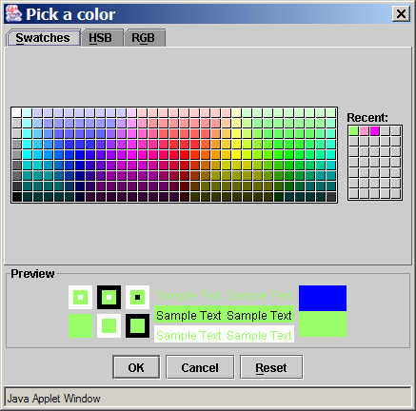
Colors (cont’d)
javax.swing.JColorChooser let’s you choose a color in a GUI application:

Slide 17
Drawing Basic Shapes
g.drawLine (x1, y1, x2, y2);
g.clearRect (x, y, w, h);
g.drawRect (x, y, w, h);
g.fillRect (x, y, w, h);
g.drawRoundRect (x, y, w, h, horzD, vertD);
g.fillRoundRect (x, y, w, h, horzD, vertD);
g.drawOval (x, y, w, h);
g.fillOval (x, y, w, h);
g.drawArc (x, y, w, h, fromDegr, measureDegrs);

Slide 18
Basic Shapes (cont’d)
g.drawPolygon (xCoords, yCoords, nPoints);
g.fillPolygon (xCoords, yCoords, nPoints);
g.drawPolyline (xCoords, yCoords, nPoints);
g.drawString (str, x, y);
g.drawImage (img, x, y, this);
abc
x, y
☺
ImageObserver, usually this

Slide 19
Fonts
Font font = new Font (name, style, size);
g.setFont (font);
abc "Serif"
abc "SansSerif"
abc "Monospaced"
int (pixels)
Font.PLAIN
Font.BOLD
Font.ITALIC

