Slide 1

UML Overview
CS321: Advanced Programming Techniques
Prof: Gregory Mierzwinski
Date: January 31, 2022
Notes:
Multi-instrument / Multi-instrument Inter-process (minus the)-with Eye Trackers-

Slide 2
Overview
UML
Git
Github

Slide 3
UML Short Summary
Used to visually model, and design your code before you code it.
Provides standardized notation.
Can be useful to convey complex ideas to fellow developers.
The concepts here are useful to remember for your class designs even if you don’t use UML.

Slide 4
UML has 9 kinds of diagrams
Class Diagram
Object Diagram
Component Diagram
Deployment Diagram
Use Case Diagram
Sequence Diagram
Collaboration Diagram
Statechart Diagram
Activity Diagram
Structural Diagrams
Behavioral Diagrams

Slide 5
UML Static VS Dynamic
Static Diagrams
show the relationships between classes and objects in the design
have no time element
Static Diagrams
Class Diagram
Object Diagram
Deployment Diagram
Dynamic Diagrams
show how the elements of the system interact with each other
have a time dependency
Dynamic Diagrams
Sequence Diagram
Collaboration Diagram
State Diagram
Activity Diagram

Slide 6
Overview of UML Relationships
dependency “A uses B”
a change in the specification of B may affect A
dashed arrow, with optional name
generalization “B inherits from A”
B is a general thing, A is a more specific thing
solid directed line, large open arrow head
association “B is part of A”
structural relationships
solid line, with optional name, direction indicator

Slide 7
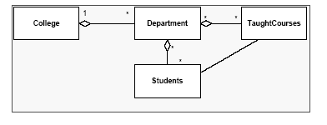
Aggregation
An aggregation is a kind of association denoting
a ‘part of’ (or 'has-a' ) relationship between
the objects of the respective classes.
Aggregation may be shared

Slide 8
Composition
Composition is a type of aggregation which links the lifetimes of the aggregate and its parts.
In other words: The parts cannot exist if the aggregate no longer exists
An entity can exist as part of only one aggregate
This is the “strong” has-a association

Slide 9
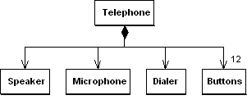
Composition
Composition Means ...
the contained item is part of the containing item
the contained item's lifetime is controlled by the containing item
the containing item is responsible for deleting the contained item (i.e. ownership)
class Telephone {
// …
private Speaker itsSpeaker;
private Microphone itsMic;
private Dialer itsDialer;
private Button itsButtons[];
} } }

