Slide 1

Template Method Pattern
CS321: Advanced Programming Techniques
Prof: Gregory Mierzwinski
Date: January 31, 2022
Notes:
Multi-instrument / Multi-instrument Inter-process (minus the)-with Eye Trackers-

Slide 2
Template Method
A behavioural pattern
Template method = concrete method in abstract class that uses calls to abstract methods (that will be implemented in subclasses)
A template method provides common behavior regardless of the concrete class which is instantiated
- saves programming effort: code is defined at the right level of abstraction
- provides a way to define high-level behavior without freezing detail implementation
- hides details from using code

Slide 3
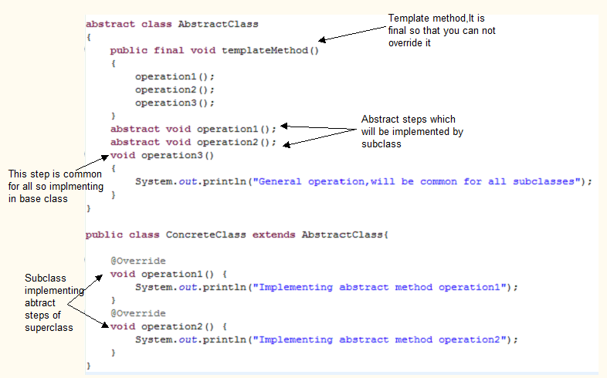

Slide 4
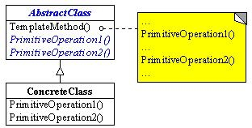
UML of Template Method Pattern

Slide 5
Template Method example: class Point
public abstract class Point {
public abstract float x(); public abstract float y();
// distance is a template method because it is defined in terms
// of the abstract methods x( ) and y( )
public float distance(Point other) { float dx = other.x() – this.x(); float dy = other.y() – this.y(); return sqrt(dx*dx + dy*dy); }
}

Slide 6
subclass CartesianPoint
public class CartesianPoint extends Point {
private float _x, _y;
public CartesianPoint (float x, float y) { _x = x; _y = y; }
public float x() { return _x; }
public float y() { return _y; }
}
Subclass CartesianPoint gets the distance( ) method from abstract class Point for free !!

Slide 7
subclass PolarPoint
public class PolarPoint extends Point {
private float _rho, _theta;
public PolarPoint (float rho, float theta) { _rho = rho; _theta = theta; }
public float x() { return _rho * cos(_theta); } public float y() { return _rho * sin(_theta); }
}
Subclass PolarPoint gets the distance( ) method from abstract class Point… for free !!

Slide 8
Template in abstract class IntSet
public abstract class IntSet { protected int sz; // the size
// constructors public IntSet () { sz = 0; }
// abstract methods public abstract void insert (int x); public abstract void remove (int x); public abstract Iterator elements ( ); public abstract boolean repOk ( );
// non - abstract methods public boolean isIn (int x) { Iterator g = elements ( ); Integer z = new Integer (x); while (g.hasNext ( )) if (g.next ( ). equals (z )) return true; return false; }
public int size ( ) { return sz; }
}

