Slide 1

Thread Synchronization
CS321: Advanced Programming Techniques
Prof: Gregory Mierzwinski
Date: January 31, 2022
Notes:
Multi-instrument / Multi-instrument Inter-process (minus the)-with Eye Trackers-

Slide 2
Thread synchronization
So far, we’ve dealt with independent, asynchronous threads.
Each thread contained all of the data and methods required for its execution and didn't require any outside resources or methods.
In addition, the threads in those examples ran at their own pace without concern over the state or activities of any other concurrently running threads.
However, there are many interesting situations where separate, concurrently running threads do share data and must consider the state and activities of other threads.
One such set of programming situations are known as producer/consumer scenarios where the producer generates a stream of data which then is consumed by a consumer.

Slide 3
Producer/Consumer
You have a Java application where one thread (the producer) writes data to a file while a second thread (the consumer) reads data from the same file.
Or, as you type characters on the keyboard, the producer thread places key events in an event queue and the consumer thread reads the events from the same queue.
Both of these examples use concurrent threads that share a common resource:
the first shares a file,
the second shares an event queue.
Because the threads share a common resource, they must be synchronized in some way.

Slide 4
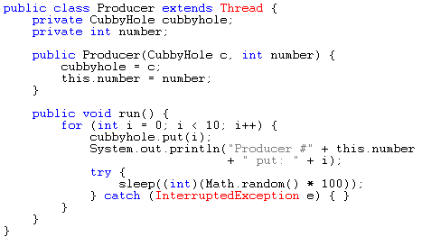
Producer/Consumer
The Producer generates an integer between 0 and 9 (inclusive), stores it in a CubbyHole object, and prints the generated number. The Producer sleeps for a random amount of time between 0 and 100 milliseconds before repeating the number generating cycle:

Slide 5
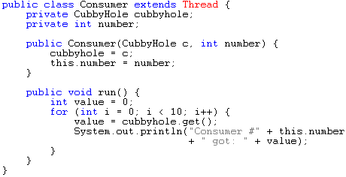
Producer/Consumer
The Consumer, being ravenous, consumes all integers from the CubbyHole (the exact same object into which the Producer put the integers in the first place) as quickly as they become available.

Slide 6
Producer/Consumer
The Producer and Consumer in this example share data through a common CubbyHole object.
Neither the Producer nor the Consumer makes any effort whatsoever to ensure that the Consumer is getting each value produced once and only once.
The synchronization between these two threads actually occurs at a lower level, within the get and put methods of the CubbyHole object.
However, let's assume for a moment that these two threads make no arrangements for synchronization and talk about the potential problems that might arise in that situation.

Slide 7
Producer/Consumer
One problem arises when the Producer is quicker than the Consumer and generates two numbers before the Consumer has a chance to consume the first one.
Thus the Consumer would skip a number.
Part of the output might look like this:
. . .
Consumer #1 got: 3
Producer #1 put: 4
Producer #1 put: 5
Consumer #1 got: 5
. . .

Slide 8
Producer/Consumer
Another problem that might arise is when the Consumer is quicker than the Producer and consumes the same value twice.
In this situation, the Consumer would print the same value twice and might produce output that looked like this:
. . .
Producer #1 put: 4
Consumer #1 got: 4
Consumer #1 got: 4
Producer #1 put: 5
. . .

Slide 9
Producer/Consumer
Either way, the result is wrong.
You want the Consumer to get each integer produced by the Producer exactly once.
Problems such as those just described are called race conditions.
They arise from multiple, asynchronously executing threads trying to access a single object at the same time and getting the wrong result.
Race conditions in the producer/consumer example are prevented by having the storage of a new integer into the CubbyHole by the Producer be synchronized with the retrieval of an integer from the CubbyHole by the Consumer. The Consumer must consume each integer exactly once.

Slide 10
Synchronizing the Producer/Consumer problem
The activities of the Producer and Consumer must be synchronized in two ways:
The two threads must not simultaneously access the CubbyHole.
A Java thread can prevent this from happening by locking an object. When an object is locked by one thread and another thread tries to call a synchronized method on the same object, the second thread will block until the object is unlocked.
The two threads must do some simple coordination. The Producer must have some way to indicate to the Consumer that the value is ready and the Consumer must have some way to indicate that the value has been retrieved.
The Thread class provides a collection of methods--wait, notify, and notifyAll--to help threads wait for a condition and notify other threads of when that condition changes

Slide 11
Locking an Object
The code segments within a program that access the same object from separate, concurrent threads are called critical sections.
In the Java language, a critical section can be a block or a method and are identified with the synchronized keyword.
The Java platform then associates a lock with every object that has synchronized code.

Slide 12
Synchronization
Every object has a lock that can be held by at most one thread at a time
A thread gets a lock by entering a synchronized block of code
A thread can give up a lock by:
leaving a block of synchronized code
calling lock.wait()
A thread executing wait() can be released by:
notify()
some waiting thread is allowed to compete for the lock
notifyAll()
all waiting threads are allowed to compete for the lock

Slide 13
Synchronized Code
There are two ways to mark code as synchronized:
use the synchronize statement
using the synchronized method shorthand
which the same as
synchronize( someObject) {
// must obtain lock to enter this block.
// wait()ing threads have to reacquire the
// lock before they are allowed to proceed.
}
public synchronized someMethod() { … }
public someMethod() {
synchronized( this ) { … } }

Slide 14
Example
import java.util.*;
public class SyncFixed extends Thread {
private static int common = 0;
private int id;
private Object lock;
public SyncFixed( int id, Object lock ) {
this.id = id; this.lock = lock;
}
public void run() {
for ( int i = 0; i < 10; i++ )
synchronized( lock ) {
int tmp = common; tmp = tmp + 1; common = tmp;
}
yield();
}

Slide 15
Example
public static void main( String args[] ) {
int numThreads = 0;
try {
numThreads = Integer.parseInt( args[ 0 ] );
} catch ( NumberFormatException e ) { System.exit( 1 ); }
List threads = new ArrayList();
Object theLock = new Integer( 0 );
for ( int i = 0; i < numThreads; i++ ) {
threads.add( new SyncFixed( i, theLock ) );
( ( Thread )threads.get( i ) ).start(); }
Iterator i = threads.iterator();
while ( i.hasNext() )
try { (Thread)i.next() ).join();
} catch( InterruptedException e ) {};
System.out.println( common ); }}

Slide 16
Locking the CubbyHole
In the producer/consumer example, the put and get methods of the CubbyHole are the critical sections.
The Consumer should not access the CubbyHole when the Producer is changing it, and the Producer should not modify it when the Consumer is getting the value.
So put and get in the CubbyHole class should be marked with the synchronized keyword.

Slide 17
Locking the CubbyHole
public class CubbyHole {
private int contents;
private boolean available = false;
public synchronized int get() { ... }
public synchronized void put(int value) { ... }
}
Note that the method declarations for both put and get contain the synchronized keyword.
The system associates a unique lock with every instance of CubbyHole (including the one shared by the Producer and the Consumer).
Whenever control enters a synchronized method, the thread that called the method locks the object whose method has been called.
Other threads cannot call a synchronized method on the same object until the object is unlocked.

Slide 18
Locking the CubbyHole
So, when the Producer calls CubbyHole's put method, it locks the CubbyHole, thereby preventing the Consumer from calling the CubbyHole's get method:
public synchronized void put(int value) {
// CubbyHole locked by the Producer ..
// CubbyHole unlocked by the Producer
}
When the put method returns, the Producer unlocks the CubbyHole. Similarly, when the Consumer calls CubbyHole's get method, it locks the CubbyHole, thereby preventing the Producer from calling put:
public synchronized int get() {
// CubbyHole locked by the Consumer ...
// CubbyHole unlocked by the Consumer
}

Slide 19
Locking the CubbyHole
The acquisition and release of a lock is done automatically and atomically by the Java runtime system.
This ensures that race conditions cannot occur in the underlying implementation of the threads, thus ensuring data integrity.
Synchronization isn't the whole story.
The two threads must also be able to notify one another when they've done their job.

Slide 20
wait()/notify()
notify()/notifyAll()
Threads waiting for
The lock
One thread selected by
the JVM
Threads waiting to be
notified
Has The Lock
Exits synchronized block
JVM Selects next thread
wait()
JVM Selects next thread

Slide 21
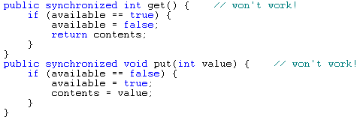
Using notify and wait
The CubbyHole stores its value in a private member variable called contents.
CubbyHole has another private member variable, available, that is a boolean.
available is true when the value has just been put but not yet gotten and is false when the value has been gotten but not yet put.
So, here's one possible implementation for the put and get methods:

Slide 22
Using notify and wait
As implemented, these two methods won't work.
Look at the get method.
What happens if the Producer hasn't put anything in the CubbyHole and available isn't true? (get does nothing.)
Similarly, if the Producer calls put before the Consumer got the value… (put doesn't do anything.)
You really want the Consumer to wait until the Producer puts something in the CubbyHole and the Producer must notify the Consumer when it's done so.
Similarly, the Producer must wait until the Consumer takes a value (and notifies the Producer of its activities) before replacing it with a new value.
The two threads must coordinate more fully and can use Object's wait and notifyAll methods to do so.

Slide 23
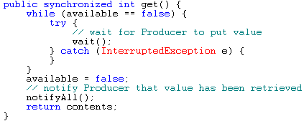
Using notify and wait

Slide 24
Using notify and wait
The put method works in a similar fashion, waiting for the Consumer thread to consume the current value before allowing the Producer to produce a new one.
The notifyAll method wakes up all threads waiting on the object in question (in this case, the CubbyHole).
The awakened threads compete for the lock.
One thread gets it, and the others go back to waiting.
The Object class also defines the notify method, which arbitrarily wakes up one of the threads waiting on this object

Slide 25
Producer/Consumer…
Here's the output of ProducerConsumerTest:
Producer #1 put: 0
Consumer #1 got: 0
Producer #1 put: 1
Consumer #1 got: 1
Producer #1 put: 2
Consumer #1 got: 2
Producer #1 put: 3
Consumer #1 got: 3
…

Slide 26
Deprecated thread methods
The stop method has been deprecated. The preferred way to stop a thread is to have the thread return from run().
A stopped thread releases any held locks.
The suspend and resume methods have been deprecated because suspend is deadlock-prone and resume is used only in conjunction with suspend.

Slide 27
Critical section problems
Solutions to critical section problems are judged on four criteria.
The synchronization mechanism in Java helps satisfy two of the four criteria.

Slide 28
Critical section problems
The four criteria are:
Progress. If a critical section is unlocked, a thread should be able to enter it. The synchronized construct ensures this behavior.
Mutual exclusion. At most one thread can hold a lock only a critical section. The synchronized construct ensures this behavior.
Starvation. None of the threads trying to enter a critical section should be permanently prevented from doing so. The synchronized construct does not prevent starvation.
Fairness. Each of N contending threads should enter the critical section roughly the same amount of time. The synchronized construct does not ensure fairness.

Slide 29
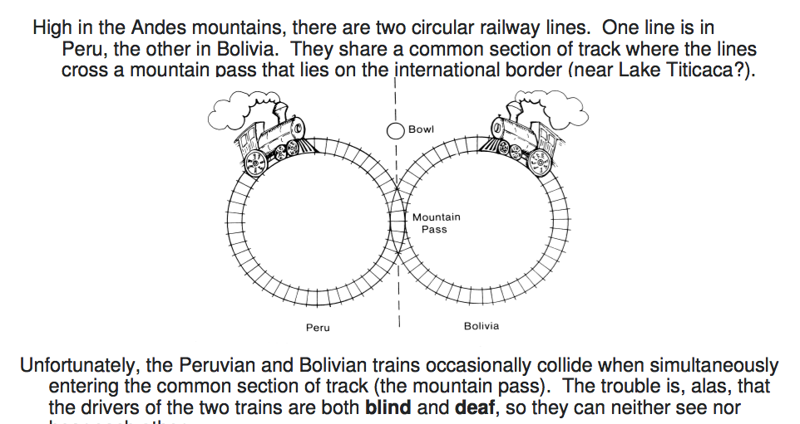
Critical section problems

Slide 30
Critical section problems

