Slide 1

Inheritance & Polymorphism
CS321: Advanced Programming Techniques
Prof: Gregory Mierzwinski

Slide 2
Overview
Inheritance
Polymorphism
Modes of Inheritance

Slide 3
Terminology
Class based Inheritance is a fundamental Object Oriented concept
It is a code re-use mechanism as well as a modeling tool
It models the “is-a-kind-of” relationship
It makes the use of component libraries possible without requiring source code sharing

Slide 4
Terminology
A class can be defined as a "subclass" of another class.
The subclass inherits all data attributes of its superclass The subclass inherits all methods of its superclass
The subclass inherits all associations of its superclass
A subclass does NOT have direct access to private members of the superclass
The subclass can:
Add new functionality
Use inherited functionality
Override inherited functionality
superclass:
Person
- name: String
- dob: Date
subclass:
Employee
- employeeID: int
- salary: int
- startDate: Date

Slide 5
What really happens?
When an object is created using new, the system must allocate enough memory to hold all its instance variables.
This includes any inherited instance variables
In this example, we can say that an Employee "is a kind of" Person.
An Employee object inherits all of the attributes, methods and associations of Person
Person
- name: String
- dob: Date
Employee
name = "Sally Halls"
dob = Mar 15, 1968
employeeID = 37518
salary = 65000
startDate = Dec 15, 2000
Person
name = "John Smith"
dob = Jan 13, 1954
is a kind of
Employee
- employeeID: int
- salary: int
- startDate: Date

Slide 6
Inheritance in Java
Inheritance is declared using the "extends" keyword
If inheritance is not defined, the class extends a class called Object
public class Person
{
private String name;
private Date dob;
[...]
Person
- name: String
- dob: Date
public class Employee extends Person
{
private int employeID;
private int salary;
private Date startDate;
[...]
Employee
- employeeID: int
- salary: int
- startDate: Date
Employee anEmployee = new Employee();

Slide 7
Inheritance Hierarchy
Each Java class has one (and only one) superclass.
C++ allows for multiple inheritance
Inheritance creates a class hierarchy
Classes higher in the hierarchy are more general and more abstract
Classes lower in the hierarchy are more specific and concrete
There is no limit to the number of subclasses a class can have
There is no limit to the depth of the class tree.
Class
Class
Class
Class
Class
Class
Class
Class

Slide 8
The class called Object
At the very top of the inheritance tree is a class called Object
All Java classes inherit from Object.
All objects have a common ancestor
This is different from C++
The Object class is defined in the java.lang package
Examine it in the Java API Specification

Slide 9
Constructors and Initialization
Classes use constructors to initialize instance variables
When a subclass object is created, its constructor is called.
It is the responsibility of the subclass constructor to invoke the appropriate superclass constructors so that the instance variables defined in the superclass are properly initialized
Superclass constructors can be called using the "super" keyword in a manner similar to "this"
It must be the first line of code in the constructor
If a call to super is not made, the system will automatically attempt to invoke the no-argument constructor of the superclass.

Slide 10
Constructors - Example
public class BankAccount
{
private String ownersName;
private int accountNumber;
private float balance;
public BankAccount(int anAccountNumber, String aName)
{
accountNumber = anAccountNumber;
ownersName = aName;
}
[...]
}
public class OverdraftAccount extends BankAccount
{
private float overdraftLimit;
public OverdraftAccount(int anAccountNumber, String aName, float aLimit)
{
super(anAccountNumber, aName);
overdraftLimit = aLimit;
}
}

Slide 11
Method Overriding
Subclasses inherit all methods from their superclass
Sometimes, the implementation of the method in the superclass does not provide the functionality required by the subclass.
In these cases, the method must be overridden.
To override a method, provide an implementation in the subclass.
The method in the subclass MUST have the exact same signature as the method it is overriding.

Slide 12
Method overriding - Example
public class BankAccount
{
private String ownersName;
private int accountNumber;
protected float balance;
public void deposit(float anAmount)
{
if (anAmount>0.0)
balance = balance + anAmount;
}
public void withdraw(float anAmount)
{
if ((anAmount>0.0) && (balance>anAmount))
balance = balance - anAmount;
}
public float getBalance()
{
return balance;
}
}

Slide 13
Method overriding - Example
public class OverdraftAccount extends BankAccount
{
private float limit;
public void withdraw(float anAmount)
{
if ((anAmount>0.0) && (getBalance()+limit>anAmount))
balance = balance - anAmount;
}
}

Slide 14
Object References and Inheritance
Inheritance defines "a kind of" relationship.
In the previous example, OverdraftAccount "is a kind of" BankAccount
Because of this relationship, programmers can "substitute" object references.
A superclass reference can refer to an instance of the superclass OR an instance of ANY class which inherits from the superclass.
BankAccount anAccount = new BankAccount(123456, "Craig");
BankAccount account1 = new OverdraftAccount(3323, "John", 1000.0);
BankAccount
name = "Craig"
accountNumber = 123456
OverdraftAccount
name = "John"
accountNumber = 3323
limit = 1000.0
anAccount
account1

Slide 15
Polymorphism
The typing rules allow a reference variable to be assigned an object of it’s static type ( the type that it has been declared with) or any type that inherits from that type
class A {
public void speak () { System.out.println(“I’m A”); }
}
class B extends A {
public void speak () { System.out.println(“I’m B”); }
}
class C extends B {
public void speak () { System.out.println(“I’m a C”); }
public void shout () { System.out.println(“I’m shoutin”); }
}
class D extends A {
public void speak () { System.out.println(“I’m a D”); }
}

Slide 16
Polymorphism
The typing rules allow a reference variable to be assigned an object of it’s static type ( the type that it has been declared with) or any type that inherits from that type
class A {
public void speak () { System.out.println(“I’m A”); }
}
class B extends A {
public void speak () { System.out.println(“I’m B”); }
}
class C extends B {
public void speak () { System.out.println(“I’m a C”); }
public void shout () { System.out.println(“I’m shoutin”); }
}
class D extends A {
public void speak () { System.out.println(“I’m a D”); }
}
A myA ;
B myB ;
C myC ;
D myD ;
myA = new A(); // OK
myA = new B(); // OK
myB = new C(); // OK
myB = new D(); // NOT OK
myC = new A(); // NOT OK
myD = new A(); // NOT OK
myC = new D(); // NOT OK
myA = new C(); // OK
myA.speak(); // what would be called ??
myB.speak(); // what ??
myA.shout(); // ??
(( C ) myA ).shout(); // casting

Slide 17
Polymorphism
In the previous slide, the two variables are defined to have the same type at compile time: BankAccount
However, the types of objects they are referring to at runtime are different
What happens when the withdraw method is invoked on each object?
anAccount refers to an instance of BankAccount. Therefore, the withdraw method defined in BankAccount is invoked.
account1 refers to an instance of OverdraftAccount. Therefore, the withdraw method defined in OverdraftAccount is invoked.
Polymorphism is: The method being invoked on an object is determined AT RUNTIME and is based on the type of the object receiving the message.

Slide 18
Final Methods and Final Classes
Methods can be qualified with the final modifier
Final methods cannot be overridden.
This can be useful for security purposes.
Classes can be qualified with the final modifier
The class cannot be extended
This can be used to improve performance. Because there can be no subclasses, there will be no polymorphic overhead at runtime.
public final boolean validatePassword(String username, String Password)
{
[...]
public final class Color
{
[...]

Slide 19
Motivation for Inheritance
The basic reason for wanting to make use of inheritance is to leverage the creation of new software structures from existing software units.
Productivity
why create a “Scrollable Window” from scratch when you can simply modify a “Window” class from a library
for a simulation program you want an “aircraft” class to run as an independent thread. It can inherit thread functionality from a class “Thread”

Slide 20
Motivation for Inheritance
Quality
The “Window” and “Thread” classes have been created, tested, debugged by the makers of the Operating System. Chances are that they will be of higher quality than if they were developed from scratch by a user

Slide 21
Tension between Generality and Specialization
A software system designed for a specific project must usually be very specialized.
A banking system developed by and for CIBC will provide the specific account types that CIBC offers
A software system designed as a reusable tool must usually be very general.
A software company that develops banking applications would create very general account types
Inheritance allows one to take a very general software component and specialize it for use in a specific project.

Slide 22
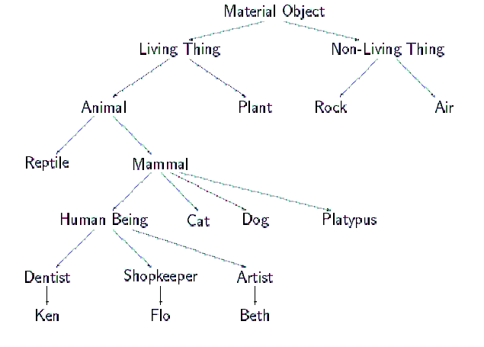
Abstract idea of Inheritance

Slide 23
Practical Meaning of Inheritance
Data areas and behavior defined in a parent class are accessible from within a child class.
Data areas and behavior of a child class are an extension (strictly larger) than the data areas and behavior of parent classes.
A child class is in a certain sense both an extension and a restriction of the parent class.

Slide 24
Practical Meaning of Inheritance
Data areas and behavior defined in a parent class are accessible from within a child class.
Data areas and behavior of a child class are an extension (strictly larger) than the data areas and behavior of parent classes.
A child class is in a certain sense both an extension and a restriction of the parent class.

Slide 25
Is-a is NOT Has-a
Our idealization of inheritance is captured in a simple rule-of-thumb.
Try forming the English sentences ``An A is-a-kind-of B''. If it ``sounds right'' to your ear, then A can be made a subclass of B.
A Student is-a-kind-of human so student inherits from human
A dog is-a-kind-of mammal, and therefore a dog inherits from mammal
A car is-a-kind-of engine sounds wrong, and therefore inheritance is not natural. but a car has-a engine.

Slide 26
is-a-kind-of is NOT is-a either
Try this:
George is a professor.
The class Professor is a profession..
Therefore George is a Profession !!
The problem comes up when we mix up is-an-instance-of and is-a-kind-of
Some authors refer to is-a-kind-of as generalization and is-an-instance-of as classification

Slide 27
Generalization VS Classification
1. Shep is a Border Collie.
2. A Border Collie is a Dog.
3. Dogs are Animals
4. A Border Collie is a Breed.
5. Dog is a Species
1+2: Shep is a Dog
1+2+3: Shep is a animal
1+4: Shep is a breed ?????
2+5: A Border Collie is a Species ?????
Generalization (is kind of) is transitive
Classification (is instance of) is not

Slide 28
Idealized Image of Inheritance
Consider the following argument:
Instances of the subclass must possess all data areas associated with the parent class.
Instances of the subclass must implement, through inheritance at least (if not explicitly overridden) all functionality defined for the parent class. (They can also define new functionality, but that is unimportant for the present argument).
Thus, an instance of a child class can mimic the behavior of the parent class and should be indistinguishable from an instance of the parent class if substituted in a similar situation.
This constitutes the LISKOV PRINCIPLE of SUBSTITUTABILITY
This is also what the type system assumes ( ?? )

Slide 29
Subclass, Subtype and Substitutability
A subtype is a class that satisfies the principle of substitutability.
f.e. an odd integer can always be substituted for an integer
A subclass is something constructed using the inheritance mechanism of the language, whether or not it satisfies the principle of substitutability.f.e.
class OddInteger extends Integer{
// But… what if we changed the definition
// of “+” for oddInteger, then we could
// not substitute it for Integer
// in this case it is a subclass
// but not a subtype
}
The two concepts are independent.
Not all subclasses are subtypes, and (at least in some languages) you can construct subtypes that are not subclasses.

Slide 30
Forms of Inheritance
Inheritance is used for a variety of different purposes and in a variety of different ways.

Slide 31
Specialization
By far the most common form of inheritance is for specialization.
“Scrollable-Window” specializes “Window”
“Savings Account” specializes “Account”
A good example is the Java hierarchy of Graphical components in the AWT:
Component ( in Java AWT)
Label
Button
TextComponent
TextArea
TextField
CheckBox
ScrollBar
a Java application
public class PinBallGame extends Frame {
...
}

Slide 32
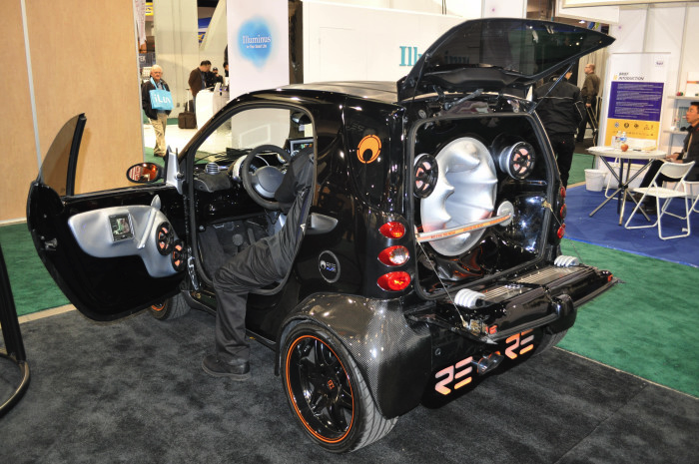
Construction
The parent class is used only for its behavior,
the child class has no is-a relationship to the parent.
An example might be subclassing the idea of a Set from an existing List class.
Generally not a good idea, since it can break the principle of substitutability.
Does this Car inherit from Speaker ?
If it does it should be able to be used anywhere a “speaker” is required !!

Slide 33
Extension
The child class extends the parent class by providing more functionality.
The child doesn't change anything inherited from the parent, it simply adds new features.
Example, Java Properties inheriting from Hashtable.
A Hashtable is a perfectly fine data structure on its own. Properties represent information concerni ng the current execution environment. Examples of properties are the name of the user running a program, the version of the Java interpreter, the name of the operating system, and so on.
The properties class adds new methods that will load and store the property list, but uses the inherited hashtable routines for the actual data representation.

Slide 34
Limitation
The child class limits some of the behavior of the parent class.
Example, you have an existing List data type, and you want a Stack to inherit from List, but override the methods that allow access to elements other than top so as to produce errors.
This once again breaks the principle of substitutability.

Slide 35
Limitation
class Set extends Vector {
// methods addElement, removeElement, contains
// isEmpty and size
// are all inherited from vector
public int indexOf (Object obj)
{
throw new IllegalOperation("indexOf");
}
public int elementAt (int index)
{
throw new IllegalOperation("indexOf");
}
}
//Where IllegalOperation is a subclass of Exception:
class IllegalOperation extends Exception
{
IllegalOperation (String str) { super(str)};
}

Slide 36
Variance
Two or more classes that seem to be related, but its not clear who should be the parent and who should be the child.
Example: Mouse and TouchPad and JoyStick
Better solution, abstract out common parts to new parent class, and use subclassing for specialization.
The child class and parent class are variants of each other, and the class-subclass relationship is arbitrary.

Slide 37
Summary of Forms of Inheritance
Subtype. The child class is a special case of the parent class but has the same behaviour as the parent..
Specification. The parent class defines behavior that is implemented in the child class but not in the parent class.
Construction. The child class makes use of the behavior provided by the parent class, but is not a subtype of the parent class.
Specialization. The child class modifies or overrides some of the methods of the parent class.

Slide 38
Summary of Forms of Inheritance
Extension. The child class adds new functionality to the parent class, but does not change any inherited behavior.
Limitation. The child class restricts the use of some of the behavior inherited from the parent class.
Variance. The child class and parent class are variants of each other, and the class-subclass relationship is arbitrary.
Combination. The child class inherits features from more than one parent class. This is multiple inheritance and will be discussed later.

