Slide 1

Quick Java Overview and Hello World
CS321: Advanced Programming Techniques
Prof: Gregory Mierzwinski
Date: January 14th, 2022
Notes:
Multi-instrument / Multi-instrument Inter-process (minus the)-with Eye Trackers-

Slide 2
Why Java?
Strongly typed
Object-oriented programming language
Used in many areas
Similar to C++ but at a bit of a higher level
Keep in mind, this class is about programming techniques, not about a programming language.

Slide 3
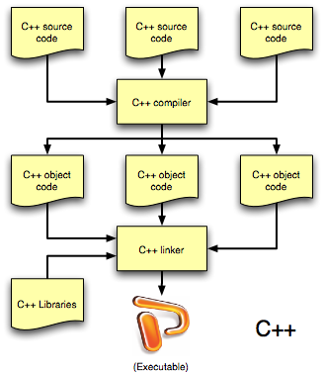
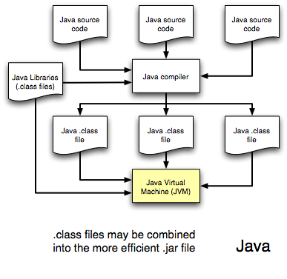
Java vs. C++ Compilation/Running

Slide 4
Java vs. C++ Compilation/Running
Bytecode
Platform-dependent Area
Platform-dependent Area

Slide 5
Java vs. C++
“No pointers”
Generally considered safer due to
Sandboxing
Checks for out-of-bounds access
Automatic garbage collection
Pointer abstraction (no pointers)
Multiple inheritance

Slide 6
Java vs. C++
(Almost) everything is an object
Only primitive types (boolean, char, int, long, float, double) are not objects
Function arguments are always passed by value
Objects are not copied – only their references are
No separation between header and implementation
No operator overloading
No structs
Functions are virtual
Function code that gets executed is determined at run-time rather than compile-time

Slide 7
Java vs. C++ Multiple Inheritance
C++ inheritance forces the inheritance of both data and behavior (code)
Multiple inheritance in Java
Java does not allow multiple non-abstract class inheritance. Only one at a time.
Java has abstract interfaces that allows for multiple inheritance.
These only define expected behaviours (arguments, return type) but not the behaviour itself.

Slide 8
Java Documentation
StackOverflow won’t solve all your problems!
Found here: https://docs.oracle.com/javase/7/docs/api/

Slide 9
JavaDoc
All languages have some form of code documentation tooling or standards.
In Java, we use the JavaDoc standard: https://www.oracle.com/technical-resources/articles/java/javadoc-tool.html

Slide 10
Java Final Points
Much nicer compiler and run-time error messages than C++
Exception handling
Powerful and easy-to-use libraries for data structures, multi-threading, networking, I/O, graphics, GUI

Slide 11
Hello World!
public static void main (String[] args) {
System.out.println(“hello world!”);
}

Slide 12
Hello World!
public static void main (String[] args) {
System.out.println(“hello world!”);
}
First class functions are not allowed in Java!

Slide 13
Hello World!
public class Foo {
public static void main (String[] args) {
System.out.println(“hello world!”);
}
}

Slide 14
Hello World!
Foo.java
public class Foo {
public static void main (String[] args) {
System.out.println(“hello world!”);
}
}

Slide 15
Hello World!
Foo.java
public class Foo {
public static void main (String[] args) {
System.out.println(“hello world!”);
}
}
The filename must match the public class name.

Slide 16
Lab 1
Labs will be listed here on the morning of the lab, or the night before:
https://gmierzwinski.github.io/bishops/cs321/labs.html
First lab will be online on January 18th, see Moodle for meeting links

