Slide 1

CS321 Advanced Programming Techniques
Unit 5: Class design
What should an industrial strength class have
based on ch 2 of Bill Venner’s book. ( see notes )

Slide 2
Methods common to all objects
The class Object provides a number of methods designed to be overriden.
equals()
toString( )
clone( )
finalize( )
A default behaviour is implemented but that might not be what you want.

Slide 3

Methods common to all objects: public boolean equals(Object ob )
Or : When are two things EQUAL ?

Slide 4
Methods common to all objects: public boolean equals(Object ob )
By default the equals() method compares the reference.
Point p1 = new Point( 2,6 );
Point p2 = new Point( 2,6 );
If ( P1.equals(p2) ) System.out.print( “yes”);
else System.out.print( “no”);
Would display “no”
If we want to compare our objects for equality we have to OVERRIDE equals() so that it implements our notion of logical equality

Slide 5
Methods common to all objects: public boolean equals(Object ob )
if we really want each instance to be equal only to itself then DO NOT override. This would be when:
Each instance of the class is inherently unique.
classic example: a Thread or a RandomNumber Generator ( an active entity)
You don’t care whether the class provides a “logical equality” test. It may simply not make sense to ask if a random number generator is “equal” to another one
A superclass has already overridden equals(), and the behavior inherited from the superclass is appropriate for this class.
You are certain that its equals() method will never be invoked.

Slide 6
Methods common to all objects: public boolean equals( )
override when there is a notion of logical equality that is different from object identity and a parent class has not already overriden with the desired behaviour( f.e. Strings, Complex numbers, etc. Usually classes designed to encapsulate values)
Obey the general contract ( see documentation of class Object ) when overriding equals
This means making sure that equals( ) is reflexive, symmetric, transitive, consistent

Slide 7

Scary, mathematical stuff
It is reflexive: For any reference value x, x.equals(x)
must return true.
It is symmetric: For any reference values x and y,
x.equals(y) must return true
if and only if y.equals(x) returns true.
It is transitive: For any reference values x, y, and z, if x.equals(y) returns
true and y.equals(z) returns true, then x.equals(z) must return true.
It is consistent: For any reference values x and y, multiple invocations of
x.equals(y) consistently return true or consistently return false.
public boolean equals(Object o) {
  Complex x = (Complex) o;
  boolean result = ( this.real == o.real) && (this.imag == o.imag);
  0.real += 10.0;
  return result;
  }
For any non-null reference value x, x.equals(null) must return false.

Slide 8
Recipe for good quality equals( ) method
Use the == operator to check if the argument is a reference to this object.
Use the instanceof operator to check if the argument is of the correct type.( some people argue about this)
Cast the argument to the correct type.
For each “significant” field in the class, check to see if that field of the argument matches the corresponding field of this object.
Always override hashCode( ) when you override equals
Equal objects must have equal hash codes.
When you are finished writing your equals method, ask yourself three questions: Is it symmetric, is it transitive, and is it consistent?

Slide 9

Recipe for good quality equals( ) method
DON’Ts
Don’t write an equals method that relies on unreliable resources.
( f.e. An email to your grandmother..)
Or, more seriously, the existence of some file
Don’t substitute another type
for Object in the equals declaration.
This is overloading not overriding
    public boolean equals(MyClass o) {
    ...
    }
    We WANT to override the Object equals()

Slide 10
Methods common to all objects: public String toString( )
providing a good toString implementation makes your class much more pleasant to use.
f.e. you can print out objects of this class for debugging reasons using println( )
f.e Sheep joey = new Sheep( “Joey”, 56.7, 20 );
System.out.println( joey);
When practical, the toString method should return all of the interesting information contained in the object,

Slide 11


Methods common to all objects: protected Object clone()
Or: How to Make a total Copy of an object

Slide 12
Methods common to all objects: protected Object clone()
Making copies of objects is called cloning.
Java provides an automatic and general way of doing it.
The class Object has a method
protected Object clone();
which does this for you.
Since every class extends Object, every class has this method.

Slide 13
Java's clone()
BUT…..
By default, the clone() method
creates a new object of the same class
copies the value of the fields of the original object to the new clone
returns the new clone object.
someObject.clone();
Notice that we now have two ways of creating an object: either directly using a constructor as in
new MyObject();
or by calling clone()
Object ob = someObject.clone();
on some object.

Slide 14
First problem with clone()
The clone() method will throw a CloneNotSupportedException if it is called on an object of a class which does not implement an interface called Cloneable.
So, to allow ourselves to clone a class Warehouse, we must write
public class Warehouse
implements Cloneable {
//... rest of class here
}
There are no methods in the Cloneable interface, so that's all that is required.

Slide 15
Second problem with clone()
The clone() method has protected access, which is annoying sometimes, so it is common to override the method and make it public.
However, since in general, clone() may throw an exception, we must declare that it may do so.
The code for simply overriding clone() so that it has public access often looks like this.
public Object clone() throws
CloneNotSupportedException {
return(super.clone());
}

Slide 16
Catching the Exception
Alternatively, we can catch the exception at source. This is a good idea since we know it will never in fact be thrown!
public Object clone() {
try {
return(super.clone());
}
catch (CloneNotSupportedException e) {
return null; // this never happens
}
}
This is much cleaner. Programs which call our clone() method now do not have to worry about the exception.

Slide 17
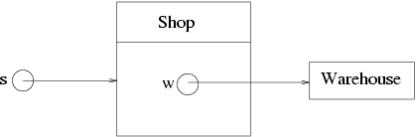
Third problem with clone():
Cloning is shallow
clone() copies the values of fields of the object it is cloning. If all these fields are basic types, this is just right.
If some of them are reference types, more evil aliasing can be introduced by this!
For example, consider a Shop class which has a field holding (a pointer to) the shop's supplier's warehouse.

Slide 18
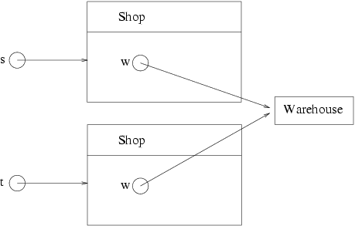
Cloning is shallow
Cloning this shop using
t = (Shop)s.clone();

Slide 19
Clone() returns type Object
When cloning this shop using
t = (Shop)s.clone();
We must cast it to the desired type,
since clone() returns type Object

Slide 20
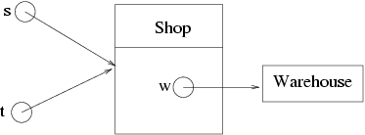
Cloning is shallow
This is one level better than plain old
t = s;
but may not be what we wanted.
clone()
gives us what is called shallow cloning: it does not chase chains of pointers cloning all the way

Slide 21
Deeper Cloning
If you want deeper cloning for a class, you should implement it yourself by overriding the original clone() method. For example:
public Object clone() {
try {
Shop cloneShop = (Shop)super.clone();
Warehouse cloneWarehouse = (Warehouse)w.clone();
cloneShop.w = cloneWarehouse;
return cloneShop
}
catch (CloneNotSupportedException e) {
return null; // this shouldn't happen
}
}

Slide 22
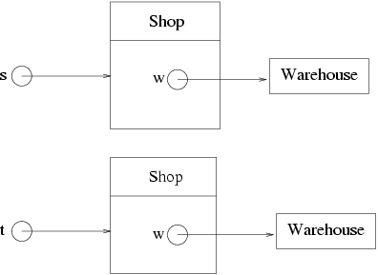
Deeper Cloning
Calling this method gives:

Slide 23
A fine approach to object copying is to provide a copy constructor.
public Matrix( Matrix m);
Or provide a static factory in place of a constructor:
public static Matrix makeAnInstance( Matrix m );

Slide 24
Methods common to all objects: compareTo()
Consider implementing Comparable
  By implementing Comparable, a class indicates that its instances have a natural ordering. Sorting an array of objects that implement Comparable is as simple as this:
  Arrays.sort(a);

