Slide 1

Industrial Class Design
CS321: Advanced Programming Techniques
Prof: Gregory Mierzwinski
Date: January 14th, 2022
Notes:
Multi-instrument / Multi-instrument Inter-process (minus the)-with Eye Trackers-

Slide 2
Overview
equals
clone
toString
compareTo

Slide 3
Methods common to all objects
The class Object provides a number of methods designed to be overriden.
equals()
toString( )
clone( )
finalize( )
A default behaviour is implemented but that might not be what you want.

Slide 4
Equals
public boolean equals(Object ob )

Slide 5
Equals
public boolean equals(Object ob )
By default the equals() method compares the reference.
Would display “no”
If we want to compare our objects for equality we have to OVERRIDE equals() so that it implements our notion of logical equality
Point p1 = new Point( 2,6 );
Point p2 = new Point( 2,6 );
if ( P1.equals(p2) ) System.out.print( “yes”);
else
System.out.print( “no”);

Slide 6
Equals
public boolean equals(Object ob )
If we really want each instance to be equal only to itself then DO NOT override. This would be when:
Each instance of the class is inherently unique.
classic example: a Thread or a RandomNumber Generator ( an active entity)
You don’t care whether the class provides a “logical equality” test. It may simply not make sense to ask if a random number generator is “equal” to another one
A superclass has already overridden equals(), and the behavior inherited from the superclass is appropriate for this class.
You are certain that its equals() method will never be invoked.

Slide 7
Equals
public boolean equals(Object ob )
override when there is a notion of logical equality that is different from object identity and a parent class has not already overriden with the desired behaviour ( f.e. Strings, Complex numbers, etc. Usually classes designed to encapsulate values)
Obey the general contract ( see documentation of class Object ) when overriding equals
This means making sure that equals( ) is reflexive, symmetric, transitive, consistent

Slide 8
Equals General Contract
It is reflexive:
For any reference value x, x.equals(x) must return true.
It is symmetric:
For any reference values x and y, x.equals(y) must return true if and only if y.equals(x) returns true.
It is transitive:
For any reference values x, y, and z, if x.equals(y) returns true and y.equals(z) returns true, then x.equals(z) must return true.
It is consistent:
For any reference values x and y, multiple invocations of x.equals(y) consistently return true or consistently return false.
For any non-null reference value x, x.equals(null) must return false.

Slide 9
Equals General Contract
It is reflexive:
For any reference value x, x.equals(x) must return true.
It is symmetric:
For any reference values x and y, x.equals(y) must return true if and only if y.equals(x) returns true.
It is transitive:
For any reference values x, y, and z, if x.equals(y) returns true and y.equals(z) returns true, then x.equals(z) must return true.
It is consistent:
For any reference values x and y, multiple invocations of x.equals(y) consistently return true or consistently return false.
For any non-null reference value x, x.equals(null) must return false.
public boolean equals(Object o) {
Complex x = (Complex) o;
boolean result = (
( this.real == o.real) &&
(this.imag == o.imag)
);
0.real += 10.0;
return result;
}

Slide 10
Recipe for good quality equals( ) method
Use the == operator to check if the argument is a reference to this object.
Use the instanceof operator to check if the argument is of the correct type.( some people argue about this)
Cast the argument to the correct type.
For each “significant” field in the class, check to see if that field of the argument matches the corresponding field of this object.
Always override hashCode( ) when you override equals
Equal objects must have equal hash codes. Used in hash tables!
When you are finished writing your equals method, ask yourself three questions: Is it symmetric, is it transitive, and is it consistent?

Slide 11
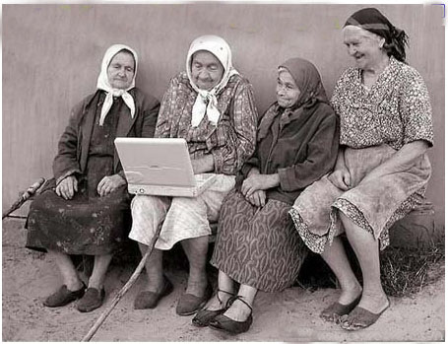
DONT’S with Equals
Don’t write an equals method that relies on unreliable resources.
( f.e. An email to your grandmother..)
Or, more seriously, the existence of some file
Don’t substitute another type for Object in the equals declaration.
This is overloading not overriding
We WANT to override the Object equals()
public boolean equals(MyClass o) {
...
}

Slide 12
toString()
public String toString( )
providing a good toString implementation makes your class much more pleasant to use.
f.e. you can print out objects of this class for debugging reasons using println( )
When practical, the toString method should return all of the interesting information contained in the object,
Sheep joey = new Sheep( “Joey”, 56.7, 20 );
System.out.println( joey);

Slide 13

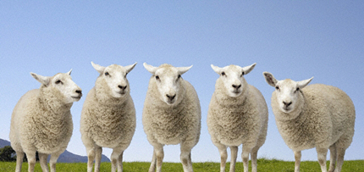
Clone
protected Object clone()
Or: How to Make a total Copy of an object

Slide 14
Clone
Making copies of objects is called cloning.
Java provides an automatic and general way of doing it.
The class Object has a method
which does this for you.
Since every class extends Object, every class has this method.
protected Object clone()

Slide 15
Recipe for good quality equals( ) method
protected Object clone()
BUT…..
By default, the clone() method creates a new object of the same class copies the value of the fields of the original object to the new clone returns the new clone object.
Notice that we now have two ways of creating an object: either directly using a constructor as in
Or by calling the objects clone method:
on some object.
someObject.clone();
new MyObject();
Object ob = someObject.clone();

Slide 16
Problems with Object’s Clone
The clone() method will throw a CloneNotSupportedException if it is called on an object of a class which does not implement an interface called Cloneable.
So, to allow ourselves to clone a class Warehouse, we must write
There are no methods in the Cloneable interface, so that's all that is required.
public class Warehouse implements Cloneable {
//... rest of class here
}

Slide 17
Problems with Object’s Clone
The clone() method has protected access, which is annoying sometimes, so it is common to override the method and make it public.
However, since in general, clone() may throw an exception, we must declare that it may do so.
The code for simply overriding clone() so that it has public access often looks like this.
public Object clone() throws CloneNotSupportedException {
return(super.clone());
}

Slide 18
Problems with Object’s Clone
Alternatively, we can catch the exception at source. This is a good idea since we know it will never in fact be thrown!
This is much cleaner. Programs which call our clone() method now do not have to worry about the exception.
public Object clone() {
try {
return(super.clone());
} catch (CloneNotSupportedException e) {
return null; // this never happens
}
}

Slide 19
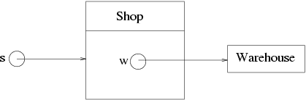
Java clone is shallow!
clone() copies the values of fields of the object it is cloning. If all these fields are basic types, this is just right.
If some of them are reference types, more evil aliasing can be introduced by this!

Slide 20
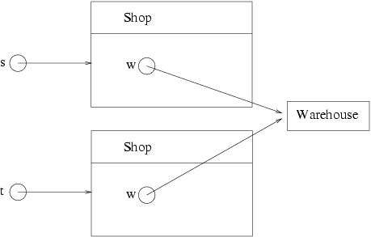
Java clone is shallow!
Cloning this shop using
We must cast it to the desired type, since clone() returns type Object.
t = (Shop)s.clone();

Slide 21
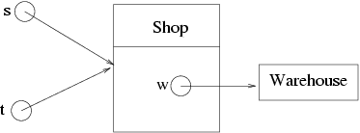
Java clone is shallow!
This is one level better than plain old
but may not be what we wanted.
clone() gives us what is called shallow cloning: it does not chase chains of pointers cloning all the way

Slide 22
Deep Cloning
If you want deeper cloning for a class, you should implement it yourself by overriding the original clone() method. For example:
public Object clone() {
try {
Shop cloneShop = (Shop)super.clone();
Warehouse cloneWarehouse = (Warehouse)w.clone();
cloneShop.w = cloneWarehouse;
return cloneShop
} catch (CloneNotSupportedException e) {
return null; // this shouldn't happen
}
}

Slide 23
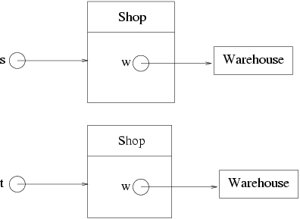
Deep Cloning

Slide 24
Clone
A fine approach to object copying is to provide a copy constructor.
Or provide a static factory in place of a constructor:
public Matrix( Matrix m);
public static Matrix makeAnInstance( Matrix m );

Slide 25
compareTo
Consider implementing Comparable
By implementing Comparable, a class indicates that its instances have a natural ordering. Sorting an array of objects that implement Comparable is as simple as this:
Arrays.sort()

