Slide 1

Linters
CS321: Advanced Programming Techniques
Prof: Gregory Mierzwinski
Date: January 31, 2022
Notes:
Multi-instrument / Multi-instrument Inter-process (minus the)-with Eye Trackers-

Slide 2
Overview
Linting
Real-life Example
Reformatting your Java code

Slide 3
Linting (or Static Analysis)
Static Analysis of your code
Analyzes the static aspect (e.g. the code, file names etc.) of your program
Doesn’t care about what your code does at runtime
Only cares if it looks right, and could compile it as well
Examples:
PEP-8 in Python
IntelliJ-builtin, & Google Style in Java
ESLint, & Mozilla Style in Javascript
Custom Validators
In contrast, dynamic analysis involves analyzing your code during runtime
Example: Code Coverage

Slide 4
Using Linters
Automated code checks before landing your code to the default branch of your repository
Usually happens during code reviews with some form of continuous integration (CI) tooling
Running these linters locally will (in most cases) automatically reformat your code

Slide 5
Advantages to using Linters
Quicker, and more powerful code reviews
People can spend more time on the internals rather than the structure
Consistent code quality
Enforcement of organizational standards
No need to stress about your formatting anymore
E.g. a misplaced curly brace `{` on line 10,276

Slide 6
Disadvantages to using Linters
?????

Slide 7
Disadvantages to using Linters
Can take some time to setup
Need to maintain the versions properly
Can potentially provide a false sense of security about code correctness (e.g. bugs in the linter)

Slide 8
Real-life Example
The mozilla-central repo runs a barrage of linters on all of the source code: https://treeherder.mozilla.org/jobs?repo=mozilla-central&searchStr=lint
Linters documented here: https://firefox-source-docs.mozilla.org/code-quality/lint/index.html#Linter_Implementations
Run on our PR system Phabricator: https://phabricator.services.mozilla.com/p/reviewbot/

Slide 9
IntelliJ Code Style
Uses a built in format that is their own
There are alternatives, see here for more information: https://www.jetbrains.com/help/idea/configuring-code-style.html
Suggested to use the Google Java code style: https://github.com/google/google-java-format#intellij-android-studio-and-other-jetbrains-ides

Slide 10
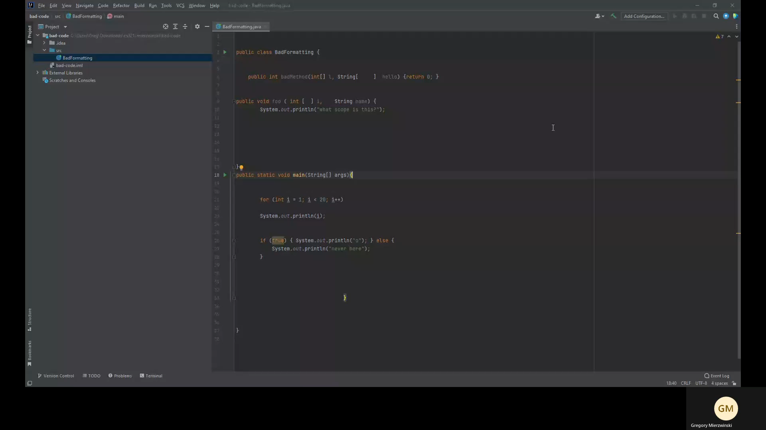
How to Autoformat Your Code

