Slide 1

Java Generics
CS321: Advanced Programming Techniques
Prof: Gregory Mierzwinski
Date: January 31, 2022
Notes:
Multi-instrument / Multi-instrument Inter-process (minus the)-with Eye Trackers-

Slide 2
Overview
Generic Classes
Generic Methods
Wildcard

Slide 3
Key Points for Errors/Exceptions
Errors are internal, exceptions are external
Check and sanitize input before doing anything
Setup default values if needed
Raise exceptions when you can’t set a default value.
Put try/catch around crucial pieces of code that can potentially crash your program, not everything.
These are areas that you have less control over (e.g. making a network request, file manipulations, using source-code from dependencies, running external programs).

Slide 4
Key Points for Errors/Exceptions
When building large programs, remember where you generate and catch exceptions. Sometimes you maybe duplicating code and some catch code becomes unreachable as you always catch an exception earlier.
Logging is incredibly important for debugging errors!

Slide 5
Key Points for Errors/Exceptions
These become really important in weakly-typed languages!
You can pass any type as any parameter in any method
Exceptions will help

Slide 6
Key Points for Errors/Exceptions
Keyboard Interrupts (Ctrl+C)
There are cases where you absolutely want to catch these to prevent data corruption
In general, don’t catch these or make a routine that handles a special shutdown on (Ctrl+C) for critical pieces

Slide 7
Generics
A way to build classes with arbitrary or unknown types (classes) that may or may not need to define a particular set of methods.

Slide 8
Parameterized Classes and Generics
The class ArrayList is a parameterized class
It has a parameter, denoted by Base_Type, that can be replaced by any reference type to obtain a class for ArrayLists with the specified base type
Starting with version 5.0, Java allows class definitions with parameters for types
These classes that have type parameters are called parameterized class or generic definitions, or, simply, generics

Slide 9
Generics (Cont’d)
A class definition with a type parameter is stored in a file and compiled just like any other class.
Once a parameterized class is compiled, it can be used like any other class.
However, the class type plugged in for the type parameter must be specified before it can be used in a program.
Doing this is said to instantiate the generic class.
Sample<String> ob = new Sample<String>();

Slide 10
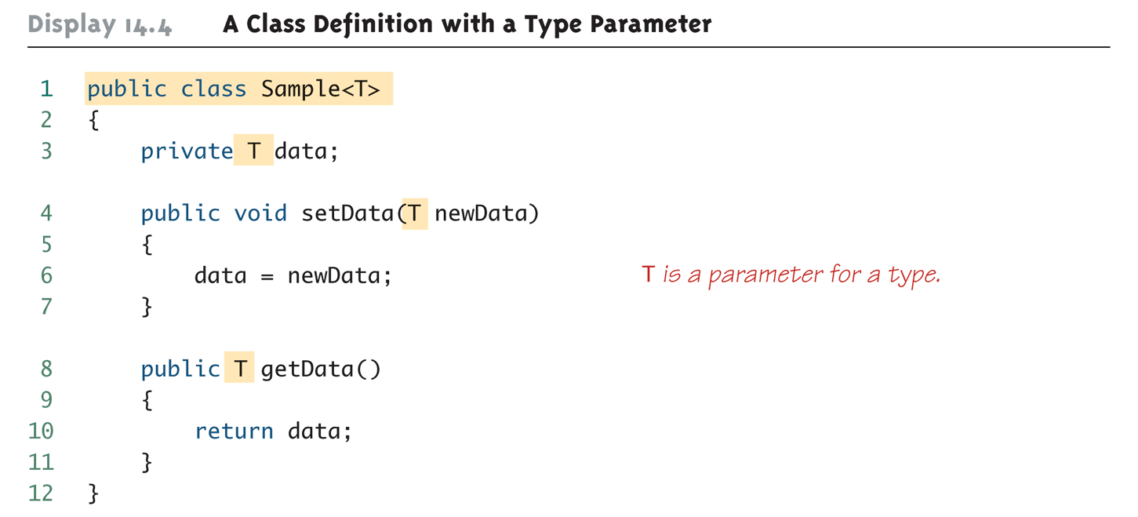
A Class Definition with a Type Parameter

Slide 11
A Class Definition with a Type Parameter (Cont’d)
A class that is defined with a parameter for a type is called a generic class or a parameterized class
The type parameter is included in angular brackets after the class name in the class definition heading.
Any non-keyword identifier can be used for the type parameter, but by convention, the parameter starts with an uppercase letter.
The type parameter can be used like other types used in the definition of a class.

Slide 12
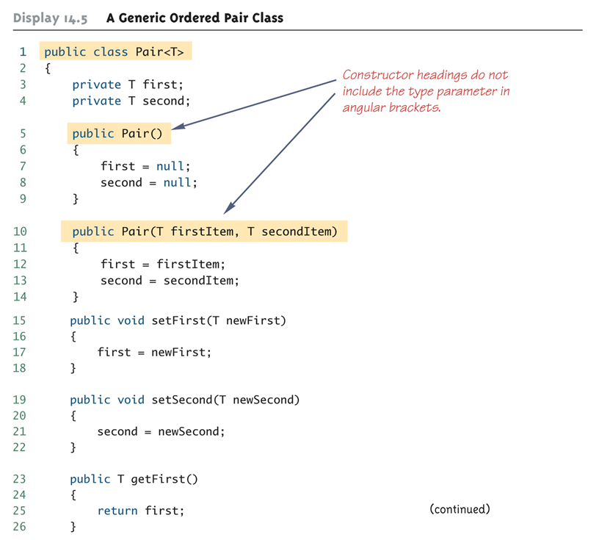
Generic Class Definition: An Example

Slide 13
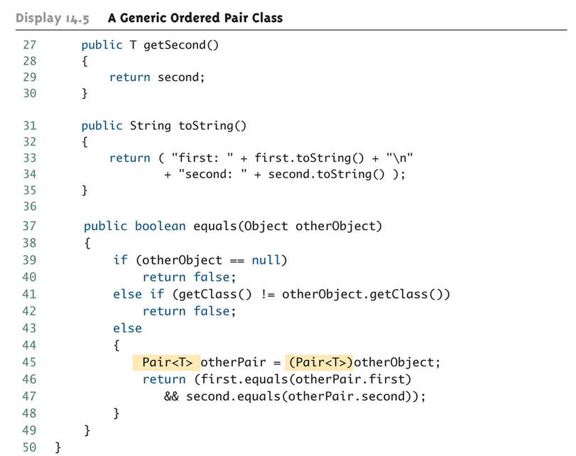
Generic Class Definition: An Example (Cont’d)

Slide 14
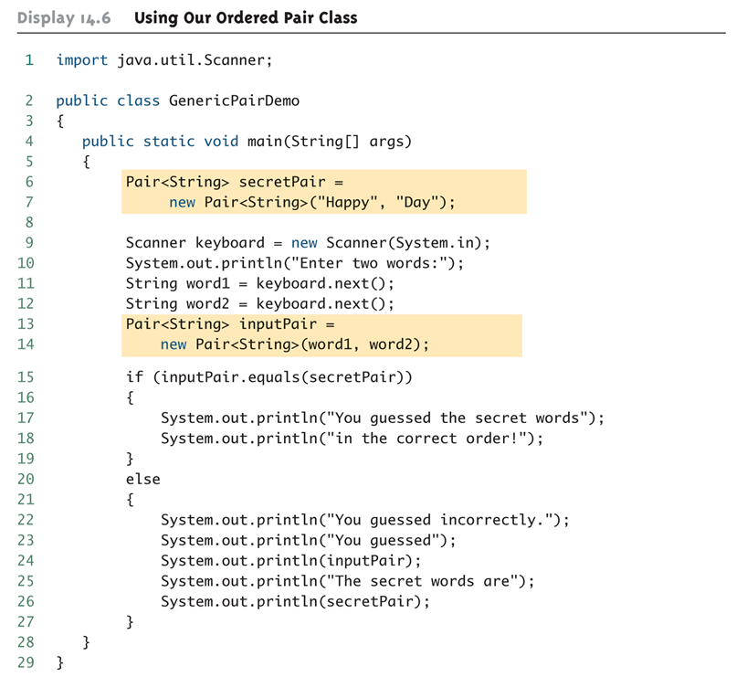
Generic Class Usage: An Example

Slide 15
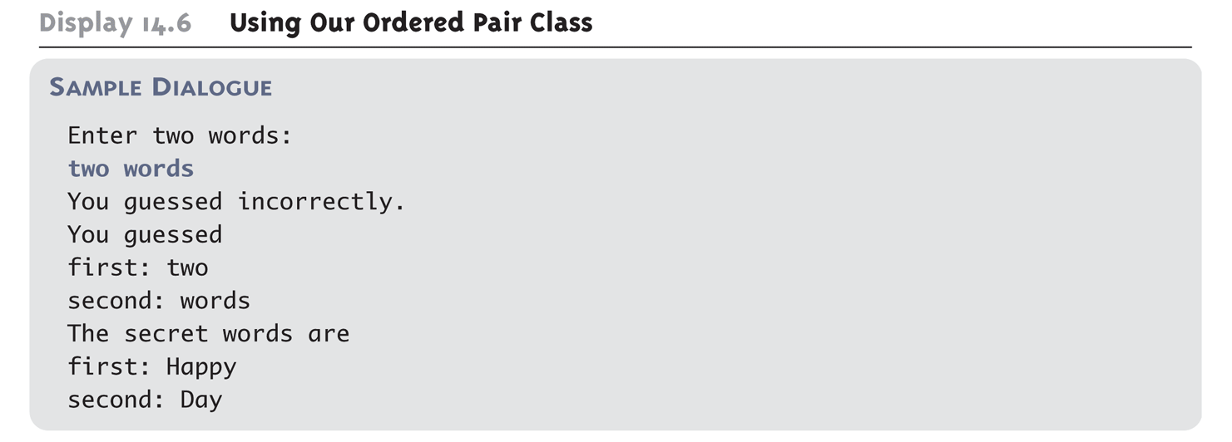
Generic Class Usage: An Example (Cont’d)
Program Output:

Slide 16
A Generic Constructor Name Has No Type Parameter!!!
Although the class name in a parameterized class definition has a type parameter attached, the type parameter is not used in the heading of the constructor definition:
public Pair<T>()
A constructor can use the type parameter as the type for a parameter of the constructor, but in this case, the angular brackets are not used:
public Pair(T first, T second)
However, when a generic class is instantiated, the angular brackets are used:
Pair<String> pair = new Pair<String>("Happy", "Day");

Slide 17
A Primitive Type Cannot be Plugged in for a Type Parameter!!!
Although the class name in a parameterized class definition has a type parameter attached, the type parameter is not used in the heading of the constructor definition:
public Pair<T>()
A constructor can use the type parameter as the type for a parameter of the constructor, but in this case, the angular brackets are not used:
public Pair(T first, T second)
However, when a generic class is instantiated, the angular brackets are used:
Pair<String> pair = new Pair<String>("Happy", "Day");

Slide 18
A Primitive Type Cannot be Plugged in for a Type Parameter!!!
The type plugged in for a type parameter must always be a reference type:
It cannot be a primitive type such as int, double, or char
However, now that Java has automatic boxing, this is not a big restriction.
Note: Reference types can include arrays.

Slide 19
Limitations on Type Parameter Usage
Within the definition of a parameterized class definition, there are places where an ordinary class name would be allowed, but a type parameter is not allowed.
In particular, the type parameter cannot be used in simple expressions using new to create a new object
For instance, the type parameter cannot be used as a constructor name or like a constructor:
T object = new T();
T[] a = new T[10];

Slide 20
Limitations on Generic Class Instantiation
Arrays such as the following are illegal:
Pair<String>[] a =
new Pair<String>[10];
Although this is a reasonable thing to want to do, it is not allowed given the way that Java implements generic classes

Slide 21
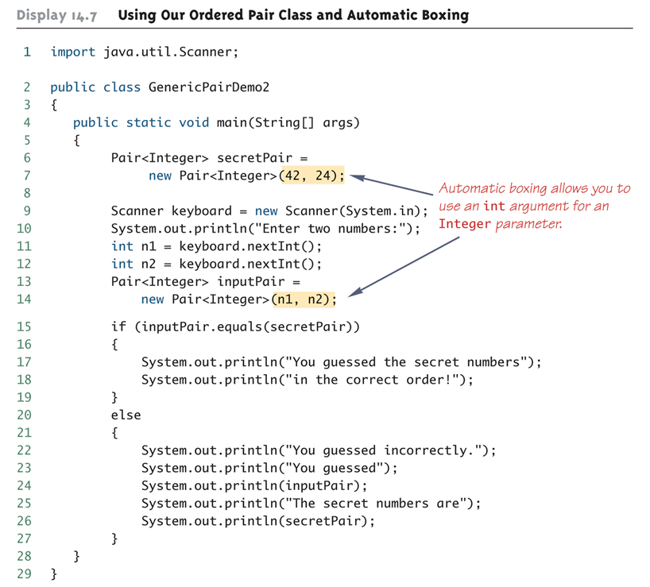
Using Generic Classes and Automatic Boxing

Slide 22
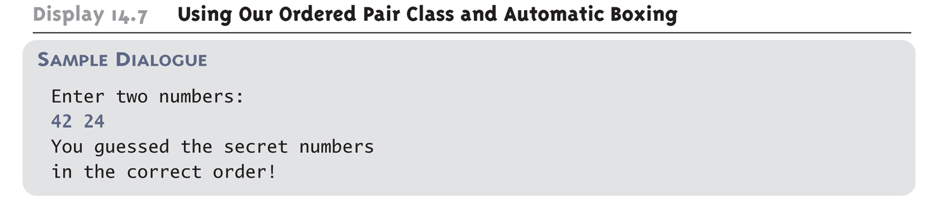
Using Generic Classes and Automatic Boxing (Cont’d)
Program Output:

Slide 23
Multiple Type Parameters
A generic class definition can have any number of type parameters.
Multiple type parameters are listed in angular brackets just as in the single type parameter case, but are separated by commas.

Slide 24
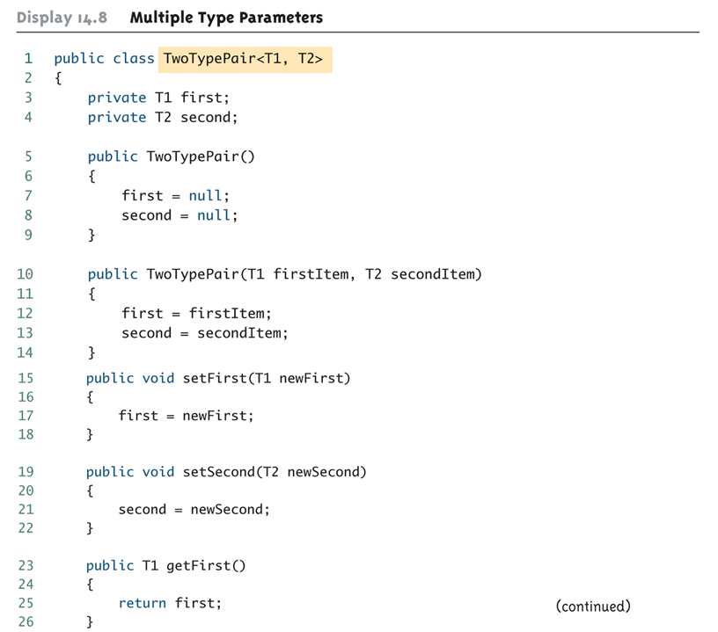
Multiple Type Parameters

Slide 25
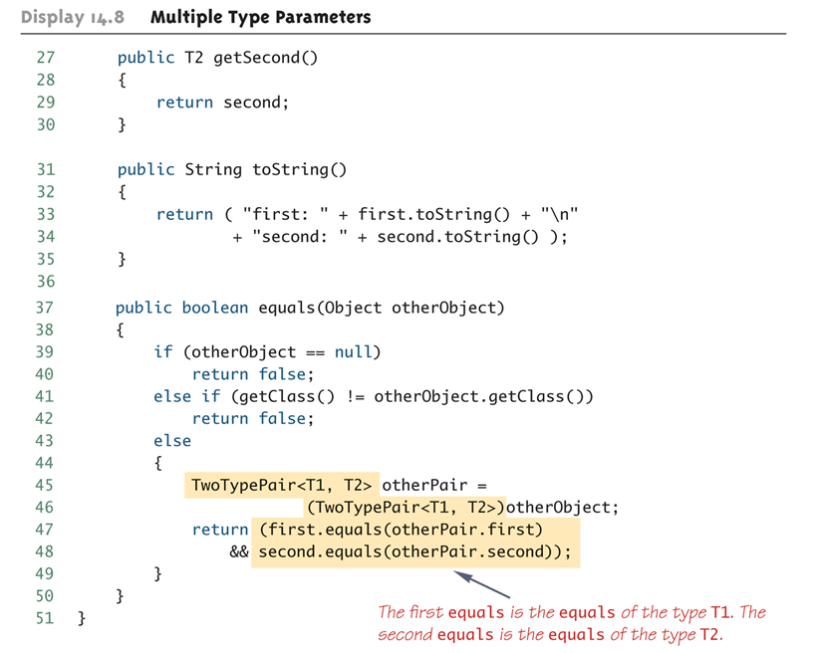
Multiple Type Parameters

Slide 26
Generic Classes and Exceptions
It is not permitted to create a generic class with Exception, Error, Throwable, or any descendent class of Throwable
A generic class cannot be created whose objects are throwable
public class GEx<T> extends Exception
The above example will generate a compiler error message

Slide 27
Bounds for Type Parameters
Sometimes it makes sense to restrict the possible types that can be plugged in for a type parameter T.
For instance, to ensure that only classes that implement the Comparable interface are plugged in for T, define a class as follows:
public class RClass<T extends Comparable>
"extends Comparable" serves as a bound on the type parameter T.
Any attempt to plug in a type for T which does not implement the Comparable interface will result in a compiler error message.

Slide 28
Bounds for Type Parameters
A bound on a type may be a class name (rather than an interface name)
Then only descendent classes of the bounding class may be plugged in for the type parameters:
public class ExClass<T extends Class1>
A bounds expression may contain multiple interfaces and up to one class.
If there is more than one type parameter, the syntax is as follows:
public class Two<T1 extends Class1, T2 extends Class2 & Comparable>

Slide 29
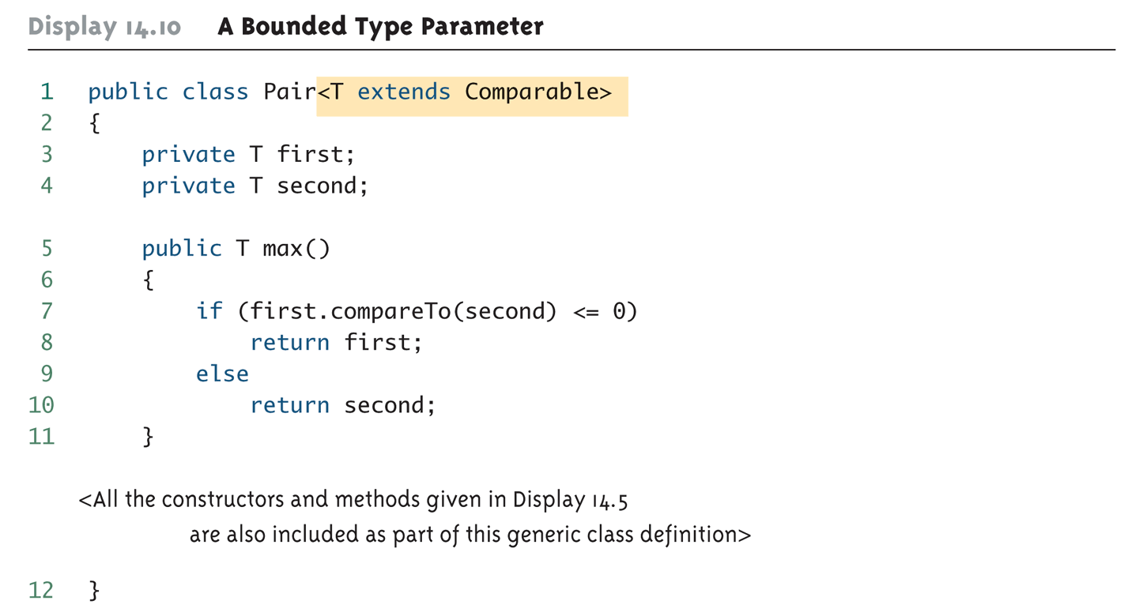
Bounds for Type Parameters

Slide 30
Generic Interfaces
An interface can have one or more type parameters.
The details and notation are the same as they are for classes with type parameters.

Slide 31
Generic Methods
When a generic class is defined, the type parameter can be used in the definitions of the methods for that generic class.
In addition, a generic method can be defined that has its own type parameter that is not the type parameter of any class
A generic method can be a member of an ordinary class or a member of a generic class that has some other type parameter.
The type parameter of a generic method is local to that method, not to the class.

Slide 32
Generic Methods
The type parameter must be placed (in angular brackets) after all the modifiers, and before the returned type:
public static <T> T genMethod(T[] a)

Slide 33
Inheritance with Generic Classes
A generic class can be defined as a derived class of an ordinary class or of another generic class
As in ordinary classes, an object of the subclass type would also be of the superclass type
Given two classes: A and B, and given G: a generic class, there is no relationship between G<A> and G<B>
This is true regardless of the relationship between class A and B, e.g., if class B is a subclass of class A

Slide 34
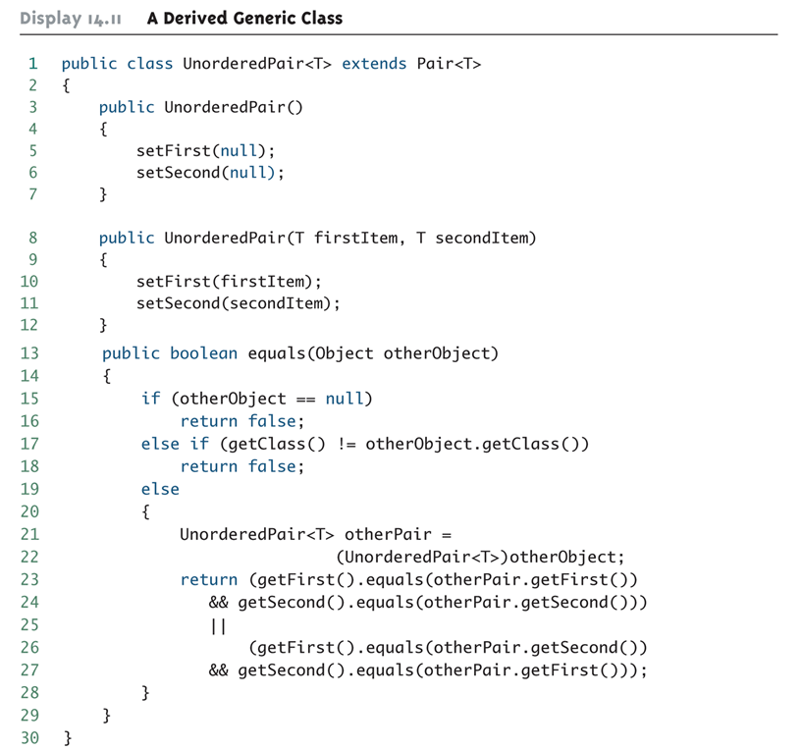
A Derived Generic Class: An Example

Slide 35
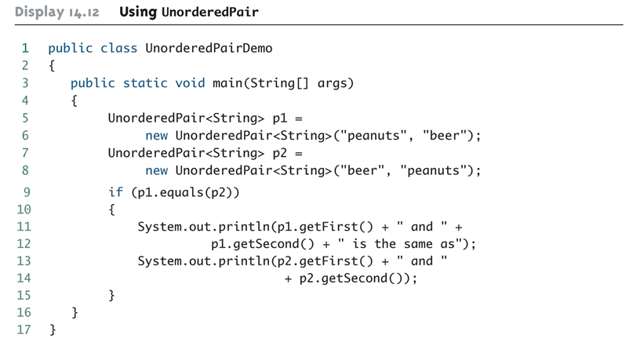
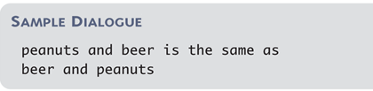
A Derived Generic Class: An Example (Cont’d)

Slide 36
Erasure
There is no real copy for each parameterized type (Unlike Templates in C++)
What is being done?
Compile time check (e.g. List<Integer> adds only Integers)
Compiler adds run-time casting (e.g. pulling item from List<Integer> goes through run-time casting to Integer)
At run-time, the parameterized types (e.g. <T>) are Erased – this technique is called Erasure
At run-time, List<Integer> is just a List !

Slide 37
Is the following possible?
public class GenericClass<T> {
private T obj;
...
public void print() {
System.out.println("obj type: " + T.class.getName());
System.out.println(obj);
}
}
Answer is: NO (compilation error on: T.class)
But, the following, however, is possible:
System.out.println("obj type: " + obj.getClass().getName());

Slide 38
Is the following possible?
public class GenericClass<T> {
private T obj;
public GenericClass() {
obj = new T();
}
}
Answer is: NO (compilation error on: new T();)
One should either send an instantiated object or go back to reflection and send the class:
public GenericClass(Class<T> klass) {
obj = klass.newInstance(); // handle exceptions..
}

Slide 39
Is the following possible?
if(obj instanceof T) {
...
}
Or:
if(someClass == T.class) {
...
}
Answer is: NO (compilation error, T is erased)
T is not a known type during run-time.
To enforce a parameter of type T we will have to use compile time checking (e.g. function signature)

Slide 40
Is the following possible?
if(obj instanceof List<Integer>) {
...
}
Or:
if(someClass == List<Integer>.class) {
...
}
Answer is: NO (compilation error, List<Integer> isn’t a class)
List<Integer> is not a known type during run-time.
To enforce List<Integer> we will have to use compile time checking (e.g. function signature)

Slide 41
Is the following possible?
List myRawList;
List<Integer> myIntList = new LinkedList<Integer>();
myRawList = myIntList;
Needed for backward compatibility
Answer is: Yes (List<Integer> is in fact a List)
The problem starts here:
myRawList.add("oops"); // gets type safety warning
System.out.println(myIntList.get(0)); // OK, prints oops // (though might be compiler dependent)
Integer x3 = myIntList.get(0); // Runtime ClassCastException
// this explains why operations on raw type // should always get type safety warning
Not checked at run-time (erasure…)

Slide 42
By the way… is the following possible?
List myRawList = new LinkedList();
List<Integer> myIntList;
myIntList = myRawList;
Wow, that’s ugly and quite disturbing
Answer is: Yes (with type-safety warning)
And run-time errors risk
The reason is again backward compatibility:
myRawList might result from an old library that does not use generics
the following casting should have been the solution:
myIntList = (List<Integer>)myRawList; // illegal casting
But: List<Integer> is not a type (as it was “erased”)

Slide 43
There is no real copy for each parameterized type (Unlike Templates in C++)
What is being done?
Compile time check (e.g. List<Integer> adds only Integers – checked against the signature List<T>.add)
Compiler adds run-time casting (e.g. return type from List<T>.get() goes through run-time casting to T)
At run-time, the parameterized types (e.g. <T>) are Erased and thus CANNOT BE USED during run-time
F.e. in making a new object
At run-time, List<Integer> is just a List !

Slide 44
Generics [Subtyping]
Parameterized types can be restricted:
public class GenericSerializer<T extends Serializable> {
…
}
- Type T provided for our GenericSerializer class must implement Serializable
- Note that the syntax is always "extends", also for interfaces
Multiple restrictions might be provided, separated by &:
public class Foo<T extends Comparable<T> & Iterable<T>> {
…
}

Slide 45
Generics [Wildcards and subtyping]
Is the following possible?
List<String> listStrings = new ArrayList<String>();
List<Object> listObjects = listStrings;
Well, we know that the following is of course fine:
String str = "hello"; Object obj = str;
Answer is: NO (compilation error)
This comes to avoid the following:
listObjects.add(7);
String str = listStrings.get(0); // wd’ve been run-time error

Slide 46
Suppose we want to implement the following function:
void printCollection(Collection col) {
for(Object obj : col) {
System.out.println(obj);
}
}
Can get ONLY collection of Objects
(go one slide back for explanation)
Cannot support Collection<String> Collection<Float> etc.
But we want to do it in a “generic” way, so we write:
void printCollection(Collection<Object> col) {
for(Object obj : col) {
System.out.println(obj);
}
}
What’s wrong with the 2nd implementation?

Slide 47
The proper way is:
void printCollection(Collection<? extends Object> col) {
for(Object obj : col) {
System.out.println(obj);
}
}
Which is the same, for this case, as:
void printCollection(Collection<?> col) {
for(Object obj : col) {
System.out.println(obj);
}
}
Now we support all type of Collections!

Slide 48
One more wildcard example:
public interface Map<K,V> {
…
void putAll(Map<? extends K, ? extends V> map)
…
}
And another one:
public interface Collection<E> {
…
void addAll(Collection<? extends E> coll)
…
}

Slide 49
Wildcards can be used also for declaring types:
// the following collection might be Collection<Shape>,
// but it can also be Collection<Circle> etc.
Collection<? extends Shape> shapes;
...
// the following is OK and is checked at compile-time!
Class<? extends Collection> clazz = shapes.getClass();
// the following is not OK (compilation error), why?
Class<? extends Collection<? extends Shape>> clazz = shapes.getClass();

Slide 50
Wildcards for declaring types, cont’:
// the following collection might be Collection<Shape>,
// but it can also be Collection<Circle> etc.
Collection<? extends Shape> shapes;
...
// Now, what can we do with the shapes collection?
// [1] Add - NOT allowed
shapes.add(new Shape()); // (compilation error)
// [2] but this is OK:
for(Shape shape: shapes) {
shape.print(); // (assuming of course Shape has print func')
}

Slide 51
Take a look at the following function signature in class Class<T>:
public Class<? super T> getSuperclass()
The keyword ‘super’ is used here to denote that the return type of
Class<T>.getSuperclass()
is going to be an object of type Class<? super T> and ? is obliged to be a super of T The ‘super’ refers to any level of T or above (including T itself)

Slide 52
Parameterized type can be added also to a function, example from the interface Collection:
public <T> T[] toArray(T[] arr)
The parameterized type T is not specified when calling the function, the compiler guesses it according to the arguments sent
Another Generic Method example, from the class Class:
public <U> Class<? extends U> asSubclass(Class<U> clazz)
And another one, from class java.utils.Collections:
public static <T> void copy (List<? super T> dest, List<? extends T> src)

Slide 53
The following is the max function from JDK 1.4 Collections class:
static public Object max(Collection coll) {
Iterator itr = coll.iterator();
if(!itr.hasNext()) {
return null;
}
Comparable max = (Comparable)itr.next();
while(itr.hasNext()) {
Object curr = itr.next();
if(max.compareTo(curr) < 0) {
max = (Comparable)curr;
}
}
return max;
}
When Sun engineers wanted to re-implement the max function to use generics in Java 5.0, what was the result?

Slide 54
The following is the JDK 5.0 max function (Collections class):
static public <T extends Object & Comparable<? super T>>
T max(Collection<? extends T> coll) {
Iterator<? extends T> itr = coll.iterator();
if(!itr.hasNext()) {
return null;
}
T max = itr.next();
while(itr.hasNext()) {
T curr = itr.next();
if(max.compareTo(curr) < 0) {
max = curr;
}
}
return max;
}
Look at the &
For other interesting Generic examples, go to java.utils.Collections

Slide 55
Exercise
Implement a generic class that holds an inner object T.
- The class should have relevant setter and getter
- Implement equals function for the class
- Implement the Comparable interface for the class

