Slide 1

Singleton Pattern
CS321: Advanced Programming Techniques
Prof: Gregory Mierzwinski
Date: January 31, 2022
Notes:
Multi-instrument / Multi-instrument Inter-process (minus the)-with Eye Trackers-

Slide 2
The Singleton pattern
A creational pattern
Ensures that a class has only one instance and provides a global point of access to it
- printspooler - file system - window manager
Singletons improve performance and reduce errors
To enforce singleton-ness the constructor is private and a static method provides access to the singleton
Allows subclasses to refine behavior

Slide 3
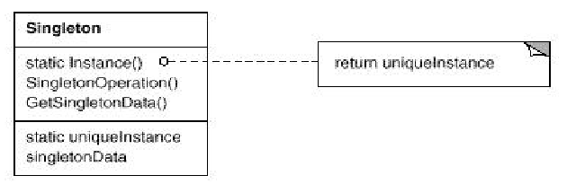
UML of Singleton Pattern

Slide 4
Singleton
public class Singleton { // OVERVIEW: there is only one // Singleton object which can be obtained // by calling the getInstance() method
private static Singleton t; // the single instance
private Singleton ( ) // the hidden constructor { // initialize the singleton }
public static Singleton getInstance ( ) { if (t == null)
t = new Singleton ( );
return t; }
// methods
}

Slide 5
Benefits of Singleton pattern
Controlled access: the class has strict control over the use on its instance
Can be used to encapsulate global variables: instead of n global variables, one instance
Easy extension: subclassing the singleton
Allows you to change your mind and provide a limited number of instances: change implementation of instance() method

Slide 6
Real World Uses
Spreading a configuration across your program and preventing your options from getting mixed.
Logging in a centralized manner to prevent slowdown in high output programs, and/or log to a single file from across anywhere.

Slide 7
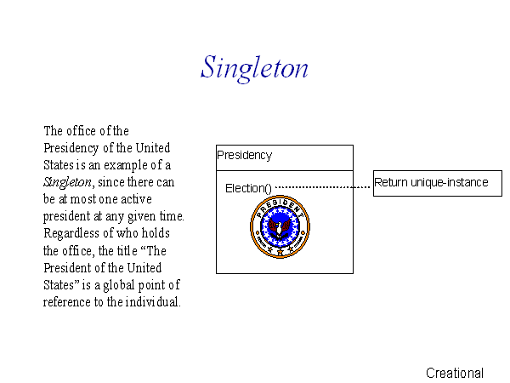
Non-programming example

