Slide 1

Adapter Pattern
CS321: Advanced Programming Techniques
Prof: Gregory Mierzwinski
Date: January 31, 2022
Notes:
Multi-instrument / Multi-instrument Inter-process (minus the)-with Eye Trackers-

Slide 2
Overview
Structural Patterns
Patterns that describe how we can form larger structures from classes or objects.
The Adapter Pattern is a structural pattern which can be a class or an object pattern.
Class patterns use inheritance to compose classes.
Object patterns use object composition.

Slide 3

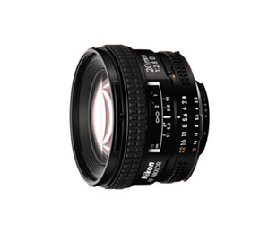
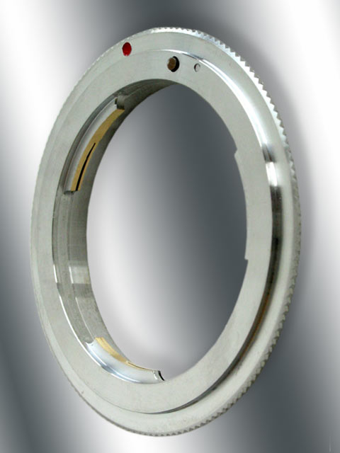
The Adapter Pattern

Slide 4
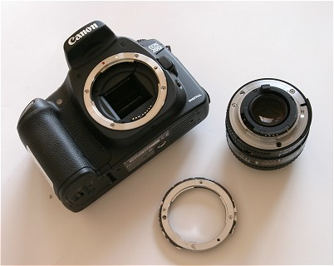
The Adapter Pattern
ADAPTEE
TARGET
ADAPTER

Slide 5
Adapter Design Pattern
Motivation
Sometimes a class implements functionality similar to what an application requires, but not the correct interface for that application
E.g.: We wish to implement a BookList class, implementing a list of text books used in a course ( perhaps because a remote program accessing our database expects this interface )
int getNumBooks()
Book getBook (int n)
void addBook (Book newBook)
These operations are very similar to the
operations in the predefined Vector class
BookList bl = new …;
…..
BL.addBook ( new Book(“ history of Bla”));
BL.addBook ( new Book(“ history of Blo”));
System.out.println (“Book list has ” +
BL.getNumBooks() + “ books”);
Book b = BL.getBook(1)
…

Slide 6
Options
Implement BookList from scratch
Expensive and error prone; why do it ?
Use Vector
Don’t get desired interface for BookList

Slide 7
Adapter Pattern
Adapt Vector to BookListinterface
Two ways of adapting the Vector
Class adapter
Based on inheritance
Object adapter
Based on composition

Slide 8
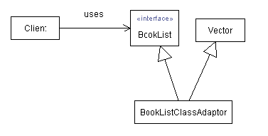
The Class Adapter Pattern

Slide 9
The Class Adapter Pattern
This is the interface the client program expects
interface BookList {
public int getNumBooks();
public Book getBook(int n);
void addBook(Book newBook);
}

Slide 10
The Class Adapter Pattern
import java.util.Vector;
class BookListClassAdapter
extends Vector implements BookList {
public int getNumBooks() {
return size();
}
public Book getBook(int n) {
return (Book) elementAt(n);
}
public void addBook(Book newBook) {
for (int i=0; i<getNumBooks(); i++) {
Book b=getBook(i);
if (b.isSameBook (newBook)) {
b.setQuantity (b.getQuantity() +
newBook.getQuantity());
return;
}
}
add (newBook);
}
}
// This code simply shows how a book list is
// used
public class SampleClient {
public static void main (String [] args) {
Book b = new Book (…);
BookList bl = new BookListClassAdapter ();
bl.addBook ();
System.out.println (“Book list has ” +
bl.getNumBooks() + “ books”);
}
}
SampleClient.java
Clients use BookList interface,
not BookListClassAdapter directly

Slide 11
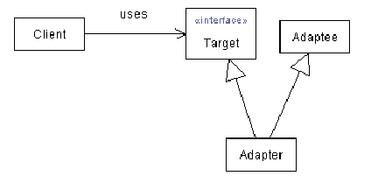
The Class Adapter Pattern
Adapter simply inherits operations of Vector ( so it actually IS a Vector )
Clients use BookList interface, not BookListClassAdapter directly
This hides public methods of Vector from client

Slide 12
The Object Adapter Pattern
import java.util.Vector;
class BookListObjectAdapter implements BookList {
private Vector books = new Vector();
public int getNumBooks() {
return books.size();
}
public Book getBook(int n) {
return (Book) books.elementAt(n);
}
public void addBook(Book newBook) {
for (int i=0; i<getNumBooks(); i++) {
Book b=getBook(i);
if (b.isSameBook (newBook)) {
b.setQuantity (b.getQuantity() +
newBook.getQuantity());
return;
}
}
books.add (newBook);
}
}
// This code simply shows how a book list is
// used
public class SampleClient {
public static void main (String [] args) {
Book b = new Book (…);
BookList bl = new BookListObjectAdapter ();
bl.addBook ();
System.out.println (“Book list has ” +
bl.getNumBooks() + “ books”);
}
}

Slide 13
The Object Adapter Pattern
This pattern lets classes work together that normally would not because their interfaces were incompatible (in the previous example SampleClient and Vector
Modifiability
Adapter class provides clean interface to clients of adapted object
Reusability
Takes advantage of adapted class for reuse
Correctness
Takes advantage of tested code

Slide 14
The Object Adapter Pattern
The object adapter:
Lets a single Adapter work with many Adaptees.
Could allow subclasses to be adapted by simply passing them in as part of the constructor.
Requires that you specifically bring to the surface any of the adapted object's methods that you wish to make available.
Makes it harder to override Adaptee behavior. It will require subclassing Adaptee and making Adapter refer to the subclass rather than the Adaptee itself.
The class adapter:
Introduces only one object.
Lets the adapter change some of the adapted class's methods but still allows the others to be used unchanged.
Are simpler than object adapters in that they involve fewer classes and are useful if total de-coupling of the client and Adaptee is not needed.
Won't work when you want to adapt a class and all of its subclasses, since you define the class that it derives from when you create it.
Has a problem with name conflicts if methods of the same signature exist on both the target and the Adaptee.

Slide 15
Non-Software Scenario
Outlets and Plugs
Outlets in the Quebec require a certain type of plug.
For example, a plug made in Europe for a European outlet, may not fit in an outlet in the Quebec .
To use this appliance in the Quebec , one would need to purchase an adapter.

Slide 16
Implementation
myStack Adapter Pattern is an Object Pattern
abstract class Stack{
abstract Object top();
abstract Object pop();
abstract void push(Object v);
}
public class myStack { Adapter class
private Vector stack = new Vector(); Adaptee object
public boolean empty() {return stack.size() == 0;}
pubic Object top() {return stack.lastElement();}
public Object pop() {
Object rslt = stack.lastElement();
stack.removeElementAt(stack.size()-1);
return rslt;}
void push(Object v) {stack.addElement(v);}
}
Target class

Slide 17
Another example: The SquarePeg class
/**
* The SquarePeg class.
* This is the Target class.
*/
public class SquarePeg {
public void insert(String str) {
System.out.println("SquarePeg insert(): " + str);
}
}
Target class

Slide 18
And the RoundPeg class:
/**
* The RoundPeg class.
* This is the Adaptee class.
*/
public class RoundPeg {
public void insertIntoHole(String msg) {
System.out.println("RoundPeg insertIntoHole(): " +
msg);
}
}
If a client only understands the SquarePeg interface for inserting pegs using the insert() method, how can it insert round pegs? A-HA a peg adapter!
Target class

Slide 19
Here is the PegAdapter class:
/**
* The PegAdapter class.
* This is the Adapter class.
* It adapts a RoundPeg to a SquarePeg.
* Its interface is that of a SquarePeg.
*/
public class PegAdapter extends SquarePeg {
private RoundPeg roundPeg;
public PegAdapter(RoundPeg peg) {
this.roundPeg = peg;
}
public void insert(String str)
{roundPeg.insertIntoHole(str);}
}
Target class
PegAdapter takes a RoundPeg as a constructor parameter.
This is an example of a pluggable adapter ( think of how we use “pluggable” look and feel in Swing components

Slide 20
Typical client program:
// Test program for Pegs.
public class TestPegs {
public static void main(String args[]) {
// Create some pegs.
RoundPeg roundPeg = new RoundPeg();
SquarePeg squarePeg = new SquarePeg();
// Do an insert using the square peg.
squarePeg.insert("Inserting square peg...");
// Now we'd like to do an insert using the round peg.
// But this client only understands the insert()
// method of pegs, not a insertIntoHole() method.
// The solution: create an adapter that adapts
// a square peg to a round peg!
PegAdapter adapter = new PegAdapter(roundPeg);
adapter.insert("Inserting round peg...");
}
}
Target class

