Slide 1

Semaphores
CS321: Advanced Programming Techniques
Prof: Gregory Mierzwinski
Date: January 31, 2022
Notes:
Multi-instrument / Multi-instrument Inter-process (minus the)-with Eye Trackers-

Slide 2
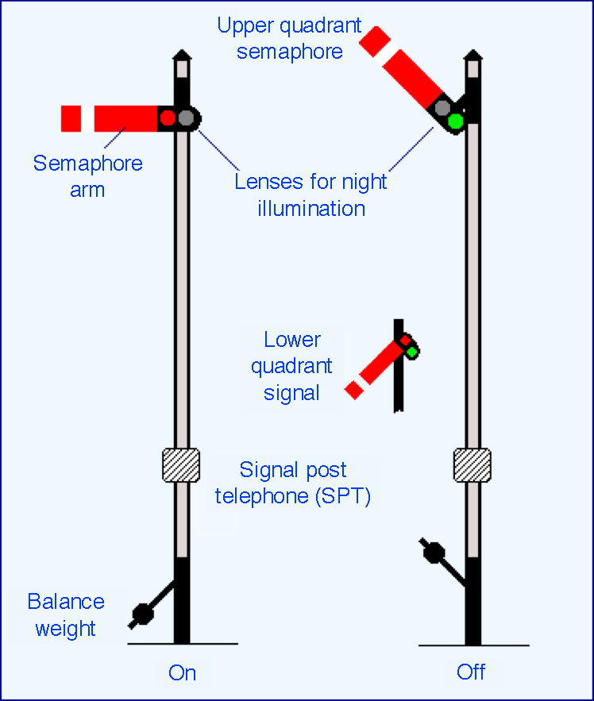
Semaphores
Historically a method for signaling by means of flags or lights

Slide 3
Semaphores
Semaphore: A synchronization primitive at a lower level than monitors.
A lock with a counter.
Implementation: primitive data type + operations (atomic)
E.g. a special integer + two operations P wait , V signal
s.P : if s == 0 then wait_until( s != 0 ); s := s - 1;
s.V : s := s + 1;

Slide 4
Usage
Thread 1:
semaphore s1 = 1; /* to protect R1 resource
initial value: free */
.
.
P(s1); /* lock R1 if available */
<operations on R1>
V(s1); /* free R1 */
.
.

Slide 5
Example: Semaphores in Java
public class Semaphore {
long sem;
public Semaphore(long init) {
sem = init;
}
public synchronized void P() throws InterruptedException {
while ( sem == 0 ) wait();
sem -= 1;
}
public synchronized void V() {
sem += 1;
notifyAll();
}
public boolean isDown() {
return sem == 0;
}
}

Slide 6
Example: Semaphores in Java
public class Semaphore {
long sem;
public Semaphore(long init) {
sem = init;
}
public synchronized void acquire() throws InterruptedException {
while ( sem == 0 ) wait();
sem -= 1;
}
public synchronized void release() {
sem += 1;
notifyAll();
}
public boolean isDown() {
return sem == 0;
}
}

Slide 7
Semaphores
When the semaphore is equal to 0, we say that is has no permits/contracts available.
When the semaphore is greater than 0, we say that it has X permtis/contracts available.
This means we can let X threads acquire a single lock. It won’t be unlocked until all threads are complete (or release the locks they acquired).

