Slide 1


IEEE General Body Meeting 2
Building Up Your Resume

Slide 2
Agenda
Updates and Announcements
A New Vice President!
Review of Professional Development Week
Building Up Your Resume
No Experience? No Problem!

Slide 3
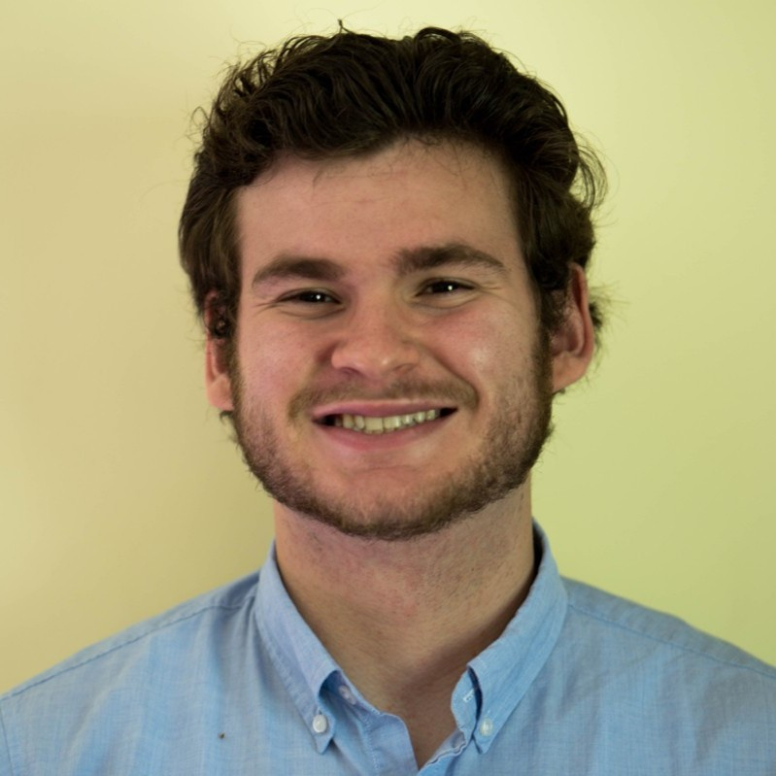
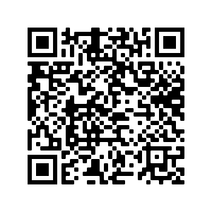
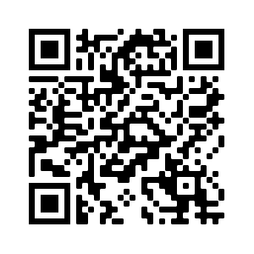
Updates & Announcements
NEW VP!
Colin Kilburn, Electrical Engineering, Class of 2022
We will now be taking attendance at all meetings
Will determine active members, have voting rights, and more!
Be a part of resume-sharing efforts with employers
Become an IEEE Student Member!
Only $32!
Access
Seminars
Papers
Networking opportunities
And more!
Join IEEE Here!
Attendance!

Slide 4
Resume Building Overview
What if I don’t have work experience?

Slide 5
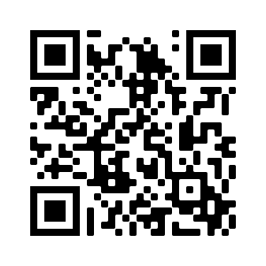




Clubs
Professional / Honor societies (IEEE, HKN, Engineers Without Borders)
Build your network and access technical papers, seminars, and more!
Technical clubs (Motorsport, Rocket Society, Electric Vehicle, DBF, etc.)
Hands-on experience!
Other clubs are still important - employers care about initiative & involvement
Join leadership if you can!
RPI Club Directory
Notes:
Plug IEEE student membership

Slide 6
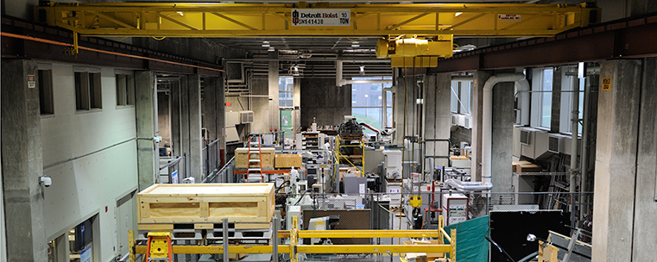
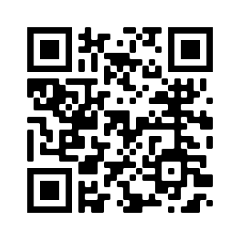
Research
RPI Center for Innovation and Technologies Lab
(CATs Lab)
Speak with your professors about research they are working on
Show interest in their work and ask about undergraduate positions - just send an email!
Often, interest in the research is all you need!
Reach out to professors that work on topics you are interested in
Look into and ask questions about their research
Show genuine interest in their fields
The earlier in the semester, the better!
ECSE Faculty List
Notes:
Add images?

Slide 7



Volunteering
Food pantries, Habitat for Humanity, STEM tutoring, and more!
Include service work as a part of Greek Life and other clubs
Mentor student teams for FIRST Robotics Competition, VEX Robotics, and other STEM groups
Search your community for areas of need!

Slide 8
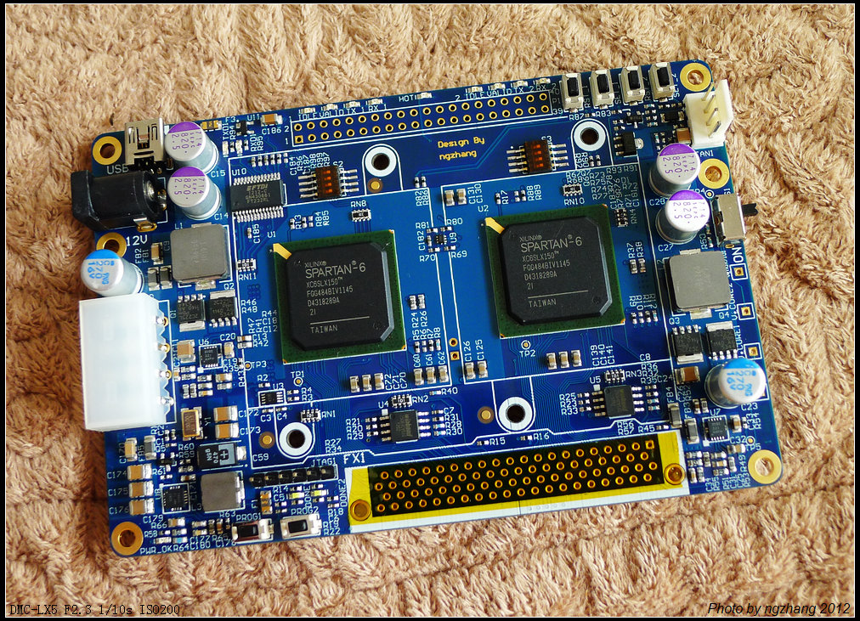


Personal Projects
Personal projects show that you are making an active effort to broaden your skills in a practical setting
Examples:
Arduino / Raspberry Pi project: There are tons of online projects that you can try out (RPI Embedded Hardware Club!)
FPGA Programing
Building Web Apps / Web Dev skills (React, JS, HTML, CSS, Python, Flask)
DIY Electronics, Automation, ML & CV, etc.
Notes:
Add images?

Slide 9



Personal Learning
Some skills are not taught directly taught to you at RPI.
Show employers that you have active interest in these subjects
Some methods to learn new skills:
Youtube has many tutorials on a wide range of topics.
Udemy is a good site to learn skills in a paid course format
MIT / University Courseware (Robotics)
Look into skills like:
Web Development and AWS
Unfamiliar programing languages (JS, C, C++, Python, etc)
Linux Command Lines
Topics in the field you are interested in

Slide 10
Conclusion
Employers want you to be passionate and involved, about anything
Hands-on experience is important!
Take initiative!
Organize service events
Take opportunities to lead
Reach out to professors
Make projects for yourself
Show your extracurricular work on your resume!
Any Questions?
Attendance!
Notes:
In most circumstances, leave out high school activities/GPAs past freshman/sophomore year if possible
Don’t be afraid to ask the CCPD!

Slide 11
Some Helpful Links
MIT OCW - https://ocw.mit.edu/index.htm
Stanford Online - https://online.stanford.edu/free-courses
(There are lots of other universities that offer similar free courses, these are just two examples!)
Udemy - https://www.udemy.com/
edX - https://www.edx.org/
(Lots of other free and paid courseware out there too!)
HackerRank - https://www.hackerrank.com/
Edabit Code Challenges - https://edabit.com/challenges
(Again, there are TONS of other code challenge websites to look through!)
Linux / Unix Tutorial - https://www.tutorialspoint.com/unix/index.htm
Arduino Project Hub - https://create.arduino.cc/projecthub
More Project Ideas for Arduino, RPi, and more - https://www.hackster.io/raspberry-pi/projects
Machine Learning Datasets - https://archive.ics.uci.edu/ml/index.php
Xilinx FPGA Projects - https://www.xilinx.com/community/projects.html

