Slide 1

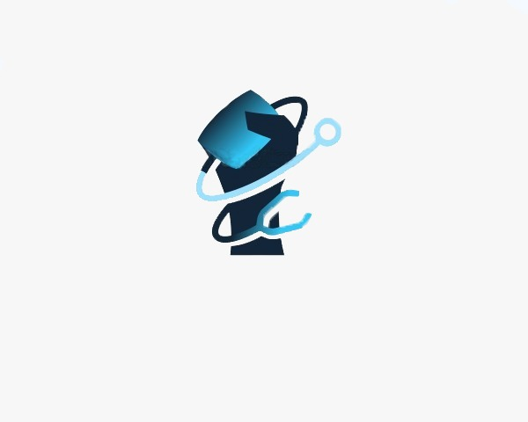
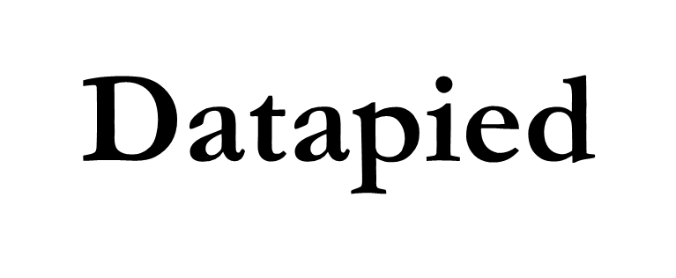
Revolutionizing Healthcare

Slide 2

Inspiration
In the ‘highly developed’ world that we live in today, Health systems face unprecedented challenges in meeting the current and projected eye care needs of the world’s population. There is no choice but to take on these challenges. The proposition of our idea and technology is to play our part to accelerate change and meet these challenges. Globally, at least 2.2 billion people have some sort of vision impairment out of which 1 billion individuals have conditions which could have been prevented.
Technology is progressively becoming a bigger part of our lives. The increase in Internet and mobile phone access has significant implications for how eye diseases can be better detected around the world
1 Billion
People have a vision impairment that could have been prevented

Slide 3
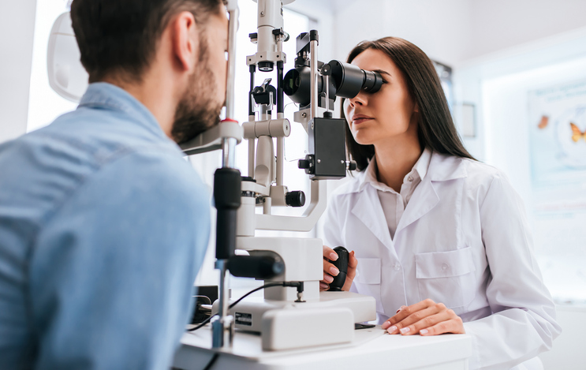


Transition

Slide 4


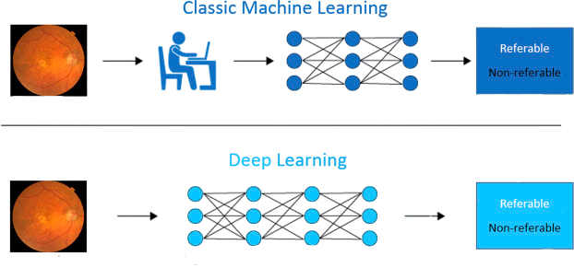









Slide 5

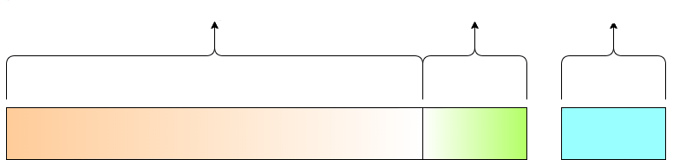



1052 Images
Were tested on the model to give an accuracy of 94%

Slide 6
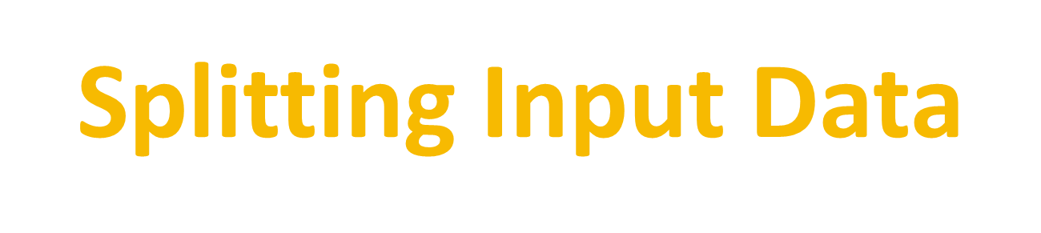
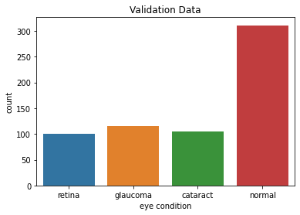
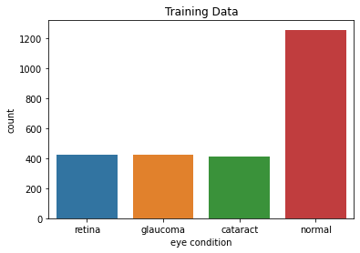
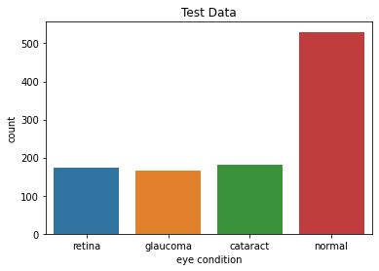


Slide 7

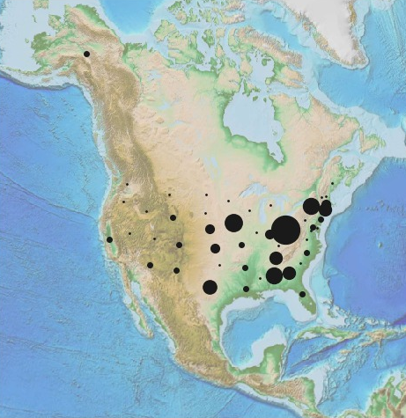


Slide 8
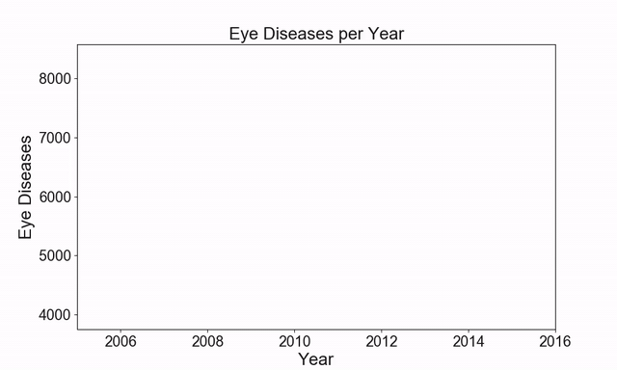


Slide 9



Technologies used
Using Google Cloud’s Inception V3 model loaded on the ImageNet dataset and Keras, we employ transfer learning on the model to improve the accuracy of results predicted by it. We set the parameter (include_top=False) to leave out the last fully connected layer and add our custom classification layer to output to our number of classes(4), while also preserving the model architecture .

Slide 10


Model Tweaking
24 Million
T

Slide 11
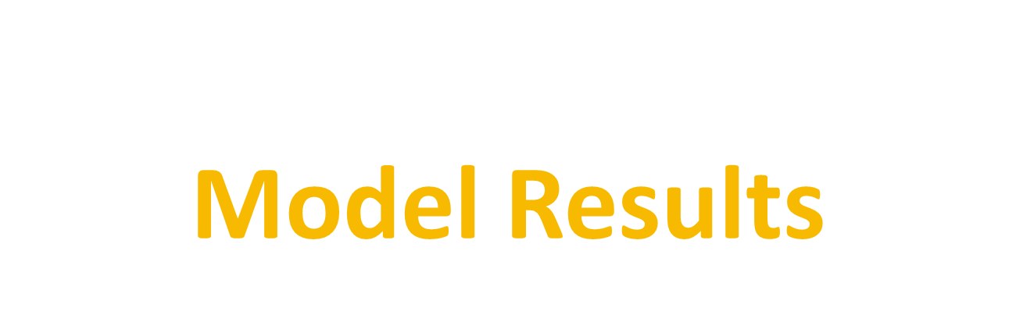
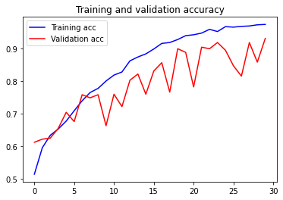
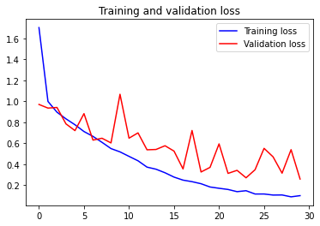

Slide 12

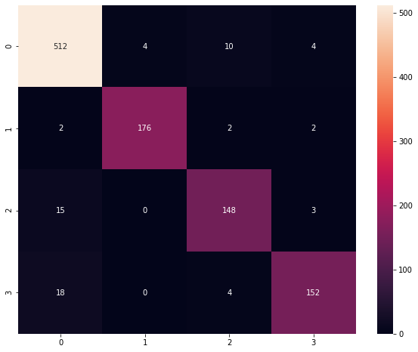

Category | Disease
0 | Normal
1 | Cataract
2 | Glaucoma
3 | Retina disease

Slide 13
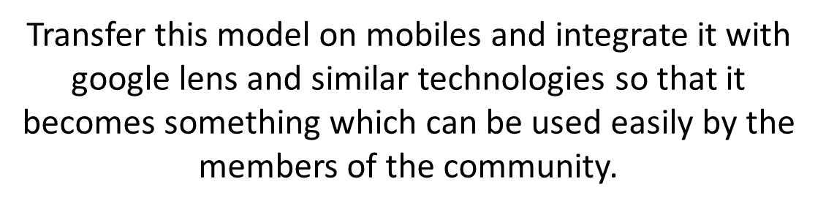
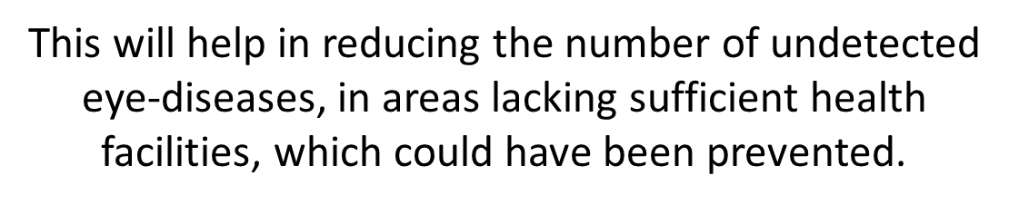
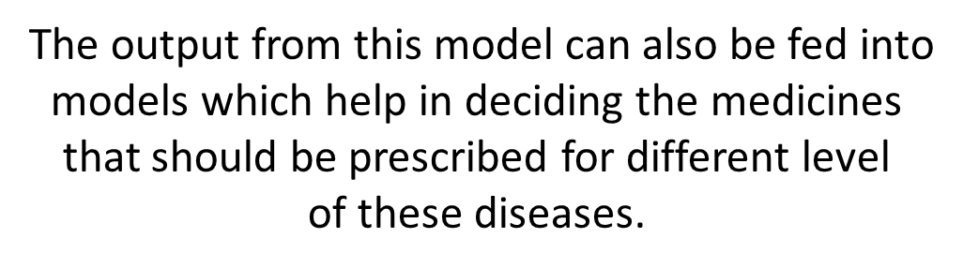
Looking back
What’s NEXT
Challenges
Understanding neural networks
Use of ML modules such as Keras
Configuring the model to prevent overfitting
What we learned
.
Accomplishments
Developed a model which not only had accuracy for data it was trained on, but also predicted the classes accurately for validation as well as the test set.

Slide 14
Thank you

