Slide 1
Group 1: Zip-Codes & House Price Index
Issues & Research Questions:
Explore relationships between house prices and economic & geographic factors (schools & green spaces)
Introduction to the Datasets:
Redfin home price history
Federal Reserve housing market & macro economics
Geographic information APIs (green space, school, etc.)
Normalized price explanation, HPI explanation

Slide 2
Methodology
Project broken into 3 major steps. Each analysis has it’s own Jupyter Notebook.
Data gathering
Data cleaning
Data analysis & reporting
API
Datasets
Aggregating code
Cleaning code
Cleaned datasets
Analysis Notebook
Analysis Notebook
Analysis Notebook
Analysis Notebook
Analysis Notebook

Slide 3
Analytics: 1
Method:
X
Key Findings:
x

Slide 4
Analytics: 1 (charts)

Slide 9
Further Research Opportunities

Slide 10
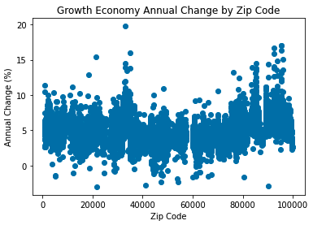
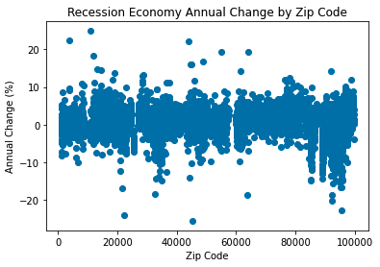
Impact of Recession on Price Growth
Recessions reduce growth (1% nationally vs 5% in non-recession markets)
Some ZIP-codes grew even during recessions

