Slide 1
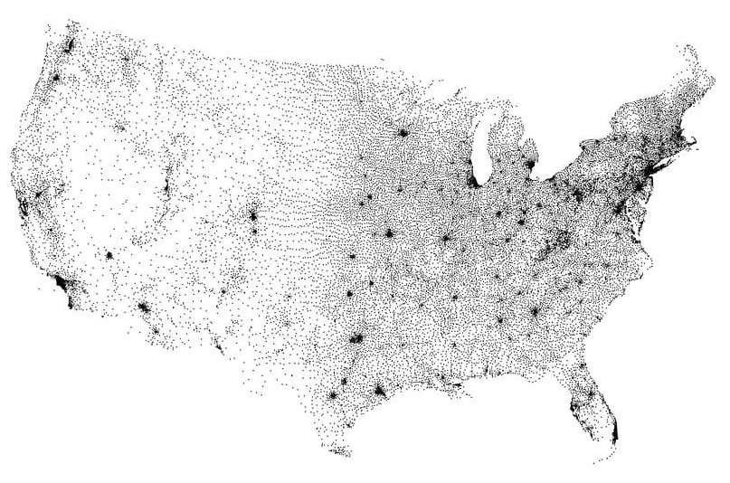
Analytics: 1
Data Characteristics and Considerations:
Years with data ranged 48 years from 1975 to 2022, for exactly 13,000 unique Zip Codes.
Zip Codes do not have specific geographic boundaries - they specify delivery routes from a single postal station. So they can not be easily put onto a map.
Zip codes vary in geographical size and population. In the contiguous 48 states, the largest is in NV at over 10,000 sqr miles. The most populous is in TX with more than 114,000 people. The smallest and least populated is a two-block area in Manhattan with 1,400 people.
Every physical location has a Zip Code, so it can be used to group locations, but geographic considerations (such as proximity to schools) are not cleanly described by the Zip Code number.
Figure ##: Map of Zip Code Tabulation Area (ZTCA) Centroids

Slide 2
Analytics: 1
Method:
Change in HPI from the prior year was computed for each year starting in 1976, for all Zip Codes, and outliers were determined for each year, to identify Zip Codes of high growth and large decline.
Zip Codes with no data for a particular year were dropped, so there are Zip Codes that were included some years but not others.
Change in HPI was computed for periods of 3, 5, 10, and 20 years, as well as the full 48 years, and outliers were determined for each period. There were 126 outliers for the 20-year period, 273 for the 3-year period. The full 48-year period had no outliers.
Results were stored as .csv files that could be utilized by other group members for further analysis.
Further Work:
It would be interesting to cross-check the period outliers lists to separate recent outliers from long-term ones.
Multiple .csv files were used to store the results, but it would be possible to use a single file, so a future improvement would be to update this analysis code to do that, which would require altering the code for later analysis that accesses those files.
Add consideration into the code for periods with no mathematically outliers – perhaps top and bottom 5 zip codes.

