Slide 1
Team 1 Project 1
Mary O., Sydney, Craig, Galen

Slide 2
Introduction
Project, Methodology

Slide 3
Zip-Codes & House Price Index
Issues & Research Questions:
Explore relationships between house prices and economic & geographic factors (schools & green spaces)
Introduction to the Datasets:
Redfin home price history
Federal Reserve housing market & macro economics
Geographic information APIs (green space, school, etc.)
Housing data:
Sales per year per ZIP
Single-family only
Weighted mean prices across types
Created single unified House Price Index (HPI) anchored to 2012
Economic data:
Recessions: flagged each year
Federal funds rate (drives mortgage rates)
Geographic information:
Centroid of ZIP -> Lat, Lon
Distance to schools

Slide 4
Methodology
Data gathering
Data cleaning
Data analysis & reporting
API
Datasets
Aggregating code
Cleaning code
Cleaned datasets
Analysis Notebook
Analysis Notebook
Analysis Notebook
Analysis Notebook
Analysis Notebook

Slide 5
Our Data
Descriptions, limitations, etc.

Slide 6
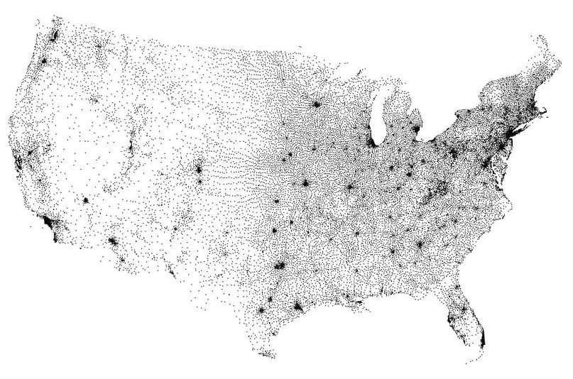
Our Data: Historical ZIP Codes
Characteristics and Considerations:
48 years: 1975 to 2022.
13,000 unique Zip Codes.
Zip Codes do not have specific geographic boundaries - ZCTAs are roughly analogous.
Zip codes vary greatly in geographical size and population.
Geographic considerations are not cleanly described by the Zip Code number.
Figure ##: Map of Zip Code Tabulation Area (ZTCA) Centroids

Slide 7
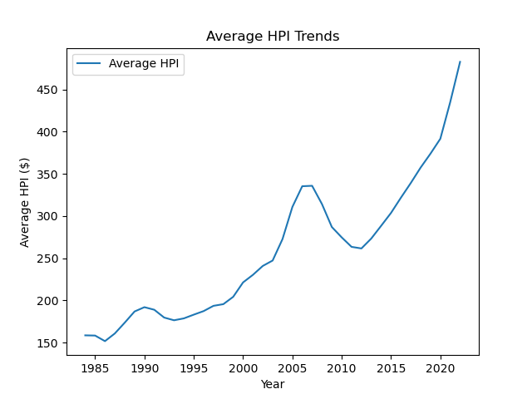
Our Data: Cleaning & Aggregation
Method:
Change in HPI from the prior year was computed to determine outliers.
Zip Codes with no data for a particular year were dropped.
Outliers were determined for five longer periods.
Results were stored as .csv files that could be utilized by other group members for further analysis.
Figure ##:

Slide 8
Executive Summary
Key Findings:
xyz
Selected Areas of Interest:
Abc
Def
ghi

Slide 9
House Price Index (HPI) Geography
Regions of interest & outliers

Slide 10
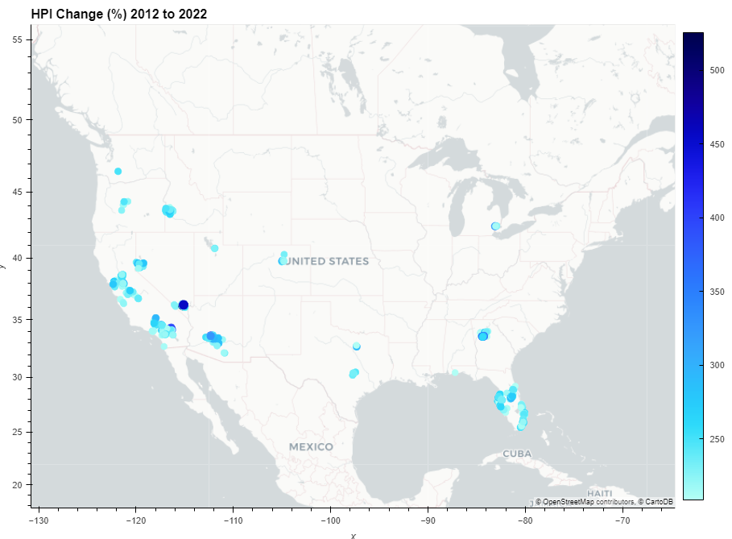
Figure ##:
Boise
Bend
Reno
Denver
Sacramento and Bay Area
Las Vegas
Atlanta
Phoenix
Dallas
San Bernardino
Austin
All of Florida

Slide 11
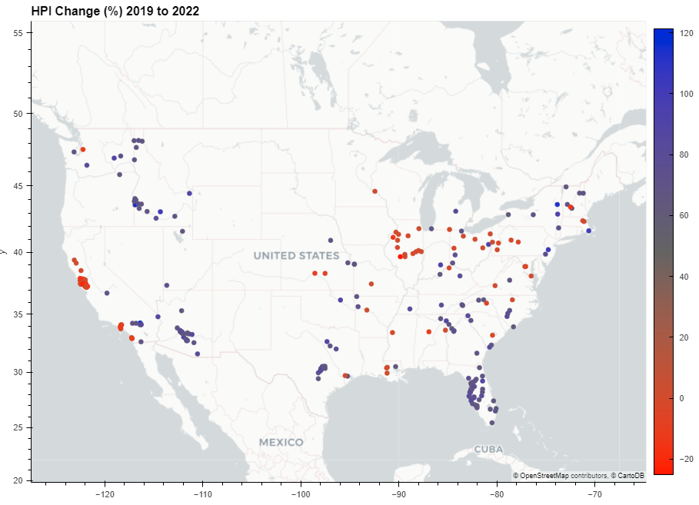
Figure ##:
Spokane Area
New England minus Boston
Boise
Rust Belt
Kansas City
Sacramento and Bay Area
Cincinnati
Tulsa
Tennessee, North Carolina
Phoenix
Phoenix
Los Angeles San Diego
Dallas
Atlanta
San Bernardino
All of Florida
Especially Gulf Side
Austin
Tampa

Slide 12
HPI Geography Discussion
Findings:
There are clear regions of the country where HPI declines
Surprisingly, California shows potential weakness in the housing market
Further Work:
It would be interesting to cross-check the period outliers lists to separate one-hit-wonder outliers from stable ones, if any.
It would be possible to use a single file to store all the data, using tags.
Periods with no mathematical outliers – perhaps top and bottom 5%.

Slide 13
HPI: West, Central, East US
ZIP Code & Regional Comparisons

Slide 14
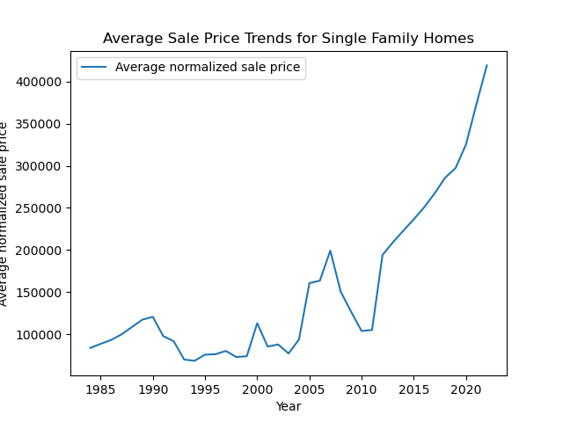
Overall US Housing Prices & HPI Trends over Time
~3x HPI increase since 1985, with 6x sale prices

Slide 15
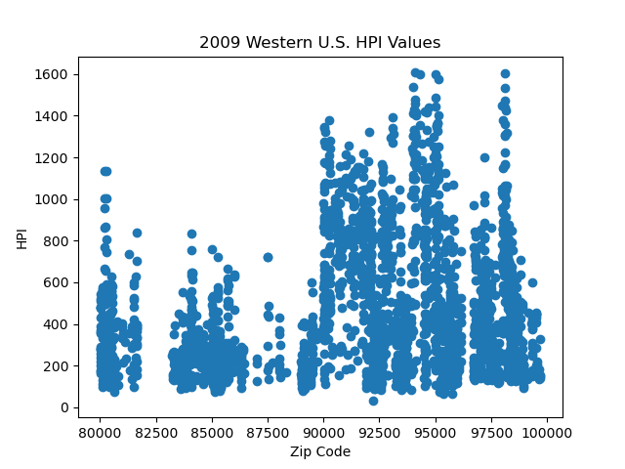
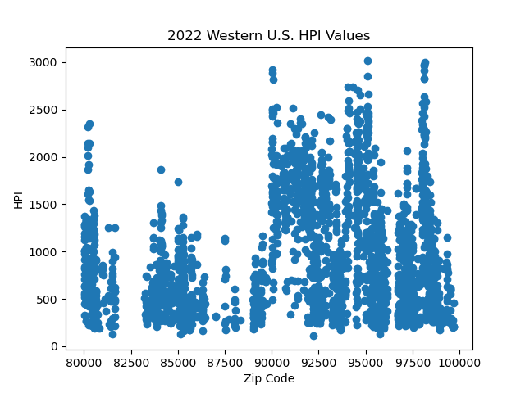
Western US: 2009-2022
Western U.S. zip code data includes WA, OR, CA, ID, UT, NV, AZ, NM, CO, & WY

Slide 16
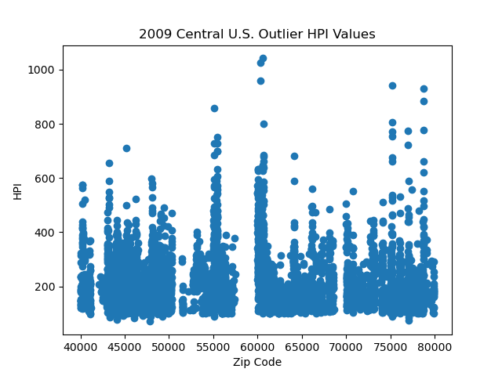
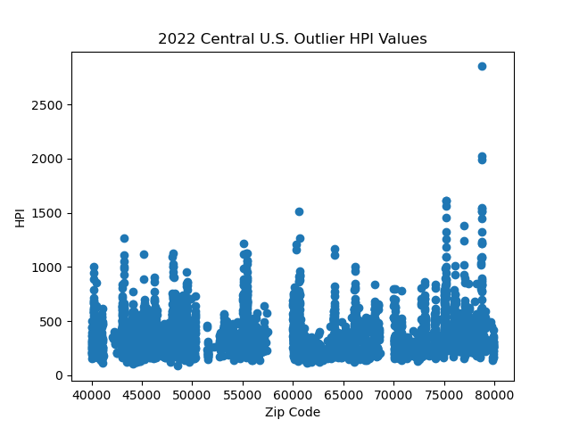
Central US: 2009-2022
Central U.S. zip code data includes MT, ND, SD, NE, WI, MN, IA, KS, OK, TX, LA, AR, MO, IL, IN, MI, OH, and KY

Slide 17
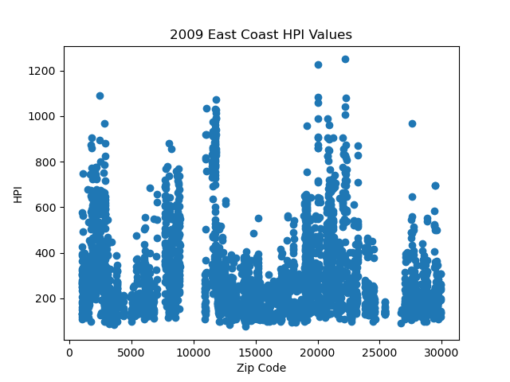
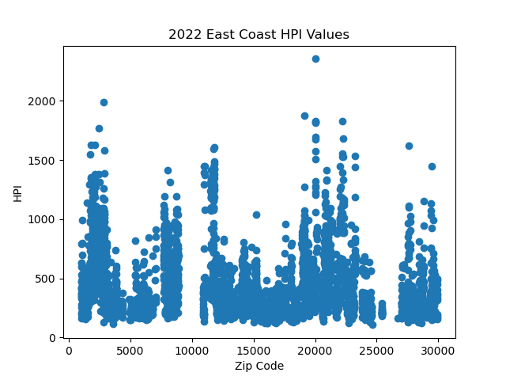
Eastern US: 2009-2022
Eastern U.S. zip code data includes ME, NH, VT, MA, CN, RI, NJ, NY, PN, MD, DC, WV, VI, NC, AND SC

Slide 18
US Regional Variation Discussion
Findings:
x
Further Work:
x

Slide 19
HPI & Macroeconomy
Impact of Recessions on HPI changes

Slide 20
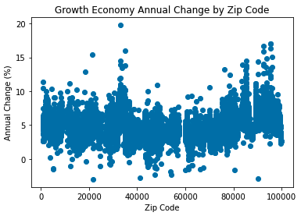
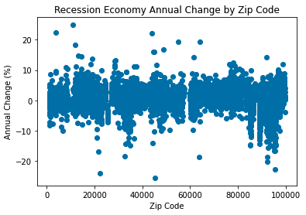
Economic Climate: Impact of Recessions on Prices
Recessions reduce growth (1.1% vs 5.0% in non-recession markets)
Some ZIP-codes grew even during recessions

Slide 21
Economic Climate: Outliers
Recession resistance: upper outliers that grew the most during recession years
Declining spaces: lower outliers that lost the most during non-recession years
Our data did not have values for all years; the growth side outliers are less meaningful
ZIP | Mean of Observed Annual Change (%)
10922 | 24.92 | Ft. Montgomery, NY
03846 | 22.39 | Jackson, NH
43840 | 22.27 | Stone Creek, OH
55087 | 19.28 | Warsaw, MN
64167 | 19.26 | Kansas City, MO
11930 | 18.28 | Amagansett, NY
48885 | 16.88 | Sidney, MI
44867 | 16.09 | Walnut Creek, OH
44454 | 16.07 | Petersburg, OH
13204 | 14.63 | Syracuse, NY
ZIP | Mean of Observed Annual Change (%)
21665 | -2.99 | Sherwood, MD
90212 | -2.93 | Beverley Hills, CA
41002 | -2.76 | Augusta, KY
54232 | -2.31 | St. Nazianz, WI
47456 | -2.28 | Quincy, ID
53937 | -1.86 | Hillpoint, WI
60029 | -1.65 | Gold, IL
80428 | -1.62 | Clark, CO
05261 | -1.49 | Pownal, VT
66075 | -1.48 | Pleasanton, KS
Year | Annual Change (%) | HPI
1993 | -18.24 | 81.76
1994 | -18.17 | 66.91
1999 | -8.16 | 96.77
2002 | -2.09 | 124.54
2003 | 12.78 | 140.45
2004 | 1.75 | 142.91
2005 | 10.72 | 158.23
2010 | -9.63 | 178.67
2011 | -4.78 | 170.13
2012 | 6.5 | 181.18
Missing years may limit usefulness of the data
Recession Resistance
Declining Spaces

Slide 22
Economic Climate Discussion
Findings
Recession years reduced avg growth from 5% to 1% nationally
Some ZIP codes appeared to grow every year regardless of overall trends
Missing years of data made the impact analysis difficult on a per-ZIP level, but overall trends were still visible
Further Work
More complete data would give a better picture of local-level sensitivity to the larger economy
Adding additional information, if available, such as local population changes and construction activity, could help explain local changes
A housing index prediction model could be built to test the sensitivity of any ZIP-code to factors that we have investigated:

Slide 23
Thank You

