Slide 1
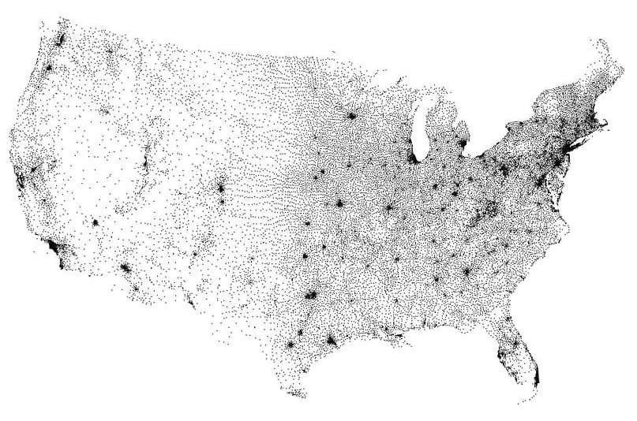
Analytics: 1
Data Characteristics and Considerations:
Years with data ranged 48 years from 1975 to 2022, for exactly 13,000 unique Zip Codes.
Zip Codes do not have specific geographic boundaries - they specify delivery routes from a single postal station. So they can not be easily put onto a map.
Zip codes vary in geographical size and population. In the contiguous 48 states, the largest is in NV at over 10,000 sqr miles. The most populous is in TX with more than 114,000 people. The smallest and least populated is a two-block area in Manhattan with 1,400 people.
Every physical location has a Zip Code, so it can be used to group locations, but geographic considerations (such as proximity to schools) are not cleanly described by the Zip Code number.
Figure ##: Map of Zip Code Tabulation Area (ZTCA) Centroids

Slide 2
Analytics: 1
Method:
Change in HPI from the prior year was computed for each year starting in 1976, for all Zip Codes, and outliers were determined for each year, to identify Zip Codes of high growth and large decline.
Zip Codes with no data for a particular year were dropped, so there are Zip Codes that were included some years but not others.
Change in HPI was computed for periods of 3, 5, 10, and 20 years, as well as the full 48 years, and outliers were determined for each period. There were 126 outliers for the 20-year period, 273 for the 3-year period. The full 48-year period had no outliers.
Results were stored as .csv files that could be utilized by other group members for further analysis.
Further Work:
It would be interesting to cross-check the period outliers lists to separate one-hit-wonder outliers from stable ones, if any.
Multiple .csv files were used to store the results, but it would be possible to use a single file, so a future improvement would be to update this analysis code to do that, which would require altering the code for later analysis that accesses those files.
Add consideration into the code for periods with no mathematically outliers – perhaps top and bottom 5 zip codes.

Slide 3
Analytics: 1
Method:
Change in HPI from the prior year was computed for each year starting in 1976, for all Zip Codes, and outliers were determined for each year, to identify Zip Codes of high growth and large decline. The overall trend is up over time, with the major exception of the housing crash in 2008.
Zip Codes with no data for a particular year were dropped, so there are Zip Codes that were included some years but not others.
Change in HPI was computed for periods of 3, 5, 10, and 20 years, as well as the full 48 years, and outliers were determined for each period. There were 126 outliers for the 20-year period, 273 for the 3-year period. The full 48-year period had no outliers.
Results were stored as .csv files that could be utilized by other group members for further analysis.
2012-2022 Outliers Map:
Major standouts from this period are Las Vegas and San Bernadino (inland from Los Angeles), Phoenix, Atlanta, and include other major population areas, seemingly most of Florida, and also Bend, Oregon.

Slide 4
Analytics: 1
2019-2022 Outliers Map:
Areas from the 10-year list still present include Phoenix, Boise, major cities/areas in Texas and Florida, and the Atlanta area. Dropouts include Bend and Denver.
The Bay Area and Sacramento region have started to decline recently (from having been on the 10-year growth list). Southern California is marked by decline on the coasts (LA and San Diego), while San Bernardino continues to grow in value. It would be interesting to study why that’s happening – maybe it’s younger people moving east to find affordable housing?
The Rust Belt is declining, with Cincinnati trying to hold out, while the Atlanta/Tennessee/North Carolina region is growing.
New England (including New York state and New Jersey) are growing, with the notable exception of Boston.
There’s a corridor of growth between Kansas City and Austin through Tulsa, OK and Dallas.
There’s a new area of growth around Spokane, WA area.

Slide 5
Analytics: 1
Further Work:
It would be interesting to cross-check the period outliers lists to separate one-hit-wonder outliers from stable ones more carefully, so a real estate investor could mix stable investments with more volatile ones.
Multiple .csv files were used to store the results, but it would be possible to use a single file, or greatly reduce the number of them, since most of our data is keyed to Zip Code. This would be a major change that would require altering all the code for later analysis that accesses those data, so the change wasn’t made to stay on track for the deadline.
Add consideration into the code for periods with no mathematical outliers – perhaps top and bottom 5 Zip Codes, or top and bottom 5%.

