Slide 1
Zip-Codes & House Price Index
Issues & Research Questions:
Explore relationships between house prices and economic & geographic factors (schools & green spaces)
Introduction to the Datasets:
Redfin home price history
Federal Reserve housing market & macro economics
Geographic information APIs (green space, school, etc.)
Housing data:
Sales per year per ZIP
Single-family only
Weighted mean prices across types
Created single unified House Price Index (HPI) anchored to 2012
Economic data:
Recessions: flagged each year
Federal funds rate (drives mortgage rates)
Geographic information:
Centroid of ZIP -> Lat, Lon
Distance to schools

Slide 2
Methodology
Three major steps, one Notebook per analysis.
Data gathering
Data cleaning
Data analysis & reporting
API
Datasets
Aggregating code
Cleaning code
Cleaned datasets
Analysis Notebook
Analysis Notebook
Analysis Notebook
Analysis Notebook
Analysis Notebook

Slide 3
Findings
Key Findings:
xyz
Selected Areas of Interest:
Abc
Def
ghi

Slide 4
Analytics: 1
Method:
X
Key Findings:
x

Slide 5
Analytics: 1 (charts)

Slide 10
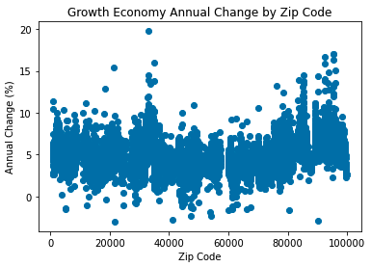
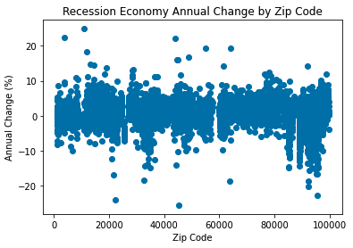
Economic Climate: Impact of Recessions on Prices
Recessions reduce growth (1.1% vs 5.0% in non-recession markets)
Some ZIP-codes grew even during recessions

Slide 11
Economic Climate: Outliers
Recession resistance: upper outliers that grew the most during recession years
Declining spaces: lower outliers that lost the most during non-recession years
Our data did not have values for all years; the growth side outliers are less meaningful
ZIP | Mean of Observed Annual Change (%)
10922 | 24.92 | Ft. Montgomery, NY
03846 | 22.39 | Jackson, NH
43840 | 22.27 | Stone Creek, OH
55087 | 19.28 | Warsaw, MN
64167 | 19.26 | Kansas City, MO
11930 | 18.28 | Amagansett, NY
48885 | 16.88 | Sidney, MI
44867 | 16.09 | Walnut Creek, OH
44454 | 16.07 | Petersburg, OH
13204 | 14.63 | Syracuse, NY
ZIP | Mean of Observed Annual Change (%)
21665 | -2.99 | Sherwood, MD
90212 | -2.93 | Beverley Hills, CA
41002 | -2.76 | Augusta, KY
54232 | -2.31 | St. Nazianz, WI
47456 | -2.28 | Quincy, ID
53937 | -1.86 | Hillpoint, WI
60029 | -1.65 | Gold, IL
80428 | -1.62 | Clark, CO
05261 | -1.49 | Pownal, VT
66075 | -1.48 | Pleasanton, KS
Year | Annual Change (%) | HPI
1993 | -18.24 | 81.76
1994 | -18.17 | 66.91
1999 | -8.16 | 96.77
2002 | -2.09 | 124.54
2003 | 12.78 | 140.45
2004 | 1.75 | 142.91
2005 | 10.72 | 158.23
2010 | -9.63 | 178.67
2011 | -4.78 | 170.13
2012 | 6.5 | 181.18
Missing years may limit usefulness of the data
Recession Resistance
Declining Spaces

Slide 12
Further Research Opportunities

