Slide 1
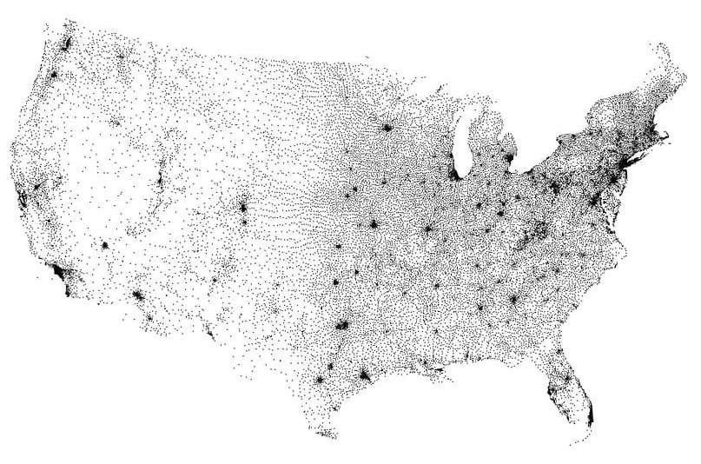
Analytics: 1
Data Characteristics and Considerations:
48 years: 1975 to 2022.
13,000 unique Zip Codes.
Zip Codes do not have specific geographic boundaries - ZCTAs are roughly analogous.
Zip codes vary greatly in geographical size and population.
Geographic considerations are not cleanly described by the Zip Code number.
Figure ##: Map of Zip Code Tabulation Area (ZTCA) Centroids

Slide 2
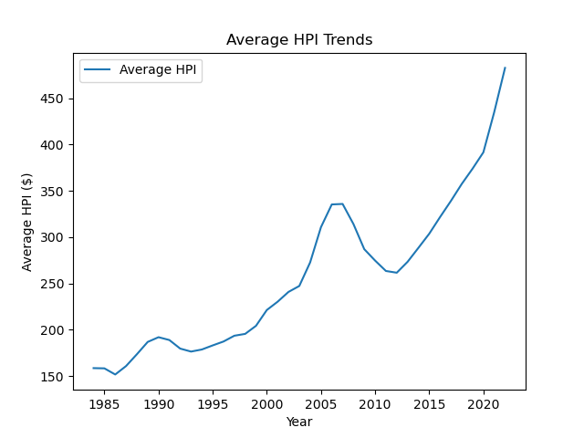
Analytics: 1
Method:
Change in HPI from the prior year was computed to determine outliers.
Zip Codes with no data for a particular year were dropped.
Outliers were determined for five longer periods.
Results were stored as .csv files that could be utilized by other group members for further analysis.
Figure ##:

Slide 3
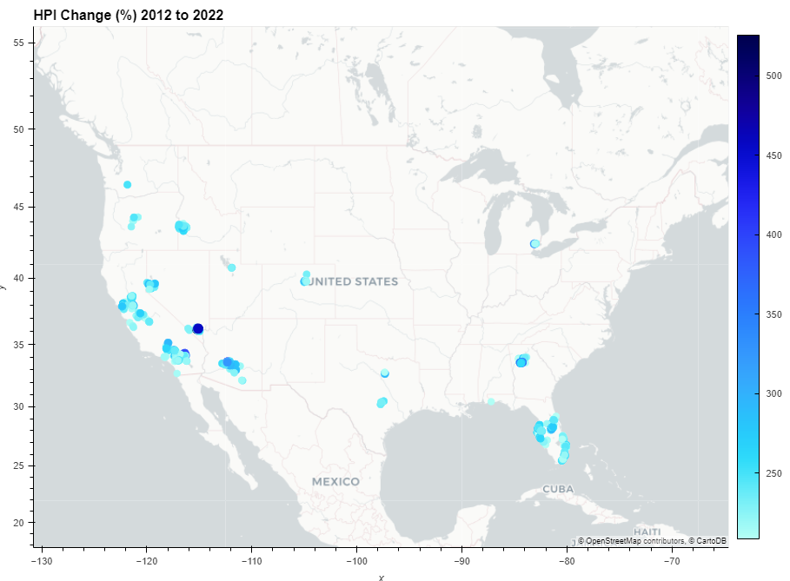
Figure ##:
Boise
Bend
Reno
Denver
Sacramento and Bay Area
Las Vegas
Atlanta
Phoenix
Dallas
San Bernardino
Austin
All of Florida

Slide 4
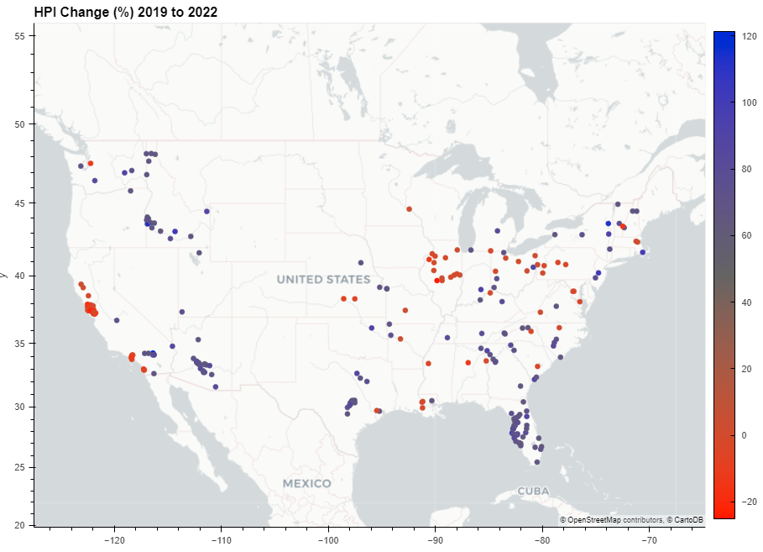
Figure ##:
Spokane Area
New England minus Boston
Boise
Rust Belt
Kansas City
Sacramento and Bay Area
Cincinnati
Tulsa
Tennessee, North Carolina
Phoenix
Phoenix
Los Angeles San Diego
Dallas
Atlanta
San Bernardino
All of Florida
Especially Gulf Side
Austin
Tampa

Slide 5
Analytics: 1
Further Work:
It would be interesting to cross-check the period outliers lists to separate one-hit-wonder outliers from stable ones, if any.
It would be possible to use a single file to store all the data, using tags.
Periods with no mathematical outliers – perhaps top and bottom 5%.

