Slide 1
Project 3
Team 1:
Michael
Montana
Robert
Galen

Slide 2
Objective & Methods
Speaker: ?
What:
Compare stock price data from top 100 companies
Metrics:
X
Y
z
How:
Use yFinance to get data from Yahoo Finance API; store in MySQL db on AWS; access via API
Flask app does…
Visualizations prompt user input to compare two stocks through metrics, OHLC (open high low close) charts, and gauge charts

Slide 3
Design
Speaker: ?
Tech Used:
Python
JavaScript
HTML
MySQL
Flask
Docker
Services & Tools:
Github
AWS
MySQL Workbench
Repository
Yahoo Finance
GitHub Pages
GitHub Files
API
Scrapers (Py)
AWS
File store (CSV/JSON)
MySQL db
(RDS)
Query (Python)
(Lambda)
xyz
API
(API Gateway)

Slide 4
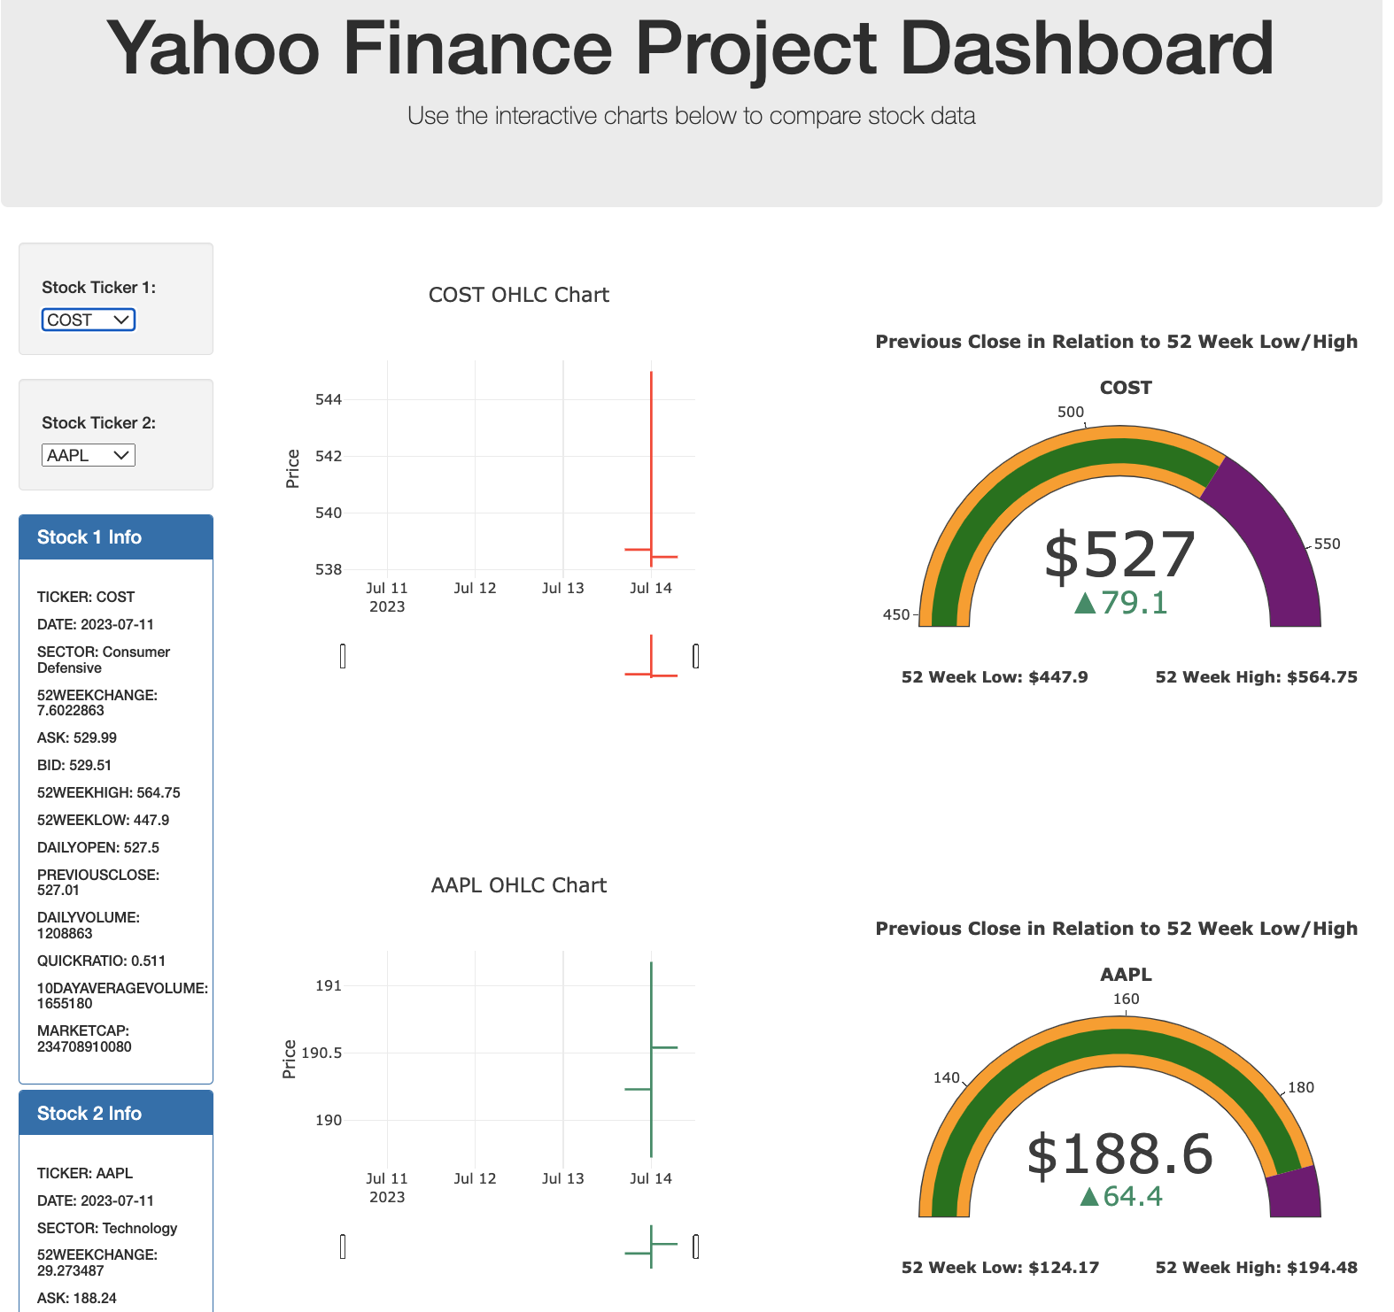
Demo
Speaker: Montana
See what we built

Slide 5
Challenges
Speaker: ?
Data:
…
Tech:
…
Services:
CORS on AWS API Gateway
Yahoo broke yFinance

