Slide 1
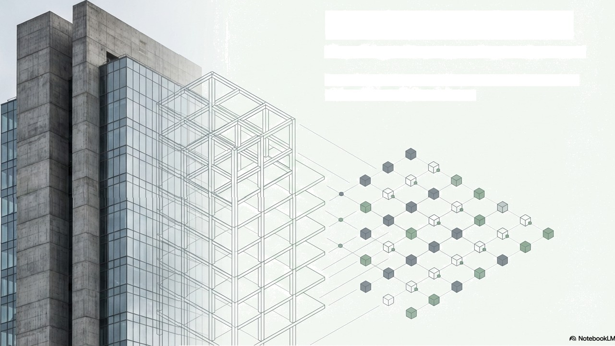
Liquid Real Estate
The Solana Fractionalization Protocol
Transforming the world‘s largest asset class into high-velocity digital liquidity.

Slide 2
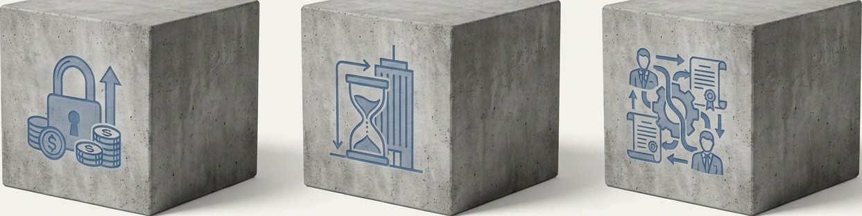
The $330 Trillion Illiquidity Problem
Exclusionary Capital Trapped Value
Opaque Intermediaries
Premium commercial investments require $500,000+ minimums, locking out retail and mid-tier participants.
Severe illiquidity. The average commercial real estate exit takes 6+ months to settle in static structures.
Heavy operational friction. Brokers, lawyers, and legacy escrow systems erode yields and obscure real-time valuation.
G NotebookLM

Slide 3
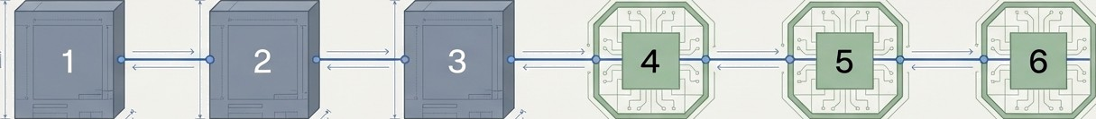
The Asset-to-Liquidity Pipeline
Physical Layer | Legal Layer | Asset Layer | Escrow Layer | Fractional Layer | Liquidity Layer
Physical Deed | Legal SPV holds | Master NFT minted | PDA Vault smart | SPL Tokens minted | DEX Trading opens
undergoes legal | the title, ensuring | as a single, immutable | contract securely | as thousands of | global 24/7
audit and valuation. | bankruptcy remoteness. | digital record. | locks the NFT. | fractional shares. | automated markets.

Slide 4
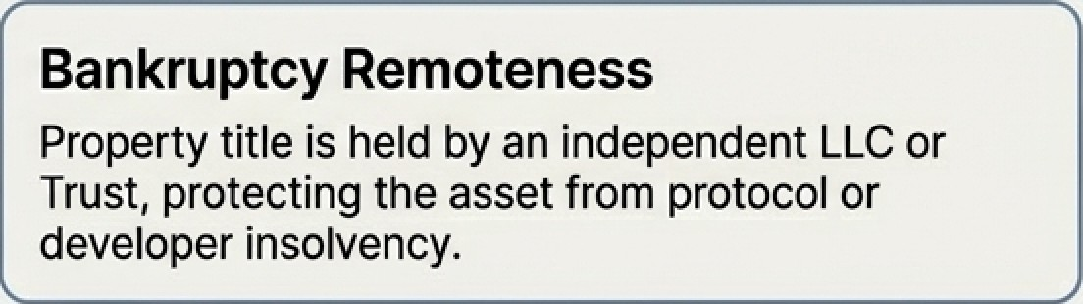
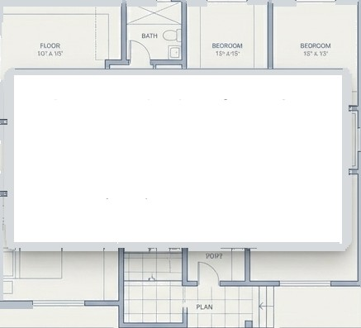
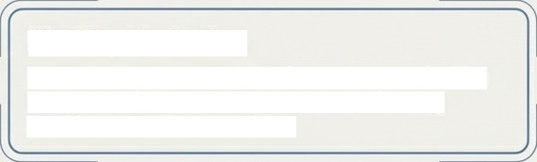
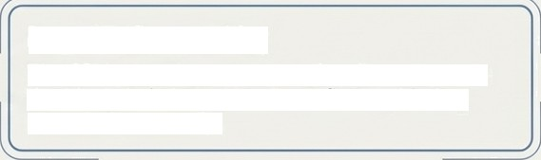
The Legal Wrapper: Bridging Law to Ledger
Bankruptcy Remoteness
Property title is held by an independent LLC or Trust, protecting the asset from protocol or developer insolvency.
Direct tokenization of land titles is restricted by legacy property registries. We bridge this gap
through the Special Purpose Vehicle
(SPV) framework.
Liability Limitation
Token holders are shielded from personal liability beyond their fractional investment, mirroring traditional stock protections.
Legal Enforceability
The SPV operating agreement legally recognizes the blockchain ledger as the definitive, binding record of ownership.

Slide 5
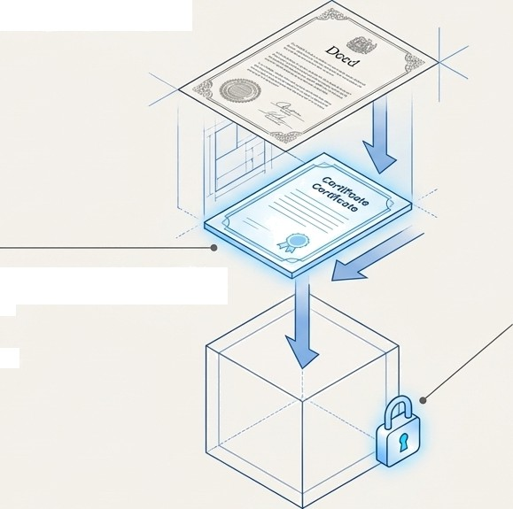
Trustless Escrow:
The PDA Vault Mechanism
The Root Asset
The property is digitized as a i-o - i Master uaition ur i containing IPFS-pinned appraisals, title insurance, and legal agreements.
Master Edition Metaplex NFT
The Lock
The NFT is deposited into a PDA. Because PDAs have no private keys, the asset cannot be moved by human intervention—only by the pre-programmed consensus of the Anchor smart contract.
Program Derived
Address (PDA) Vault

Slide 6
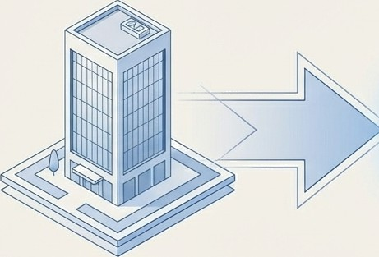
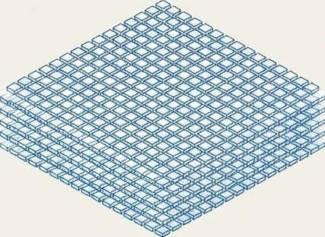
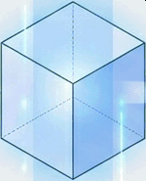

Fractionalization: Democratizing Capital
Smart Contract Minting
Value: $5,000,000
100,000SPLTokens
@ $50 each
Once the Master NFT is cryptographically locked in the PDA Vault, the contract automatically mints a predefined supply of SPL tokens.
These tokens represent a proportional, economic claim on the underlying asset‘s yield and appreciation.
Minimum investment thresholds drop from institutional levels ($500k+) to micro-retail levels ($50).

Slide 7
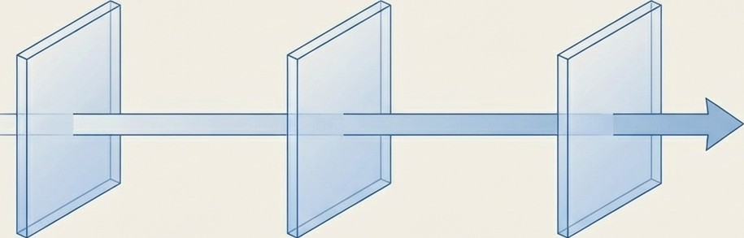


Programmable Compliance via Token-2022
Legacy tokens cannot handle institutional compliance. We utilize Solana's Token-2022 extensions to bake regulatory logic directly into the asset.
Wallet A
Wallet B
Transfer Hooks
Automatically checks
off-chain KYC/AML registries
in real-time before allowing
a transfer.
Default Account State
All new token accounts are initialized as Frozen until the user submits compliance data, at which point the backend executes a Thaw instruction.
Permanent Delegate
An administrative override key allowing the protocol to recover assets in the event of legal court orders or lost private keys.

Slide 8
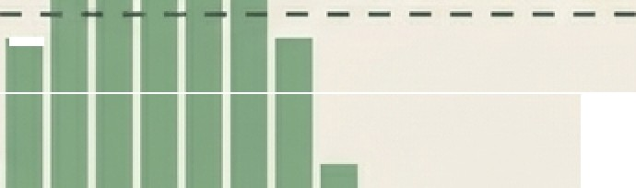
The Liquidity Engine: Why Meteora DLMM?
Discrète Price Bins
Dimension Traditional AMM Meteora DLMM
Liquidity Model
Full-range StZItÏC
Curve
Discrète Price Bins
Dynamic (0.01%—1%) based on volatility
ity Conce
Fee Structure
Fixed 0.25%
Traditional AMM
Capital
Efficiency
Low; capital sits
idle out of range
Ultra-High; captures volume surges effectively
Takeaway: Meteora's dynamic fees compensate Liquidity Providers during high-volatility
price discovery events, making it the perfect
engine for RWA tokens.
!
Current Price Price Range
"
Æ\ Nc•tebookLM

Slide 9
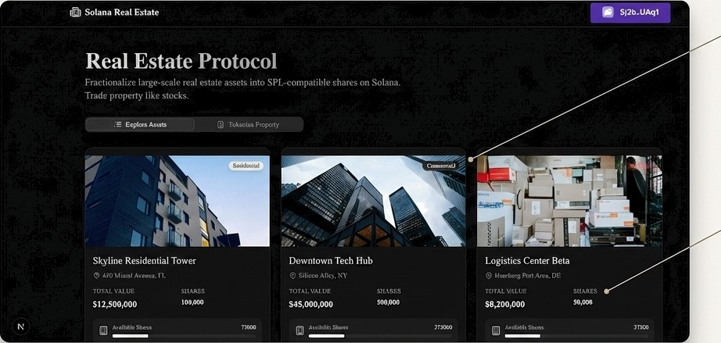
The Front-End:
Trading Property Like Stocks
Curated Premium Assets
Institutional-grade commercial, residential, and industrial properties audited and
pre-vetted.
Micro-Fractionalization
Total property values broken down into highly liquid, SPL- compatible shares accessible to global wallets.

Slide 10







The Yield Waterfall: Automated Dividend Distribution
Tenant pays monthly fiat rent
Conversion
PDA Vault (USDC)
Protocol Admin (1-2v. Fee)
Pyth Network Oracles bridge off-chain
property data to trigger smart contracts.
Smart contract automatically distributes remaining USDC yield pro-rata to all fractional token holders instantly.

Slide 11
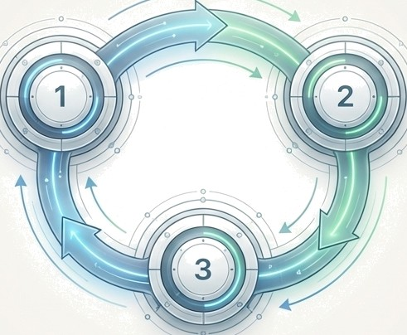
Business Strategy: Multi-Stage Value Capture
Marketplace Trading Fees
0.1% swap fee captured by the protocol on every secondary market transaction moving through the frontend order book.
Origination Fees
1-2% flat fee charged to real estate developers for legal auditing, SPV formation, and minting the asset on-chain.
Yield Administration
1-2% recurring management fee skimmed from generated rental income before USDC distribution to token holders.

Slide 12
The Evolution of Real Estate: Protocol vs. REITs
Traditional REITs
Market Hours (9:30 4:00)
Solana Protocol
Trading Hours
24/7/365 Global Markets
400 Milliseconds Atomic Settlement
Settlement Speeo
T+1 or T+2 Days
Transparency
Quarterly Opaque Reports
Real-time On-chain Verification
Minimum investment
$500+ broker minimums
$50 micro-transactions
Governance
Centralized Fund Managers
Smart Contract & DAO Voting

Slide 13




Target Audience & Global Use Cases
Retail Investors
Real Estate Developers
Accelerated Crowdfunding
Global Portfolio Allocators
Borderless Wealth Protection
Everyday Wealth Generation
Enables retail users to gain exposure to high-yield real estate without requiring massive down-payments, mortgages, or pristine credit scores.
Allows builders to tokenize finished properties for fast capital recuperation, bypassing expensive,
high-interest traditional
bank loans.
Investors in economically volatile regions can instantly protect their wealth by buying fractions of stable, high-yield US/EU real estate via self—custody wallets.

Slide 14

The Solana Imperative: Why Architecture Matters
-4ddms
Finality
Enables instant secondary market trading, eliminating counterparty settlement risk entirely.
d.dd1
Avg Fee
The only way
micro-distributions work. Distributing a $2 monthly rental yield is economically impossible if network gas fees are $5.
65,ddd+
TPS
Institutional-grade throughput capable of handling millions of fractional shares changing hands concurrently without network degradation.

Slide 15
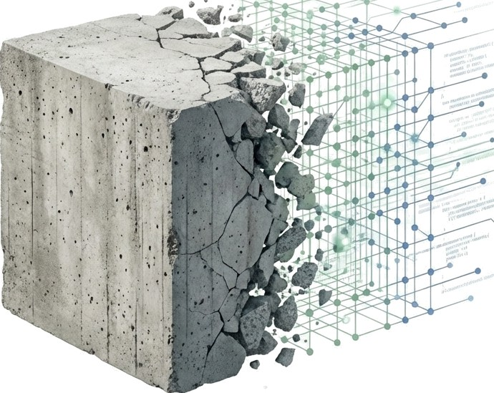
The Internet of Value
Has Arrived
We are bridging the gap between the ultra-stable, income-generating world of physical property and the ultra-ehicient, borderless world of decentralized finance.
$330 Trillion in static, illiquid value is finally moving at the speed of light.

