Slide 1
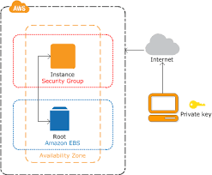
EC2 - Elastic Compute Cloud
EC2 provides scalable computing capacity in the Amazon Web Services (AWS) cloud.
You can use Amazon EC2 to launch as many or as few virtual servers as you need, configure security and networking, and manage storage.

Slide 2
Features of Amazon EC2:
Virtual computing environments, known as instances.
Preconfigured templates for your instances, known as Amazon Machine Images (AMIs), that package the bits you need for your server (including the operating system and additional software)
Various configurations of CPU, memory, storage, and networking capacity for your instances, known as instance types
Secure login information for your instances using key pairs (AWS stores the public key, and you store the private key in a secure place)
Persistent storage volumes for your data using Amazon Elastic Block Store (Amazon EBS), known as Amazon EBS volumes
Multiple physical locations for your resources, such as instances and Amazon EBS volumes, known as regions and Availability Zones
A firewall that enables you to specify the protocols, ports, and source IP ranges that can reach your instances using security groups
Static IPv4 addresses for dynamic cloud computing, known as Elastic IP addresses

Slide 3
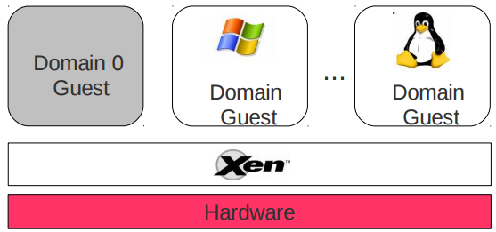
The AWS AMI and the Xen hypervisor:
Every AWS AMI uses the Xen hypervisor on bare metal.
Xen offers two kinds of virtualization:
1. HVM (Hardware Virtual Machine)
2. PV (Paravirtualization).

Slide 4
Para-virtualization used to be the recommended choice, as it gave you better performance (with a much closer integration to the virtualization host, through patched specialized kernels/drivers on both the host and the guest).
Hardware-assisted virtualization uses the benefits provided in modern hardware, and it doesn't require any kind of custom kernel or patches. Recent benchmarks has proven that HVM is actually faster on certain workloads.

Slide 5
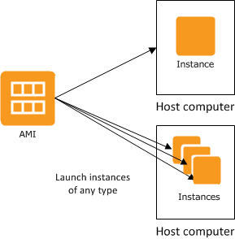
AMIs:
An Amazon Machine Image (AMI) is a template that contains a software configuration (for example, an operating system, an application server, and applications).
You can launch multiple instances of an AMI.

Slide 6
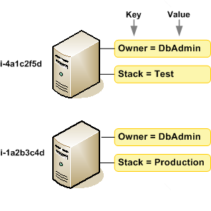
Instance Types:
When you launch an instance, the instance type that you specify determines the hardware of the host computer used for your instance.
Each instance type offers different compute, memory, and storage capabilities
Tagging Your Amazon EC2 Resources:
To help you manage your instances, images, and other Amazon EC2 resources, you can optionally assign your own metadata to each resource in the form of tags.
A tag is a label that you assign to an AWS resource. Each tag consists of a key and an optional value, both of which you define.

Slide 7
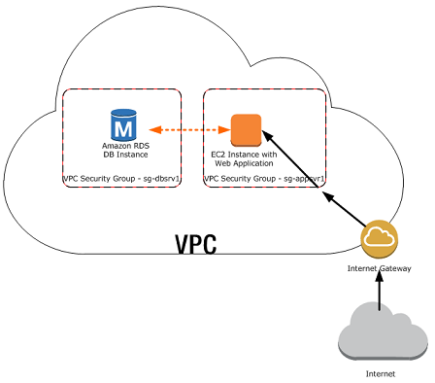
Security Groups:
A security group acts as a virtual firewall that controls the traffic for one or more instances.
When you launch an instance in a VPC, you must specify a security group that's created for that VPC.After you launch an instance, you can change its security groups.
AWS security groups (SGs) are associated with EC2 instances and provide security at the protocol and port access level.
Limited to only 100 security groups per VPC.

Slide 8
AWS Security Groups: rules
By default, security groups allow all outbound traffic.
The actual rule set that filters traffic is made up of two tables: ‘Inbound’ and ‘Outbound’.
AWS Security groups are stateful, meaning you do not need the same rules for both outbound traffic and inbound.
Each rule is comprised of four fields: ‘Type’, ‘Protocol’, ‘Port Range’, and ‘Source’. This applies for both ‘Inbound’ and ‘Outbound’ rules.
Type: The drop down list allows you to select common protocols like SSH, RDP, or HTTP. You can also choose custom protocols.
Protocol: This is typically greyed out, as it’s covered by most ‘Type’ choices. However, if you create a custom rule, you can specify your protocol (TCP/UDP etc.) here.
Port Range: This value will also usually be pre-filled, reflecting the default port or port range for your chosen protocol. However, there might be times when you prefer to use custom ports.
Source: This can be a Network Subnet range, a specific IP address, or another AWS security group. You can also leave access open to the entire Internet using the ‘Anywhere (0.0.0.0/0)’ value.

Slide 9
Elastic IP Addresses:
An Elastic IP address is a static IPv4 address designed for dynamic cloud computing.
An Elastic IP address is associated with your AWS account.
We currently do not support Elastic IP addresses for IPv6.
To use an Elastic IP address, you first allocate one to your account, and then associate it with your instance or a network interface.
By default, all AWS accounts are limited to five (5) Elastic IP addresses per region.

