Slide 1
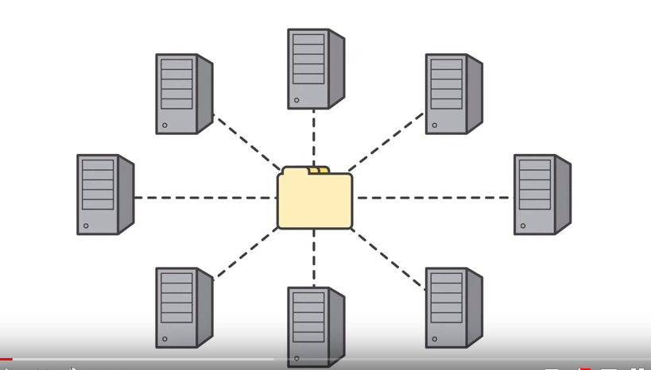
EFS
Amazon EFS provides scalable file storage for use with Amazon EC2.
You can use an EFS file system as a common data source for workloads and applications running on multiple instances.
Lots of application required shared file storage that can be access multiple computers at the same time.
Building own filesystem it takes time and can be very expensive.
EFS is shared filesystem for EC2.
To transfer the data using NFSv4 protocal
It's durable and highly available automatically replicate your data across multiple AZ's in region.
Time consuming storage administration tasks.

Slide 2
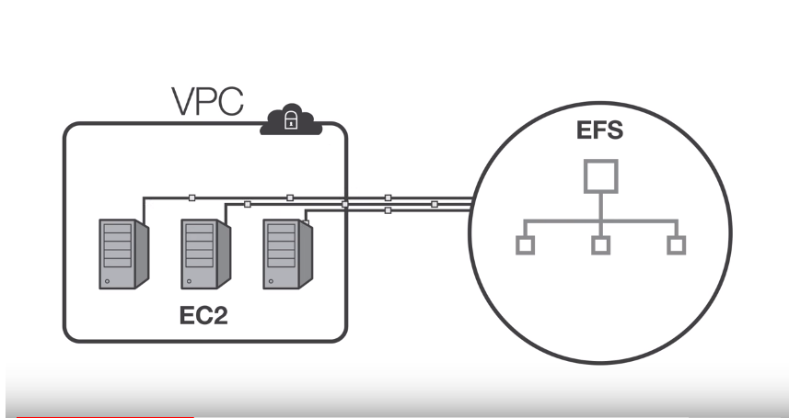
Share across thousands of instances,SSD devices.
File System grow and shrink automatically as you add and remove files.
No need to provision storage capacity or performance.
You pay only for the storage space you use.

Slide 3
Prerequisites:
Create a security group (for example, efs-sg) to associate with the EC2 instances.
Allow inbound NFS connections to the file system via the EFS mount target from the EC2 instances that are associated with this security group.

