Slide 1
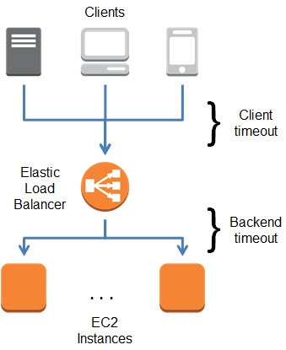
Elastic Load Balancing
ELB nothing but when appication traffic comes ELB receive the traffic it's like one single URL IP and automatically distributed traffic across multiple instance.These instance can be spread across multiple AZ's.
It's more secure your back end instance are not expose to the public.
It takes care of the fault tolerance.
There is Mask in between your ELB public ip will be expose to the public.
Elastic Load Balancing automatically distributes incoming application traffic across multiple targets, such as Amazon EC2 instances, containers, and IP addresses.

Slide 2
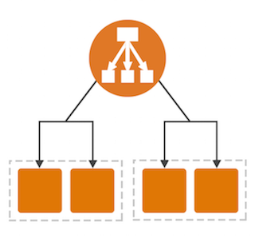
Load Balancer Types:
Application Load Balancer
Network Load Balancer
Classic Load Balancer
Application Load Balancer:
An Application Load Balancer makes routing decisions at the application layer (HTTP/HTTPS), supports path-based routing, and can route requests to one or more ports on each container instance in your cluster.
Any incoming request can go to specific target group.
Application level we are define roles.

Slide 3
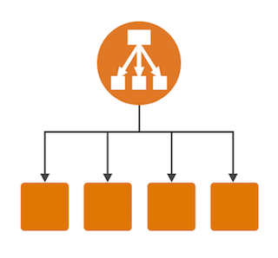
Classic Load Balancer:
A Classic Load Balancer makes routing decisions at either the transport layer (TCP/SSL) or the application layer (HTTP/HTTPS).
Classic Load Balancers currently require a fixed relationship between the load balancer port and the container instance port.
All the instance which are register to the load blancer they would have same contained.

Slide 4
Network Load Balancer:
A Network Load Balancer makes routing decisions at the transport layer (TCP/SSL).
It can handle millions of requests per second.
If extreme performance and static IP is needed for your application.

Slide 5
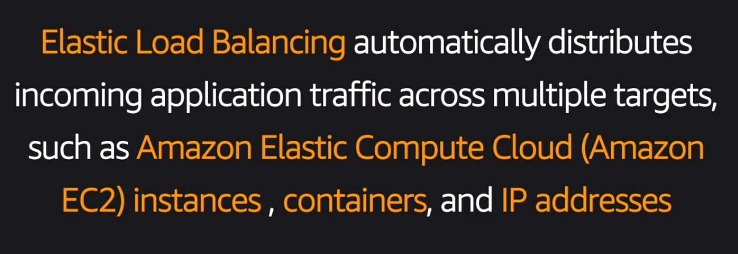

Slide 6
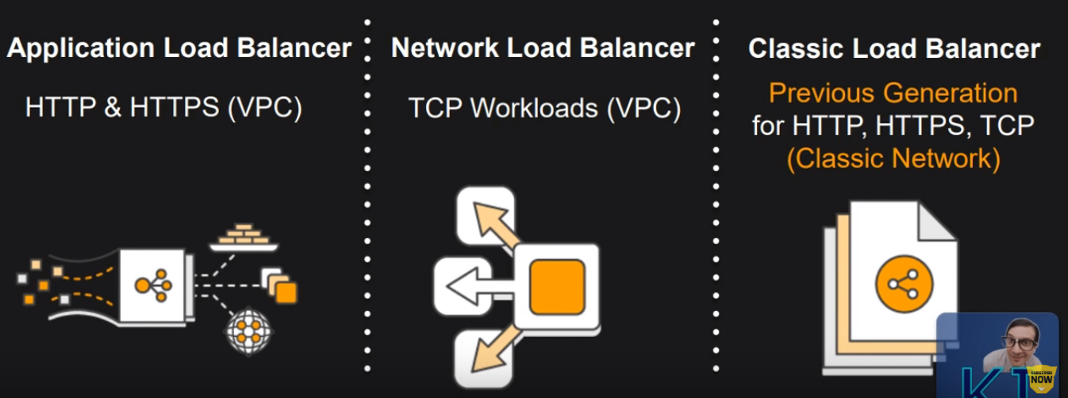

Slide 7
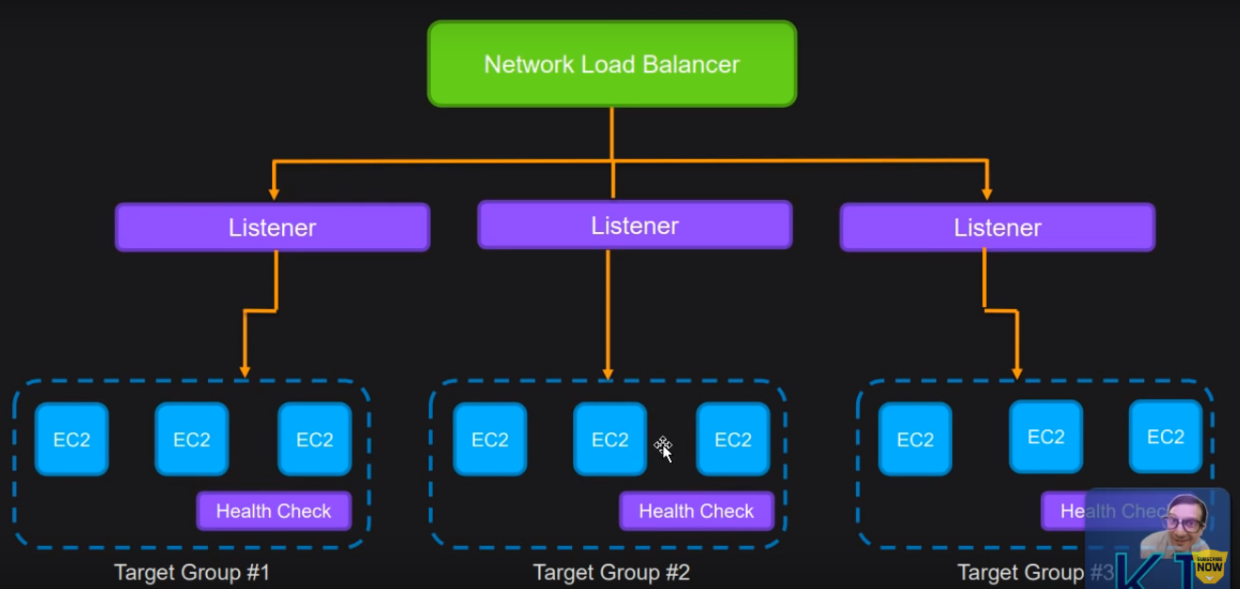

Slide 8
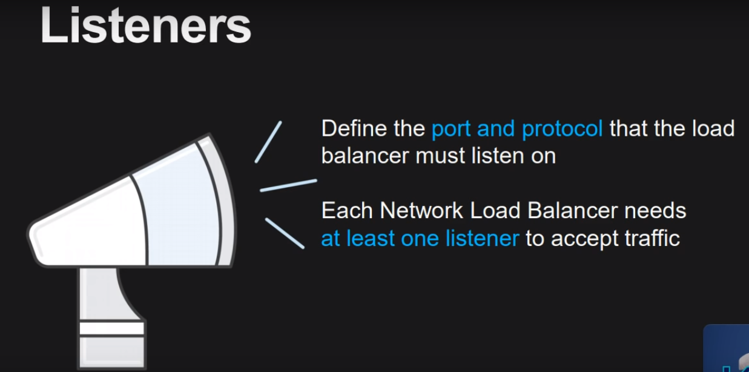

Slide 9
