Slide 1
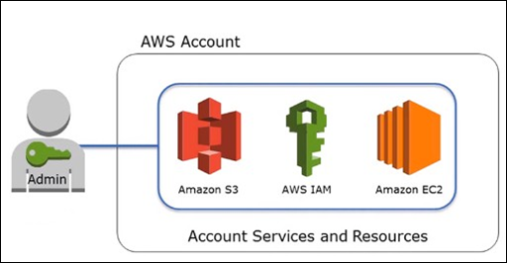
IAM
IAM enables you to securely control access to aws services and resources for users of your AWS account.
You use IAM to control who is authenticated (signed in) and authorized (has permissions) to use resources.
Using IAM you can create and manage AWS users and groups and assign permission to them to allow and deny their access to AWS resouces.

Slide 2
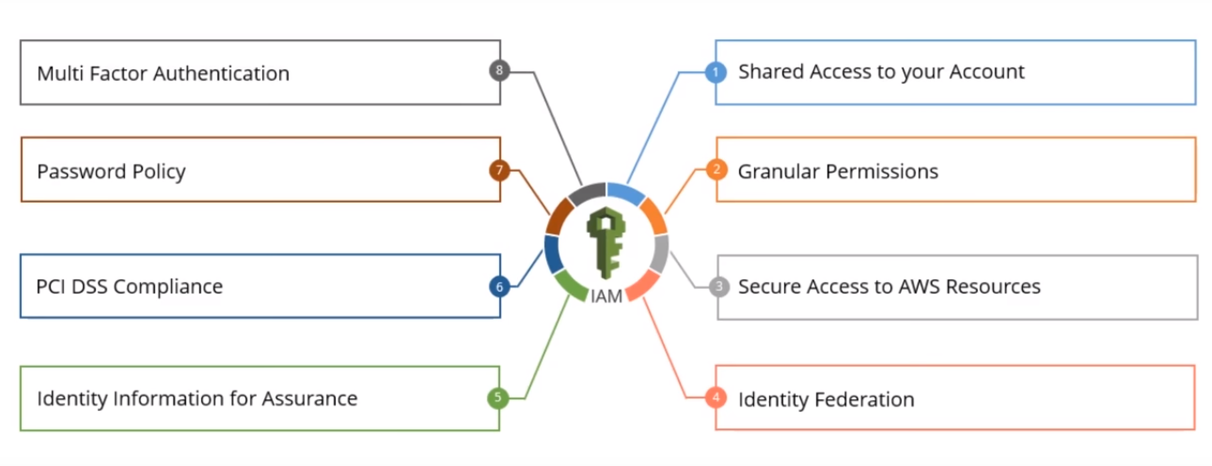
How to manage users:
you can create users in IAM assign them individual security credentials in other words,acces keys,passwords, and multi-factor authentication devices.
Permissions are managed by creating IAM policy statement.
IAM Features:

Slide 3
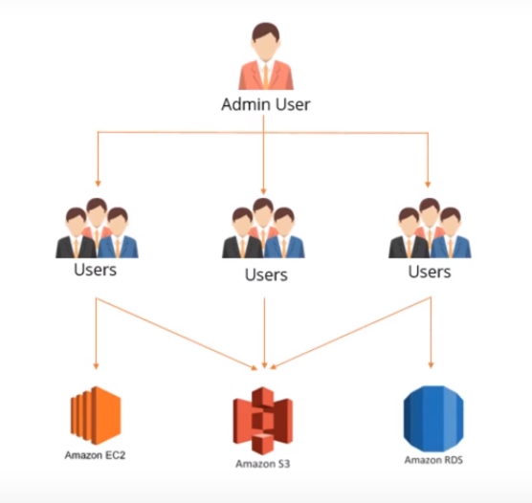
Shared access to your AWS account:
You can grant other people to access and use resources in your AWS account without sharing your password.

Slide 4
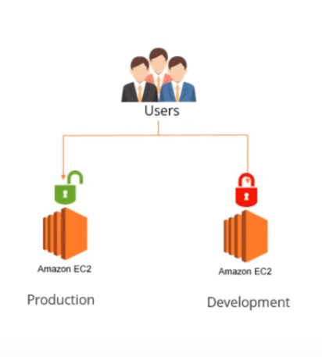
Granular permissions:
You can grant different permissions to different people for different resources.

Slide 5
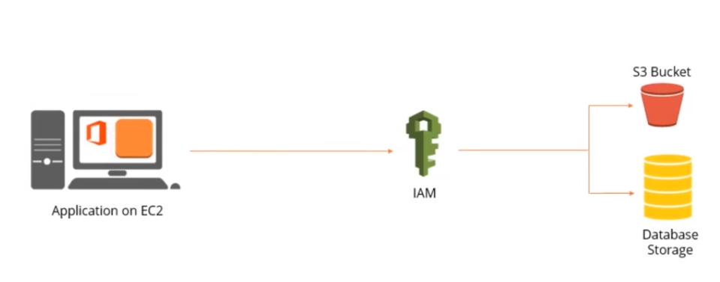
Secure access:
Yon can securely allocate credentials that applications are running on EC2 instance require to access AWS resources.

Slide 6
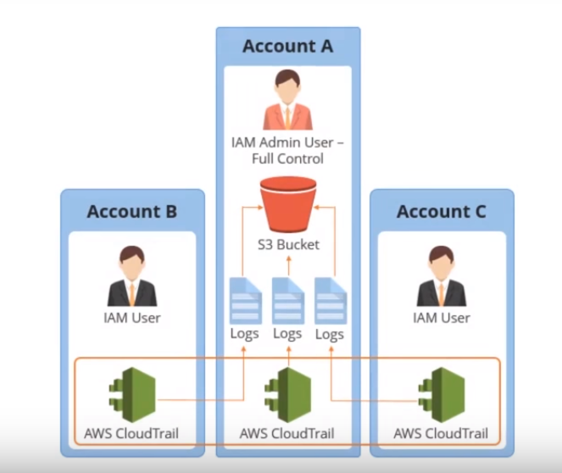
Identity information:
Logs,monitor, and track what users are doing with your AWS resources.

Slide 7
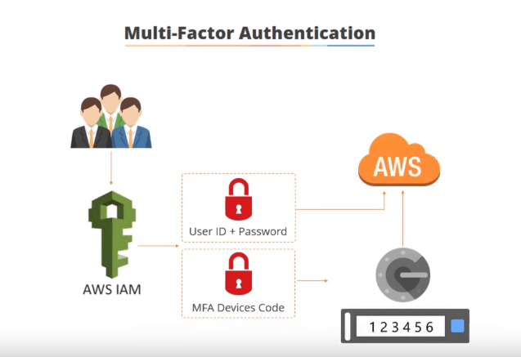
Multi-factor authentication (MFA):
You can add two-factor authentication to your account and to individual users for extra security.
With MFA you or your users must provide not only a password or access key to work with your account, but also a code from a specially configured device.

Slide 8
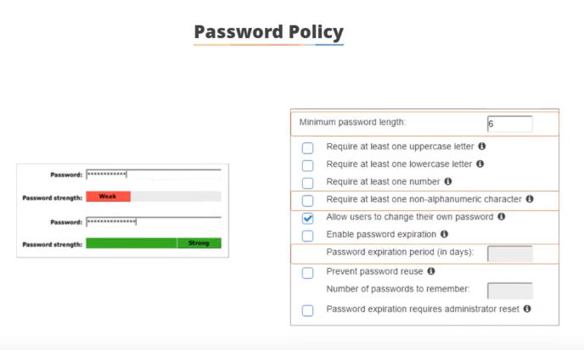
Password Policy:

Slide 9
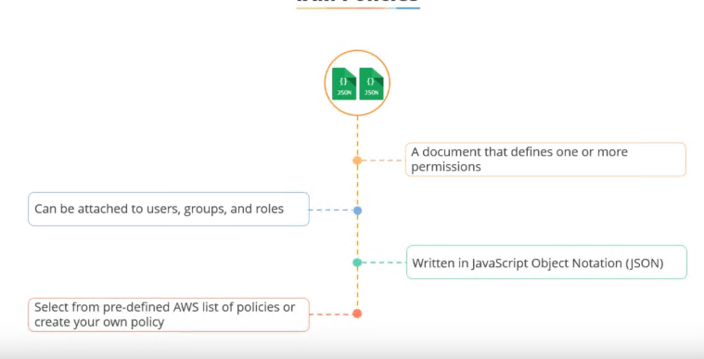
IAM Policies:
It contains permissions to add to the specific users and groups.
IAM requires that policies be in JSON format.

Slide 10
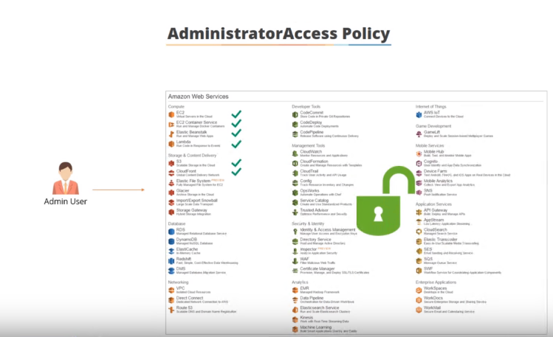

Slide 11
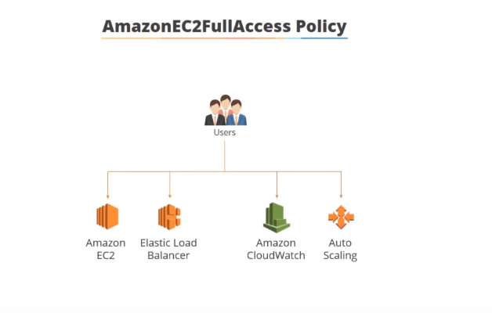

Slide 12
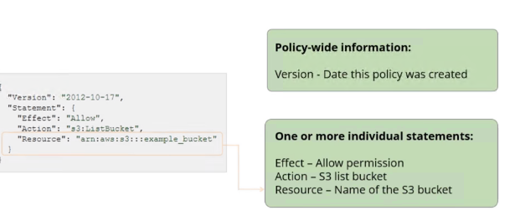
Introduction to JSON Policies:
To assign permissions to a user, group, role, or resource, you create a JSON policy, which is a document that defines permissions.
Effect – whether the policy allows or denies access
Action – the list of actions that are allowed or denied by the policy
Resource – the list of resources on which the actions can occur
Condition (Optional) – the circumstances under which the policy grants permission

Slide 13
Policies are documents that are stored using JSON. A policy consists of one or more statements.
{
"Version": "2012-10-17",
"Statement": {
"Effect": "Allow",
"Action": "s3:ListBucket",
"Resource": "arn:aws:s3:::example_bucket/*"
}
}

Slide 14
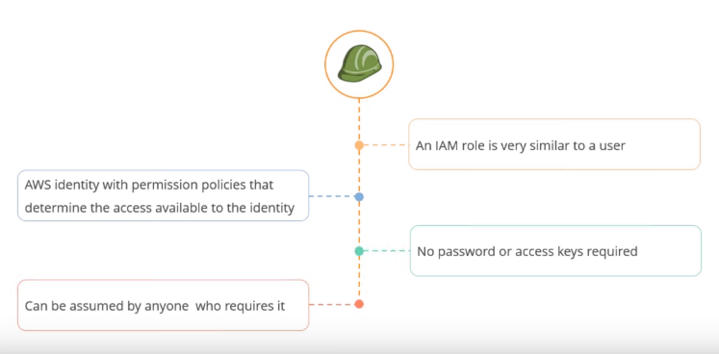
IAM role
An IAM role is similar to a user, in that it is an AWS identity with permission policies that determine what the identity can and cannot do in AWS.
However, instead of being uniquely associated with one person, a role is intended to be assumable by anyone who needs it.
Role is concept of with in a AWS IAM which you can use in-order to permission or authorise particular AWS services to call API's or take actions other AWS services.
IAM roles - Roles are not Permissions !!!. A role is also an authentication method just as IAM users and groups. As an user, a role is also a operator (could be a human, could be a machine). Difference is that credentials with roles are temporary.

Slide 15
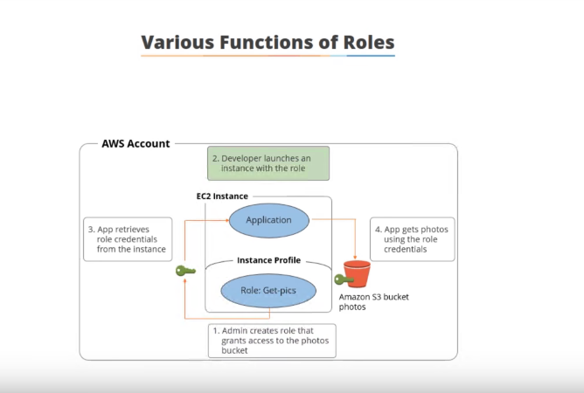

Slide 16
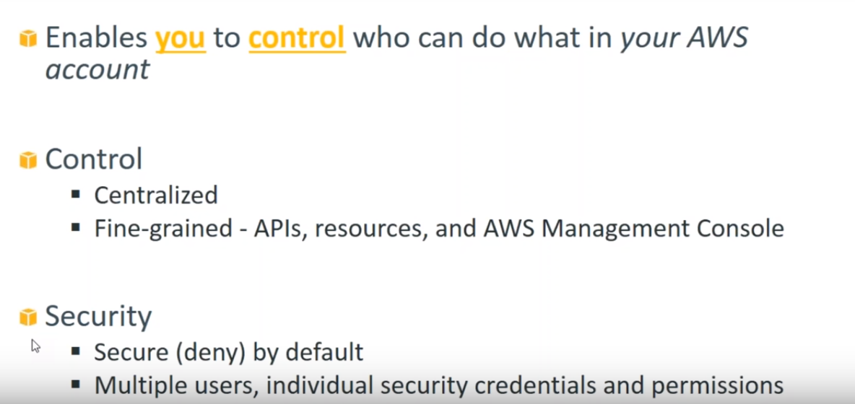

Slide 17
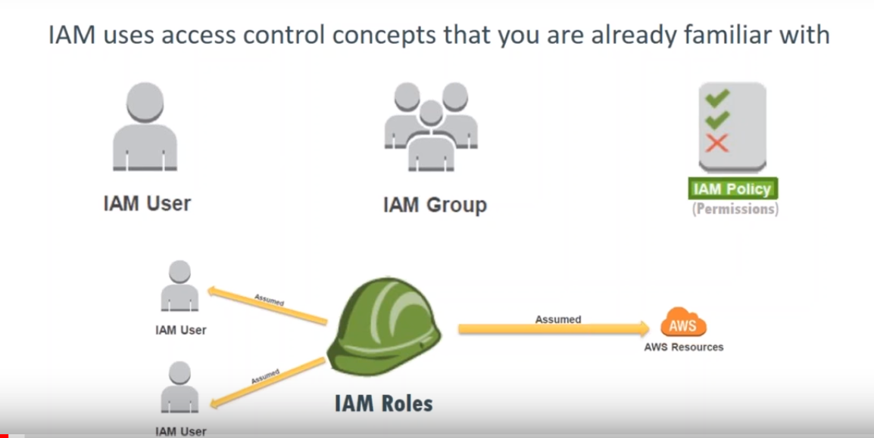

Slide 18
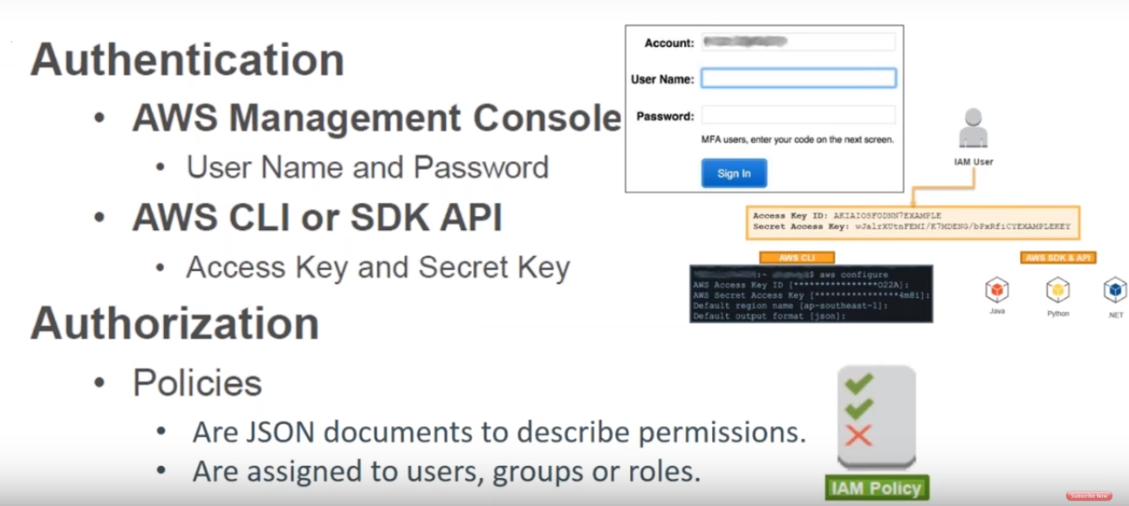

Slide 19
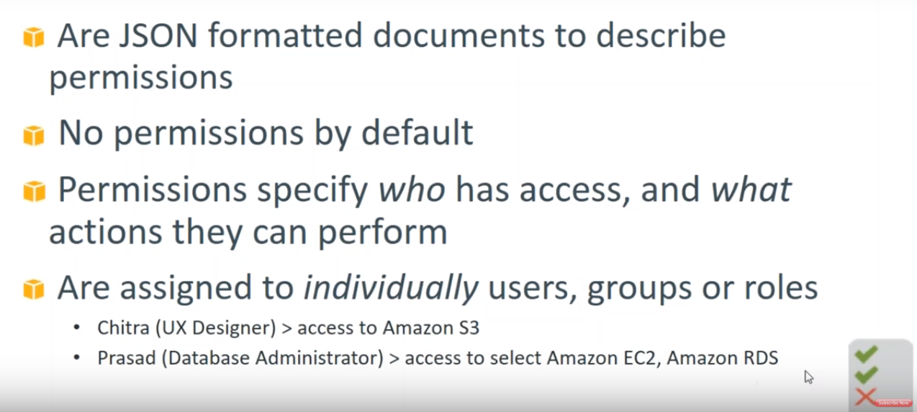

Slide 20
