Slide 1
AWS Lambda
AWS Lambda is a compute service that lets you run code without provisioning or managing servers.
You pay only for the compute time you consume - there is no charge when your code is not running.
AWS Lambda runs your code on a high-availability compute infrastructure and performs all of the administration of the compute resources, including server and operating system maintenance, capacity provisioning and automatic scaling, code monitoring and logging.
No server to maintain - serverless.
AWS Lambda supports (currently Node.js, Java, C#, Go and Python).
128 MB of Memory and the lowest CPU power, to 3008 MB of Memory and the highest CPU power.
Functions can run between 100ms and 15 minutes in a length.
Pricing depends on resource level chosen,time of execution.
Saves money as compute is used only when required.
Supports IAM role and VPC.
Lambda cloud be triggered as result of events happening from many AWS services like s3.
Lambda starts within milliseconds in responce to an event and hence reponce is very fast.
when should you consider Lambda instead of EC2 :
For stand-alone(stateless) code execution, which gets excuted and then stores the result somewhere like database,S3.
When don't want to maintain servers (Os update,security,scalability etc).

Slide 2
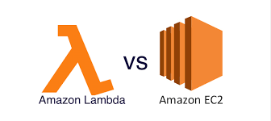
When Should I Use AWS Lambda?
AWS Lambda is an ideal compute platform for many application scenarios.
When using AWS Lambda, you are responsible only for your code.
AWS Lambda manages the compute fleet that offers a balance of memory, CPU, network, and other resources.
AWS Lambda to perform operational and administrative activities on your behalf, including provisioning capacity, monitoring fleet health, applying security patches, deploying your code, and monitoring and logging your Lambda functions.

Slide 3
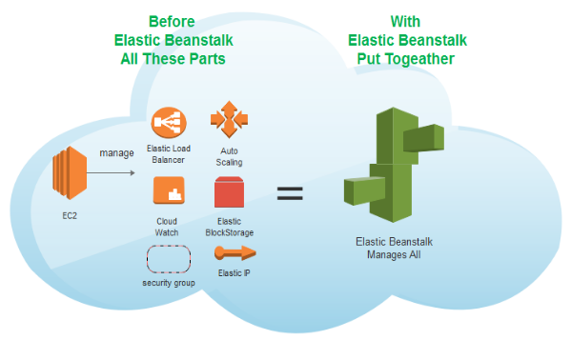
Elastic Beanstalk
AWS Elastic Beanstalk is an easy-to-use service for deploying and scaling web applications.
You can simply upload your code and Elastic Beanstalk automatically handles the deployment, from capacity provisioning, load balancing, auto-scaling to application health monitoring.
There is no additional charge for Elastic Beanstalk - you pay only for the AWS resources needed to store and run your applications.

Slide 4
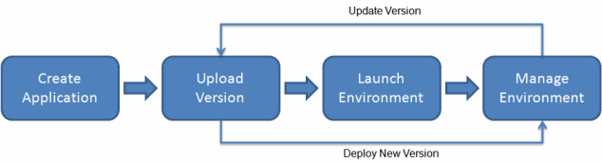
Elastic Beanstalk supports applications developed in Go, Java, .NET, Node.js, PHP, Python, and Ruby.
To use Elastic Beanstalk, you create an application, upload an application version in the form of an application source bundle (for example, a Java .war file) to Elastic Beanstalk, and then provide some information about the application.
Elastic Beanstalk automatically launches an environment and creates and configures the AWS resources needed to run your code.
After your environment is launched, you can then manage your environment and deploy new application versions.

