Slide 1
Amazon RDS
DataBase:
A database is a collection of information that is organized so that it can easily be accessed, managed, and updated.
Relational databases:
Which can also be called relational database management systems (RDBMS) or SQL databases.
The most popular of these are Microsoft SQL Server, Oracle Database, MySQL, and IBM DB2.
Which is mostly used to store data for web applications, typically as part of the popular LAMP stack .
Non-relational databases:
Also called NoSQL databases
The most popular being MongoDB, DocumentDB, Cassandra, Coachbase, HBase, Redis, and Neo4j.
These databases are usually grouped into four categories: Key-value stores, Graph stores, Column stores, and Document stores

Slide 2
Amazon Relational Database Service (Amazon RDS) is a web service that makes it easier to set up, operate, and scale a relational database in the cloud.
You can have automated backups performed when you need them, or manually create your own backup snapshot. You can use these backups to restore a database.
You can get high availability with a primary instance and a synchronous secondary instance that you can fail over to when problems occur.
DB Instances:
A DB instance is an isolated database environment in the cloud.
Each DB instance runs a DB engine. Amazon RDS currently supports the MySQL, MariaDB, PostgreSQL, Oracle, and Microsoft SQL Server DB engines.
The computation and memory capacity of a DB instance is determined by its DB instance class.
DB instance storage comes in three types: Magnetic, General Purpose (SSD), and Provisioned IOPS (PIOPS).
You can run your DB instance in several Availability Zones, an option called a Multi-AZ deployment.
DB Parameter Groups:
DB parameter groups act as a container for engine configuration values that are applied to one or more DB instances.

Slide 3
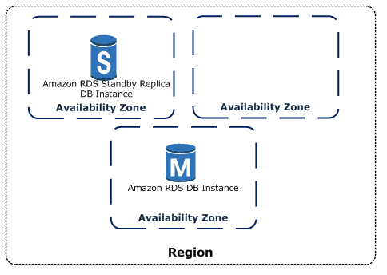
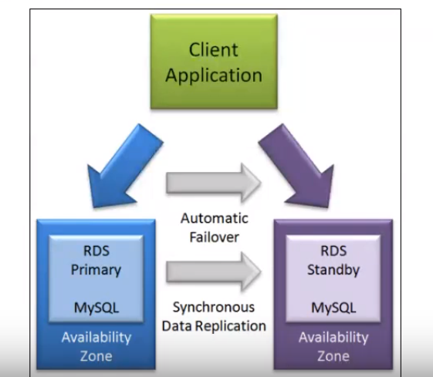
High Availability (Multi-AZ):
Amazon RDS provides high availability and failover support for DB instances using Multi-AZ deployments.
Multi-AZ deployments for Oracle, PostgreSQL, MySQL, and MariaDB DB instances use Amazon's failover technology.
SQL Server DB instances use SQL Server Mirroring.
In a Multi-AZ deployment, Amazon RDS automatically provisions and maintains a synchronous standby replica in a different Availability Zone.
The high-availability feature is not a scaling solution for read-only scenarios.
you cannot use a standby replica to serve read traffic.
To service read-only traffic, you should use a Read Replica.

Slide 4
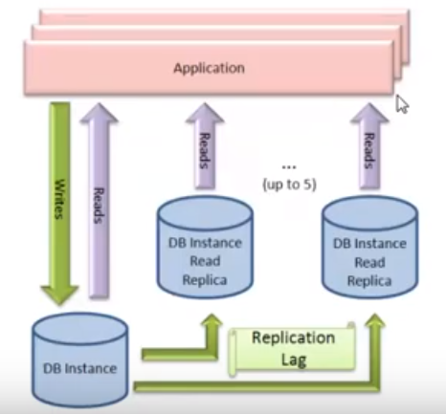
Read Replicas:
Amazon RDS uses the MariaDB, MySQL, and PostgreSQL DB engines' built-in replication functionality to create a special type of DB instance called a Read Replica from a source DB instance.
You can reduce the load on your source DB instance by routing read queries from your applications to the Read Replica.
creating Amazon RDS Read Replicas either in the same AWS Region as the source DB instance, or in a separate AWS Region.
The Read Replica operates as a DB instance that allows only read-only connections.

