Slide 1
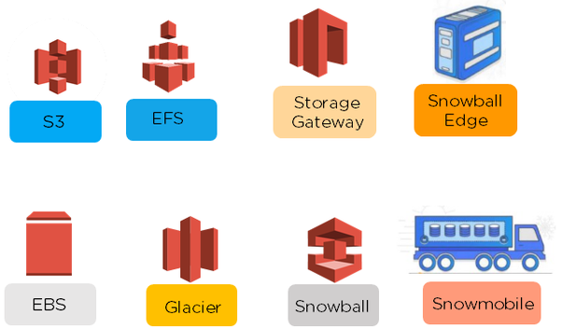
S3 - Simple Storage Service
Amazon S3 has a simple web services interface that you can use to store and retrieve any amount of data, at any time, from anywhere on the web.
Cloud storage provides a web service where your data can be stored, accessed and easily backed up by users over the internet.
WHAT ARE THE TYPES OF AWS STORAGE?
AWS storage are classified into eight broad categories, they are:

Slide 2
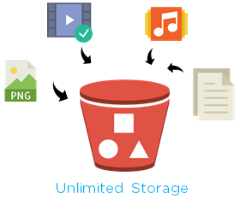
Amazon S3 (Simple Storage Service) provides object storage which is built for storing and recovering any amount of information or data from anywhere over the internet.
Amazon S3 provides storage through web services interfaces
It is designed for developers where web-scale computing can be easier for them
It provides 99.999999999% durability and 99.99% availability of objects
It can store computer files up to 5 terabytes in size

Slide 3

WHAT IS OBJECT & BUCKET?
An object consists of data, key(assigned name) and metadata
A bucket stores objects
When data is added to the bucket, Amazon S3 creates a unique version ID and allocates it to the object
Individual Amazon S3 objects can range in size from a minimum of 0 bytes to a maximum of 5 terabytes. The largest object that can be uploaded in a single PUT is 5 gigabytes.

Slide 4





WHAT ARE THE BENEFITS OF S3?
Some of the benefits of Amazon S3 are given below
One of the most important aspects of Amazon S3 is that you only pay for the storage used and not provisioned.
Durability
Low Cost
Scalability
Availability
Security

Slide 5
From UI perspective all your bucket are shown in one place. that's we see at the top it's shows Global.
S3 is not a global service it's regional service.
Bucket name should be uniq.
ARN: for s3 object : arn:aws:s3:::bucketname/objectname.
after s3 two sections are blanked : one is for region and another is for AC number. but s3 bucket totally uniq so we leave it blank.
Versioning :
If different file are in the same name both are being put into same bucket. (for example file.1 file.2 both versions are maintain in the bucket.)
In case i gohead and delete a file it is not real delete which is just marker just created.
if i want that file goto remove marker i got that file.
if you gohead versioning you can't remove just suspended.
Storage class:
It's desiged based on different types of needs, you can choose. different storage class are different prices.
By default you upload a file it is going to be standard class.
Each object in Amazon S3 has a storage class associated with it.

Slide 6
Types of storage class:
STANDARD
STANDARD_IA (Infrequent access)
RR (Reduced Redundancy)
GLACIER
STANDARD :
This storage class is ideal for performance-sensitive use cases and frequently accessed data.
STANDARD is the default storage class
If you don't specify storage class at the time that you upload an object, Amazon S3 assumes the STANDARD storage class.
Frequently access the data like images, java scripts.json...
While creating the bucket the object is replicated into 3 AZ's with in the Region.
STANDARD_IA:
This storage class (IA, for infrequent access) is optimized for long-lived and less frequently accessed data
The STANDARD_IA storage class is suitable for larger objects greater than 128 Kilobytes that you want to keep for at least 30 days.
The per GB storage class less than standard but there is try to rectrive data there is additional fee.
Example backup files.
while creating the bucket the object is replicated into 3 AZ's with in the Region.

Slide 7
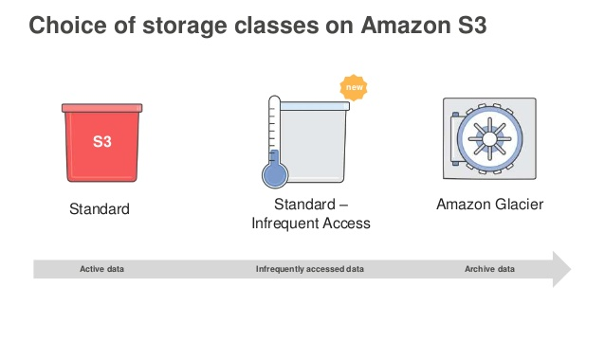
REDUCED_REDUNDANCY :
RRS storage class is designed for noncritical
Reproducible data stored at lower levels of redundancy than the STANDARD storage class, which reduces storage costs.
While creating the bucket the object is replicated into 2 AZ's with in the Region.
Durability bit lesserthan object, cost also.
GLACIER :
The GLACIER storage class is suitable for archiving data where data access is infrequent.
Archived objects are not available for real-time access.
You must first restore the objects before you can access them.
GLACIER storage class using lifecycle management.
You must first restore the GLACIER objects before you can access them .(STANDARD, RRS, and STANDARD_IA objects are available for anytime access).

Slide 8
Storage Class Durability Availability Other Considerations
STANDARD 99.999999999% 99.99% None
STANDARD_IA 99.999999999% 99.9% Which makes it most suitable for infrequently accessed data.
ONEZONE_IA 99.999999999% 99.5% Not resilient to the loss of the Availability Zone.
GLACIER 99.999999999% 99.99% GLACIER objects are not available for real-time access.
You must first restore archived objects before you can access them.
RRS 99.99% 99.99% None
Life cycle:
You can manage lifecycle of objects by using lifecycle rules.
lifecycle rules enables you to automatically transition objects to the STANDARD_IA storage class and / or archive objects to glacier.
Removed objects after a specifed time period.
Cross-Region Replication:
To copy a files from one region bucket to another region.
Any object upload bucket it will get replicated destination region.

Slide 9
Requester pays:
Enable request pays on this bucket causes the requester.
Instead of the bucket owner to pay for the charges of requester and data transfer.
Tranfer Acceleration :
We are transfer the data from one region to another region through edge locations.
Once enabled it will seach nearest edge locations and route the traffic to that location.
From base location to edge loaction transfer data through public n/w , then transfer through aws n/w.
Data transfer 300% faster.
Amazon S3 Transfer Acceleration enables fast, easy, and secure transfers of files over long distances between your client and an S3 bucket.
Server Access Logging:
To track requests for access to your bucket, There is no extra charge for enabling server access logging on an Amazon S3 bucket.
You can delete the log files at any time.
Access log information can be useful in security and access audits.
It can also help you learn about your customer base and understand your Amazon S3 bill.
No data transfer charges are assessed for log file delivery, but access to the delivered log files is charged the same as any other data transfer.

Slide 10
Hosting a Static Website on Amazon S3:
You can host a static website on Amazon Simple Storage Service (Amazon S3).
On a static website, individual webpages include static content. They might also contain client-side scripts.
Dynamic website relies on server-side processing, including server-side scripts such as PHP, JSP, or ASP.NET. Amazon S3 does not support server-side scripting.
The website is then available at the AWS Region-specific website endpoint of the bucket, which is in one of the following formats:
** <bucket-name>.s3-website-<AWS-region>.amazonaws.com **
ONEZONE_IA:
Amazon S3 stores the object data in only one Availability Zone, which makes it less expensive than STANDARD_IA.
We recommend the following:
STANDARD_IA—Use for your primary or only copy of data that can't be recreated.
ONEZONE_IA—Use if you can recreate the data if the Availability Zone fails, and for object replicas when setting cross-region replication (CRR).

Slide 11
Default Encryption
You can set default encryption on a bucket so that all objects are encrypted when they are stored in the bucket.
The objects are encrypted using server-side encryption with either Amazon S3-managed keys (SSE-S3) or AWS KMS-managed keys (SSE-KMS).
When you use server-side encryption, Amazon S3 encrypts an object before saving it to disk in its data centers and decrypts it when you download the objects.

Slide 12
S3 vs EBS vs EFS
Block storage
Object storage
Block level operations are possible.
Hence , one block is changed (piece of the file) that contanins the changed data.
Entire file must be removed and new file needs to be put there.
S3:
S3 to be used for WORM operations(Write onces read many times)
Scalable, size not be planned.
But not suitable for hosting OS or Database.(can not keep os and database related files).
EBS:
EBS works best as server disks.
persistent and high performance in terms of read and write.(stop your instance data would be in disk)
Replicated with in AZ and could be mounted to one EC2 instance in the same AZ.(To create ebs volume by default whenever it is replicated to two times with in the same AZ.
EC2 and volume both should be created in same AZ.

Slide 13
EFS:
EFS provides file storage for use with your EC2 instance.
People wanted to mount a filesystem different servers at the same time
Replicated across AZs in a region.
Could be mounted to on premise servers well (over vpn or direct connect).
Could be mounted to multiple EC2 at the same time.
No sizing to be done.

