Slide 1
VPC
Amazon Virtual Private Cloud (Amazon VPC) enables you to launch AWS resources into a virtual network that you've defined.
A virtual private cloud (VPC) is a virtual network dedicated to your AWS account. It is logically isolated from other virtual networks in the AWS Cloud.
A subnet is a range of IP addresses in your VPC.
You can launch AWS resources into a specified subnet. Use a public subnet for resources that must be connected to the internet,
private subnet for resources that won't be connected to the internet.
To protect the AWS resources in each subnet, you can use multiple layers of security, including security groups and network access control lists (ACL).

Slide 2
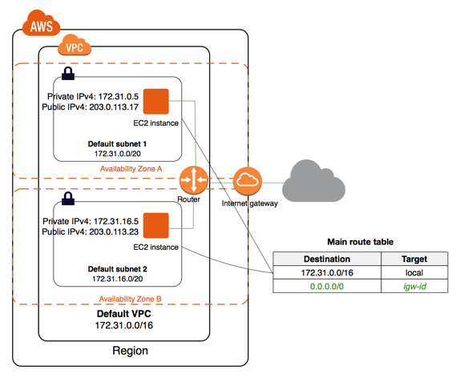

Slide 3
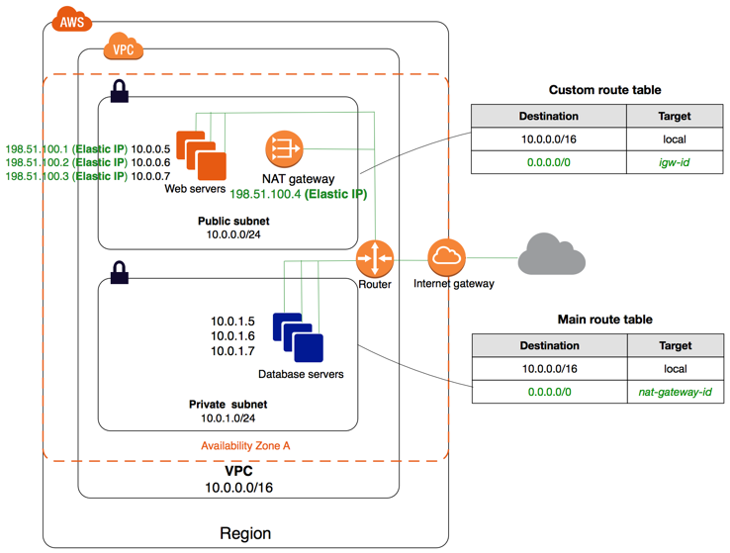
NAT Gateways:
You can use a network address translation (NAT) gateway to enable instances in a private subnet to connect to the internet or other AWS services.
You are charged for creating and using a NAT gateway in your account.
NAT gateway supports 5 Gbps of bandwidth and automatically scales up to 45 Gbps
You can associate exactly one Elastic IP address with a NAT gateway
NAT gateway supports the following protocols: TCP, UDP, and ICMP.

Slide 4
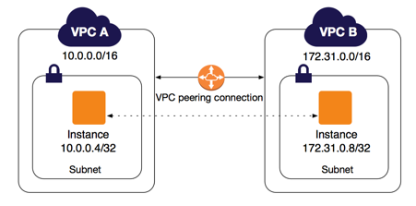
VPC Peering:
A VPC peering connection is a networking connection between two VPCs that enables you to route traffic between them using private IPv4 addresses or IPv6 addresses.
You can create a VPC peering connection between your own VPCs, or with a VPC in another AWS account.

Slide 5
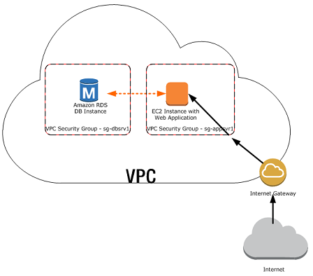
Security Groups:
A security group acts as a virtual firewall that controls the traffic for one or more instances.
When you launch an instance in a VPC, you must specify a security group that's created for that VPC.After you launch an instance, you can change its security groups.
AWS security groups (SGs) are associated with EC2 instances and provide security at the protocol and port access level.
limited to only 100 security groups per VPC.

Slide 6
AWS Security Groups: rules
By default, security groups allow all outbound traffic.
The actual rule set that filters traffic is made up of two tables: ‘Inbound’ and ‘Outbound’.
AWS Security groups are stateful, meaning you do not need the same rules for both outbound traffic and inbound.
Each rule is comprised of four fields: ‘Type’, ‘Protocol’, ‘Port Range’, and ‘Source’. This applies for both ‘Inbound’ and ‘Outbound’ rules.
Type: The drop down list allows you to select common protocols like SSH, RDP, or HTTP. You can also choose custom protocols.
Protocol: This is typically greyed out, as it’s covered by most ‘Type’ choices. However, if you create a custom rule, you can specify your protocol (TCP/UDP etc.) here.
Port Range: This value will also usually be pre-filled, reflecting the default port or port range for your chosen protocol. However, there might be times when you prefer to use custom ports.
Source: This can be a Network Subnet range, a specific IP address, or another AWS security group. You can also leave access open to the entire Internet using the ‘Anywhere (0.0.0.0/0)’ value.

Slide 7
Network ACLs (NACL):
A network access control list (ACL) is an optional layer of security for your VPC that acts as a firewall for controlling traffic in and out of one or more subnets.
ACLs monitor and filter traffic moving in and out of a network.
You can attach an ACL to one or more subnets within your Virtual Private Cloud (VPC).
If you haven’t created a custom ACL, then your subnets will automatically be associated with your VPC’s default ACL which ‘Allows’ all traffic to flow into and out of the network.
This is important, because ACL rules are read in ascending order
You can number of your rules starting at one (which will be read first), and going as high as 32766.
I would suggest that you leave a gap of at least 50 numbers between each of your rules (i.e., 50, 100, 150…) to allow you to more easily add new rules in sequence later, if it should be necessary.
ACLs, on the other hand, are stateless.
Therefore, when creating your rules, you may need to apply an outbound reply rule to permit responses to inbound requests.

Slide 8
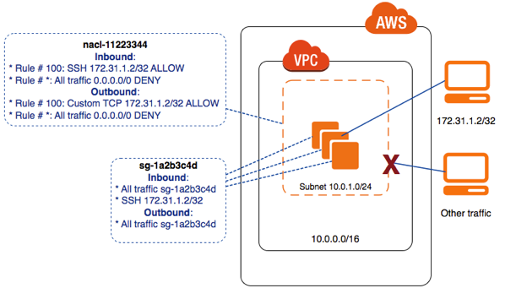

Slide 9
Let’s explain these fields:
Rule: As we mentioned, ACL rules are read in ascending order, but only until a rule matching the packet is found.
Care should be taken to number your rules appropriately when creating your rule base.
Type: This drop down list allows you to select from a list of common protocol types, including SSH, RDP, HTTP, and POP3. You can alternatively specify custom protocols such as varieties of ICMP.
Protocol: Based on your choice for ‘Type’, the Protocol option might be greyed out. For custom rules like TCP/UDP however, you should provide a value.
Port Range: If you do create a custom rule, you’ll need to specify the port range for the protocol to use
Source: This can be a network subnet range, a specific IP address, or even left open to traffic from anywhere (using this value: 0.0.0.0/0).
Allow/Deny: Each rule must include an action specifying whether the defined traffic will be allowed to pass or not.
When creating your ACLs be aware that there is a default limit of 20 inbound and 20 outbound rules per list.
You can associate a network ACL with multiple subnets; however, a subnet can be associated with only one network ACL at a time.
The highest number that you can use for a rule is 32766.
We recommend that you start by creating rules in increments (for example, increments of 10 or 100) so that you can insert new rules where you need to later on.

Slide 10
Difference between security groups and the network access control list
Security Groups
Security Groups supports only Allow rules.
Security Group is Stateful, any changes applied to an incoming rules is automatically applied to an outgoing rule.
Security groups are tied to an instance.
Secuity group is the first layer of the defense.
Security group all rules are applied.
NACL
Network ACL is Stateless changes applied to incoming will not be applied to outbond.
Network ACL are tied to the subnet.
Network ACL is the second layer of the defense.
Network ACL rules are applied in order, with rules with lower number processed first.

Slide 11
Security Group by default is ‘Deny All’ inbound. ACL by default is ‘Allow All’ both inbound & outbound.
In ACL you can specify both allow and deny. In SG, you can only specify allow entries.
Security Groups are stateful, i.e- if you open inbound port 80, it will automatically open outbound port 80 as well. In an ACL, you have to manually do this for both inbound and outbound i.e -stateless.
Security Groups are applied to individual resources. i.e- EC2, RDS etc. ACL is applied on a network level i.e- VPC.
ACLs take precedence as traffic hits it before the Security group. If port 80 is blocked on the ACL, it will not come through to the security group even if it is allowed on the security group.

Slide 12
VPN
Accessing a Corporate or Home Network:
You can optionally connect your VPC to your own corporate data center using an IPsec AWS managed VPN connection,
Making the AWS Cloud an extension of your data center.
A VPN connection consists of a virtual private gateway attached to your VPC and a customer gateway located in your data center.
A virtual private gateway is the VPN concentrator on the Amazon side of the VPN connection.
A customer gateway is a physical device or software appliance on your side of the VPN connection.

Slide 13
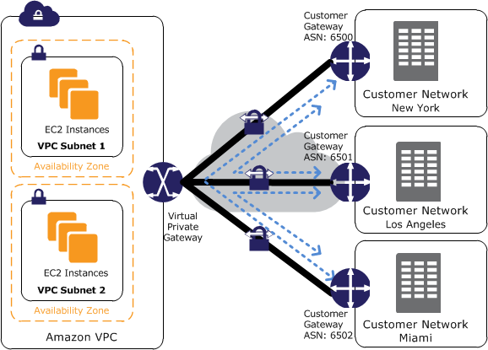

Slide 14
Difference between virtual private gateway VPG and customer gateway CG in aws
To establish VPN connection in AWS ,need Customer Gateway (CG ) and Virtual Private Gateway (VPG).Its similar traditional site to site VPN.
The difference is one end is your office router or appliance and another end is AWS router.But in AWS side you can see everything as virtual resources. They made it very user friendly GUI to setup VPN connection.
Connectivity between Client office /DC to AWS VPC.
Customer Gateway :
A customer gateway is the anchor on your side of that connection. It can be a physical or software appliance.
Ex: Cisco ASA router can be a customer gateway to configure VPN. AWS supports most of the major vendors router device to configure VPN.
If the specific device type not found you can raise try with generic model.
If still its not working you can open a case.AWS technical will look and advise.

Slide 15
Virtual Private Gateway:
The anchor on the AWS side of the VPN connection is called a virtual private gateway.Simply we can say router kind of device in AWS side.
But you wont get any information about that and no need to configure much on this part.
Just click to create VPG and attach to required VPC. AWS will automatically assign two public IP.

