Slide 1
AWS Shared Responsibility Security Model
By
Keshav Kummari

Slide 2
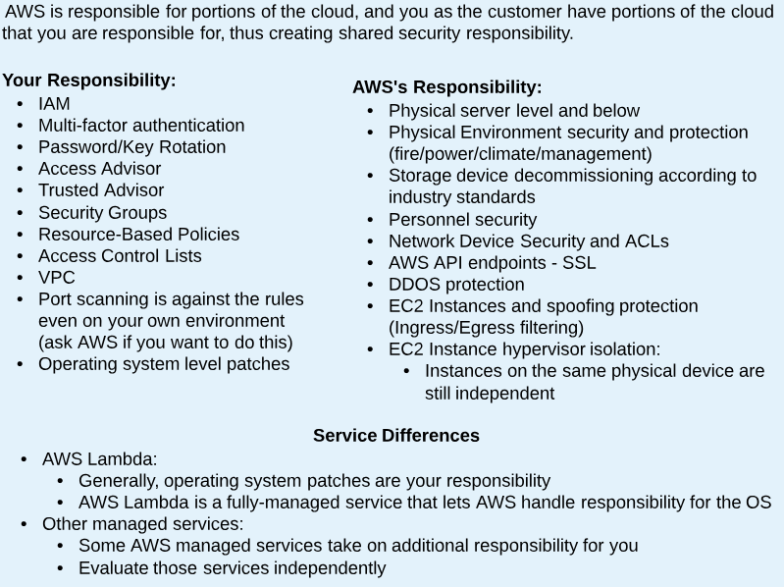
Shared Security Responsibility Model

Slide 3
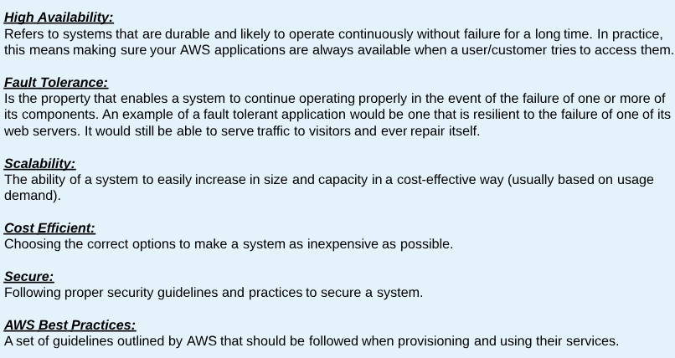
Terminology

