Slide 1
AWS Certified DevOps Engineer – Professional level
By
Keshav Kummari

Slide 2
AWS – Certified DevOps Engineer- Course Introduction
Auto Scaling Deployment Concepts
How to configure Auto Scaling & Deploy applications using Auto Scaling.
Deployment Concepts with EC2
Using EC2 in deployments including EC2 logging and Backup Strategies.
Cloud Watch For DevOps
Utilizing Cloud Watch for DevOps including Monitoring & Logging.
CloudFormation for DevOps
Utilizing CloudFormation to deploy infrastructure on AWS
Elastic Beanstalk for DevOps
Using Elastic Beanstalk to quickly deploy applications on AWS.
Application Deployments with OpsWorks
Using OpsWorks to create and Manage resources for our applications, as well as managing the applications themselves.

Slide 3
7. DynamoDB Concepts
Reviewing the basics of DynamoDB as well as understanding the role of DynamoDB and its use cases in DevOps.
8. Data Pipeline with DynamoDB
We will use AWS Data Pipeline to retrieve data from a tab-delimited file in Amazon S3 to populate a DynamoDB table, use a Hive script to define the necessary data transformation steps, and automatically create an Amazon EMR cluster to perform the work.
9. S3 Concepts for DevOps
Utilizing S3 buckets as a key repository for DevOps via Cross-Account Access.
10. A/B Testing
A/B Testing concepts for DevOps
11. Blue/Green Deployments
Using Automation for DevOps to facilitate Blue/Green Deployments.

Slide 4
1. Auto Scaling Deployment Concepts
A DevOps Engineer will spend time in:
Creating
Monitoring &
Tune Auto Scaling Groups
You will be learning:
Auto Scaling
Termination Policies
Suspending Auto Scaling Processes
LifeCycle Hooks
Controlling instance &
Application Deployment

Slide 5
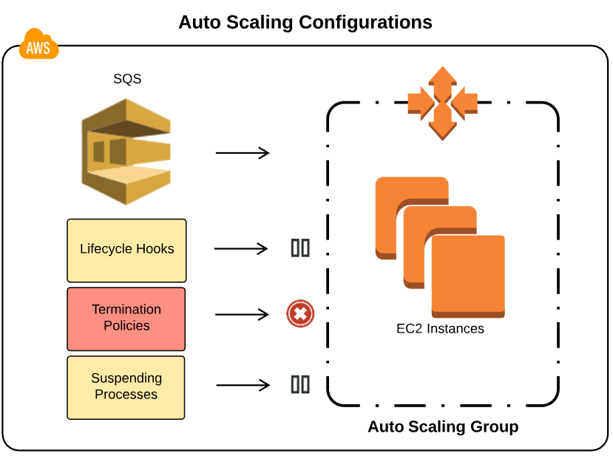

Slide 6
2. Deployment Concepts With EC2
A DevOps engineer will be required to work with EC2 instances and a key will be using various techniques to backup EC2 instances.
Elastic Load Balancers as a part of Deployments will be a common tool in the DevOps engineer’s toolset.
The ability to configure ELB’s securely, with appropriate Health Checks, and to configure logging will be required both professionally and as a demonstrable skill.
IAM Roles with EC2
ELB & EC2 logging
ELB Health Checks
ELB Security
EC2 Backup Strategies

Slide 7
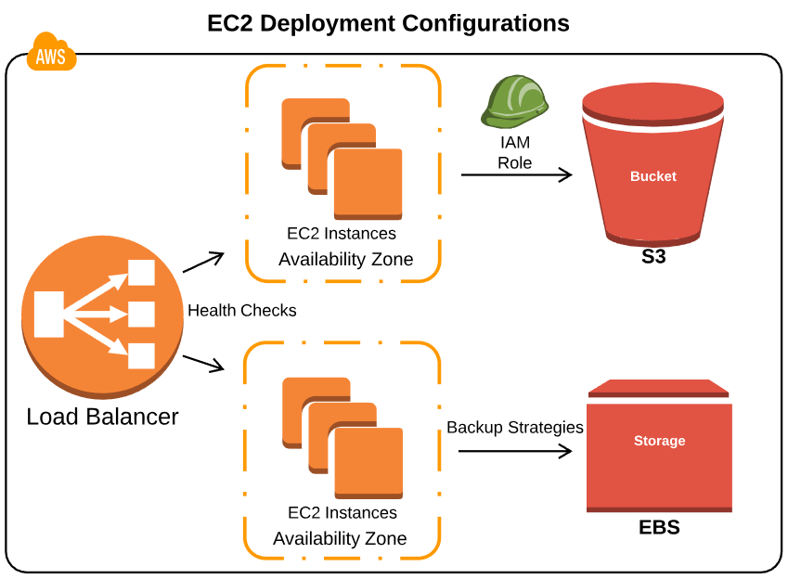

Slide 8
3. Cloud Watch For DevOps
Cloud Watch is an essential tool for the DevOps Engineer.
Cloud Watch supports the DevOps concepts of Automation, Communication, and Collaboration, by giving access to Monitoring and logging.
Cloud Watch metrics can be used to work with Elastic Load Balancers and determine the scaling actions of Auto Scaling Groups.
Custom Metrics are a very Powerful tool which allow the DevOps engineer to leverage Cloud Watch monitoring in a Wide range of scenarios.
Concepts & Terminology
ELB Metrics
Auto Scaling & EC2 Metrics
EC2 OS & Application Logging
Using SNS with Cloud Watch
Using Kinesis with Cloud Watch

Slide 9
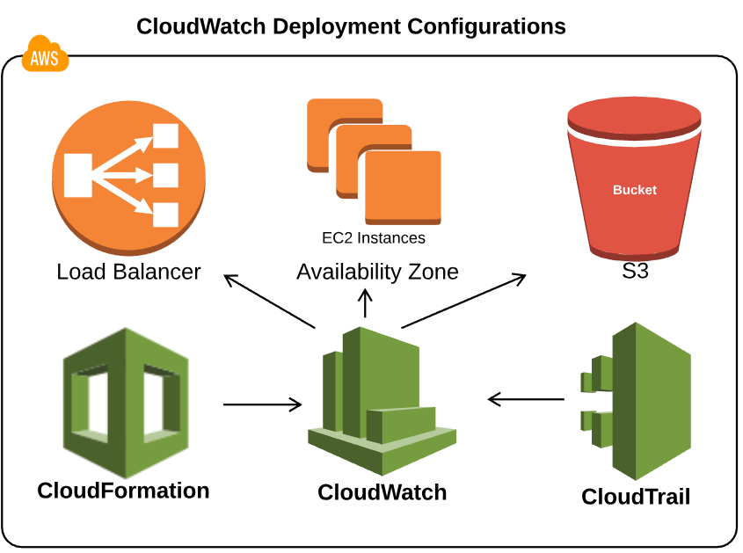

Slide 10
4. CloudFormation For DevOps
Using CloudFormation to create infrastructure, known as infrastructure as Code, is a common technique that a DevOps Professional will need to master.
The Code is a CloudFormation template which describes the infrastructure that will be deployed.
The infrastructure is a CloudFormation Stack, created from the template.
In this scenario we’ll create a stack containing an Auto Scaling Group of EC2 instances backed by an Amazon RDS database.
Several ways to Work with Stacks:
Key Points
Deployment Strategies
Wait Conditions
Creation Policy
Creation Policy with Auto Scaling
Helper Scripts
Stack Policies
Update Policies

Slide 11
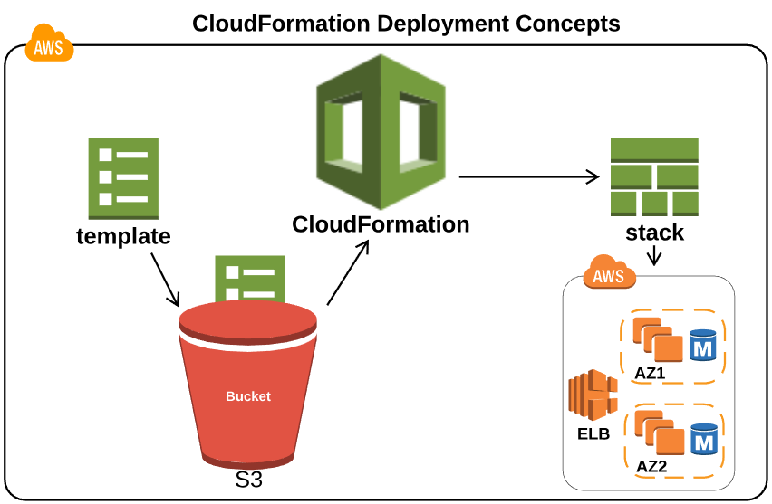

Slide 12
5. Elastic Beanstalk for DevOps
With Elastic Beanstalk, you can quickly deploy and manage applications in the AWS Cloud without worrying about the infrastructure that runs those applications.
AWS Elastic Beanstalk reduces management complexity without restricting choice or control.
You simply upload your application, and Elastic Beanstalk automatically handles the details of capacity provisioning, load balancing, scaling, and application health monitoring.
Introduction
Deployment Strategies
Docker with Elastic Beanstalk
Environment Configurations
Using With CloudFormation
Elastic Beanstalk Scenarios

Slide 13
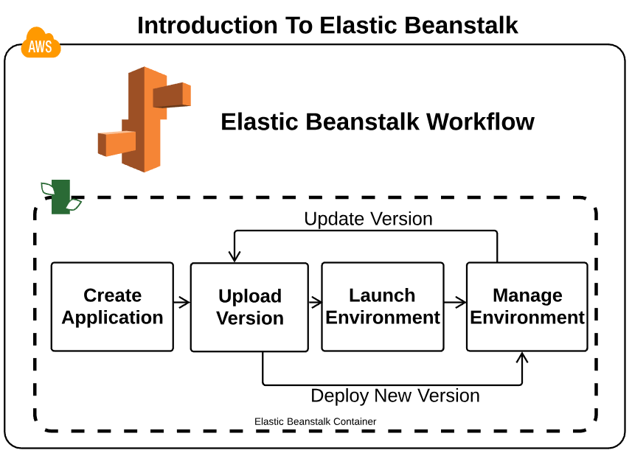

Slide 14
6. Application Deployments with OpsWorks
AWS OpsWorks is a configuration management service that provides managed instances of Chef & Puppet.
Chef & Puppet are automation platforms that allow you to use code to automate the configurations of your servers.
OpsWorks lets you use Chef & Puppet to automate how servers are configured, deployed, and managed across your Amazon EC2 instances or On-Premises compute environments.
OpsWorks can be seen as a Platform as a Service, however, unlike most PaaS, you have full control over the OS, Instance Count, and can make changes directly to the deployment mechanisms.
OpsWorks Essentials
Deplyment Strategies
Stack Creation

Slide 15
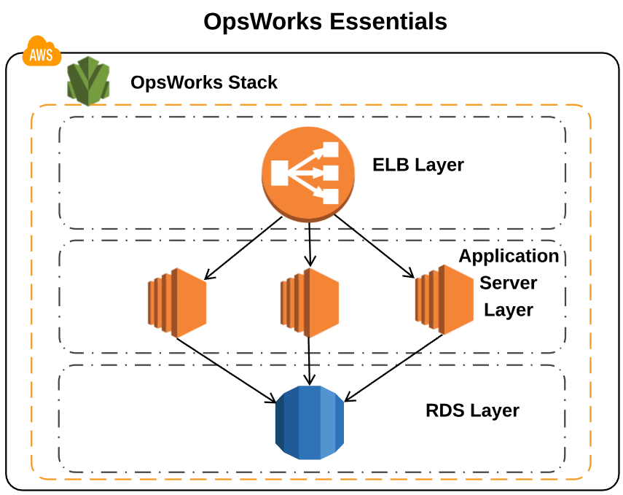

Slide 16
7. DynamoDB with Applications
Amazon DynamoDB is a fully managed NoSQL database service that makes it simple and cost-effective to store and retrieve any amount of data and serve any level of request traffic.
It is important to understand the foundational concepts of DynamoDB, such as Partition Keys and Sort Keys as well as Local and Global Secondary indexes, at the DevOps Pro level it is important to understand the use case for DynamoDB, such as storing metadata and the services used to export data to DynamoDB(Data Pipline, DynamoDB streams).
Secondary Indexes
Provisioned Throughput
Web Identity Federation
Data Pipeline

Slide 17
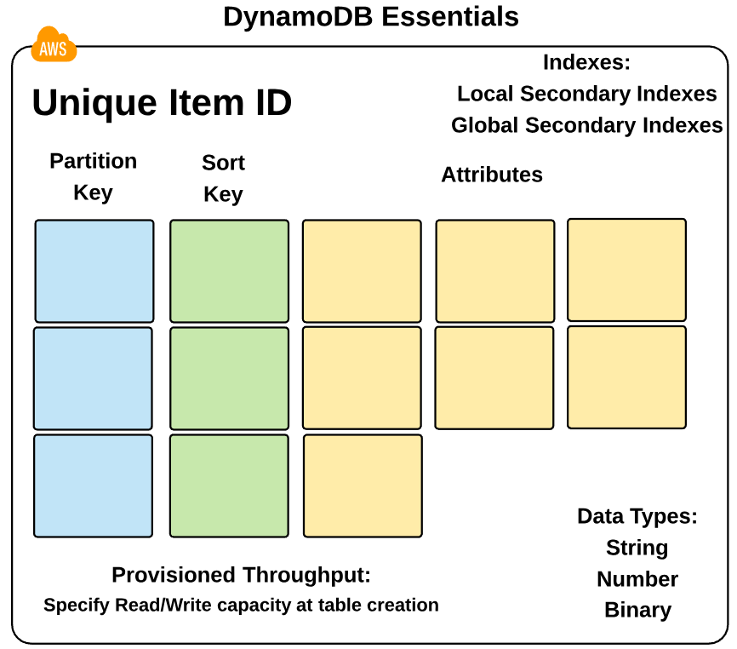

Slide 18
8. Deployment Concepts with S3
Amazon S3 is used extensively in AWS DevOps operations.
It’s low cost and high durability dictates that it should always be considered as a storage option.
Additionally, S3 provides comprehensive security and compliance capabilities that meet even the most stringent regulatory requirements.
DevOps specific uses for S3 including Log Data storage, secure storage to only be accessed via IAM Roles, and configuring Cross-Account Access for S3 access from other AWS accounts.
Lifecycle Management
Cross-Account Access
Exporting Log Data

Slide 19
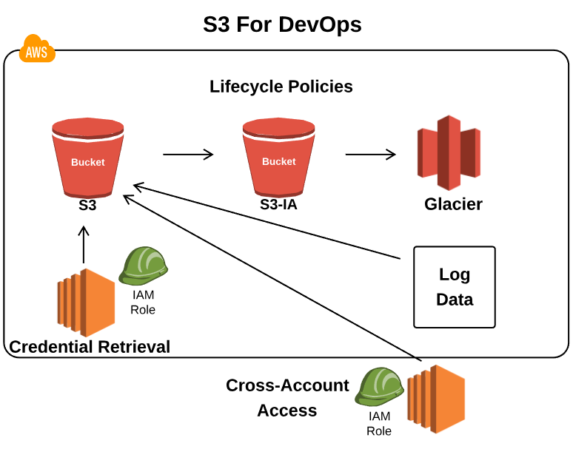

Slide 20
9. Blue/Green Deployments
Blue/Green deployments is a technique for releasing applications by shifting traffic between two identical environments running different versions of the application.
Blue/Green deployments can mitigate common risks associated with deploying software, such as downtime and rollback capability.
The DevOps Engineer will be required to properly configure Blue/Green environments in such a way that switching environments is seamless with no downtime.
Update DNS Routing
Swap ASG Behind ELB
Update ASG Launch Configuration
Docker B/G Deployments
A/B Testing

Slide 21
