Slide 1
AWS Global Infrastructure
By
Keshav Kummari

Slide 2
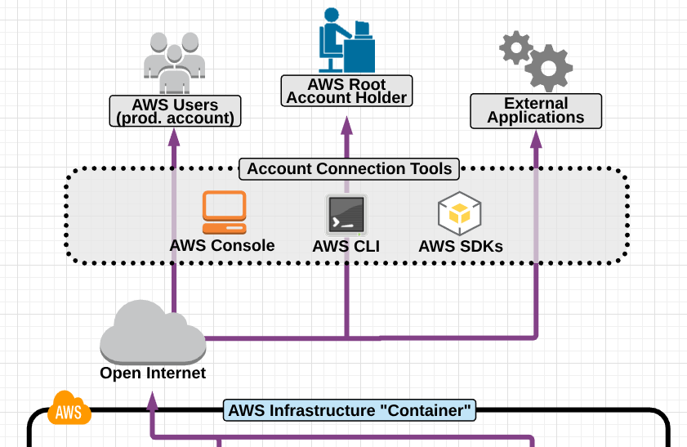
Connecting to AWS Cloud Using Various Ways

Slide 3
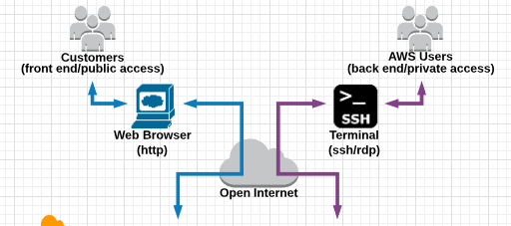
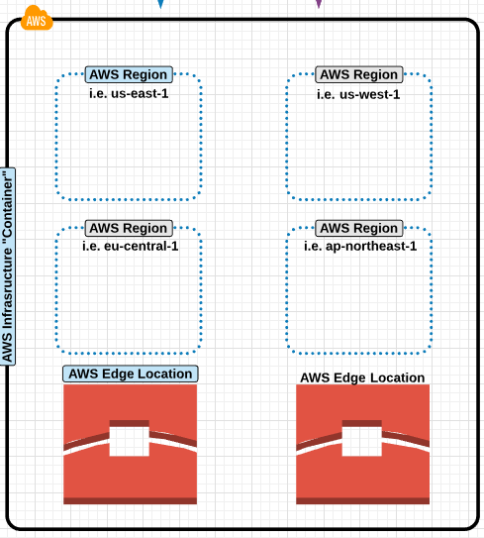
AWS Global Infrastructure

Slide 4
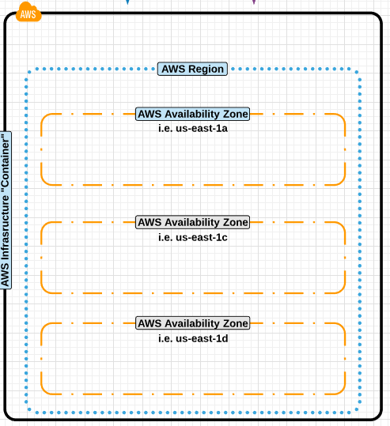
Region & Availability Zones

Slide 5
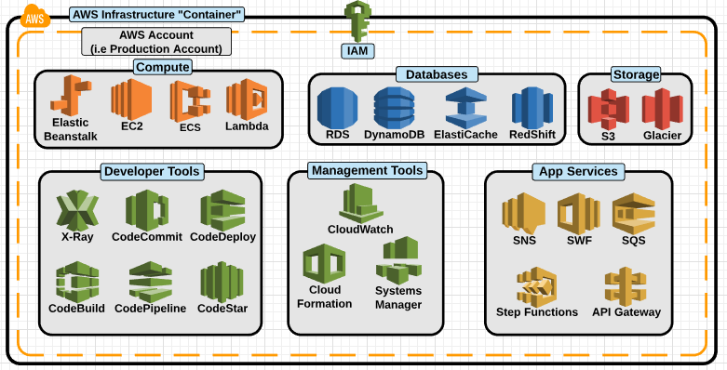
AWS Infrastructure Container

Slide 6
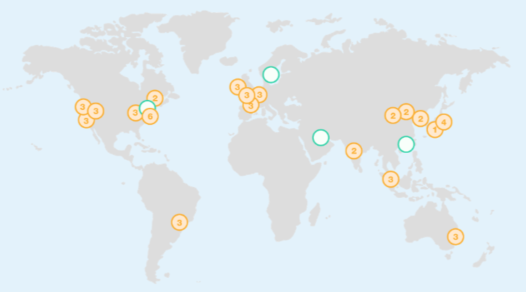
Regions & Availability Zones Map

Slide 7
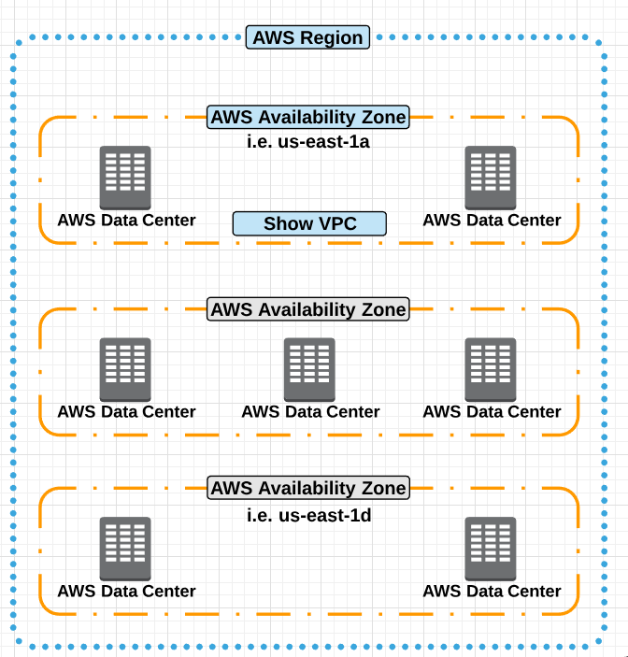
Region & Availability Zones Details

Slide 8
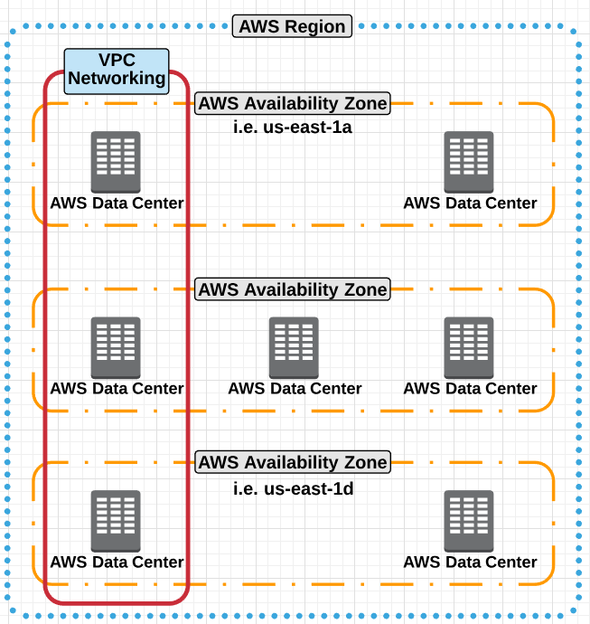
VPC

Slide 9
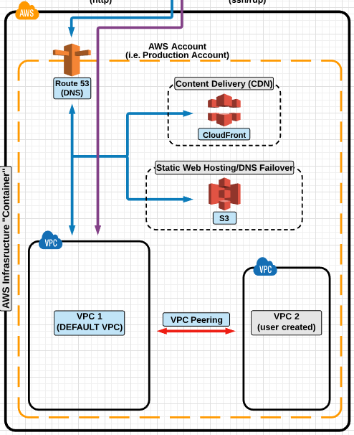
VPC & VPC Peering

Slide 10
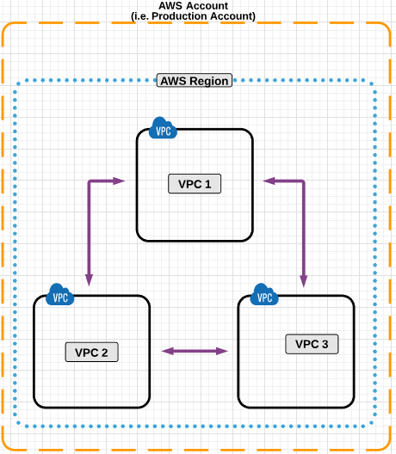
VPC Peering

Slide 11
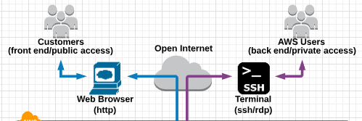
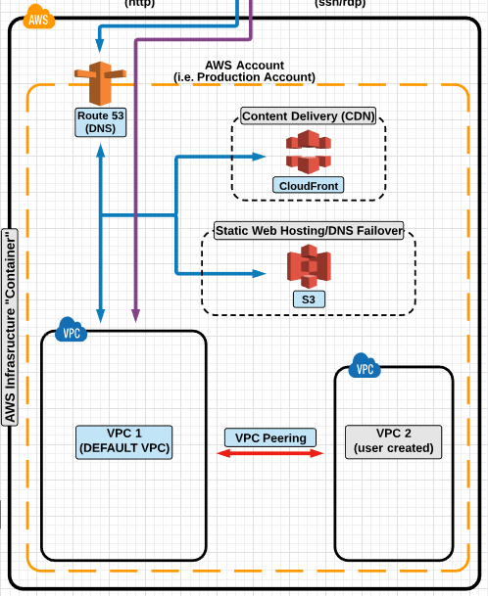
Connect a VPC Using Various ways

Slide 12
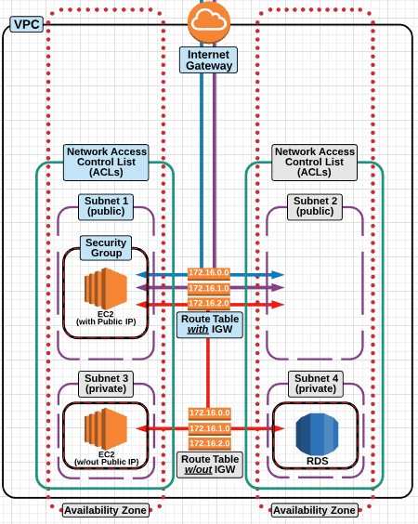
Basic VPC Infrastructure

Slide 13
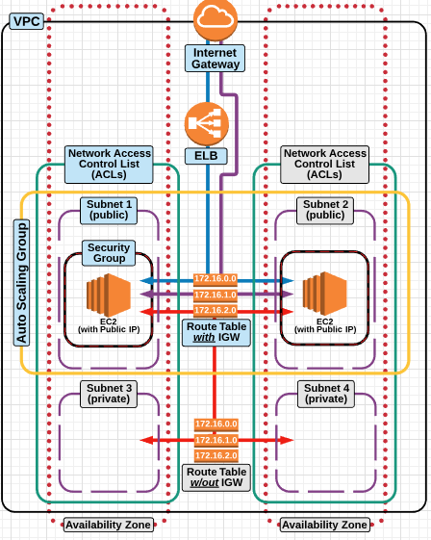
Highly Available & Fault Tolerant

Slide 14
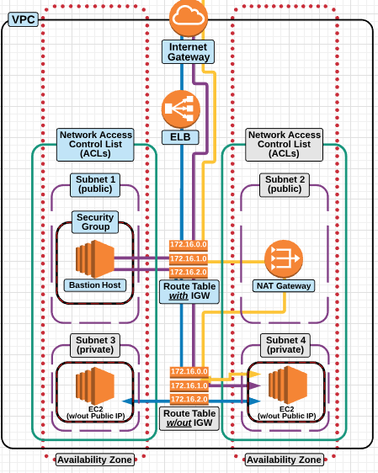
Bastion Host/NAT Networking

Slide 15
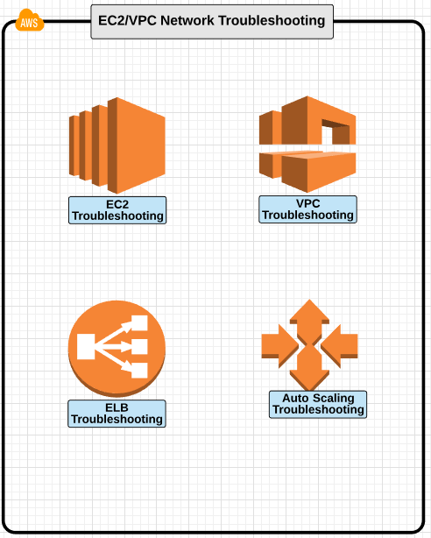
Troubleshooting

Slide 16
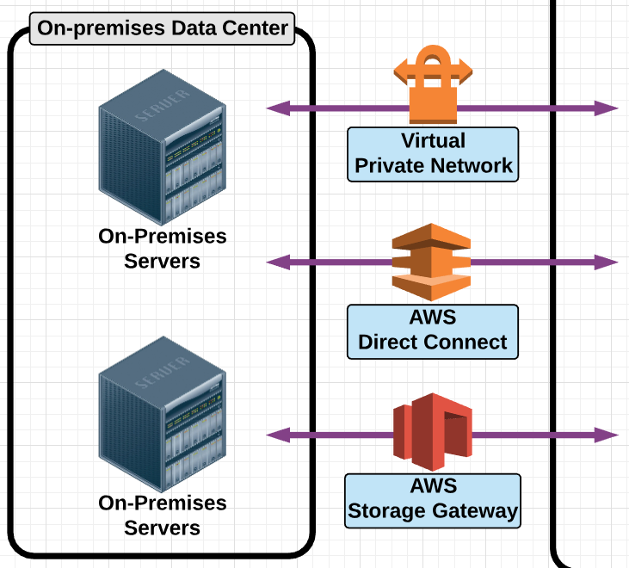
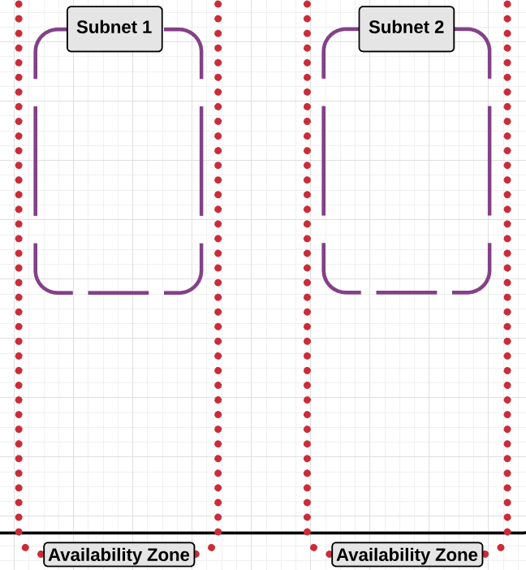
Connect On-Premises Data Center With AWS Cloud

Slide 17
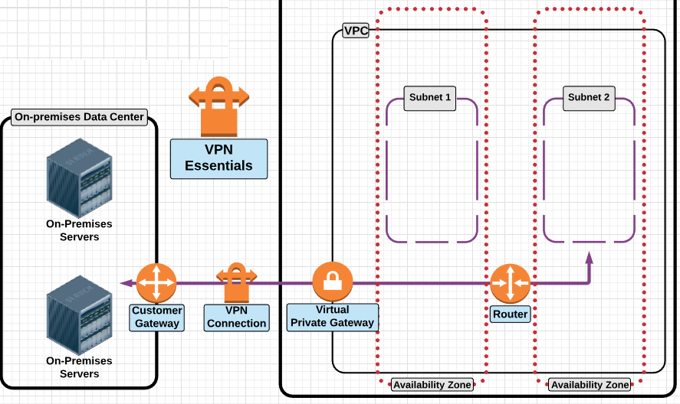
Connect On-Premises Data Center Using VPC

Slide 18
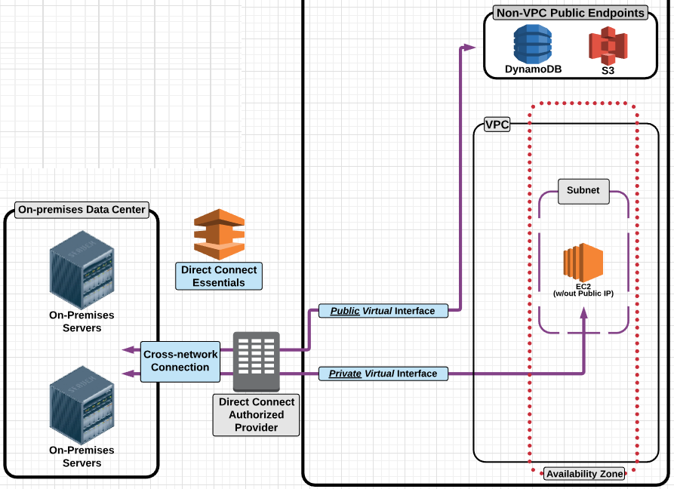
Connect On-Premises Data Center Using Direct Connect

Slide 19
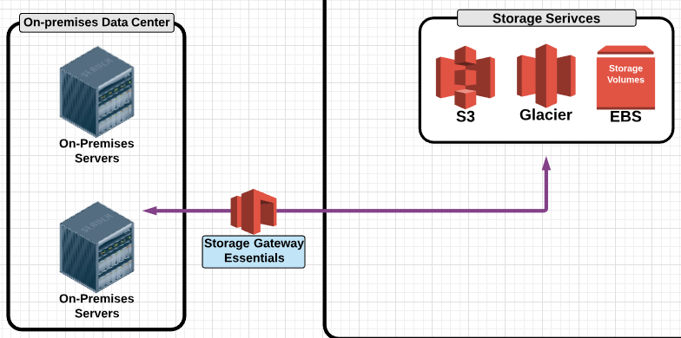
Connect On-Premises Data Center Using Storage Gateway

