Slide 1

Terraform
Lesson 1

Slide 2
Install Terraform
Devops.Course

Slide 3
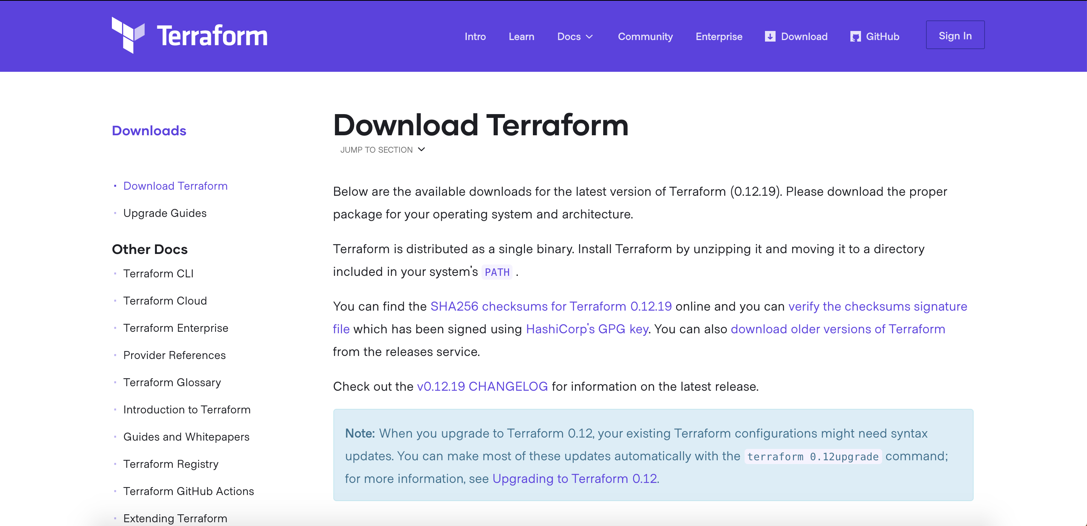
How to install terraform?

Slide 4
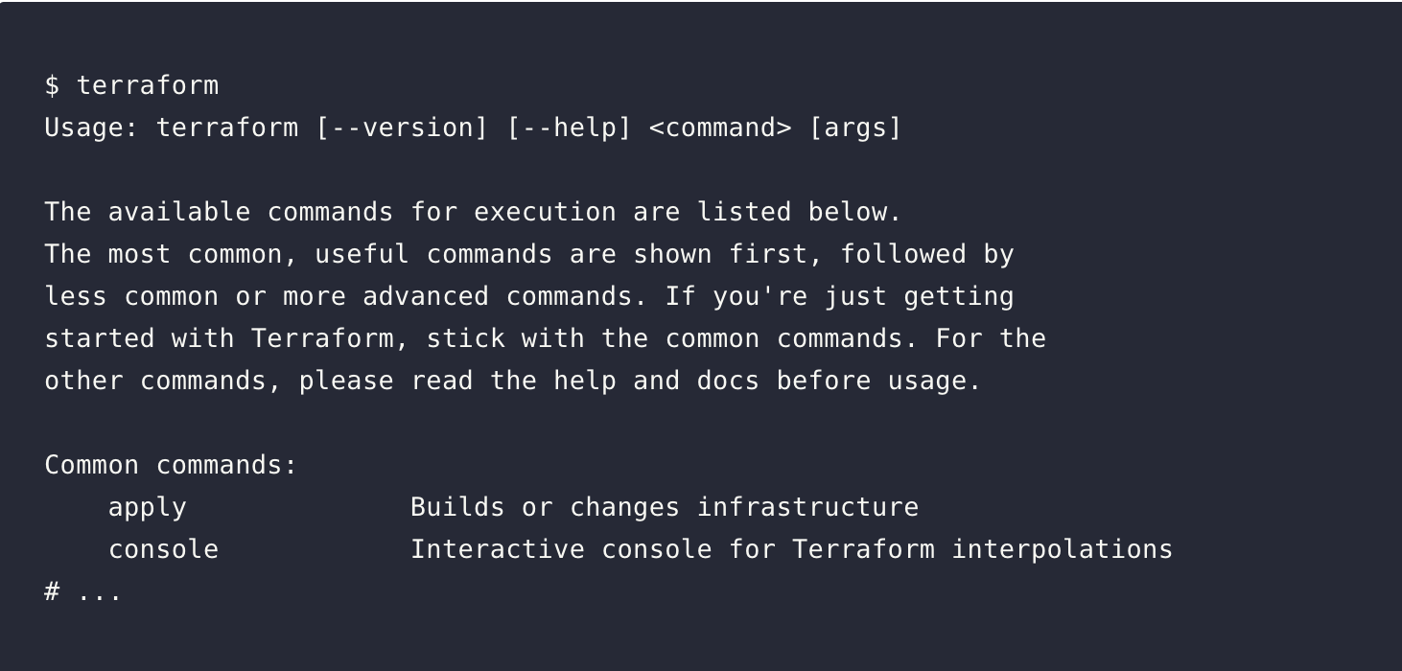
Check that all works
Devops.Events

Slide 5
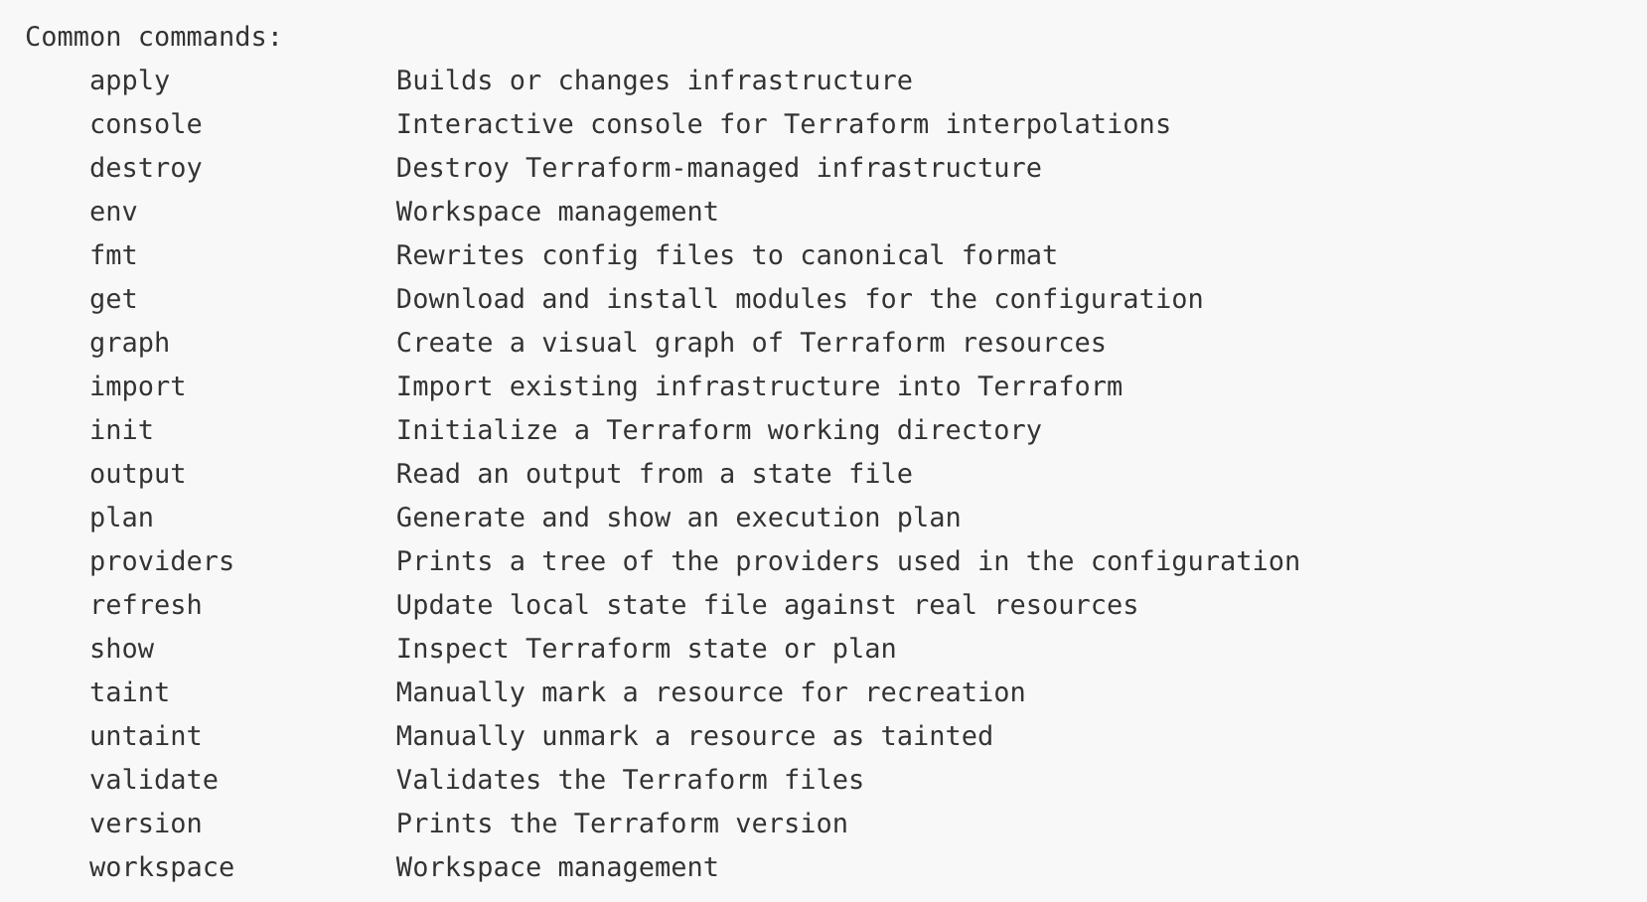
Basic commands
Devops.Course

Slide 6
Lab #1
Install terraform on your PC
Check the version of your terraform
Devops.Course

Slide 7
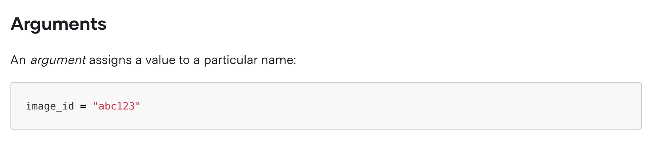
HCL
Devops.Course

Slide 8
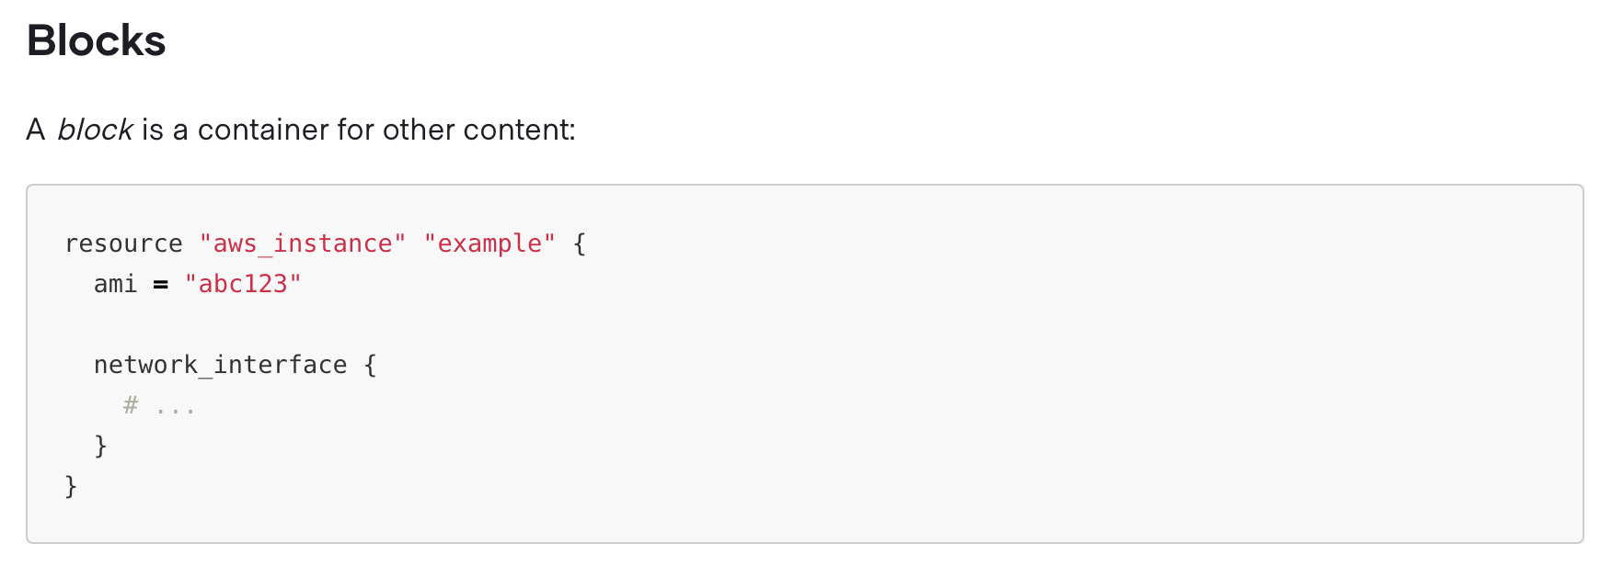
HCL
Devops.Course

Slide 9
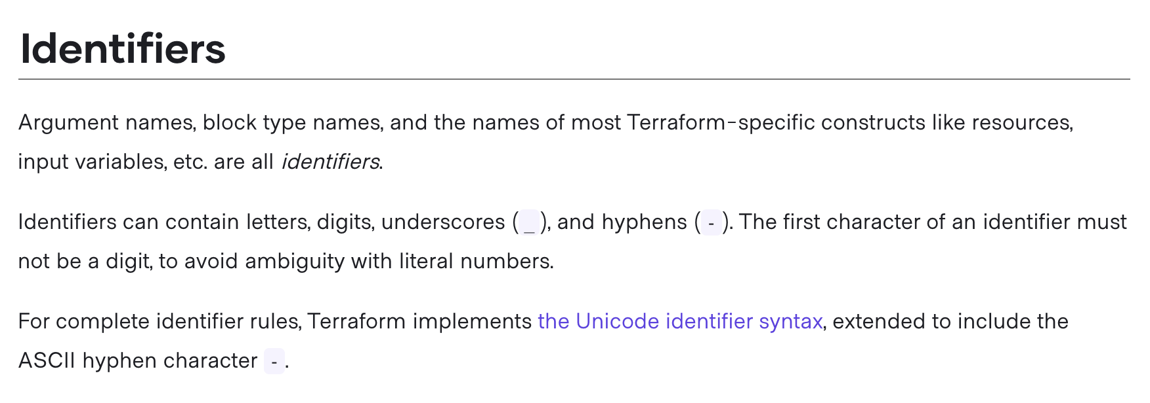
HCL
Devops.Course

Slide 10
HCL
Devops.Course

Slide 11
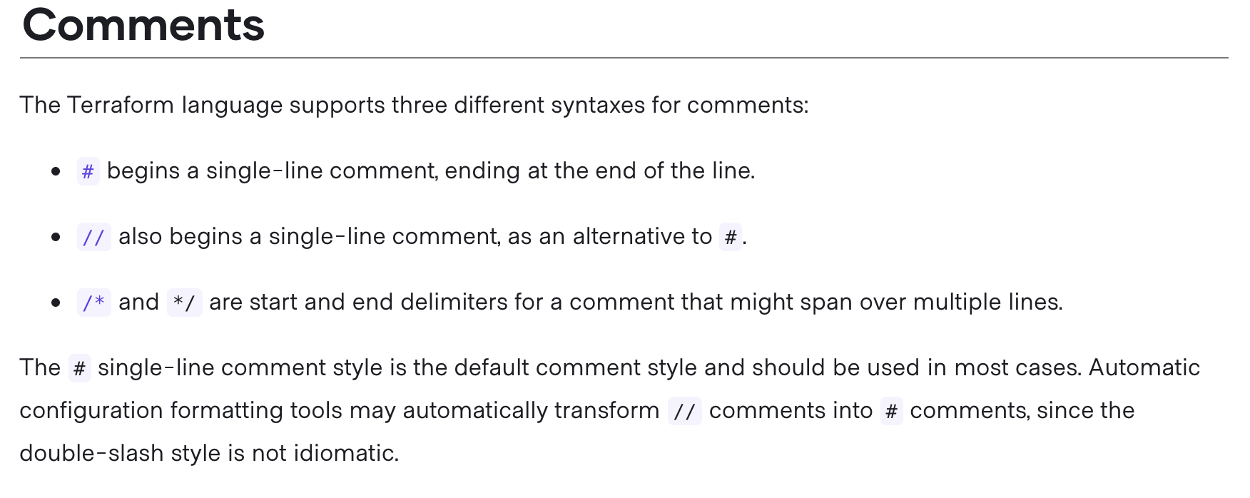
HCL
Devops.Course

Slide 12
Lab #2
Create file main.tf
In file make comment
Run command $terraform fmt
Devops.Course

Slide 13
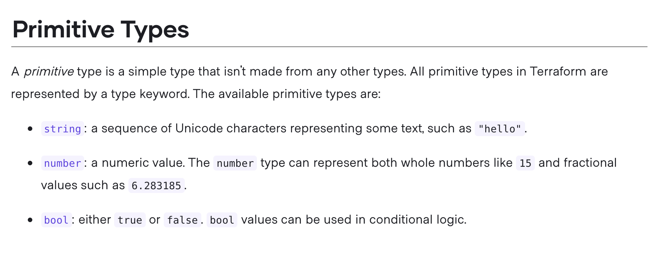
Type Constraints
Devops.Course

Slide 14
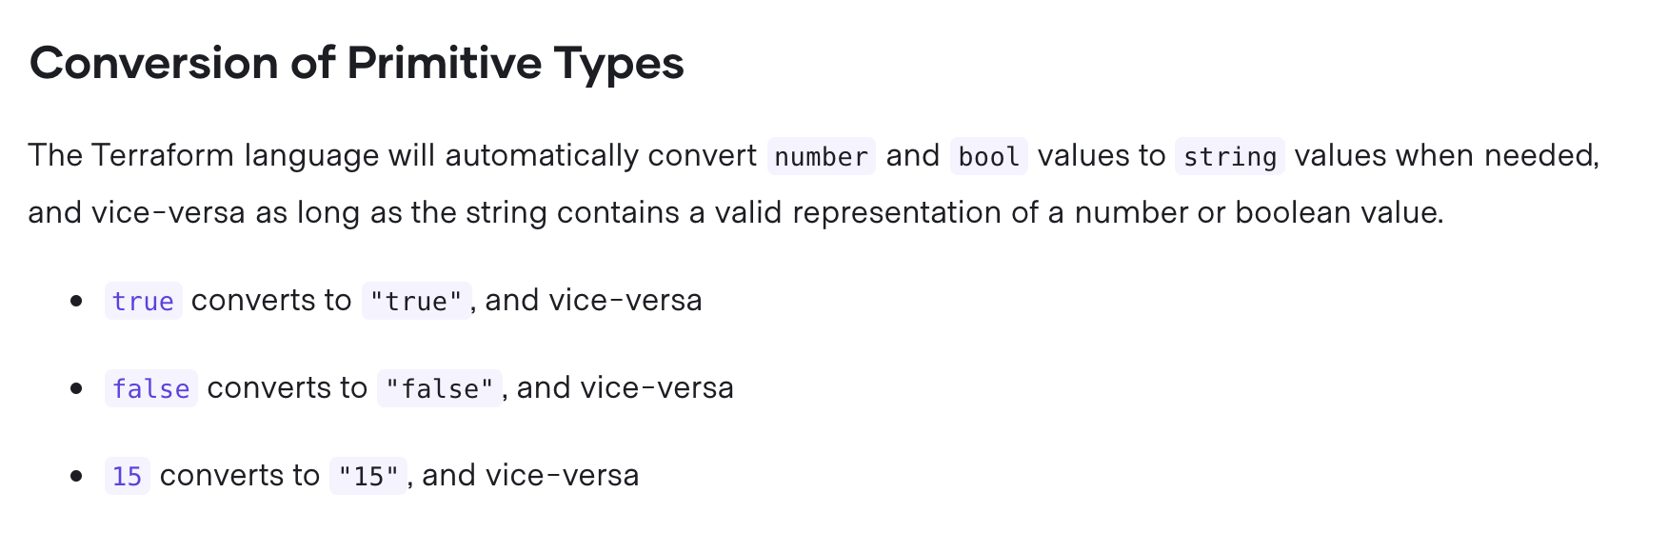
Type Constraints
Devops.Course

Slide 15
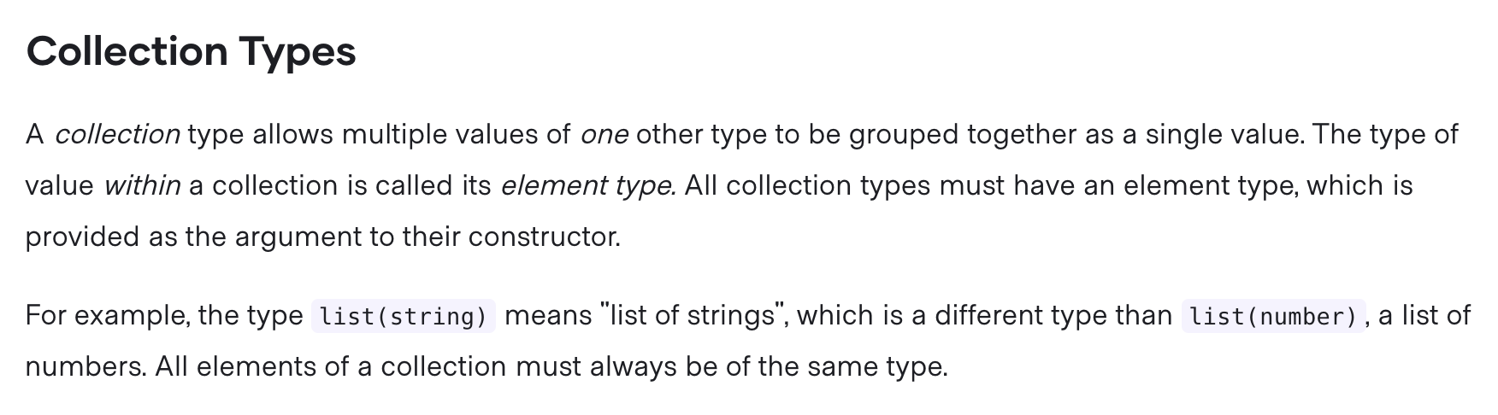
Type Constraints
Devops.Course

Slide 16
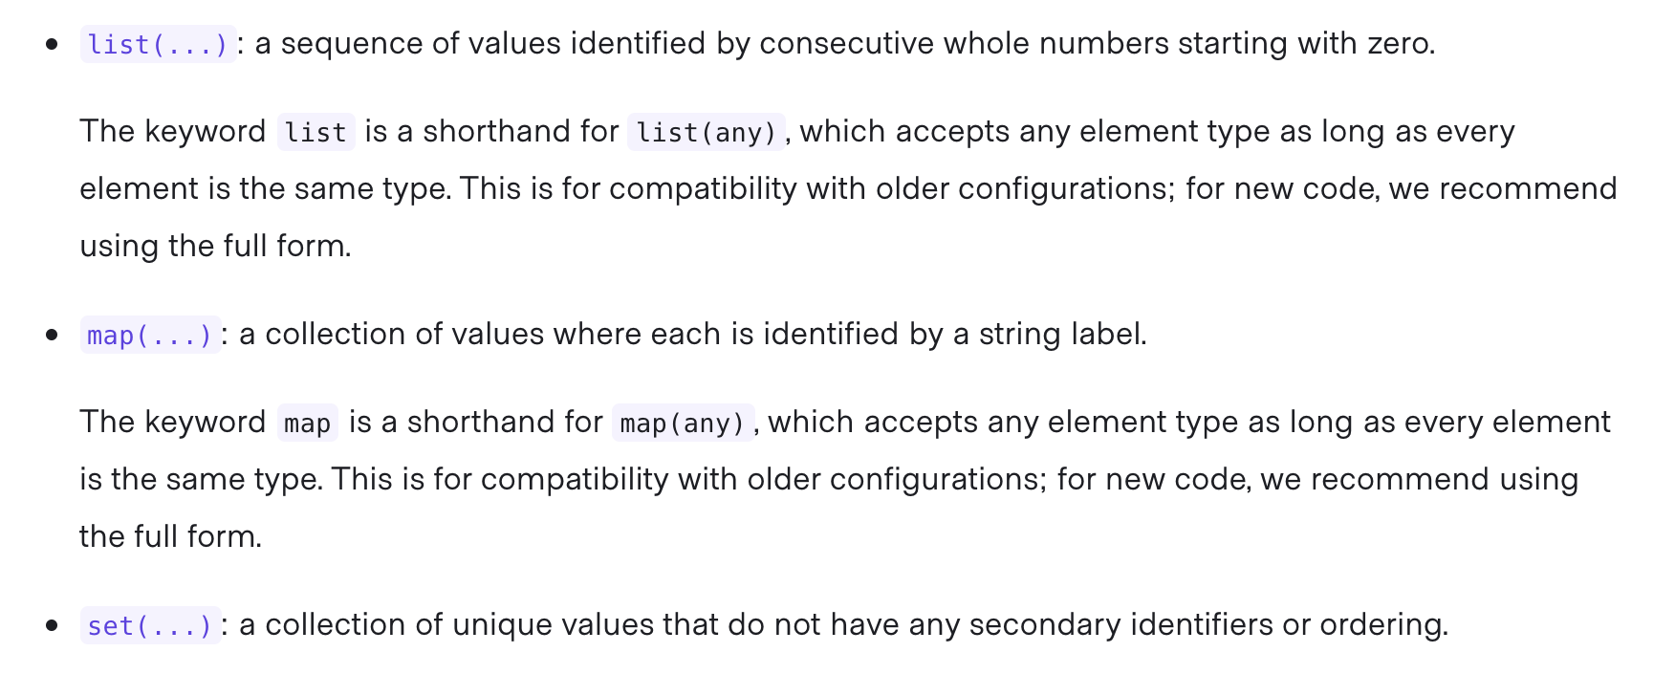
Type constraints
Devops.Course

Slide 17
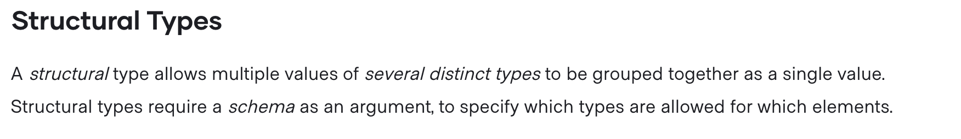
Type Constraints
Devops.Course

Slide 18
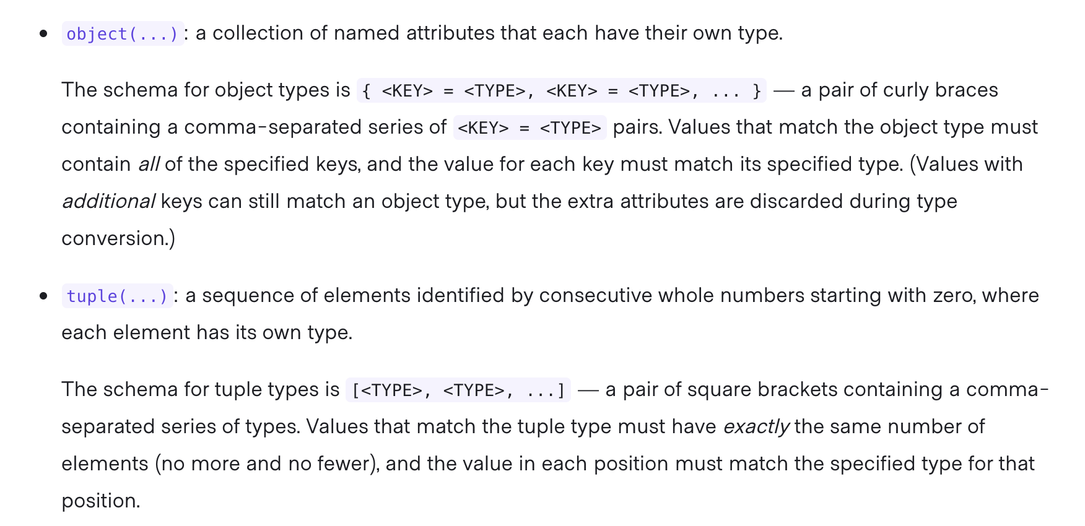
Type Constraints
Devops.Course

Slide 19
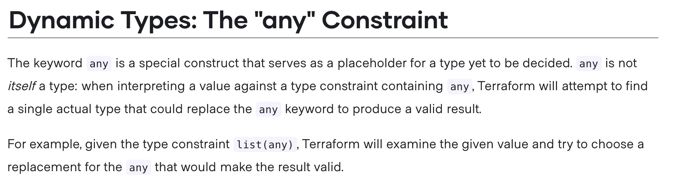
Type Constraints
Devops.Course

Slide 20
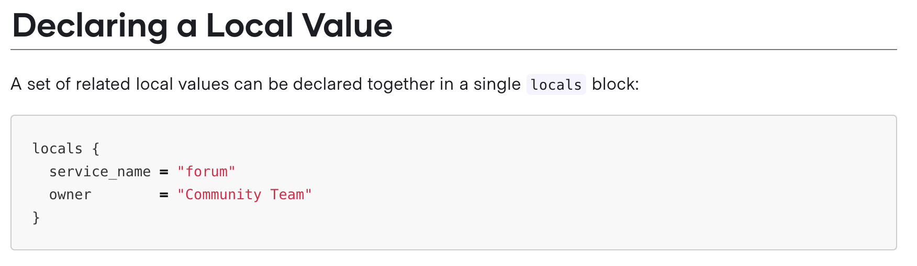
Local values
Devops.Course

Slide 21
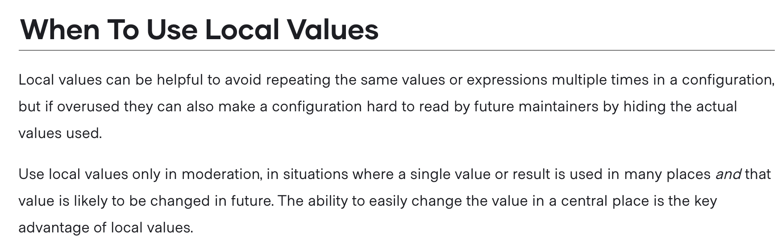
Local values
Devops.Course

Slide 22
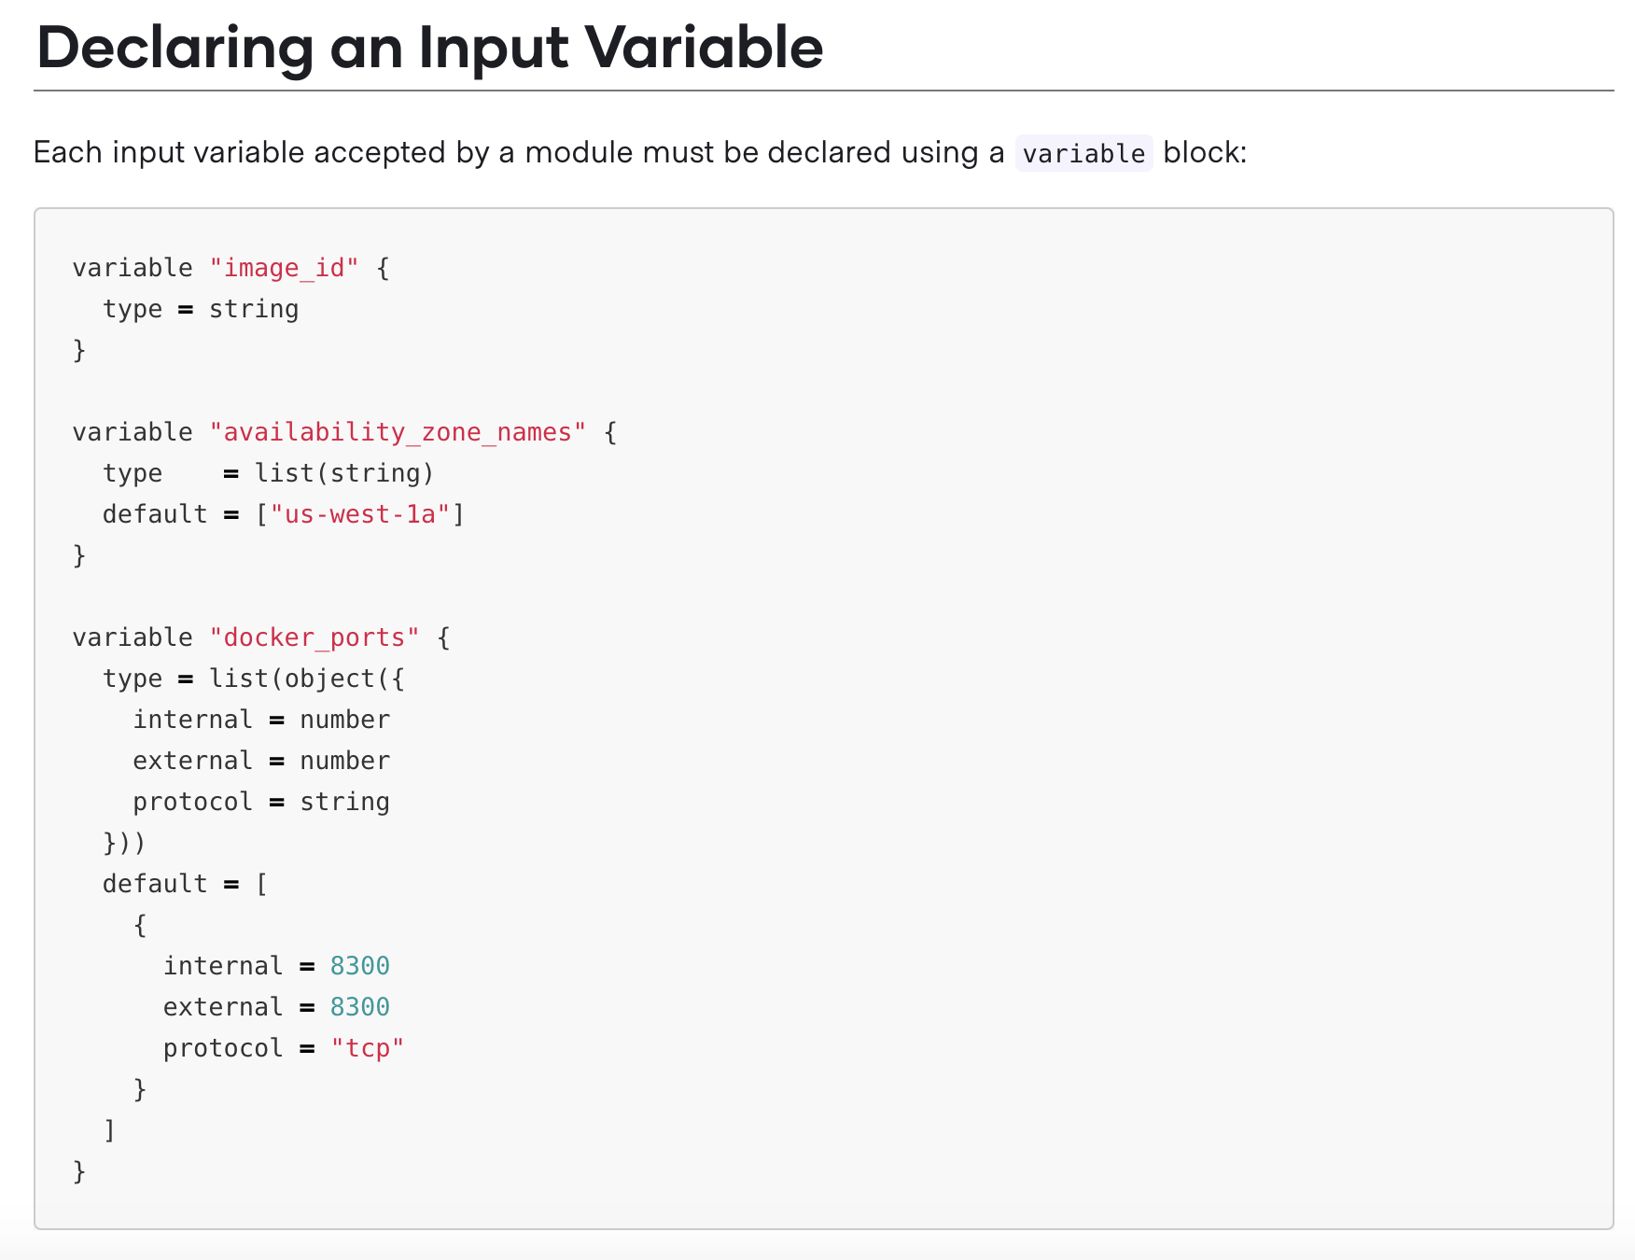
Input variables

Slide 23
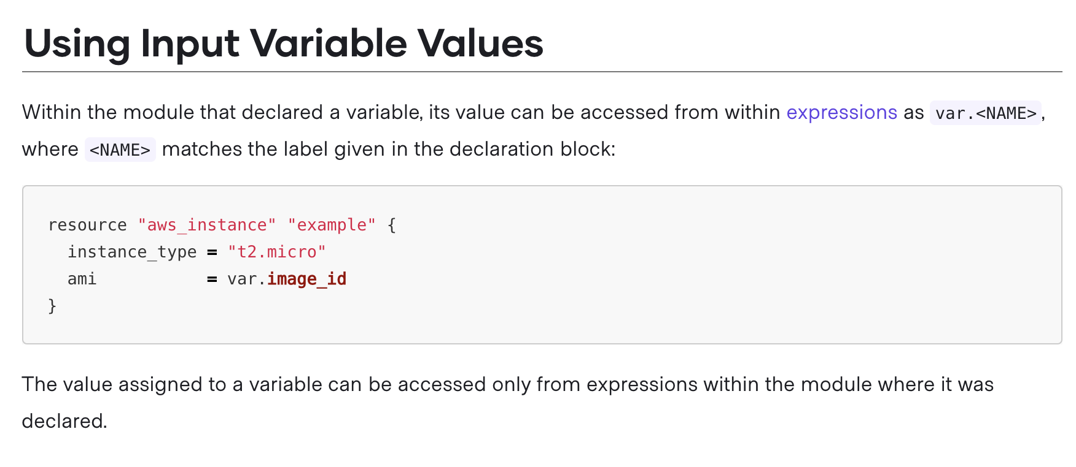
Input variables
Devops.Course

Slide 24
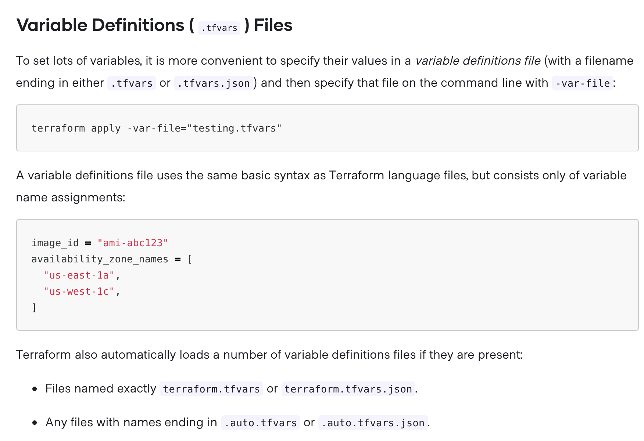
Input variables

Slide 25
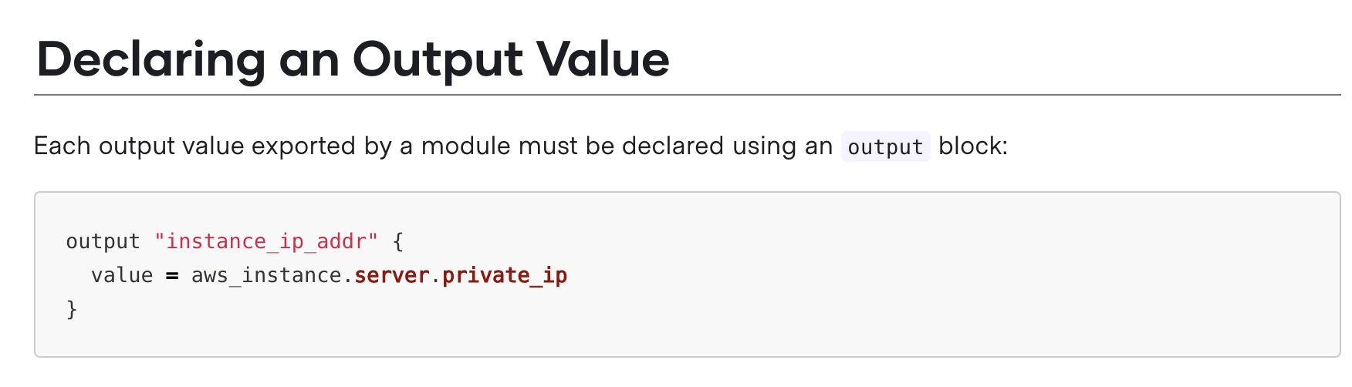
Output variables
Devops.Course

Slide 26
Lab #3
In main.tf define locals block and define locals map, list and object types
In main.tf define input variable region(string)
In local.tf file return region variable as output.
Devops.Course

Slide 27

Questions ?
Devops.Course

Slide 28
Thanks for attentions!
Devops.Course

