Slide 1

Jenkins
Basic

Slide 2
What is Jenkins
Devops.Course

Slide 3
What is Continuous Integration?
Continuous Integration is a development practice in which developers are required to commit changes to source code in a shared repository several times a day. Every commit is then build and this allows the teams to detect problems early.
Devops.Course

Slide 4
What is Continuous Integration?
It then bring following benefits to software development:
Catch issues fast and nip them in the bud.
Everyone can see what’s happening.
Automate the build.
Continuous Integration leads to Continuous Deployment allowing us to deliver software more rapidly.
Devops.Course

Slide 5
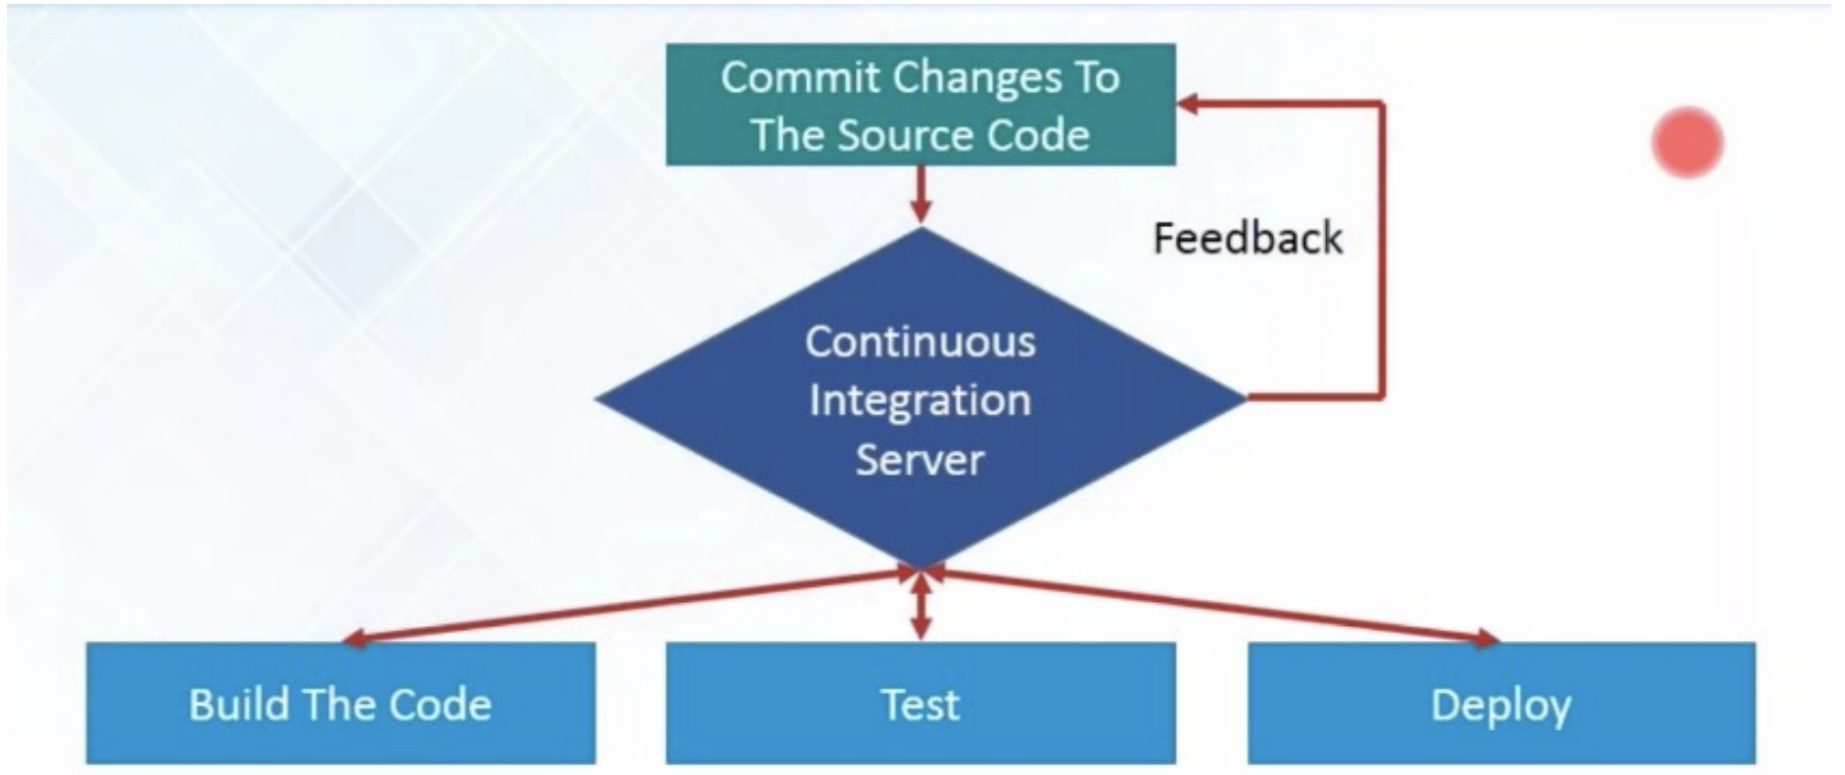
What is Continuous Integration?
Devops.Course

Slide 6
What is Continuous Integration?
“Continuous Integration doesn’t get rid of bugs, but it does make them dramatically easier to find and remove.” - Martin Fowler, chief scientist,ThoughtWorks.
Jenkins is just a framework, it achieves Continuous Integration by the help of Plugins. It provides support for over 1000 Plugins .
Devops.Course

Slide 7
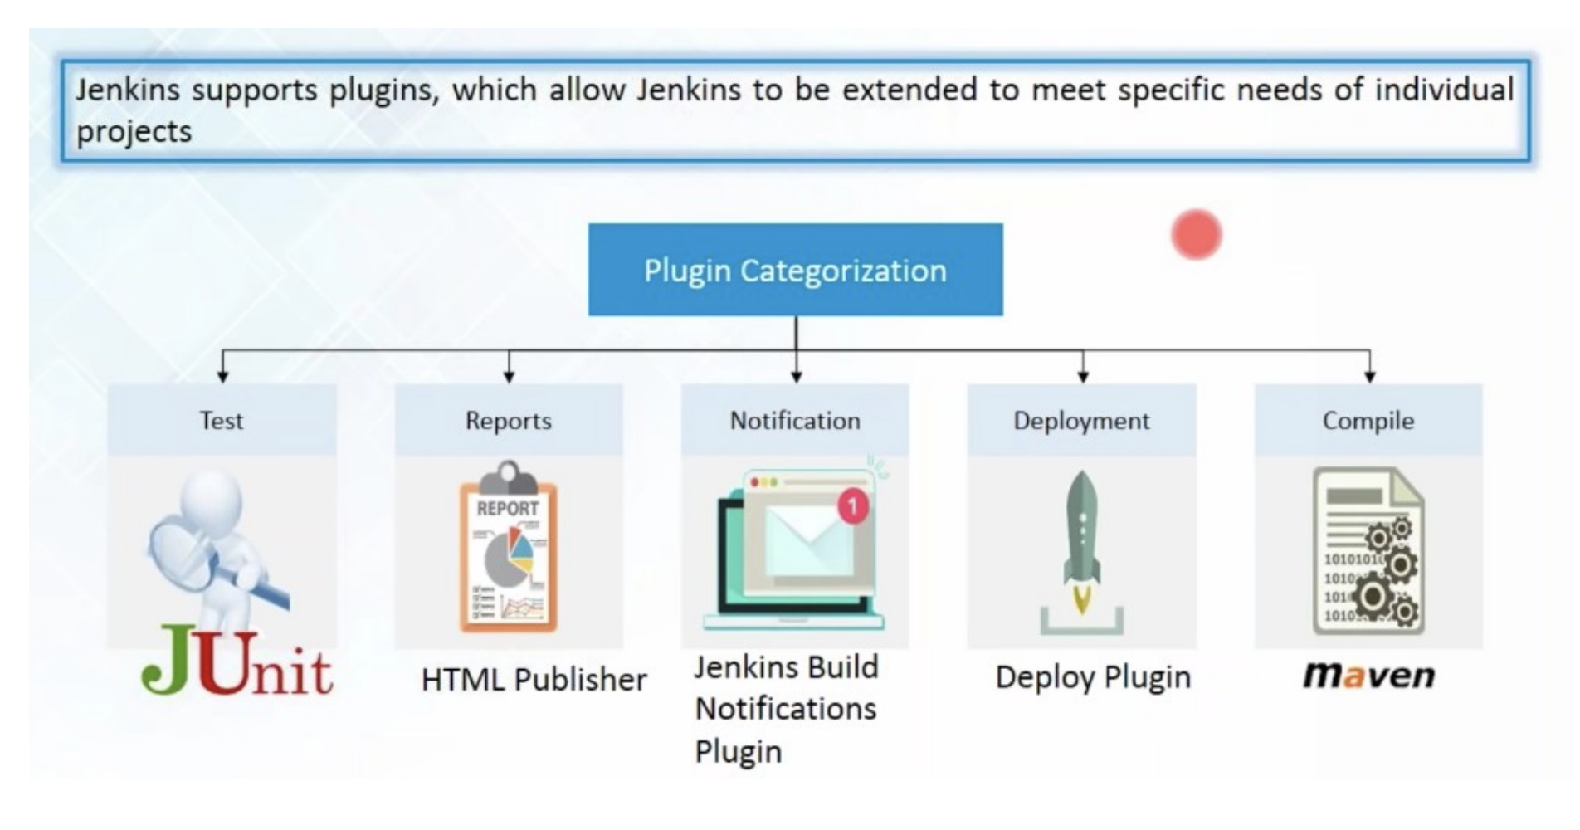
What is Continuous Integration?
Devops.Course

Slide 8
Installing and Configuring Jenkins...
Devops.Course

Slide 9
Creating a job in Jenkins
To create a new build job in Jenkins: from the Jenkins Dashboard, Click on “New Item”, Name your project and select project type.
Next step : setup configurations
Configuring Global Tool Configuration Here you can set JDK path, git configurations.
Creating or updating(if already created during project creation) project configuration settings which may include General settings, Source code management, build triggers, Pre-steps, Build, Post Steps, Emailing notification regarding build and post build actions as per your project need.
Devops.Course

Slide 10
Security
Devops.Course

Slide 11
Pipeline
Devops.Course

Slide 12
Jenkins file
Devops.Course

Slide 13
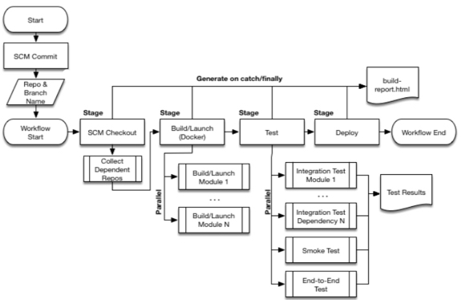
Stages
Devops.Course

Slide 14
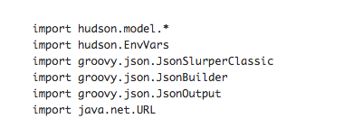
Imports
Devops.Course

Slide 15
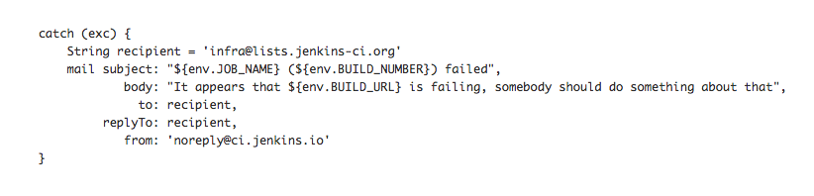
If something goes wrong
Devops.Course

Slide 16
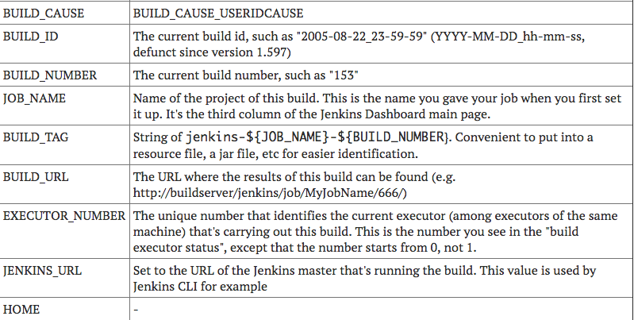
Environment variables
Devops.Course

Slide 17
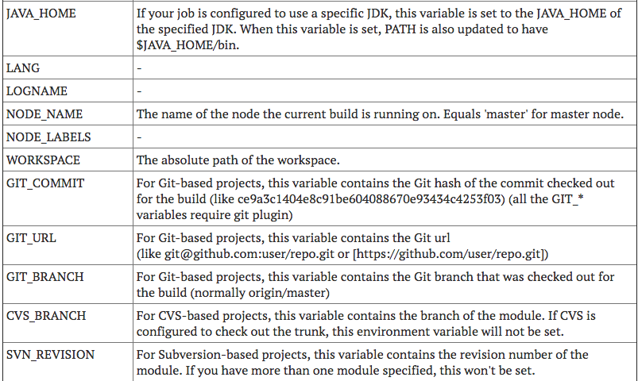
Environment variables
Devops.Events

Slide 18
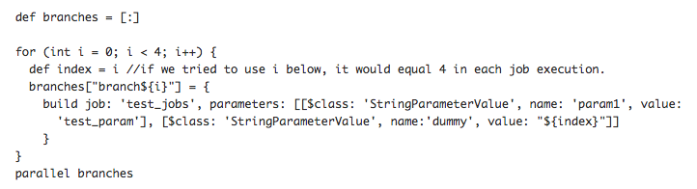
Parallel Jobs
Devops.Course

Slide 19
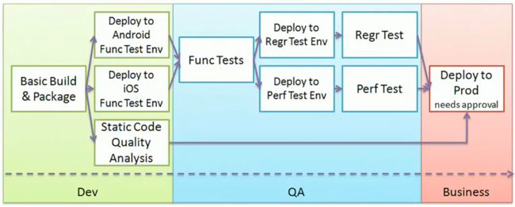
Chaining in the Pipeline
Devops.Course

Slide 20
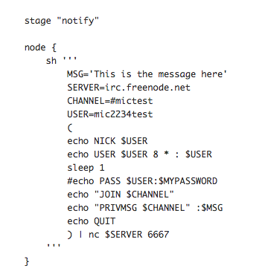
Notification
Devops.Course

Slide 21

Questions ?
Devops.Course

Slide 22
Thanks for attentions!
Devops.Course

